Slide 1
Opportunities and Challenges for Beneficial Use of Dredged Material in Puget Sound
Presented by: Tom Wang, PE, Anchor QEA

Slide 2
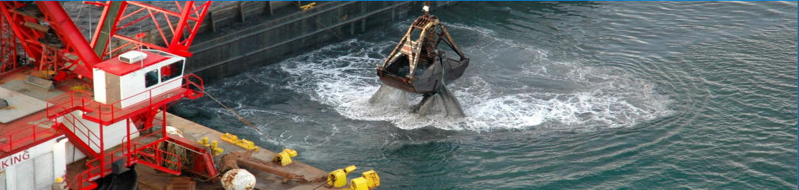
Washington Beneficial Use History and Regulations
Washington’s Dredged Material Management Program (DMMP) defines beneficial use (BU) as “the placement or use of dredged material for some productive purpose.”
DMMP and Sediment Management Standards (SMS)
Notes:
Dredge material can be managed under the DMMP or SMS
Washington has been a leader in navigational dredging reuse and the DMMP is the “match maker”
The DMMP includes all dredged material management in the State of Washington: Puget Sound, Grays Harbor, the Washington side of the lower Columbia River; and other marine and freshwater locations.
The DMMP is managed by the following agencies
U.S. Army Corps of Engineers Seattle District (USACE)
(lead agency)
U.S. Environmental Protection Agency, Region 10
Washington State Department of Ecology
Washington Department of Natural Resources
Sediment Management Standards thru Dept Ecology:
Sediment clean-up in the State of Washington is managed under the Sediment Management Standards (SMS) through the Department of Ecology
Origin of SMS Rule: Discovery of toxic compounds in Puget Sound fish led to the establishment of the sediment quality values (SQVs)
Adopted in 1991 and amended in 1995 and 2013, SMS is a regulatory set of requirements that establishes standards for surface sediment quality and provides a process for managing and cleaning up contaminated sediments.
Beneficial reuse is the preferred approach under SMS
It can be difficult to distinguish whether a project is being conducted for the purpose of navigation, cleanup or both and if the evaluation of sediment quality should be conducted 1)under the DMMP, 2) under a cleanup authority such as SMS/MTCA or CERCLA, or 3) under both types using a combination of guidelines and requirements.

Slide 3
Washington Beneficial Use History
Sediment cleanup in the State of Washington is managed under the SMS through the Department of Ecology
SMS rule was adopted in 1991 with subsequent amendments in 1995 and 2013
Under the SMS, beneficial reuse is the preferred disposal option, followed by treatment, upland disposal, and open-water disposal
Notes:
It can be difficult to distinguish whether a project is being conducted for the purpose of navigation, cleanup or both and if the evaluation of sediment quality should be conducted 1)under the DMMP, 2) under a cleanup authority such as SMS/MTCA or CERCLA, or 3) under both types using a combination of guidelines and requirements.
Origin of SMS Rule
Discovery of toxic compounds in Puget Sound fish led to the establishment of the sediment quality values (SQVs)

Slide 4
Washington Beneficial Use History (cont.)
Navigation-related dredging and disposal of sediments should be developed and performed in coordination with the DMMP
The DMMP is managed by the following agencies
  U.S. Army Corps of Engineers Seattle District (USACE)
  (lead agency)
  U.S. Environmental Protection Agency, Region 10
  Washington State Department of Ecology
  Washington Department of Natural Resources
Notes:
The DMMP includes all dredged material management in the State of Washington: Puget Sound, Grays Harbor, the Washington side of the lower Columbia River; and other marine and freshwater locations.

Slide 5
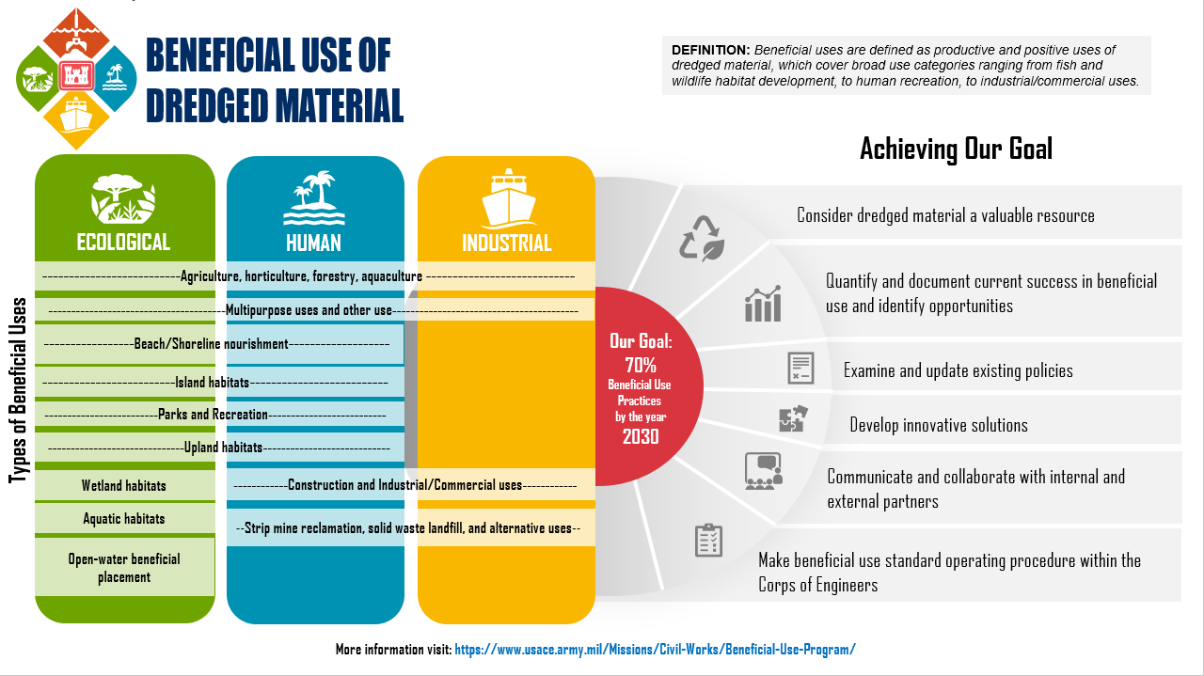
Goals of USACE
Notes:
Millions of cubic yards of sediment dredged annually from waterways and estuaries.
Sediment volumes will increase due to:
Increased maritime needs
Continued loading from outfalls/point sources
Nature-based Solution (NbS) projects
Marsh restoration
Habitat restoration and development, beach nourishment, parks and recreation, agriculture, solid waste (landfill caps), development
70% BU by 2030
Disposal capacity for dredged sediment is diminishing rapidly.
Increasing/urgent need for sediment resource to support coastal resiliency.

Slide 6
Beneficial Use Opportunities
Project background
Confined Disposal Facility (CFD)– Shoreline Development
Shoreline Remediation Cap
Confined Aquatic Disposal (CAD)

Slide 7
Beneficial Use Opportunities
Project background
Habitat Restoration - Mitigation
Beach Nourishment

Slide 8
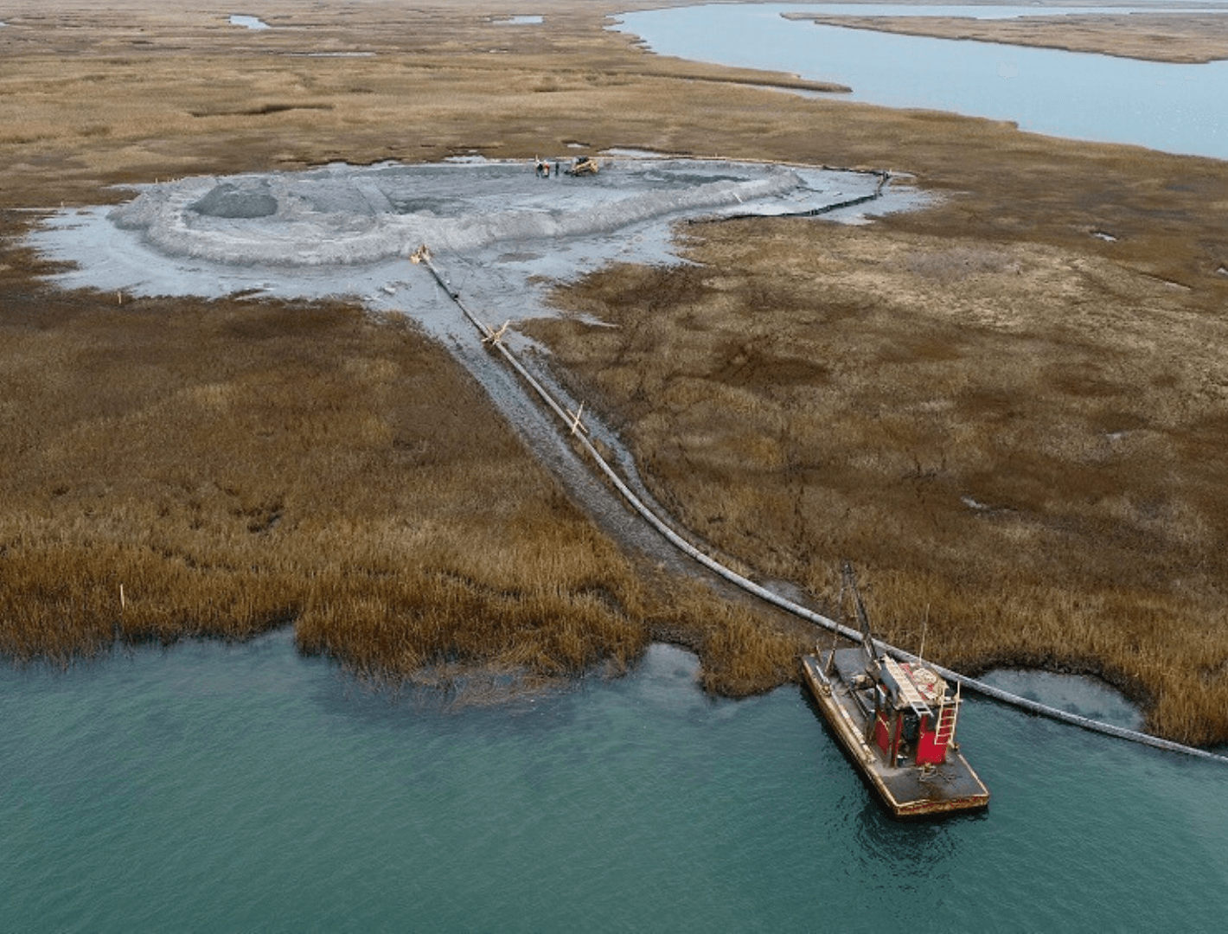
Benefits of Beneficial Use of Dredged Material
Reduced costs (public and private) for disposal of contaminated sediment
Reduced landfill use for unsuitable material
Using suitable sediment retains regional material supplies
Increased environmental value and benefits
Infrastructure improvements
Future sustainable workforce
Notes:
Reduced Costs associated with expensive landfill disposal
Sediment remediation projects can be completed faster:
Public-Private collaboration improves project execution efficiency; lowers costs
Opens new technology and sediment management options
Increased environmental footprint
Lower energy use associated with transportation/treatment of sediment.
Supports climate resiliency and restoration
Sediment can be used for shoreline and infrastructure - bank stabilization, storm attenuation, shoreline erosion control, wetland creation, land reclamation, etc.
Promotes innovation and accelerates transition of technology to full-scale implementation
Innovation creates jobs and new construction materials

Slide 9
Challenges for Beneficial Use
Material suitability—physical and chemical
Short-term impacts from sediment placement
Conflicting goals
Perception and stakeholder awareness
Regulatory and legal hurdles (e.g., indemnification) predominantly associated with cleanup sites
Permitting complexity

Slide 10
USACE Philosophy to Promote Beneficial Use
Federal project analysis
  Lifecycle cost of dredging and placement
  Consideration of environmental economic benefits
Workgroup facilitation
Creative project opportunities

Slide 11
Pathway to Beneficial Use
Increase stakeholder awareness
Encourage early collaborative planning
  Alternative analysis: BU scenarios
  Cooperation of multiorganization goals
  Regulatory framework and permitting
Explore alternative funding sources
Upland Fill
Habitat Creation
Beach Nourishment
Structural Fill
Marsh Restoration
Remedial Cover
Notes:
Stakeholder awareness
Increase familiarity with the material to be sourced, is it contaminated, can it be used elsewhere based on physical characteristics
Important to impart that there are other choices than disposal
Discuss logistics of how BU might work to show the vision
Engage with USEPA, Superfund senior management, States, public EARLY
Provide strong case for agency commitments to sustainability
Help to find the middle ground between all the participating parties' goals and interests in the projects—parties will be more likely to consider changed approaches and working through complex hurdles earlier on
Implement BU scenarios during dredge material characterization process
BU with clean sediment
Possible BU – Backfill/caps; underwater berms; shoreline stabilization; upland fills, etc
BU with spectrum of contaminated sedimentS
Industrial BU – Closure of brownfield sites; landfills; lower-tier fill for land reclamation, etc
Discuss BU benefits to regulatory agencies to increase likelihood that they will support the use of BU.

Slide 12
Case Studies
Demonstrating Success:
Real-World Applications of BU of Dredged Materials in Puget Sound

Slide 13
Examples of Beneficial Use Projects in Puget Sound
Project | Disposal Location for Beneficial Reuse | Year
Milwaukee Waterway CDF, Port of Tacoma | CDF and nearshore habitat | 1993
Georgia Pacific Mill Site, Port of Bellingham | Sediment cleanup cap and habitat restoration | 2000
Gate 3, Squalicum Harbor, Port of Bellingham | Landfill cap | 2012
Port Gamble Bay Cleanup | Upland backfill | 2015 to present
Parcel 14, Port of Tacoma | Upland highway embankment | 2022
Jetty Island, Port of Everett | Nearshore habitat | Ongoing, 2022, planned 2024
Blair Waterway Deepening Program, Port of Tacoma | Nearshore habitat | Expected 2025
Whatcom Waterway Cleanup, Port of Bellingham | CDF and maritime support facility | Expected 2027
Notes:
Current beneficial use projects are smaller…
Sampling conducted for City of Chelan, Port of Bellingham, Crescent Bar
Port of Bellingham and Crescent Bar had suitability determinations where a portion of the sediment was determined unsuitable for upland or in-water disposal.

Slide 14
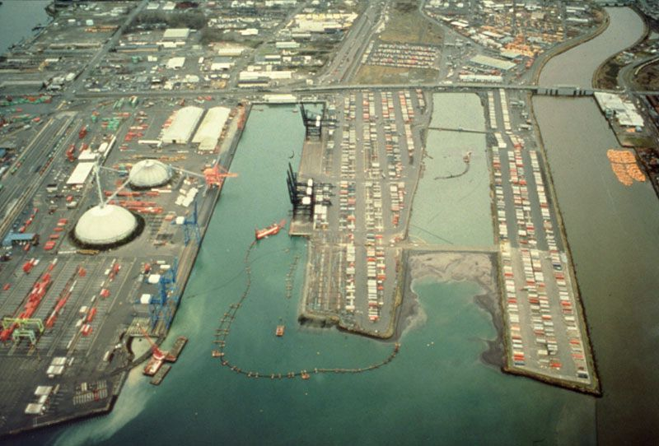
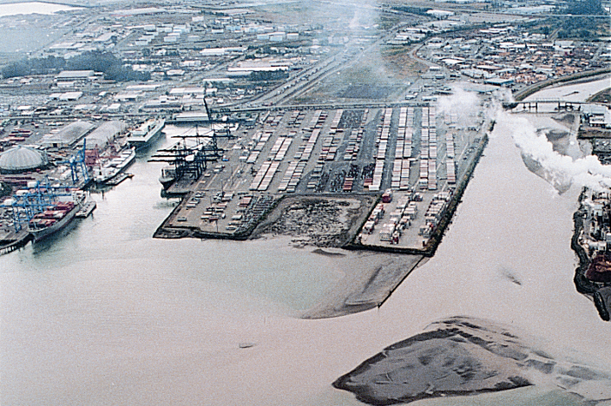
Milwaukee Waterway CDF and Habitat Restoration
Port of Tacoma
2M+ cubic yards (cy) of contaminated sediments
BU placement to contain CERCLA contaminated sediment and construct upland container space, and develop new intertidal and shallow subtidal habitat
Notes:
Former log pond with wood waste, coordinated cleanup and restoration project:
Two federal channel dredging projects, materials placed for capping of impacted sediments and restoration of intertidal and subtidal habitat

Slide 15
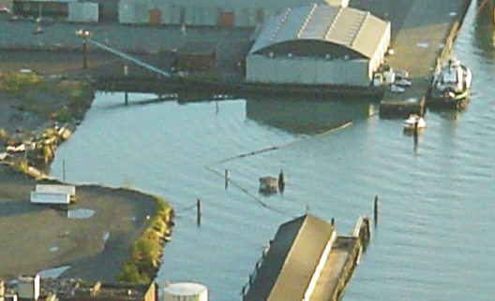
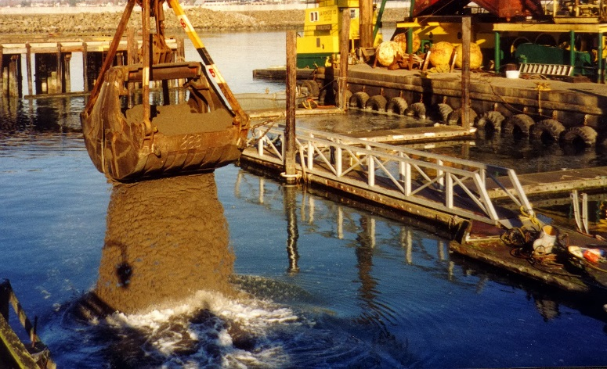
Georgia Pacific Mill Site
Port of Bellingham
43,000 cy of clean sediments dredged by USACE from two federal channel dredging projects
  Swinomish Channel (sandy)
  Squalicum Waterway (silty)
BU placement to cap impacted sediments, restore intertidal and shallow subtidal habitat, and colonize eelgrass
Notes:
Former log pond with wood waste, coordinated cleanup and restoration project:
Two federal channel dredging projects, materials placed for capping of impacted sediments and restoration of intertidal and subtidal habitat

Slide 16
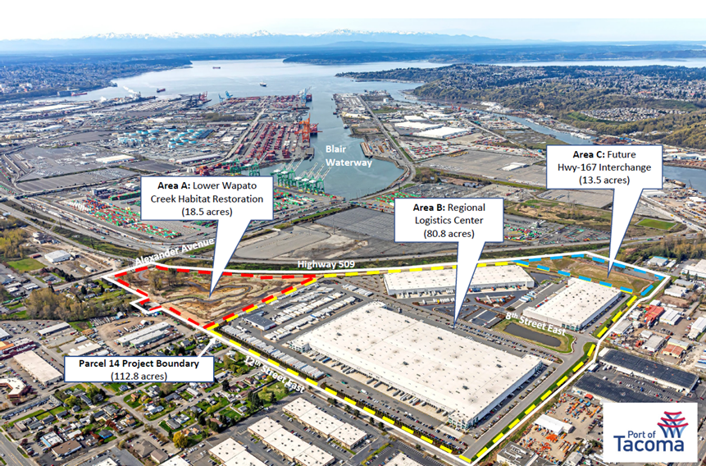
Parcel 14 Cleanup and Redevelopment
Port of Tacoma
Multipurpose redevelopment within Port of Tacoma and Puyallup Reservation
Area C: 20,000 cy of material from creek habitat restoration areas for the development of Future Highway 167 Interchange embankments (13.5 acres)

Slide 17
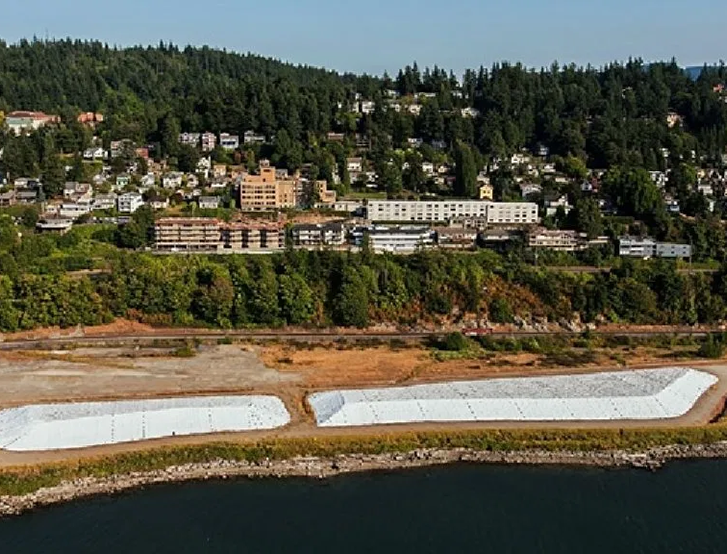
Squalicum Harbor Gate 3 Sediment Project
Port of Bellingham
40,000 cy of sediments from maintenance dredging stockpiled at landfill cleanup site for use as part of final environmental cap at the Port’s Cornwall landfill
Treatment of soil to achieve low permeability
Courtesy of Port of Bellingham
Notes:
Suitability determination determined that the material was not suitable for open water disposal to low levels of dioxin/furans, so it was transferred to uplands for use as upland cap material at Cornwall's Landfill

Slide 18
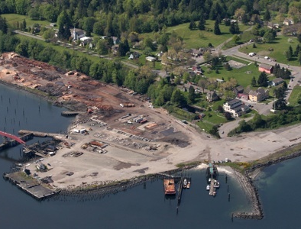
Port Gamble Cleanup and Habitat Restoration Project
Port Gamble, Washington
17,000 cy of dredged material treated to reduce salinity and reused as topsoil amendments for open space use
Future placement of dredged material from maintenance dredging for eelgrass recolonization
Notes:
Introduce the project:
Focus on the dual goals of industrial redevelopment and environmental restoration.
Detail key actions:
Explain the construction of new infrastructure to support industrial use.
Discuss the dredging process and removal of contaminated sediments – Upland disposal of dredged material allowed for permitting through County
Management of material in uplands before disposal to meet requirements.
Highlight the creation of new wetland habitats and shoreline enhancements.
Describe the results:
Improved water quality and new habitats.
New opportunities for industrial development.
Increased community engagement and usage of the restored area.

Slide 19
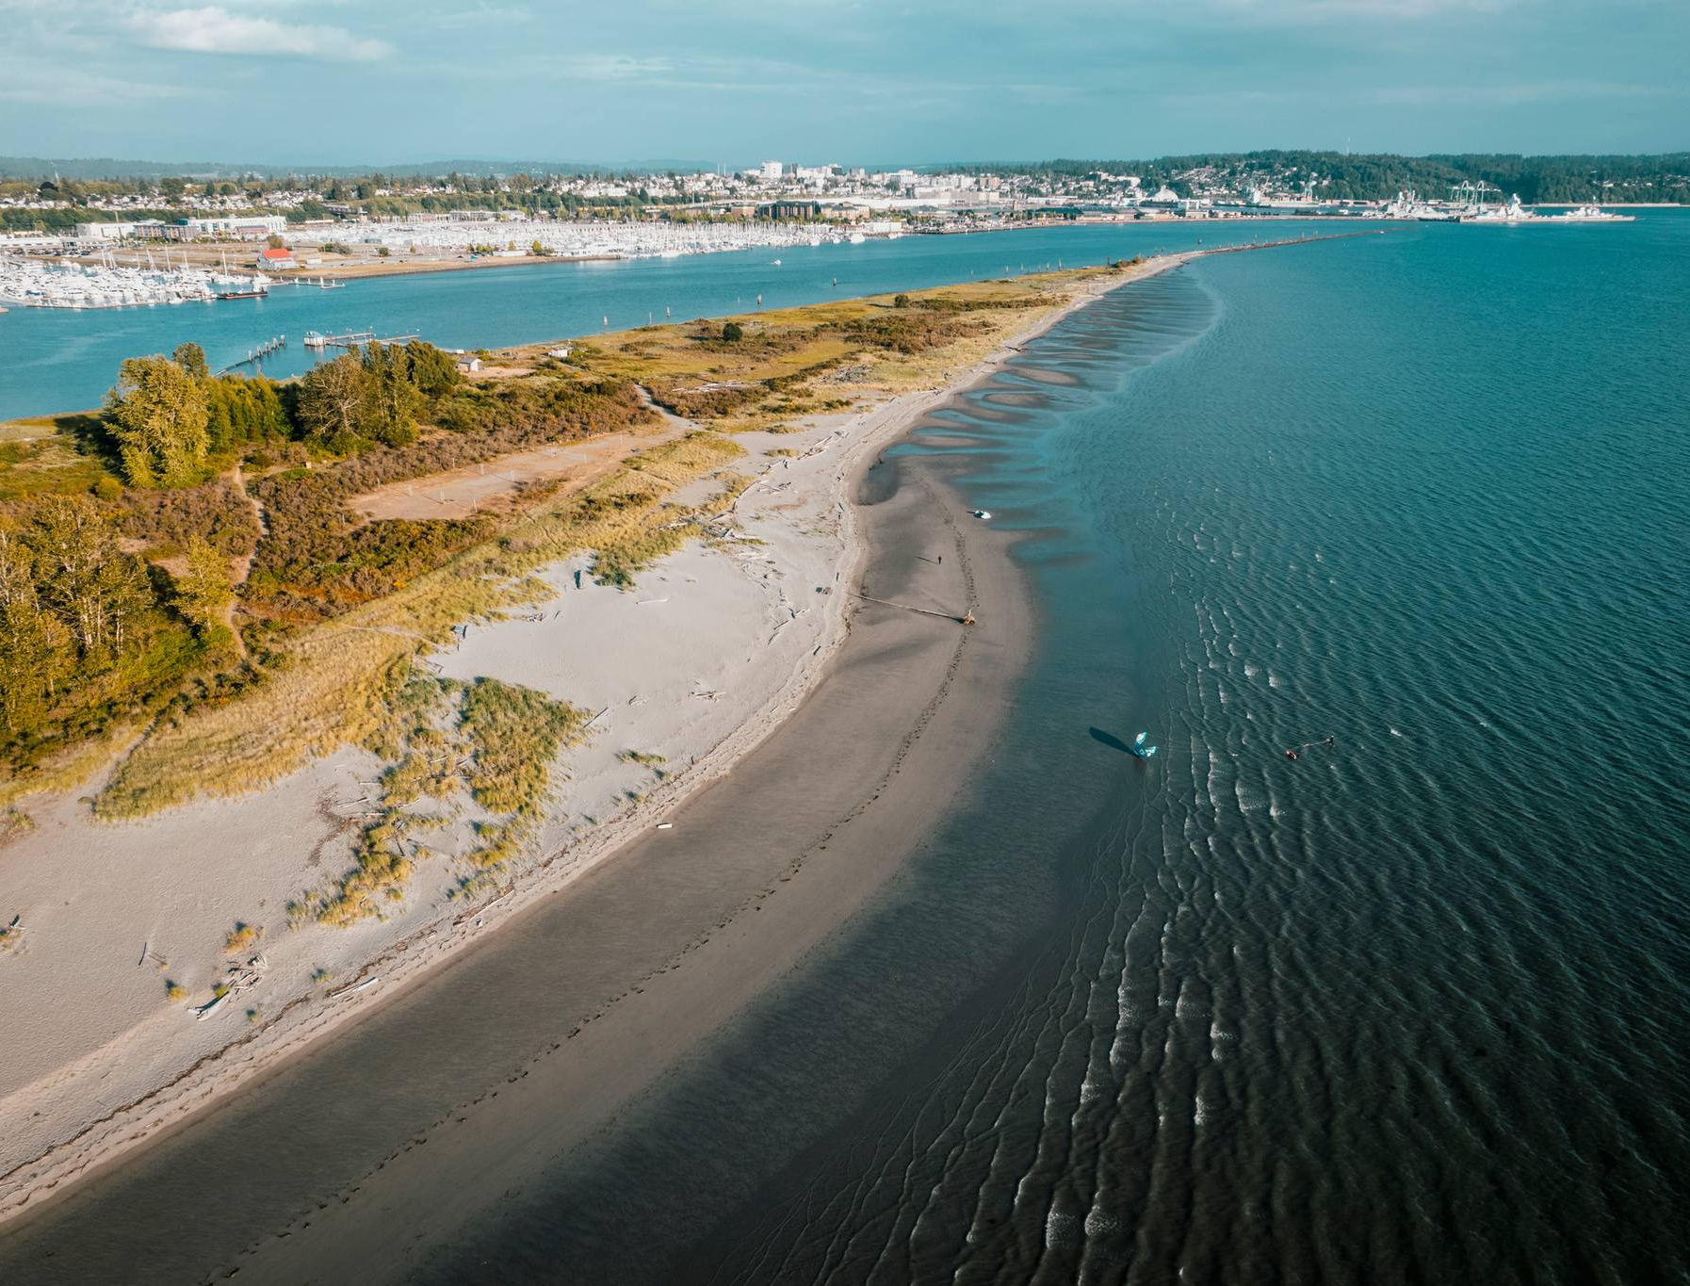
Jetty Island
USACE Seattle District and Port of Everett
1,800-acre island created through BU placement of 2M+ cy dredged material from the Snohomish River
Bi-annual placement of up to 40,000 cy allowed

Slide 20
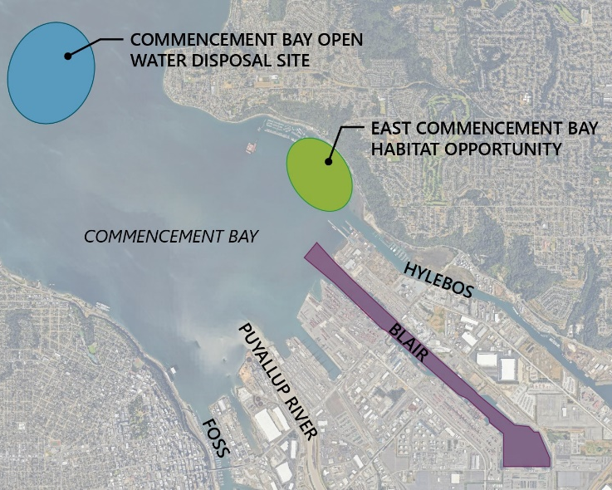
Blair Waterway Berth and Channel Deepening
Port of Tacoma
Modernize Blair Waterway for larger container vessels through deepening of federal navigation channel and berthing areas
2M cy of dredged material with planned BU
Create nearshore habitat with dredged material

Slide 21
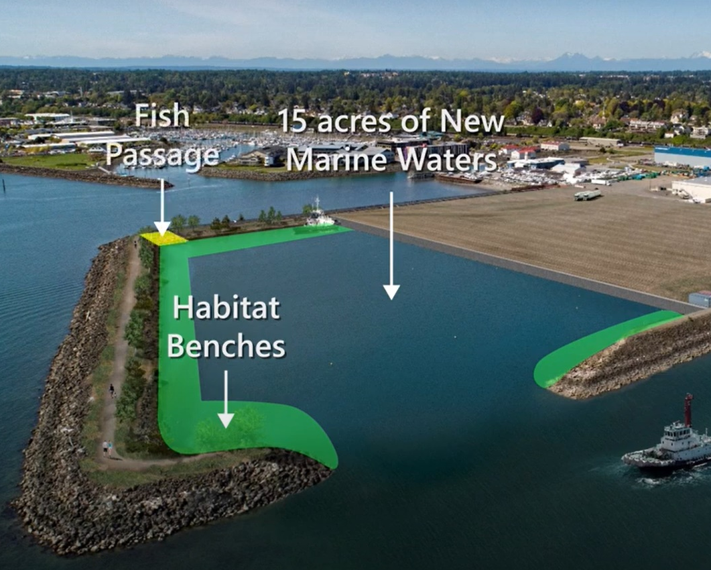
Whatcom Waterway Cleanup
Port of Bellingham
BU of 700,000 cy of contaminated sediment
Placement of dredged material within a constructed confined disposal facility for potential Port expansion

Slide 22
BU in Puget Sound has been limited due to agency, stakeholders, and Tribal concerns
  Suitability of BU materials is very restrictive
BU can help mitigate rapidly increasing landfill disposal costs
Many projects can benefit from BU
  USACE call to action
Plan ahead!
Notes:
Commerce will develop to larger ships
Marsh restoration and coastal resiliency

Slide 23
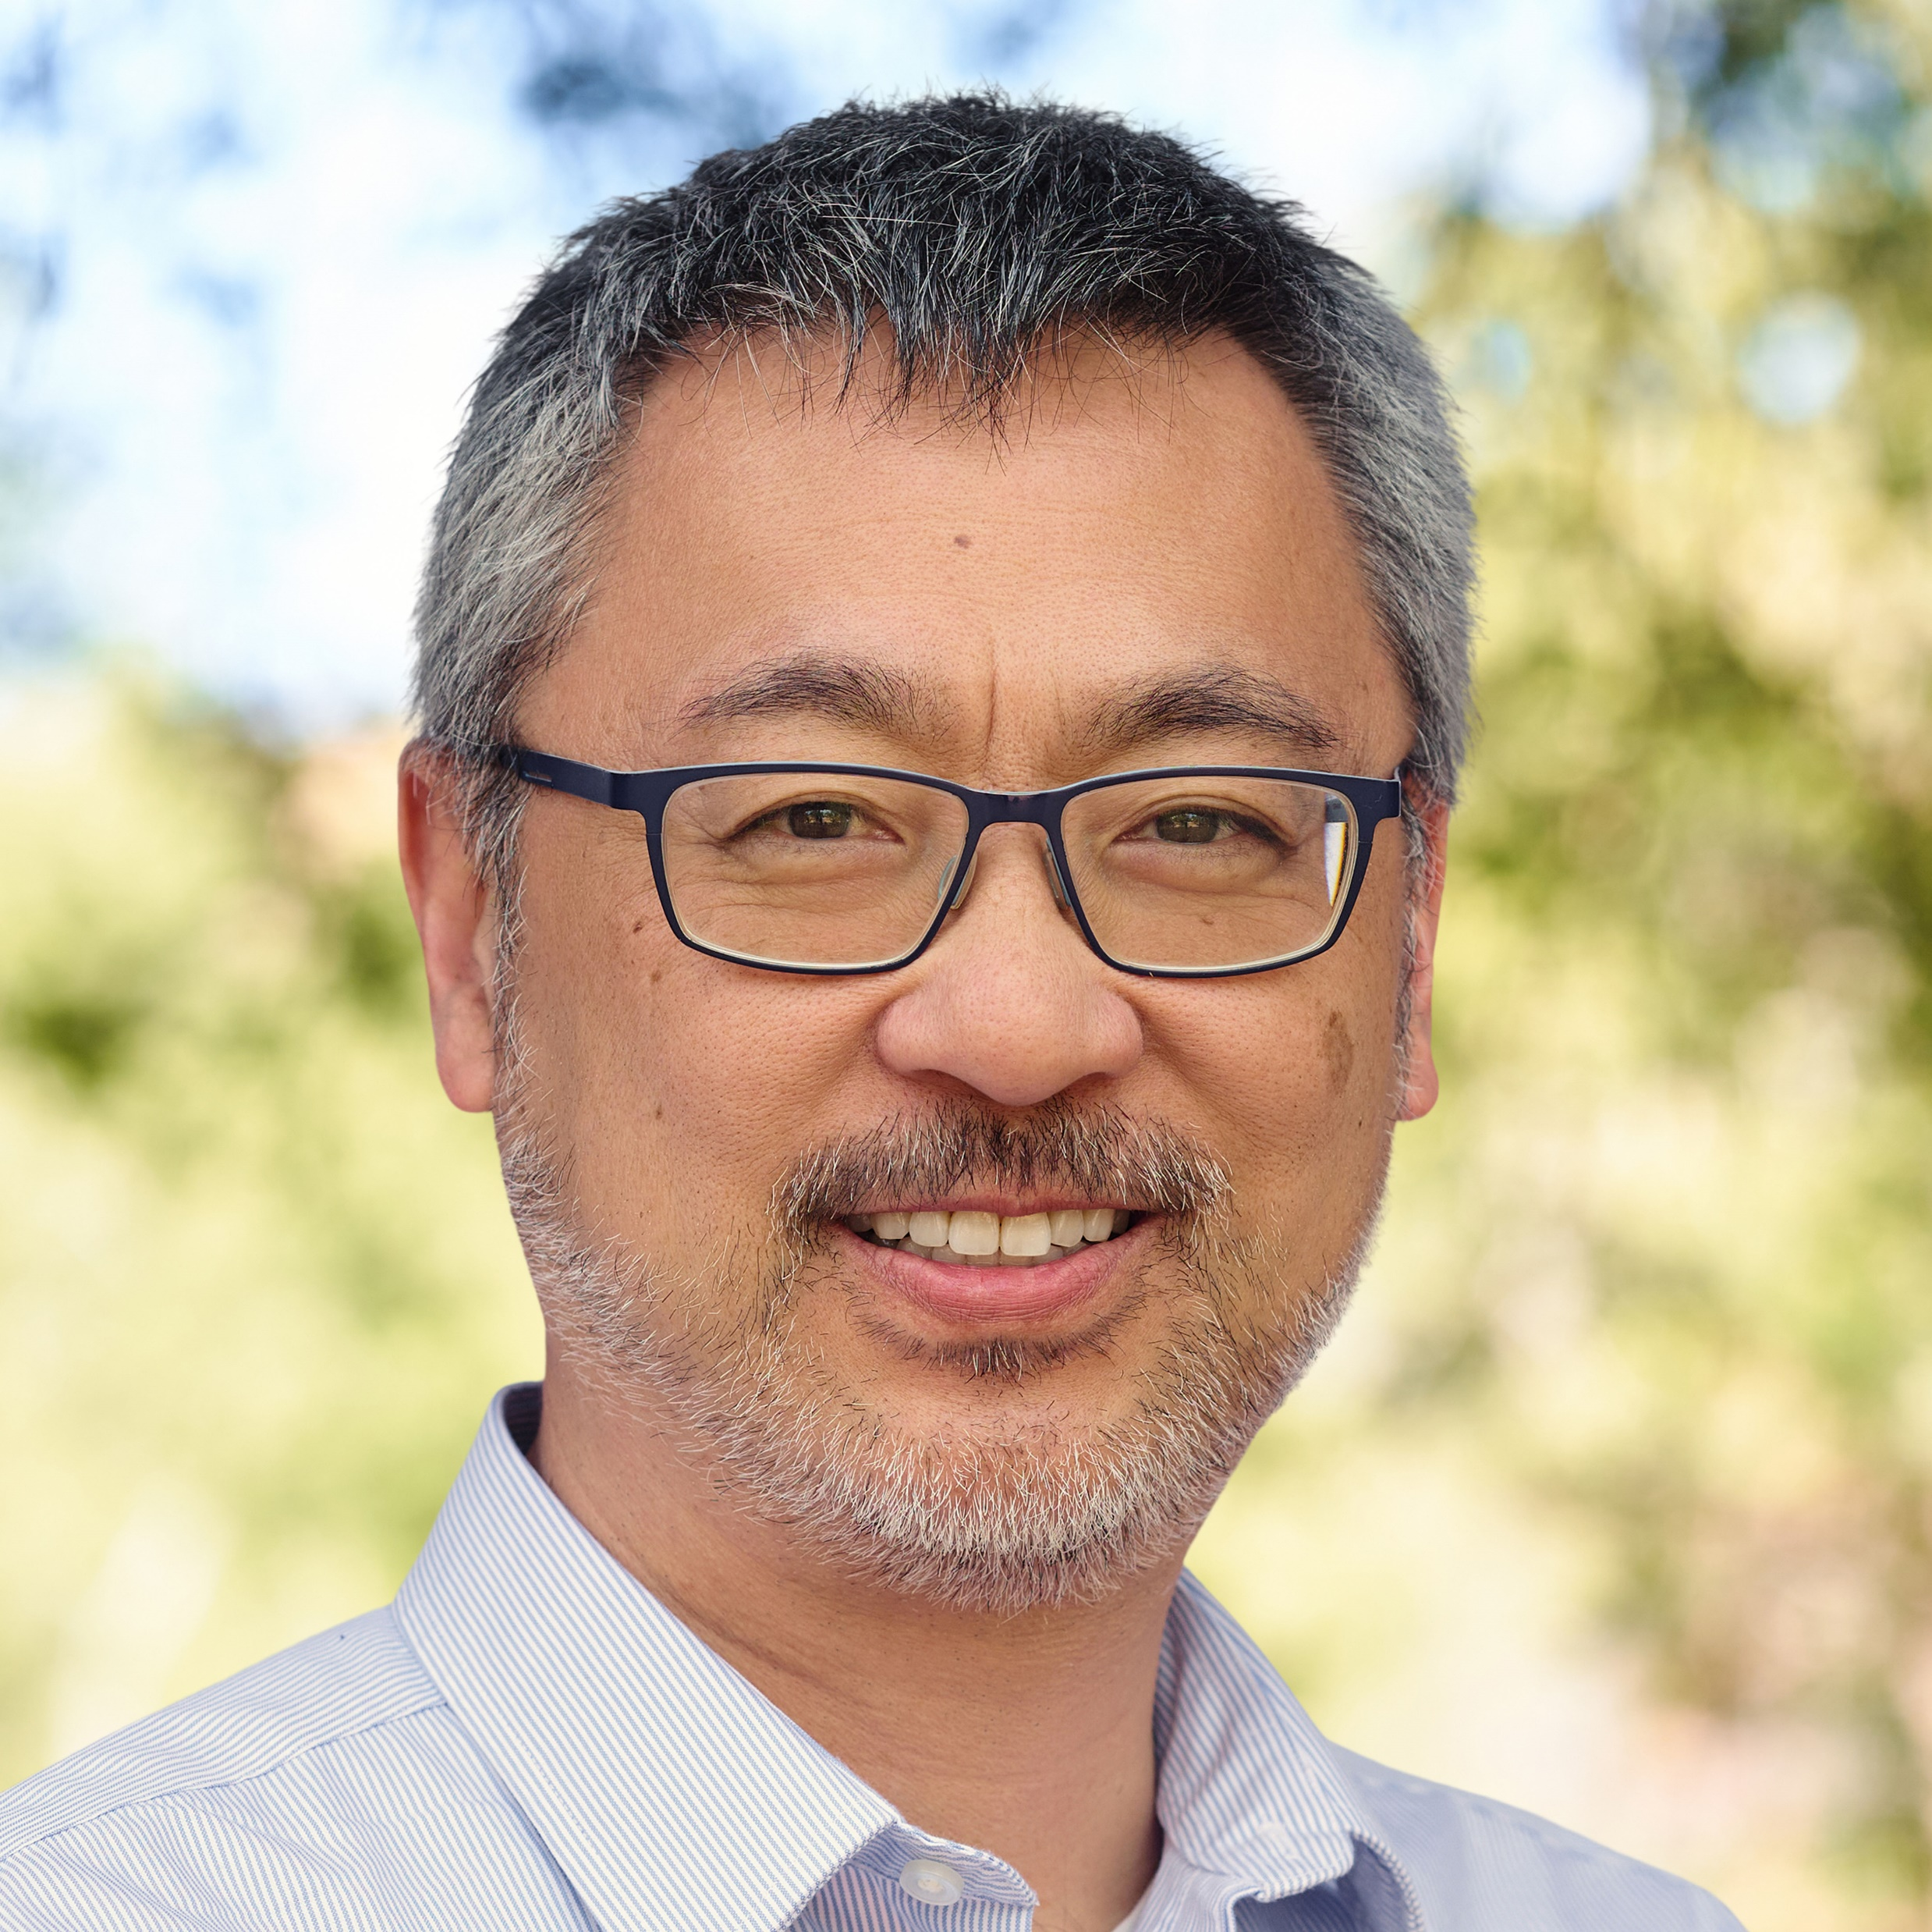

Tom
Wang, PE
Principal Engineer
twang@anchorqea.com

