Slide 1

Evaluating Green Remediation Strategies to Reduce Air Emissions for the Lower Duwamish Waterway Upper Reach Design
Presented by: Sylian Rodriguez, PhD, ENV SP, Anchor QEA
Collaborators: John Laplante and Tom Wang, Anchor QEA
Jeff Stern and Debra Williston, King County
Pete Rude; Allison Crowley; and Dave Schuchardt, City of Seattle
Joe Flaherty and Ken Nogeire, Boeing

Slide 2
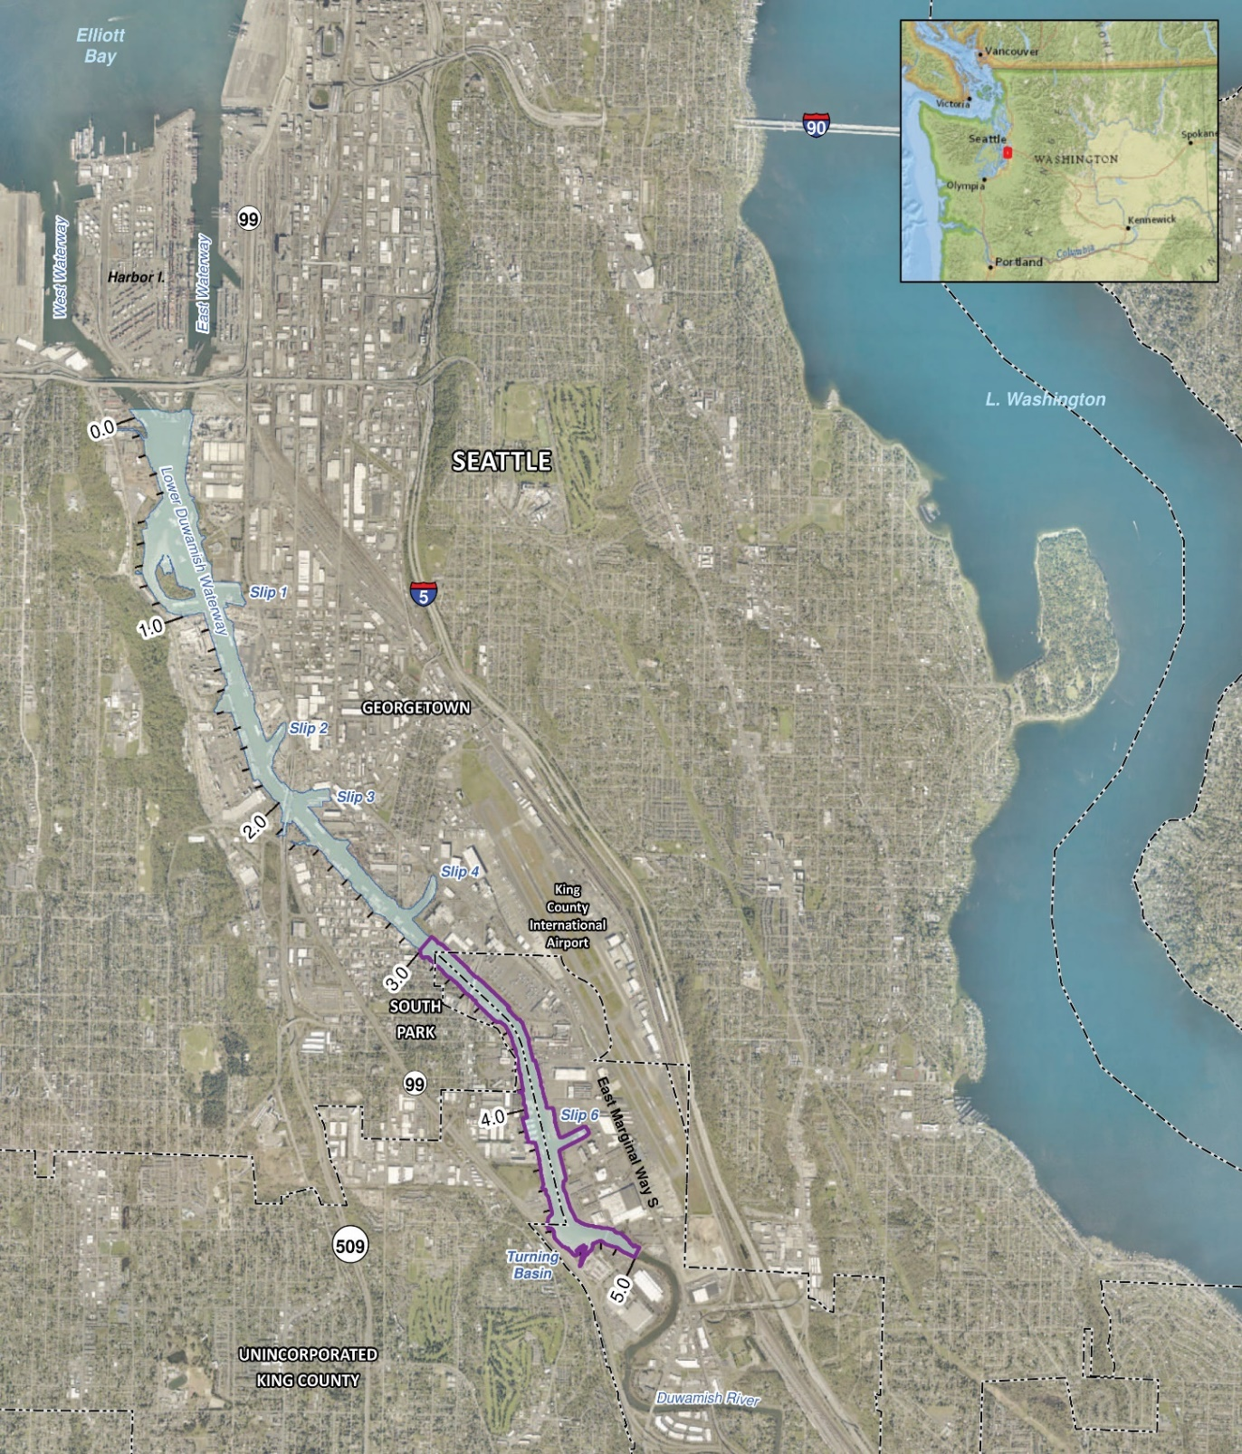
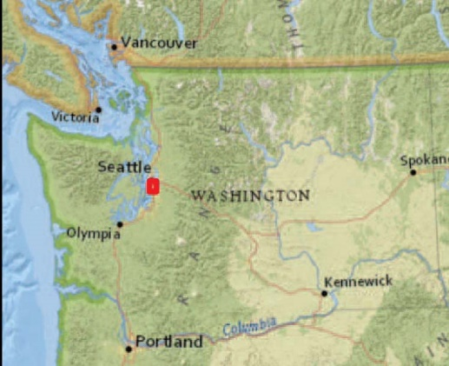
Project Summary
Elliott
Bay
Lake Washington
Located in Seattle, Washington
5-mile-long channelized waterway
Separately designed and managed in upper, middle, and lower reaches
Upper reach (river miles 3.0 to 5.0) construction started in fall 2024
Three construction seasons anticipated
Seattle
Upper Reach of the
Lower Duwamish Waterway
Superfund Site
Notes:
The LDW is located in Seattle WA and corresponds to the last 5 miles of the Duwamish River, which flows northwest prior to discharging into Elliott Bay in Puget Sound (Duwamish River originates at the confluence of the Green and Black rivers near Tukwila, WA). Last 5 miles of the Duwamish River were straightened and channelized into a commercial corridor to allow for ship traffic in the 1900s. The LDW was subject to heavy industrial operations which have led into significant sediment contamination (mostly PCBs) and was designated as a Superfund Site in 2000.

Slide 3
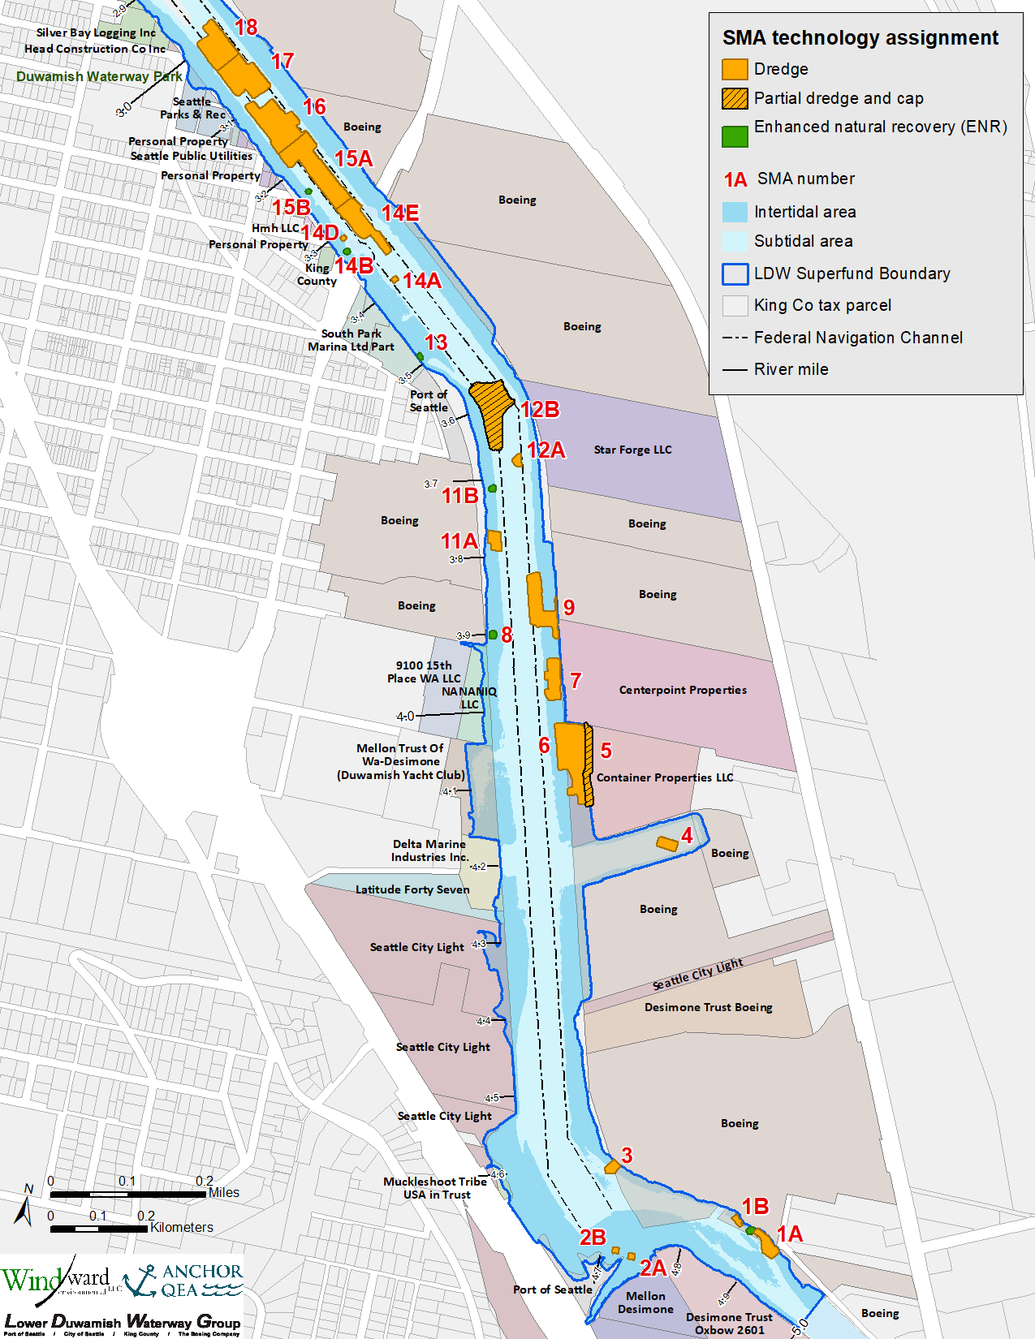
LDW UR Remedial Design
Approximately 131 acres of intertidal/ subtidal areas (15.1 acres require some type of active remedial action)
  Dredging, RMC, backfill, ENR, engineered caps, amended cover
2014 LDW ROD
  Be consistent with EPA Region 10’s Clean and Green Policy (EPA 2009)
  Include green remediation practices to be considered and incorporated into remedial design
Notes:
GR definition: "...consider all environmental effects of remedy implementation and incorporating greener options to maximize net environmental benefit of cleanup actions”
ROD requirements include considering the following practices, consistent with EPA Region 10’s Clean and Green Policy (EPA 2009):
“Use renewable energy and energy conservation and efficiency approaches, including Energy Star equipment.
Use cleaner fuels such as low-sulfur fuel or biodiesel, diesel emissions controls and retrofits, and emission reduction strategies.
Use water conservation and efficiency approaches including Water Sense products.
Use reused or recycled materials within regulatory requirements.
Minimize transportation of materials and use rail rather than truck transport to the extent practicable.” (EPA 2014)

Slide 4


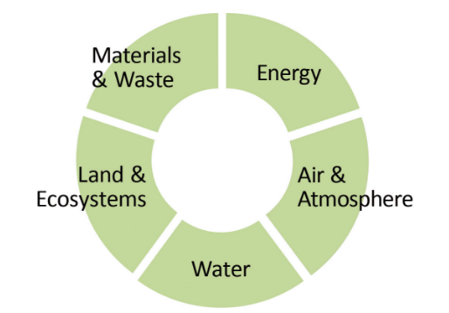



Green Remediation Guidance Framework
Principles of Greener Cleanups (EPA 2009)
Clean and Green Policy (EPA 2009)
Superfund Green Remediation Strategy (EPA 2010)
Methodology for Understanding and Reducing a Project’s Environmental Footprint (EPA 2012)
  Spreadsheets for Environmental Footprint Analysis (EPA 2018)
Considerations of Greener Cleanup Activities in the Superfund Cleanup Process (EPA 2016)
GR Core Elements
Notes:
1-Air Pollutant Emissions: onsite and offsite generation of air pollutants and GHGs from construction activities such as operation of heavy machinery, truck/barge/rail transportation, treatment operations. These emissions can be reduced by applying the most appropriate advanced/cleaner technologies (adding filters to exhaust systems), requiring high tier engine to construction equipment, applying BMPs (e.g., idling time)
2- Water Use/Protection of Water: consumption of significant amounts of water for treatment processes. GR strategies focus on reducing water consumption (especially potable water), reusing treated water, and using efficient techniques to protect water bodies
3- Land/Ecosystem Protection: minimize further harm to the area, protect land resources and ecosystems at or near the site, and restore to existing or better conditions after construction
4- Raw Materials Use and Waste Generation: site remediation may use significant amounts of raw materials and generates its own hazardous and non-hazardous wastes, that often are shipped offsite. GR strategies offer opportunities to reduce materials consumption and waste generation, use recycled and local materials and spent products, and purchase environmentally friendly products
5- Energy Use: cleanups involve energy intensive technologies and fuel consumption. GR strategies focus on opportunities to improve energy efficiency, use renewable energy sources, or use of alternate fuels
Mention on evolution of EPA emission factors
ASTM standards are not mandated by EPA but should be used as support tools to implement GR policy and to evaluate cleanup impacts
Two ASTM standards are available for GR integration and BMP selection
Standard Guide for Greener Cleanups (E2893-13, -16)
Standard Guide for Integrating Sustainable Objectives into Cleanup (E2876-13)
ASTMs provide the following:
Systematic protocol to identify, prioritize, select, and implement BMPs that reduce the environmental footprint of site-specific cleanup activities
BMP ranking system
Methodology to establish metrics for adopted GR BMPs for reporting purposes

Slide 5
Objectives of This Evaluation
Evaluate LDW UR remedy environmental footprint
  Focus on the air emissions core element
  Baseline conditions vs local average market conditions
Identify remedy components with largest impacts and combined effects
Evaluate applicable green remediation strategies
  Assess technical/logistical feasibility of electrification
Select appropriate greener options/BMPs for the design specifications
Notes:
Conducting cleanup activities to achieve site cleanup will require the use energy, water, and materials resources, and will generate waste and air emissions. Therefore, the cleanup process will create an environmental footprint of its own.
2012 EPA’s methodology states: “…does not constitute an EPA requirement. Use of this methodology is intended to support the remedial process and to help improve the environmental outcome of cleanup efforts but not to disrupt, delay, or otherwise reduce protectiveness of a remedy…”
EPA encourages (not require) the quantification of an environmental footprint for cleanups

Slide 6
Baseline Environmental Footprint (Step 1)
Baseline Construction Conditions
Identify primary and secondary construction activities
Establish meaningful GR metrics
Quantify each GR metric and the combined effect of all GR metrics
Quantify the biggest GR contributors to LDW UR
Primary: dredging/excavation, transloading, transportation, off-site disposal, material transportation and placement, structural work
Secondary: site prep, surveying, environmental compliance sampling, site closure
Eight Air Constituents:
HCs, VOCs, CO, NOx, PM₁₀, PM_{2.5}, SO₂, CO₂ (key GHG)
Emission factors through EPA’s Tier System
Primarily fossil fuel consumption (ULS diesel fuel)
Basis for Baseline Construction Conditions
  Construction conditions achievable by ALL contractors
  Use of equipment at EPA’s Tier 2 or lower engine (i.e., all equipment manufactured before 2010)
Notes:
Primary: they represent the major construction activities conducted within or outside of the project site and directly contribute to the project’s environmental footprint
Secondary: they represent the minor construction activities to be conducted within the project site
Ancillary activities: activities indirectly required or associated with the implementation of the sediment remedy, are sourced elsewhere and not dependent on the remedy itself; therefore, they are not considered applicable activities to the project’s environmental footprint. Ancillary activities are related to worker commuting, landfill emissions, mining/quarrying of raw material for material placement, import and purchase of electricity, extraction/production/refinement/transportation of fuels/lubricants, etc.
Emissions for a construction activity on a time basis (for construction equipment and vehicles) and on a mass-distance basis (for placement material and dredged sediment transport)
EFs: on-road vehicles (light and heavy duty, locomotives, motorcycles, etc.) and nonroad equipment/engines (marine engines/vessel, construction equipment) called the Tier System, with the purpose of identifying air emission standards corresponding to when a specific engine was manufactured and help reduce engine emissions (https://www.epa.gov/emission-standards-reference-guide; EPA 2022). The EPA emission standards for each tier are specific to the type of equipment (on-road vehicles, nonroad equipment/engines), the year of manufacture, and the engine power Website accessed in December 2022.
Definition of EPA’s Tier System:
Pre-Tier Engines: All equipment manufactured prior to 1996; it is assumed that this equipment was produced without a requirement to meet specific air emission standards.
Tier 1 Engines: All equipment manufactured between 1997 and 2005.
Tier 2 Engines: All equipment manufactured between 2001 and 2010.
Tier 3 Engines: All equipment manufactured between 2006 and 2011.
Tier 4 Engines: All equipment manufactured in 2008 and later.
Note that the model year range between tiers overlaps in some cases because model year requirements vary based on the horsepower (hp) of the equipment (e.g., a 50-hp engine manufactured in 2003 was required to meet Tier 1 emission standards, while a 160-hp engine manufactured in the same year [2003] was required to meet instead Tier 2 emission standards; EPA 2022). The range in model years provided represents the widest possible range for the specific tier.
sulfur content of diesel fuel is assumed to be 15 parts per million (ultra-low-sulfur diesel).
The largest GHG contributors are CO₂, methane (CH₄), and nitrous oxide (N₂O); other GHGs are emitted in smaller quantities. Total GHG emissions are typically reported as metric tons (tonnes) of carbon dioxide equivalents (CO₂-eq), calculated by multiplying the tonnes of each GHG emitted by that GHG’s global warming potential (GWP; EPA 2005) and summing the results. Therefore, CH₄ and N₂O can be typically included in the CO₂-eq total. The GWP represents the effect a given GHG has on global warming in the atmosphere relative to one unit of CO₂. GWPs for all of the GHGs are listed in Climate Leaders Greenhouse Gas Inventory Protocol - Design Principles, Table 6‑3 (EPA 2005).

Slide 7
“Improved” Environmental Footprint (Step 2)
Local Average Market Conditions
Survey local marine construction contractors
Identify reasonable and realistic changes to dominant construction activities
Re-quantify GR metrics and the combined effect of all GR metrics
  Contractor No. 1
      Cranes: 40% (Tier 4), 60% (pre-Tier standards)
      Excavators: 20% (Tier 4), 80% (Tier 2)
  Contractor No. 2
      Cranes: 100% (Tier 4)
      Excavators: entire fleet is relatively new (assume all Tier 4)
  Contractor No. 3
      most fleet is Tier 2 or lower
3 contractors in Puget Sound (WA)
Understand the age and number of pieces of marine equipment in active use (as of 2022)
Basis for Local Average Market Conditions
  Construction conditions achievable by the AVERAGE contractor
  Use of the approximate distribution of construction equipment in active use related to its Tier engine (age)
Notes:
“Improved” refers to improvements in equipment usage that result in less air emissions - therefore, a smaller environmental footprint.
The local average market conditions scenario represents a realistic distribution of tier engines, based on current availability of construction marine equipment in the Puget Sound area for sediment remediation

Slide 8
Baseline vs Local Average Market Conditions
Construction Activity | Equipment Type | Assumed Distribution of Equipment Based on EPA's Tier System (%)
 |  | Baseline Conditions |  |  | Local Average Market Conditions
 |  | Pre-Tier | Tier 2 | Tier 4 | Pre-Tier | Tier 2 | Tier 4
Sediment Dredging | Crane (150-ton) | 30% | 70% | 0% | 30% | 30% | 40%
 | Hydraulic Excavator (180 HP) | 0% | 100% | 0% | 0% | 80% | 20%
 | Push Boat (800 HP) | 100% | 0% | 0% | 100% | 0% | 0%
Sediment Transloading, Transportation, and Disposal | Offloading Crane (100-ton) | 0% | 100% | 0% | 0% | 70% | 30%
 | Front-End Loader (forklift) | 0% | 100% | 0% | 0% | 50% | 50%
 | Rail (locomotive and train) | 0% | 100% | 0% | 0% | 0% | 100%
Notes:
The local average market conditions scenario represents a realistic distribution of tier engines, based on current availability of construction marine equipment in the Puget Sound area for sediment remediation

Slide 9
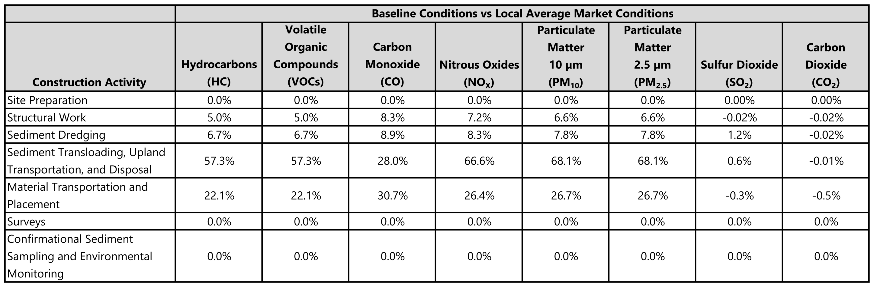
Relative Reduction in Air Emissions by Construction Activity
Note: Relative change in total emission calculation based on: (Total Emissions for Baseline - Total Emissions for Market)/(Total Emissions for Baseline). Negative percentage change indicates relative increase in total emissions; positive percentage change indicates relative decreased in total emissions.
Notes:
The largest reduction in total direct air emissions (approximately 28% for CO to 68% for PM₁₀ and PM_{2.5}) when comparing the local average market conditions to the baseline conditions is evident for the sediment transload, upland transportation, and disposal activity. This is consistent with the high percentage of Tier 4 engines assumed to be applied to equipment needed for this construction activity under the local average market conditions.
However, from this analysis, it is also shown that total emissions from some activities will have relatively little improvement with a higher tier level, such as the sediment dredging activity (which resulted in only 0% to 9% decrease in total emissions) and structural work (which resulted in only 0% to 8% decrease in total emissions). This is due to the significant influence of ancillary vessels (tugboats, push boats, etc.), supporting dredge equipment movement, which still operate with pre-Tier engines.
However, this table also shows a slight increase in total direct air emissions for the sediment dredging activity (0.02 % for CO₂); sediment transloading, upland transportation, and disposal (0.01% for CO₂); structural work (0.02% for CO₂ and SO₂); and the material transportation and placement activity (0.5% for CO₂ to 0.3% for SO₂). This is due to air emission factors for SO₂ and CO₂ which are highly dependent on the brake-specific fuel consumption, which is higher for Tier 2 and Tier 4 engines (relative to Pre-Tier engines) for equipment like cranes, resulting in slightly higher emissions as engine tiering increases.

Slide 10
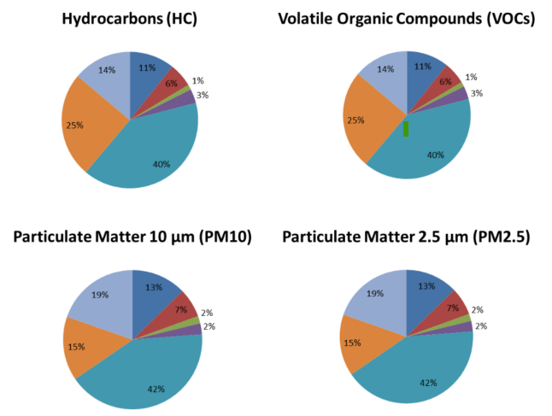
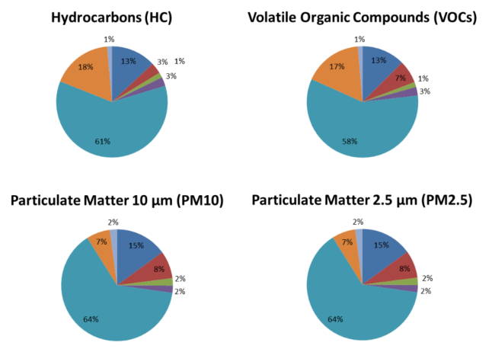
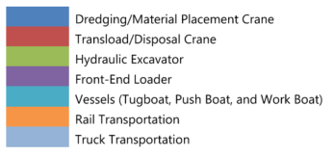
Total Air Emissions Comparison by Equipment Type
Baseline Conditions
Local Average Market Conditions
Identify primary, secondary, and ancillary construction activities
Notes:
Among all vehicle and equipment types for each of the construction activities, the use of various vessels shown in teal blue (including tugboats, push boats, and work boats, used to not only haul dredge sediment to the transload facility but also to haul clean materials for placement to the site and position other marine construction equipment) accounts for the majority of the total direct air emissions consistently for both scenarios (baseline and local average market conditions), as shown in both figures. The reason for the increase in air emissions for the vessel group between baseline and local average market conditions is because there is no improvement on Tier engine (remains in Pre-tier level) compared to all other equipment types.
It can also be observed that Tier engines improvements in rail and truck transportation result in reduced air emissions – from 15% (PM10 and 2.5) and 25% (HC and VOCs) to 7% (PM10 and 2.5) and 17% (HC and VOCs).
In both cases, six of eight air constituents (CO, NO_{X}, HC, VOCs, PM₁₀, and PM_{2.5}) are the primary contributors with total direct emissions ranging from 29% to 64%.

Slide 11
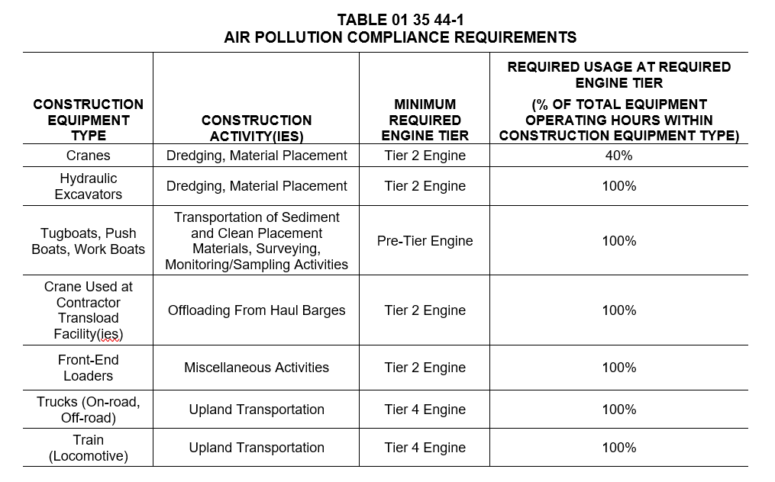
Air Emission Compliance Requirements
Developed performance-based specification requirements
  Contractor equipment must meet minimum EPA Tier engine (based on the construction activity)
  Minimum operating time at the required engine Tier
Identify primary, secondary, and ancillary construction activities
Source: Specification Section 01 35 44 (Green Remediation Requirements) – 100% Design; Anchor QEA 2023
Notes:
Performance specifications allow the Contractor to use their expertise and equipment fleet to meet the performance criteria without artificially constraining the use of certain equipment, which could restrict the number of qualified bidders.
The Specifications need to be broad enough to encompass all potential cranes that may be used by the Contractor (who will propose its specific means/methods and equipment type to conduct the work to be described in the RAWP). Therefore, the Specifications requirements should not limit engine tiering to a select few crane types.
Engine retrofits are very specific to each piece of equipment. Because it is not known what the Contractor fleet consists of, it is not possible to require specific retrofits; instead, performance-based requirements have been developed that achieve the emissions reduction objectives.
The GR evaluation done was conceptual in nature with a wide range of assumptions for engine tier use of various types of cranes (based on specific construction activities) to calculate potential air emissions for the various Project activities.

Slide 12

Assessing the Feasibility of Electrification
Target reduced fossil fuel consumption (potential 20% to 40% emission reduction by fully electric operations)
Focus on key construction activities (dredging, support vessels, transloading, upland transportation, disposal)
Outreach to local and national dredging industry
  Formal national workshop conducted in May 2023 with 10+ attendees
Notes:
Fully electric operations (dredging and material placement) could reduce air emissions by 20% to 40% combined. However, tug emissions still represent a large emission portion.
Equipment maintenance time for electric equipment is lower than the one needed for standard diesel-fueled equipment.
Pros: cheaper operating costs, reduced maintenance
Cons: significant capital costs (~$1.2M), 1-mi long cable max, cable management

Slide 13
Logistical Feasibility of Electrification
Most contractors do not own electric marine equipment
Large capital investment required
  Retrofitted, purchased brand new, or shipped from California
  Ancillary equipment needed to support electric-powered dredging (electric cables, cable reels, transformers, and protective housings)
Retrofitting
  Timeline: approximately 4 to 12 months
  If required, could have significantly limit the pool of contractor bids
Notes:
Only contractors working in CA have some electric construction equipment (mainly cutter suction dredge for hydraulic dredging) given there is an established electric infrastructure built around some CA port facilities.

Slide 14
Logistical Feasibility of Electrification (cont.)
Lack of local infrastructure along the LDW UR
  Anticipated high power load and multiple substations
  Coordination with selected contractor needed to understand power needs
  City ready to set up electrical power, but requires specific “drop” spots along the UR
  Power sources can be “temporary” (e.g., moveable platform/trailer type systems)
  ~1 year to implement
Notes:
Anticipated high load and multiple substations (or equivalent temporary power drops) would be needed to potentially allow for electric dredging in the entire LDW upper reach area and provide power source to multiple contractors at the same time

Slide 15
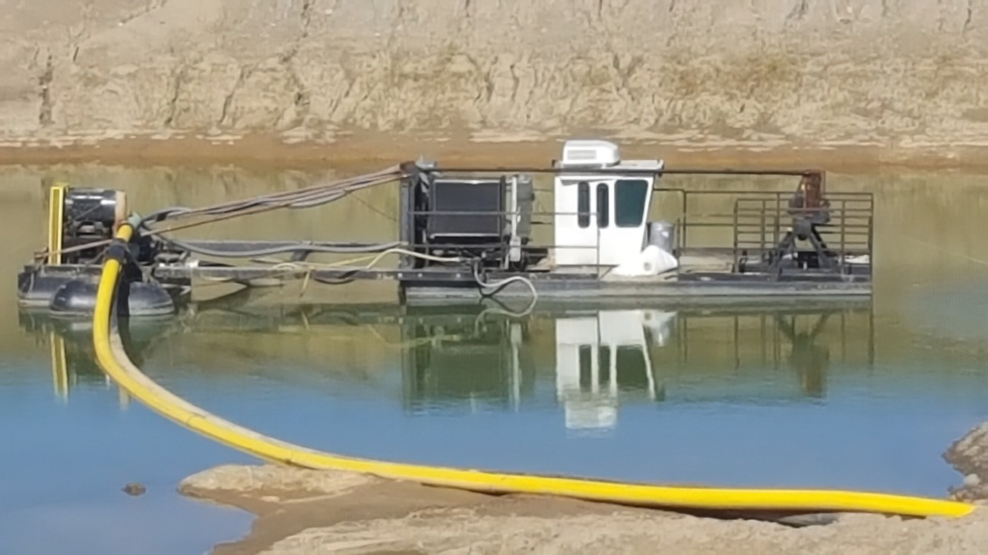
Technical Feasibility of Electrification
Maximum 1-mile radius for tethered electric dredging
Management of electric tether
High level of coordination within LDW for other vessels
Inadvertent impacts of electrification
  More air emissions from ancillary equipment (tugboat support during moves)
  Significant time to relocate/move electric equipment
    Extensive cable reeling increases downtime up to 20%
Notes:
1-mile radius could be overcome by doing battery-powered electric operations but batteries have 4-hr to 6-hr usage time
Electric hydraulic dredging works well towards emission reduction because it is a continuous operation at high power, while electric mechanical dredging require moving equipment around and operate at much lower horsepower
Note that typical electric dredge fleet will require 3 barges, one for dredge derrick, a material barge, and a reel barge for cable management, plus tugs and work boats
Cable sitting on waterway bed would require protection and adds complexity to logistics/coordination

Slide 16
Summary
Environmental footprint analysis helped understand the LDW UR remedy’s key contributors of air emissions
Baseline and local average market conditions comparison showed:
  Most air emissions reduced for sediment transload, upland transportation, disposal
  Sediment dredging shows little improvement with higher tier engine level
Need to look holistically at all equipment and construction activities when targeting air emission reductions

Slide 17
Summary (cont.)
Incorporated specifications realistic for marine contractors to achieve
  Requiring Tier 4 (or a percentage of Tier 4) is feasible in terms of reasonable retrofitting, costs, and time
  Would not restrict pool of dredge contractors qualified to bid
National dredging industry workshop informed status of marine vessel electrification and logistical/technical challenges to overcome
Electrification deemed not technically feasible for inclusion in LDW UR remedial design

Slide 18


Sylian Rodriguez, PhD, ENV SP
Senior Managing Professional
srodriguez@anchorqea.com

