Slide 1
Distilling Complex Fate and Transport Modeling into Simple-to-Understand Site Management Tools
Presented by: Ramzy Makhlouf, Anchor QEA
Collaborators: Laura Bateman, PE, and Kevin Russell, Anchor QEA

Slide 2

Photograph by Bill Rhodes
Photograph by Bill Rhodes

Slide 3
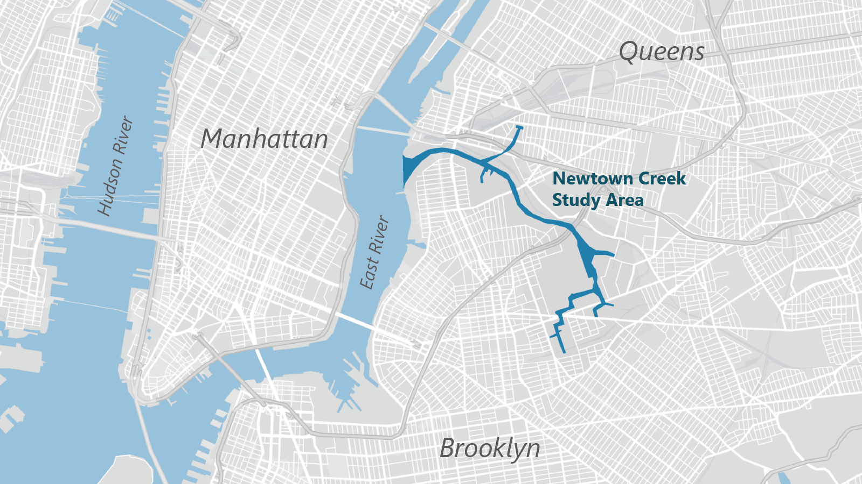

Slide 4
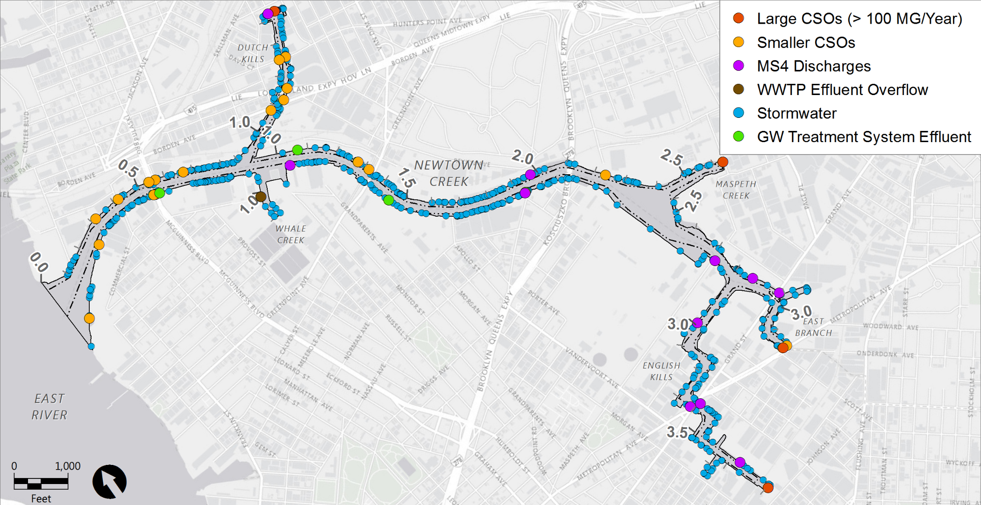
Documented Point Sources
Newtown Creek Setting
Large CSOs (> 100 MG/Year)
Smaller CSOs
MS4 Discharges
WWTP Effluent Overflow
Stormwater Discharges
GW Treatment System Effluent
Tidal Exchange

Slide 5

Continuously assess and select the simplest and most appropriate tool to evaluate the potential impact of ongoing external inputs of contaminants to Newtown Creek

Slide 6
Selecting the Most Appropriate Tool
Contaminant fate and transport (CFT) model
  The model that was originally selected to support the Feasibility Study
  Part of a state-of-the-science framework
  Designed to evaluate long-term impact of ongoing chemical loadings and legacy contamination to surface water and surface sediment post remedy
Long-term equilibrium (LTE) model
  Originally an interim tool to be used prior to finalization of the full CFT model
  A spreadsheet-based mass accounting model developed to approximate the fundamental underlying processes affecting surface sediments at the site

Slide 7
Contaminant Fate and Transport Model
Part of a large and comprehensive modeling framework that includes a complete list of important sources of contaminants of concern (COCs) and processes
Simulates COCs that contribute to risk and represent a wide range of mobility
  12 individual COCs: 5 polycyclic aromatic hydrocarbon (PAH) compounds,
  6 polychlorinated biphenyl (PCB) homologs, and copper
Robust model calibration that captures key data features for all modeled and total COCs

Slide 8
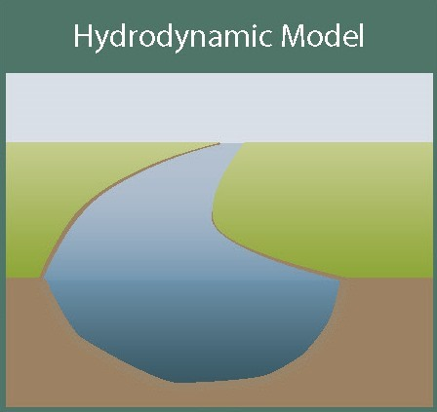
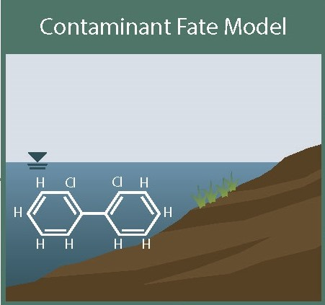
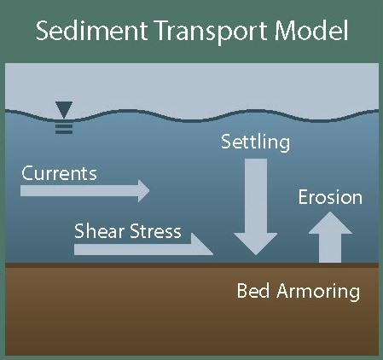
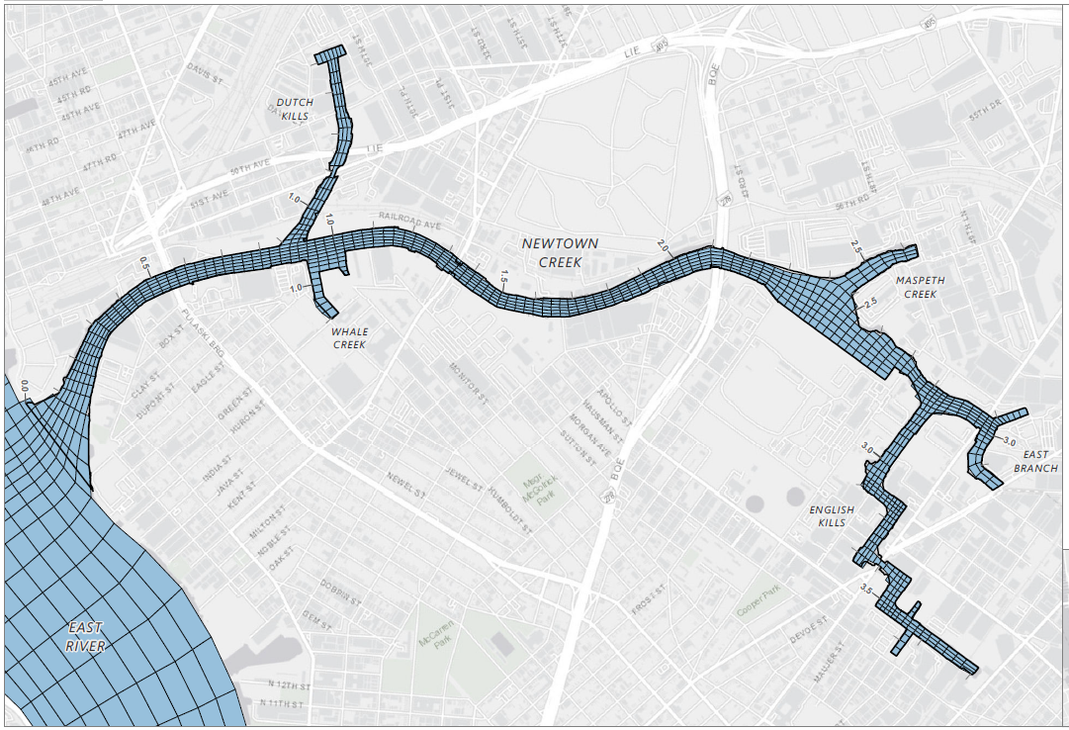
CFT MODEL AND MODELING FRAMEWORK
Model Obtained USEPA Acceptance
Point Source Flow
Flow, Volumes,
Dispersion
Point Source Load
Groundwater Flow
Groundwater Load
Flow, Volumes,
Bottom Shear Stress
Resuspension,
Deposition Fluxes, Suspended Sediment Concentrations
CFT Model Grid
Point Source Load
East River Load
Ship Propwash Parameters

Slide 9
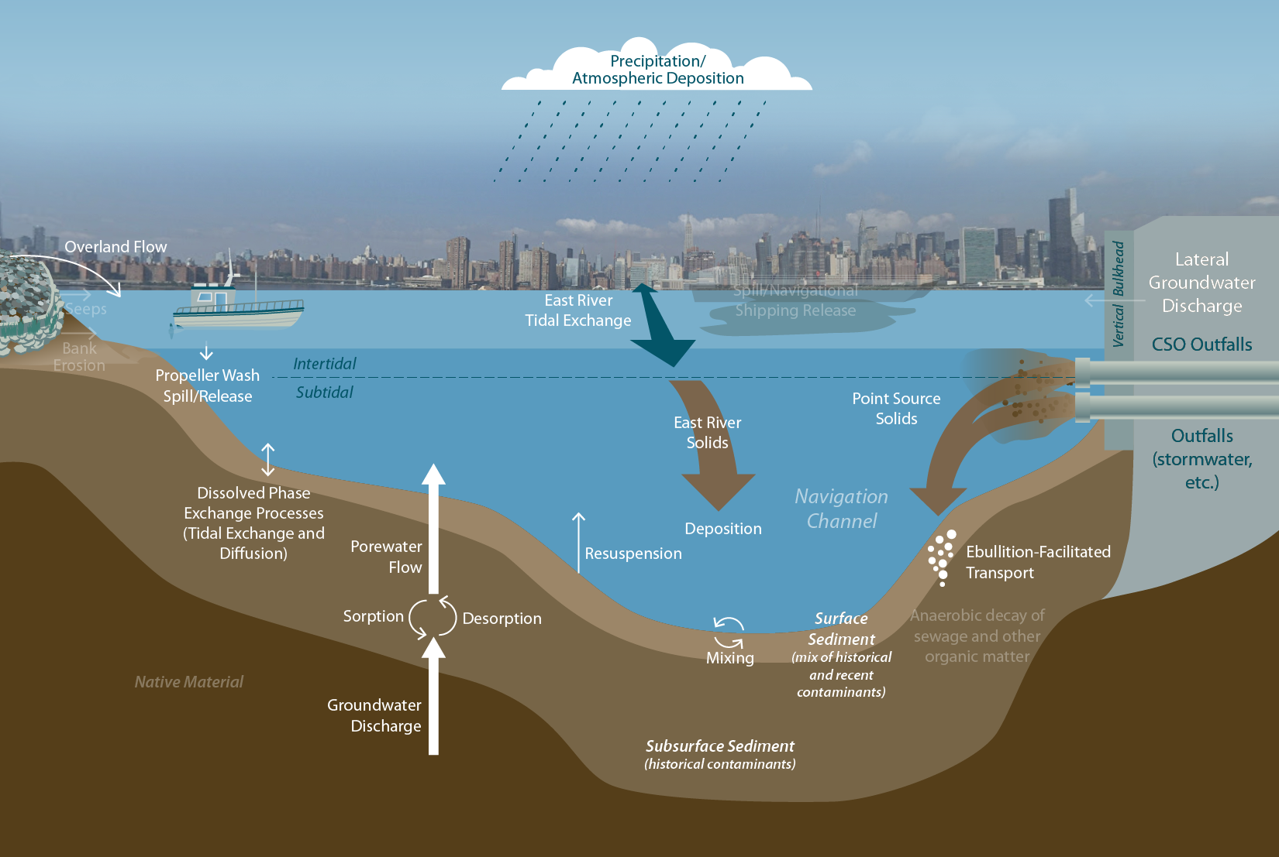
CFT Model: Complex Model for a Complex Site with Many Processes and Sources
Note: Sources and processes shown in white font (not greyed out) are actively included in the CFT model

Slide 10
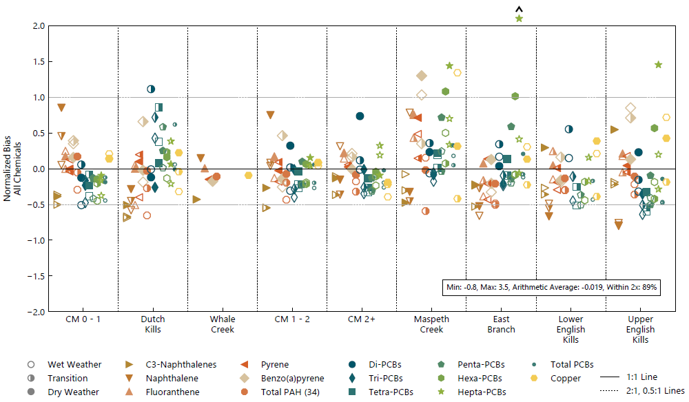
A Robust CFT Model
Accurately simulates fate and transport processes and sources of COCs
Successfully calibrated over a range of COCs with different variables
  Fate and transport properties
  Sources and historical loads
  Surface water concentrations measured over a range of various weather conditions
  Horizontal and vertical concentration gradients in sediment
Surface Water Model Results by Reach, by Weather Condition, for All Contaminants

Slide 11
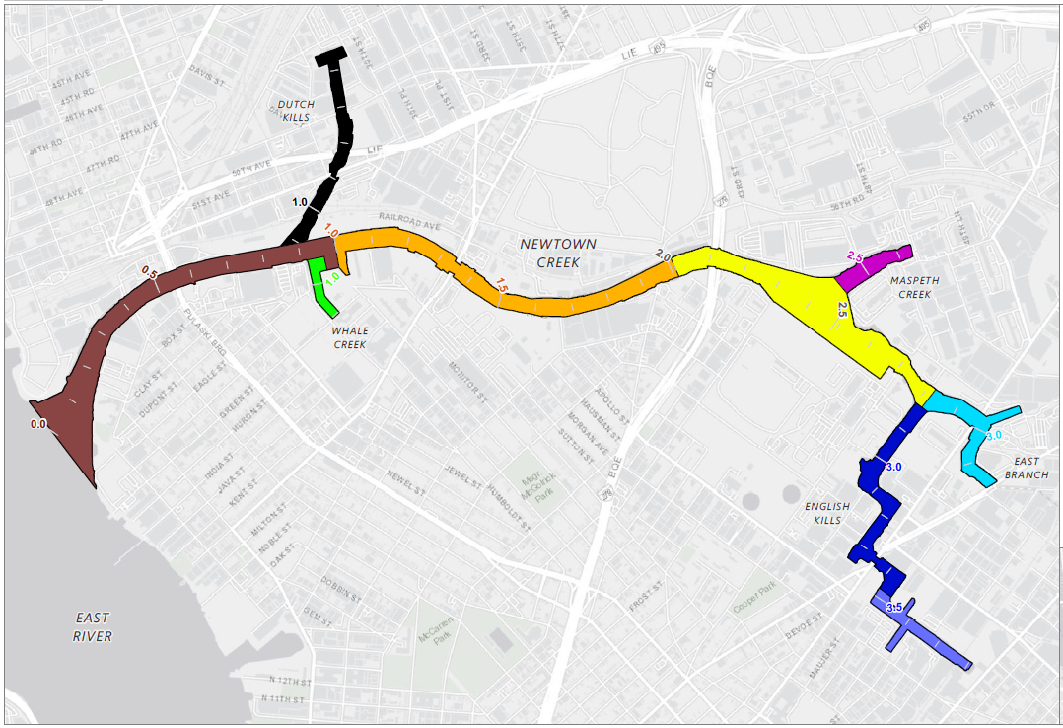
Long-term Equilibrium Model
LTE Reach Spatial Scale
A spreadsheet-based, relative mass accounting model developed
to approximate COC concentrations in surface sediments as they come to equilibrium (based on the conceptual site model and sources and processes that impact surface sediment concentrations)
Based on a mass accounting approach that includes net sedimentation rates (information from the linked modeling framework including the sediment transport models) and empirical data on COC loads for the primary contaminant inputs
Developed to approximate CFT model predictions and informed by preliminary results from the CFT model and robust datasets
Configured to produce results over a reach-wide spatial scale
Easy to use and update with available data or newly characterized loads

Slide 12
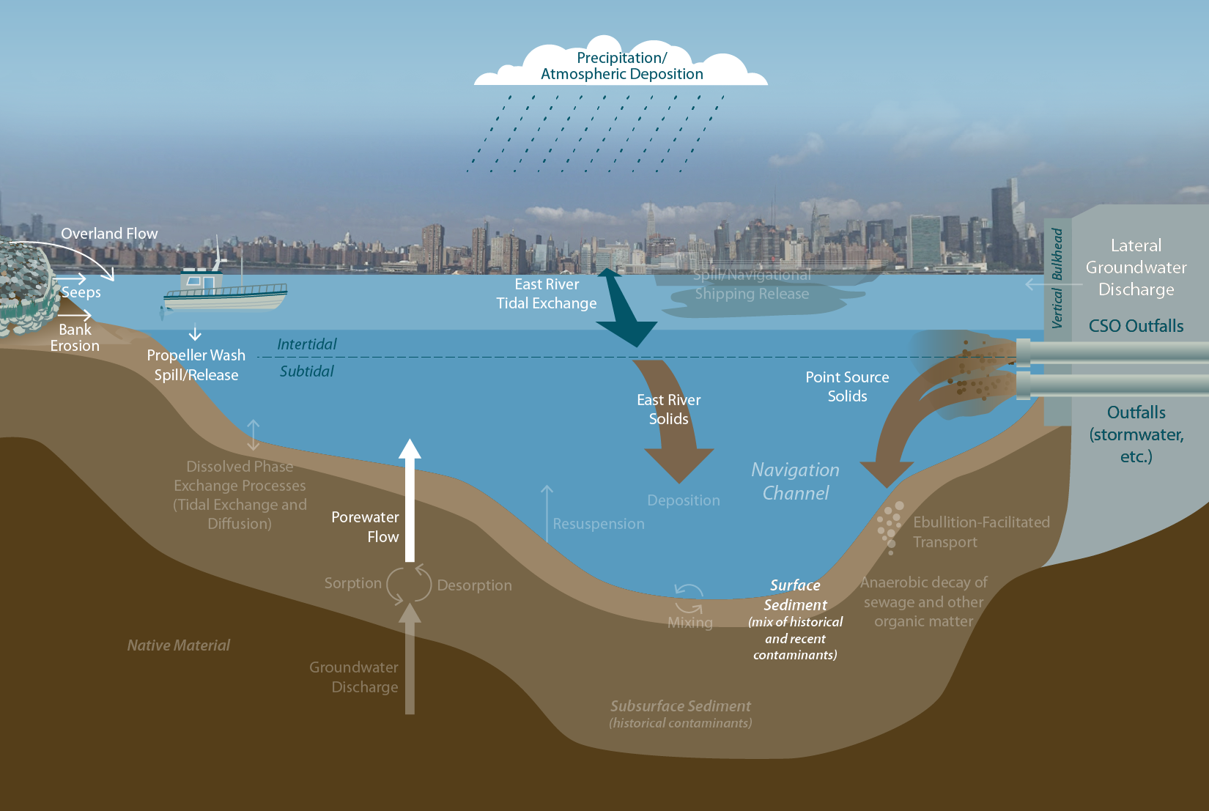
LTE Model: Simpler Model Focused on Loads Impacting Surface Sediments
Note: Sources and processes shown in white font (not greyed out) are actively included in the LTE model.

Slide 13
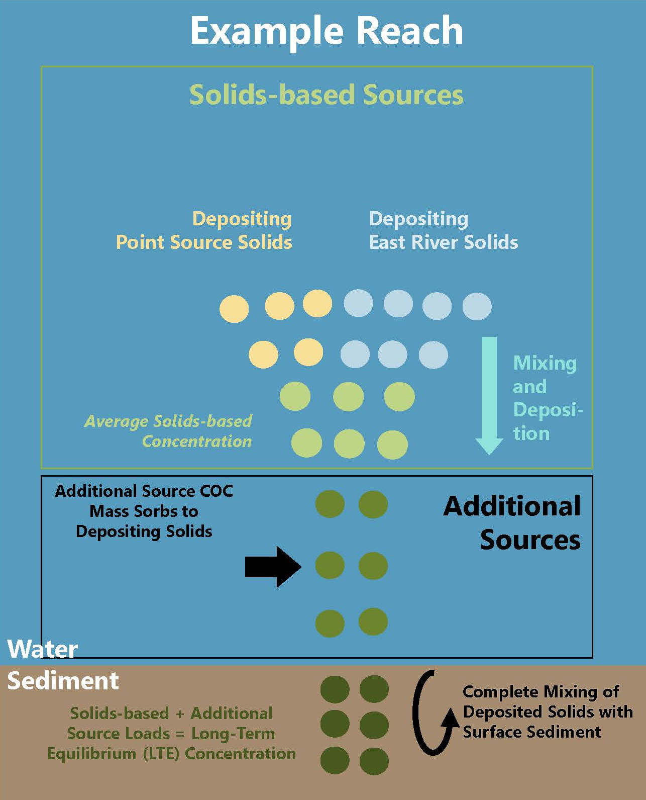
LTE Calculation Overview
Solids-based sources: Quantified by relative contribution to net sedimentation rate (NSR) and measured particulate phase contaminants
  East River surface water
  Point sources
Additional sources: Quantified by annual contaminant load estimates (mostly dissolved phase processes)
  Atmospheric deposition
  Treated groundwater effluent
  Lateral groundwater/seeps
  Porewater advection (driven by groundwater flow)
  Bank erosion

Slide 14
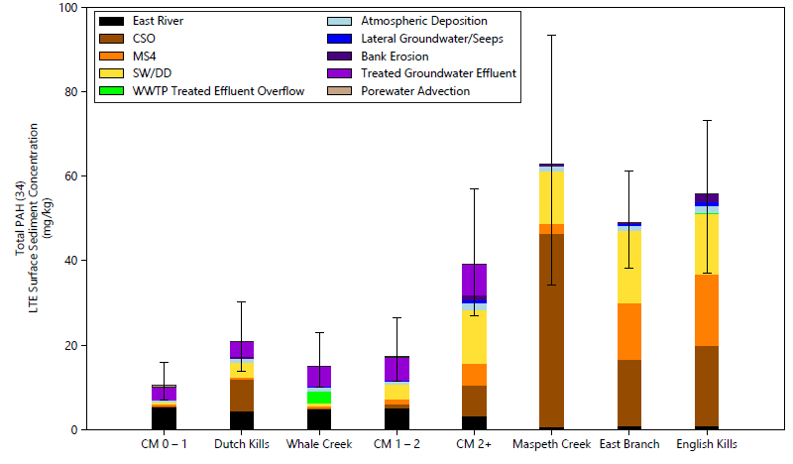
Estimated LTE Concentrations: Total PAH (34)
Predictions of the LTE model are consistent with preliminary results from the CFT model on a reach-average basis (as a result of both using the same sediment transport results)
Note: The range on each bar indicates the calculated LTE concentrations with upper- and lower-bound ranges that were developed by combining the variance of the means for the individual sources and calculating 2 times the standard error of the overall mean while the bar itself shows the base case.

Slide 15
Model Comparison
Model Characteristic | CFT Model | LTE Model | Necessary to Project
Evaluate small spatial and temporal trends | Yes | No | No
Evaluate surface water results including wet weather conditions | Yes | No | No
Predict long-term surface sediment concentrations and impacts of ongoing sources | Yes | Yes | Yes
Includes all relevant contaminants of concern | No | Yes | Yes
Necessary spatial scale for utility of model and remedial alternatives | Yes | Yes | Yes
Ease of use and transparent for stakeholder engagement | No | Yes | Yes
Quickly update model inputs to review results in real time | No | Yes | Yes
Agency acceptance | Did Not Obtain | Yes | Yes
Notes:
What that it became clear that was necessary to support a remedy was long-term clear

Slide 16
A Tale of Two Models
Although an innovative CFT model was developed and used to support the conceptual site model and was an integral component in developing the LTE model…
Based on the similarities of the model results and current realities of the project with a large robust dataset and emphasizing transparency, stakeholder engagement, ease of use, and the remedial alternatives being considered in the FS (most being bank-to-bank dredge and/or cap over multiple reaches)…
The CFT model was discontinued (as directed by USEPA) in favor of using the LTE model going forward.
Notes:
Because of these remedies only care for recontamination
Study Questions evolve, ask the question along the way, danger and harm of doing more than you need; Try to anticipate what you need before hand

Slide 17
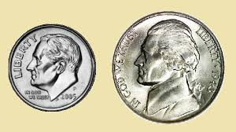
Bigger isn’t always better!
Although a more complex model can provide more features and functionality, it may not be the most appropriate tool given the remedy and project requirements (i.e., it became overly complex for its purpose).

Slide 18
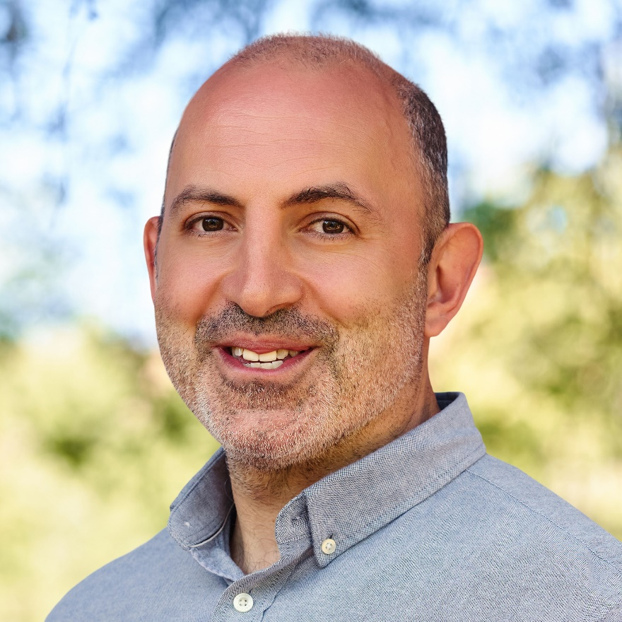
Ramzy Makhlouf
Principal
Anchor QEA
rmakhlouf@anchorqea.com

