Slide 1




Implementation of a Drum Removal Pilot Study in Torch Lake, Michigan
Presented by: Paul LaRosa, PE, Anchor QEA
Collaborators: Billie-Jo Gauley and Scott Inman, Anchor QEA
Jessica Telano, Honeywell
Heather Williams and Crawford White, USEPA GLNPO
Art Peitsch, EA Engineering, Science, and Technology, Inc., PBC
Dustin Bauman, JF Brennan

Slide 2
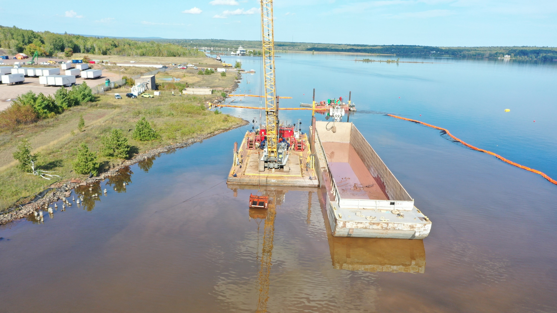

Slide 3
Project Overview
USEPA and Honeywell are performing a Focused Feasibility Study (FFS) in Torch Lake Area of Concern as part of the Great Lakes Legacy Act
  Contaminated sediment containing metals and PCBs
  Significant amounts of debris including drums
A key issue in the FFS is how to address hundreds of drums on (and in) the sediment under approximately 5 to 80 feet of water
Source and contents of the drums are not well understood

Slide 4
Can drums on the bottom of the lake be effectively removed using conventional dredging equipment?

Slide 5
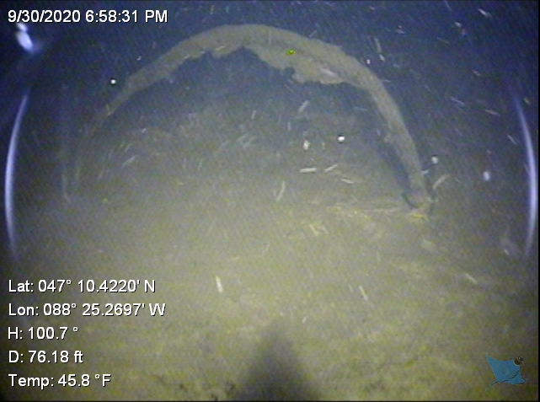
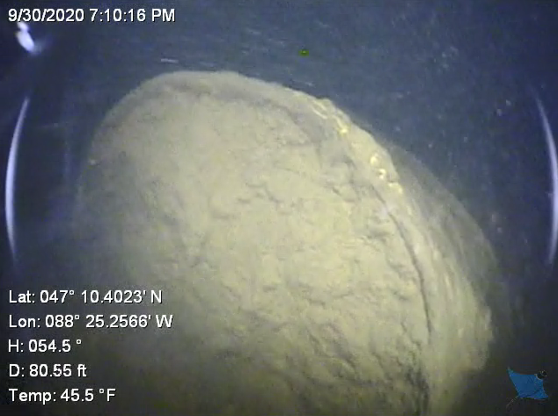
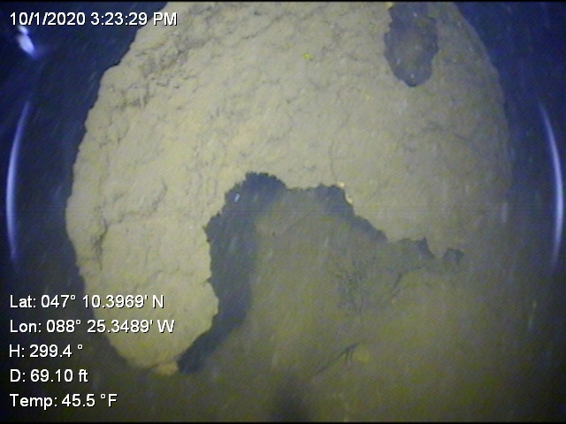
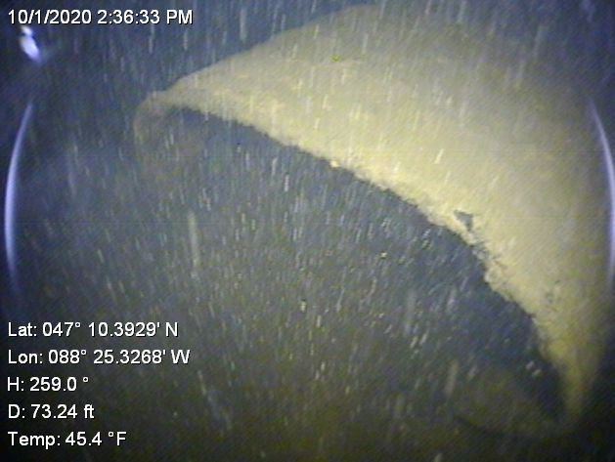
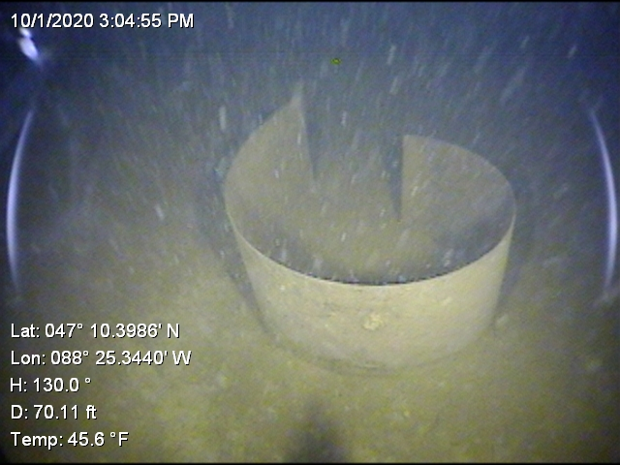
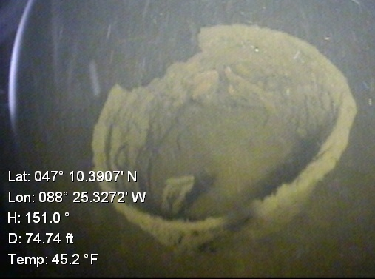
Example Drum Conditions
Source: EA 2020

Slide 6
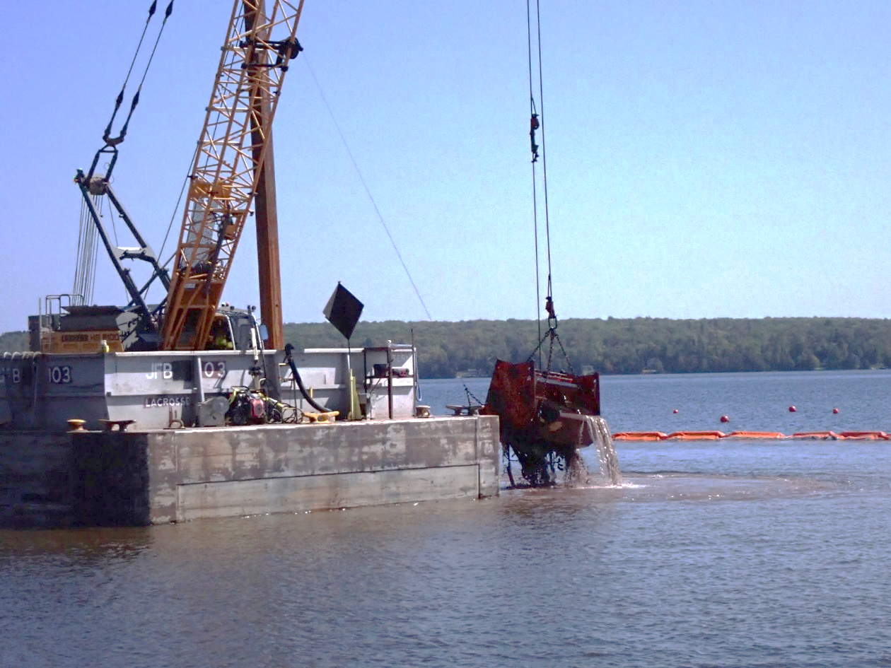
Pilot Study Objectives
Determine the effectiveness of drum removal to inform the FFS
Assess the effectiveness and implementability of various environmental controls
Evaluate methods for debris and sediment handling and processing
Mechanical Removal of Drums and Sediment

Slide 7
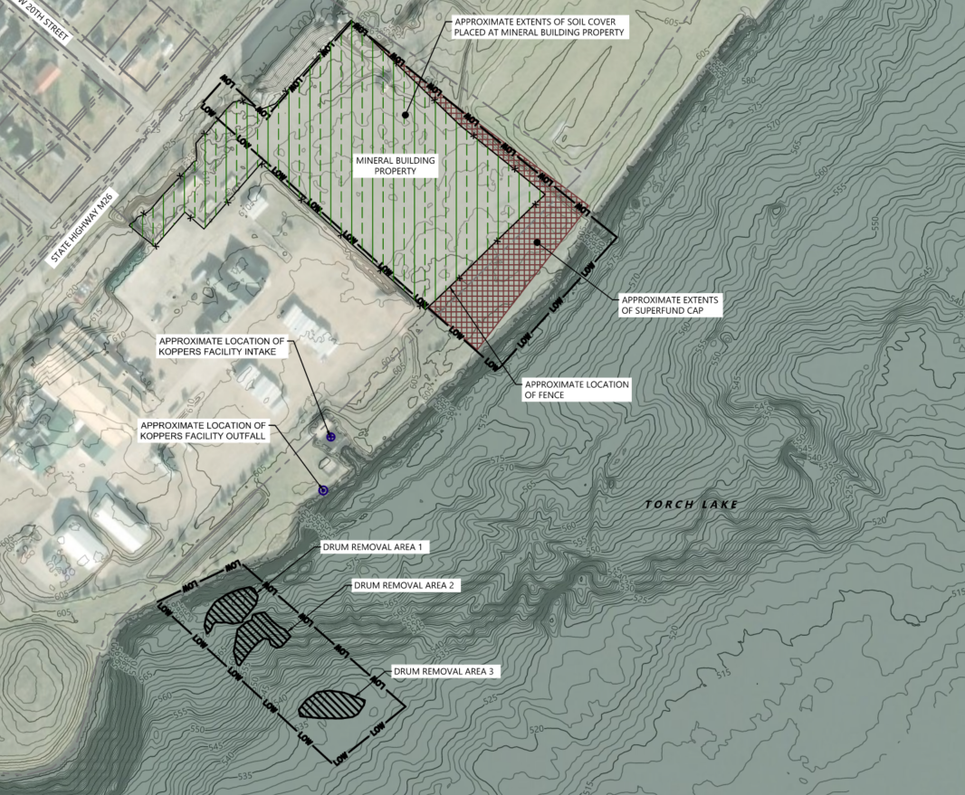
Project Scope
Three discrete areas targeting 120 drums over 0.5 acre
  Area 1: <30-foot water depth (complete sweep)
  Area 2: 30- to 50-foot water depth (targeted removal)
  Area 3: >50-foot water depth (targeted removal)
11 days of removal planned
Staging Area
Water Intake
Area 1
Area 2
Area 3
Project Area Map

Slide 8





Site surveying
Pilot Study Construction
Mechanical removal of drums
Environmental monitoring
Removal verification
Sediment/debris offloading, handling, and disposal

Slide 9
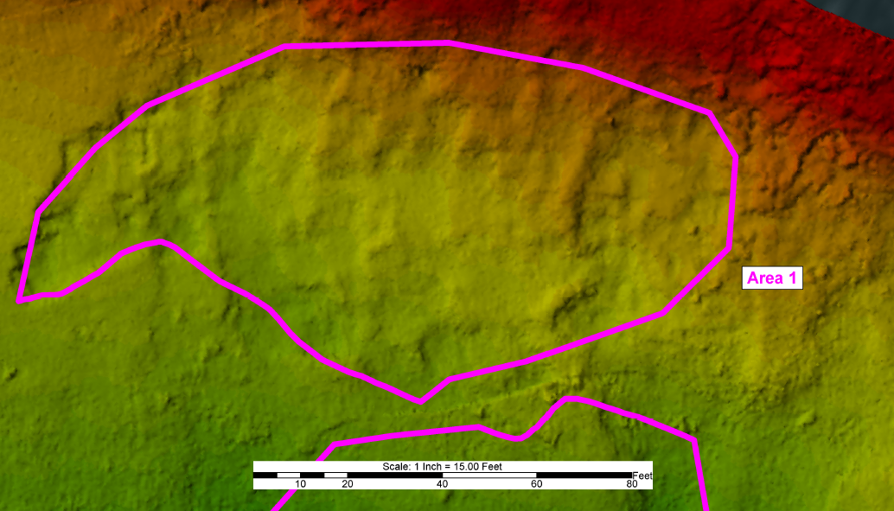
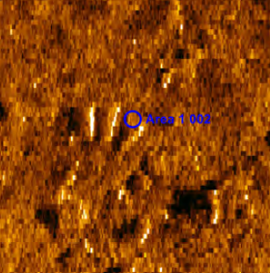
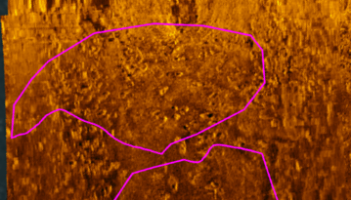
Site Surveying
Pre- and post-construction surveys
  Multibeam bathymetry
  Side-scan sonar
  Remotely operated
  vehicle (ROV)
Pre-Construction Multibeam Survey of Area 1
Side-Scan Sonar Image
Pre-Construction Side-Scan Survey of Area 1
Notes:
The side scan data was processed in Sonarwiz software and overlaid onto the multibeam surface to verify the accuracy of the imagery. The data was used to identify contacts within the work areas for a contact report and to generate a mosaic image. Sonarwiz generated a report detailing each contact with an image, contact position, width, height, length and work area.

Slide 10
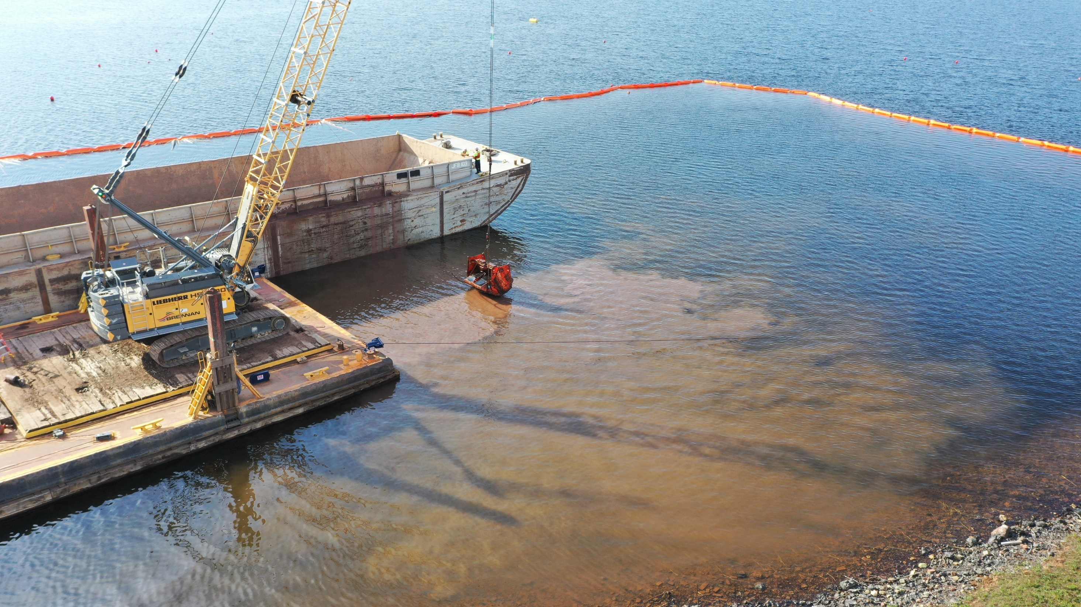
Mechanical Removal Operations with 3-Cubic-Yard Environmental Bucket

Slide 11
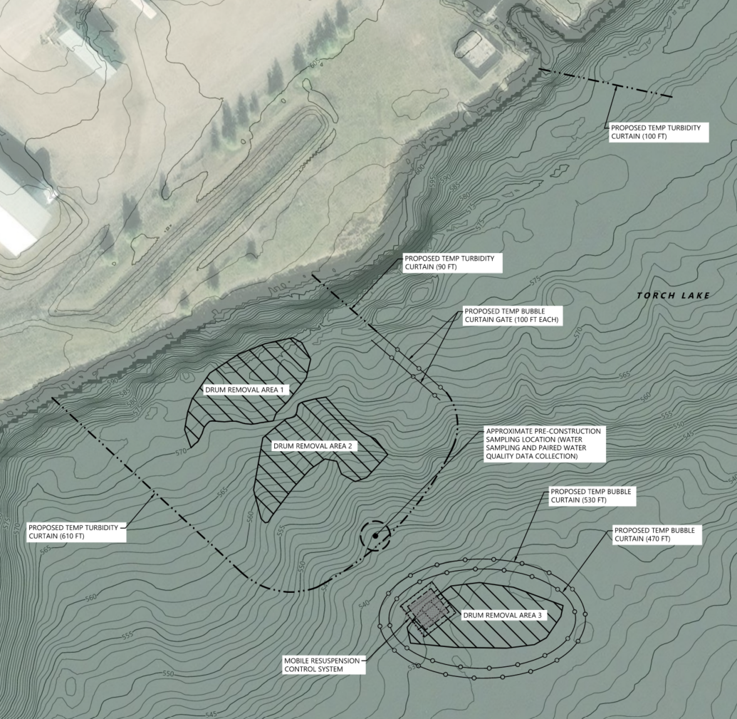
Turbidity Controls
Areas 1 and 2
    Fixed-perimeter turbidity curtain
    Small section of a fixed bubble curtain
Area 3
    Fixed-perimeter bubble curtain
    Mobile turbidity curtain (“moon pool”)
  Water Intake
    Fixed-deflector turbidity curtain
Turbidity Curtain
Turbidity Curtain
Bubble Curtain
Area 1
Area 2
Bubble Curtain
Turbidity Curtain
Bubble Curtain
Area 3
Mobile Resuspension Control System
Design Turbidity Control Layout

Slide 12
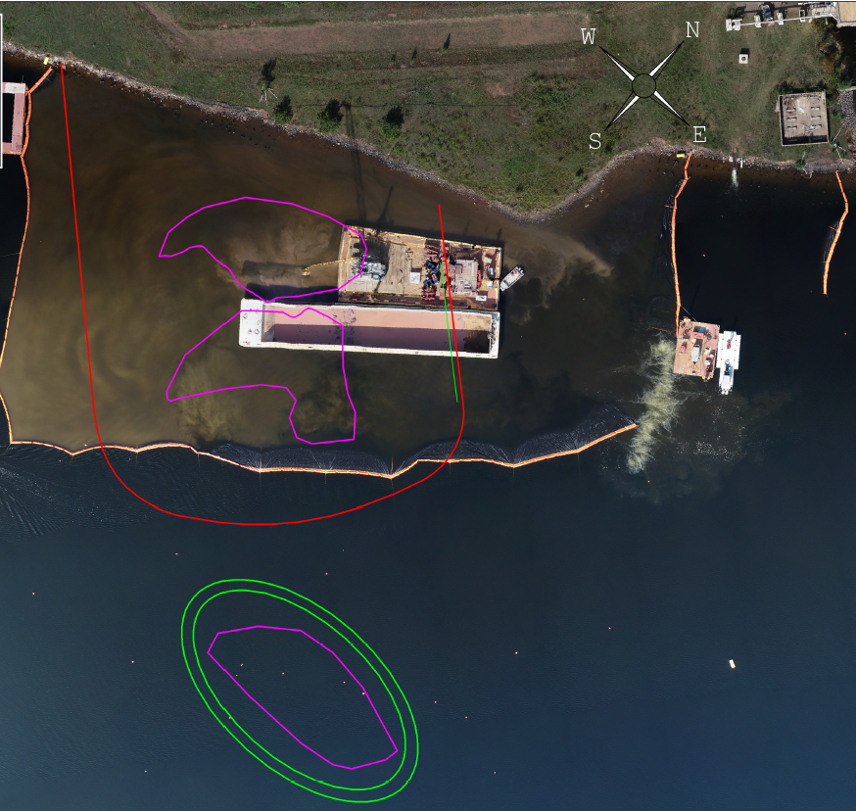
As-Built Turbidity Control Layout
Design vs. Actual Turbidity Control Layout

Slide 13
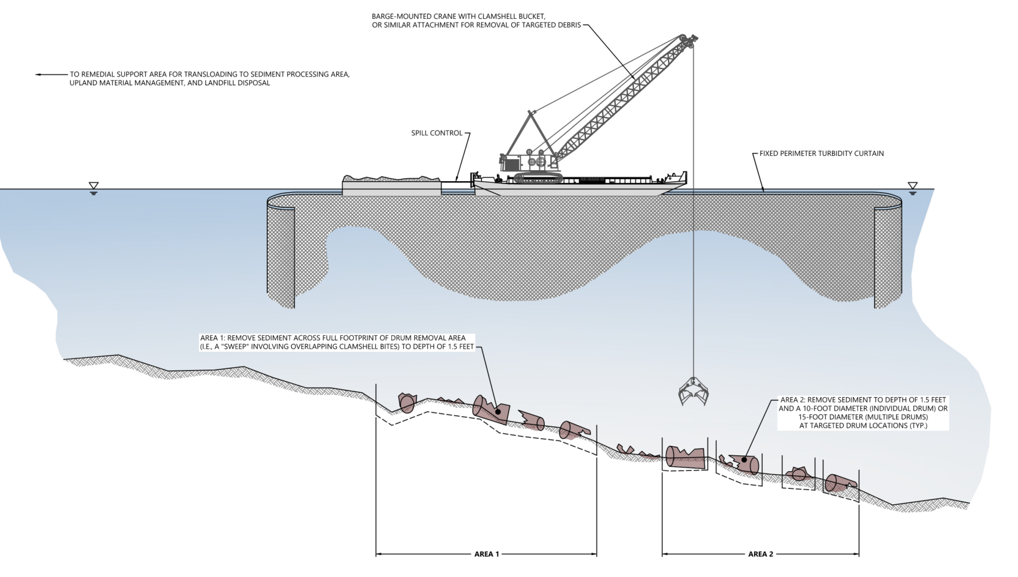
Removal and Turbidity Controls – Areas 1 and 2
Barge-Mounted Crane
Spill Control
Perimeter Turbidity Curtain
Area 1: Complete Sweep
Area 2:
Targeted Removal
Area 1
Area 2
Notes:
Discuss sweep vs. targeted removal

Slide 14
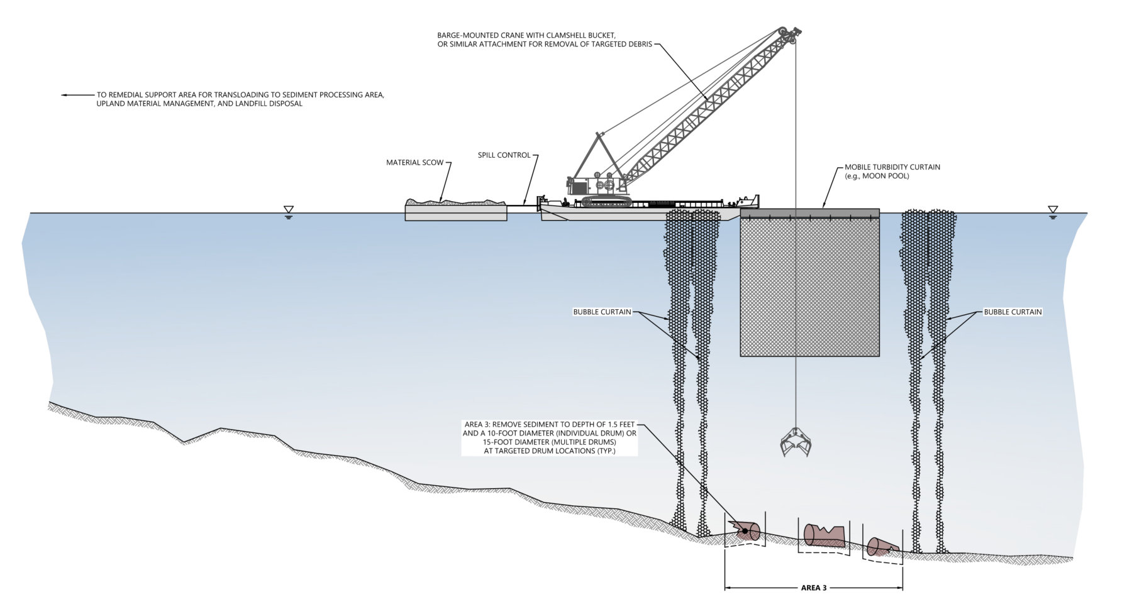
Removal and Turbidity Controls – Area 3
Barge-Mounted Crane
Scow
Spill Control
Mobile “Moon Pool”
Bubble Curtain
Bubble Curtain
Area 3:
Targeted Removal
Area 3

Slide 15
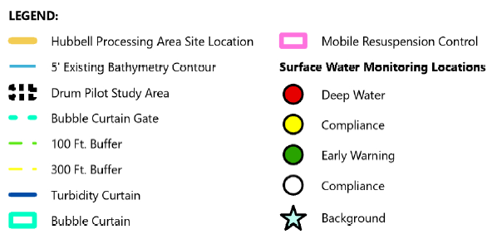
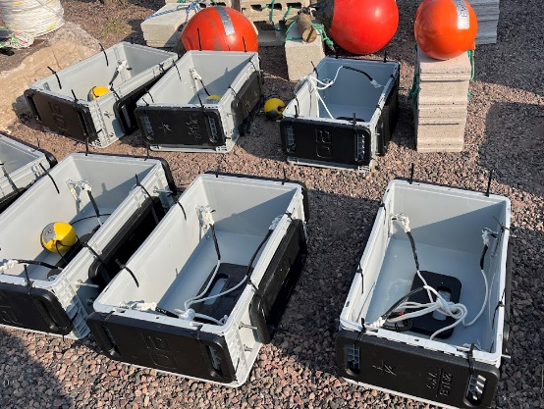
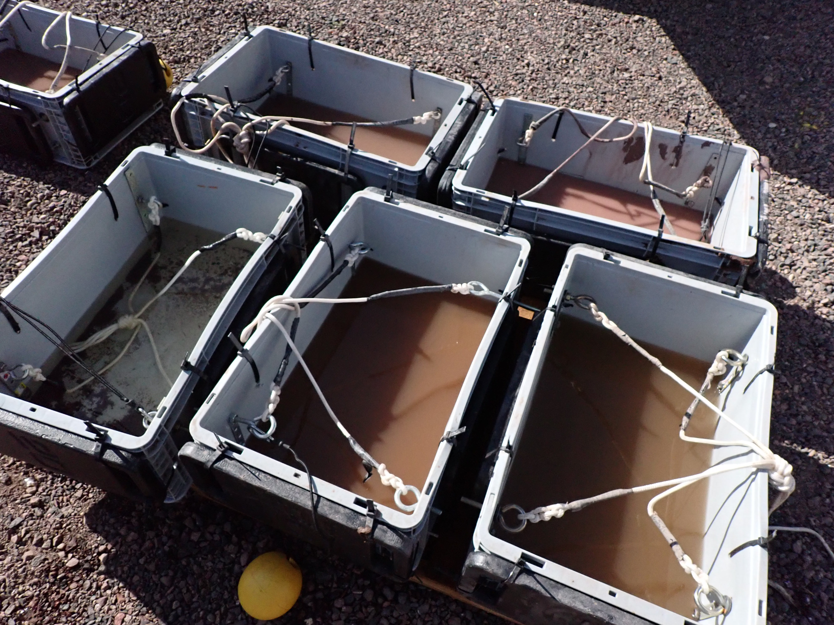
Monitoring Approach
Water quality monitoring
    Real-time turbidity measurements
    Water column sampling before and during in‑water work
Sediment traps
    Evaluate release and redeposition
Sediment Traps Pre- and Post-Deployment
Water Quality Monitoring Locations

Slide 16
Accurate identification of drum locations is critical
Drum removal was generally effective
Turbidity curtains were effective; Bubble curtains were somewhat effective
Drums removed from lake were unidentifiable following post-removal handling
Sediment processing was challenging

Slide 17
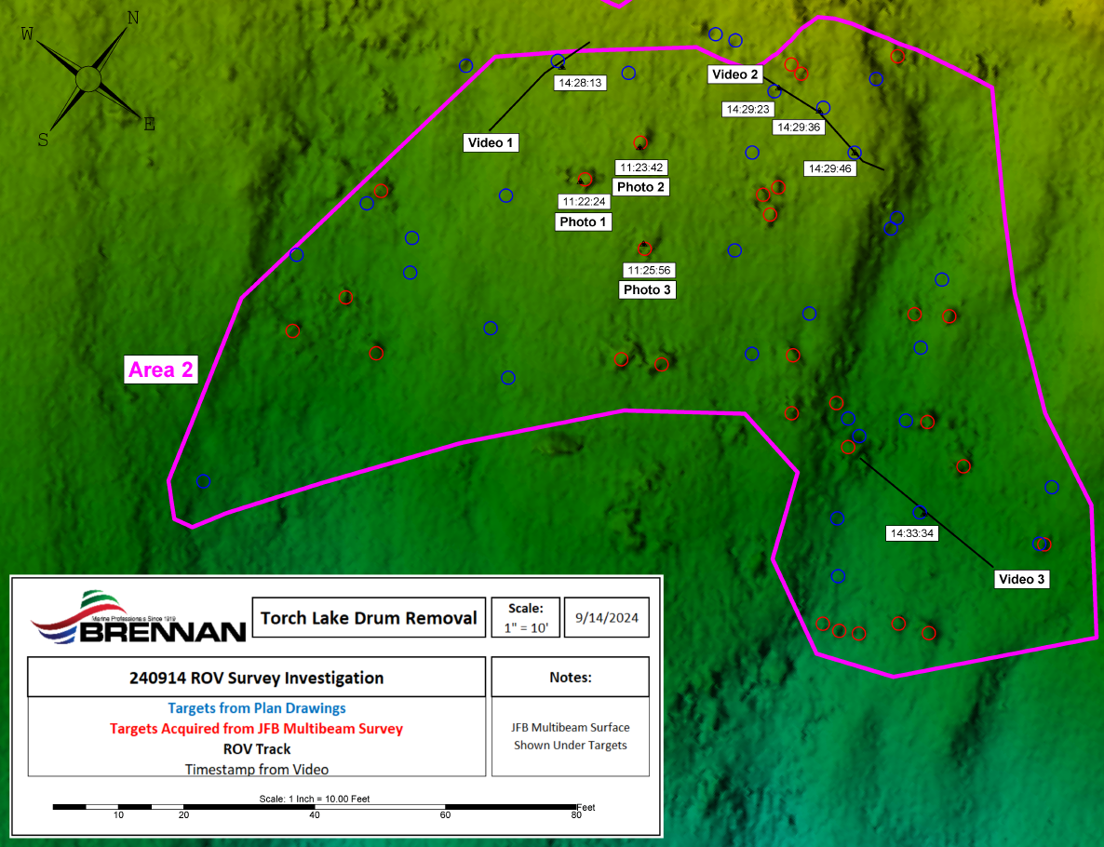
Drum Locations
Drum location based on 2020/2021 ROV survey
Drum location based on 2024 pre-construction ROV and bathymetry surveys
ROV drum surveys from FFS lack sufficient accuracy for construction; pre-construction was more accurate
Dredging operator was able to target specific drums with sufficient accuracy based on pre-construction ROV/
multibeam surveys
Source: JF Brennan (2024)
Notes:
Based on the legend I believe the blue is the targeted location based on the old EA survey and red is the targets based on the new pre removal Brennan survey
"\\Wcl-fs1\amesbury\Projects\Honeywell\Lake Linden - Torch Lake\GLNPO Project\Drums\Drum Pilot\Surveys\ROV Barrel Location Investigation\240914 ROV Survey Investigation of Plan Targets.pdf"

Slide 18
Drum Locations
Drum location based on 2020/2021 ROV survey
Drum location based on 2024 pre-construction ROV and bathymetry surveys
ROV drum surveys from FFS lack sufficient accuracy for construction; pre-construction was more accurate
Dredging operator was able to target specific drums with sufficient accuracy based on pre-construction ROV/
multibeam surveys
Source: JF Brennan (2024)
Notes:
Based on the legend I believe the blue is the targeted location based on the old EA survey and red is the targets based on the new pre removal Brennan survey
"\\Wcl-fs1\amesbury\Projects\Honeywell\Lake Linden - Torch Lake\GLNPO Project\Drums\Drum Pilot\Surveys\ROV Barrel Location Investigation\240914 ROV Survey Investigation of Plan Targets.pdf"

Slide 19
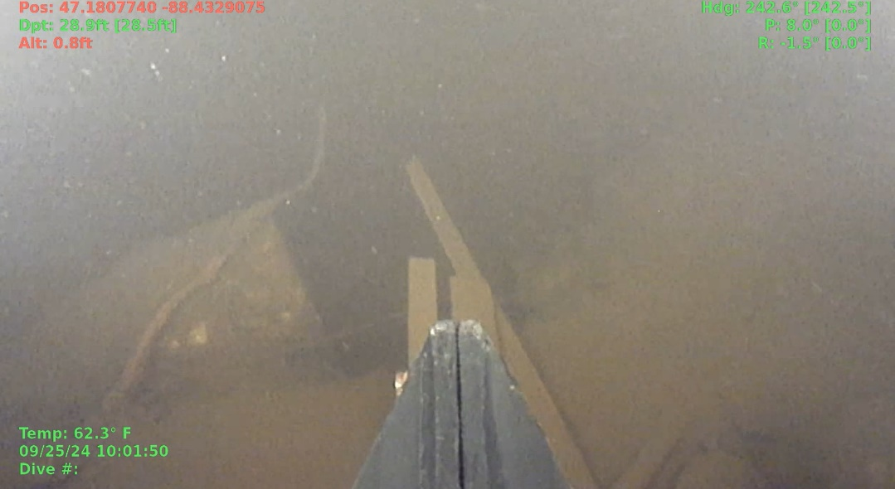
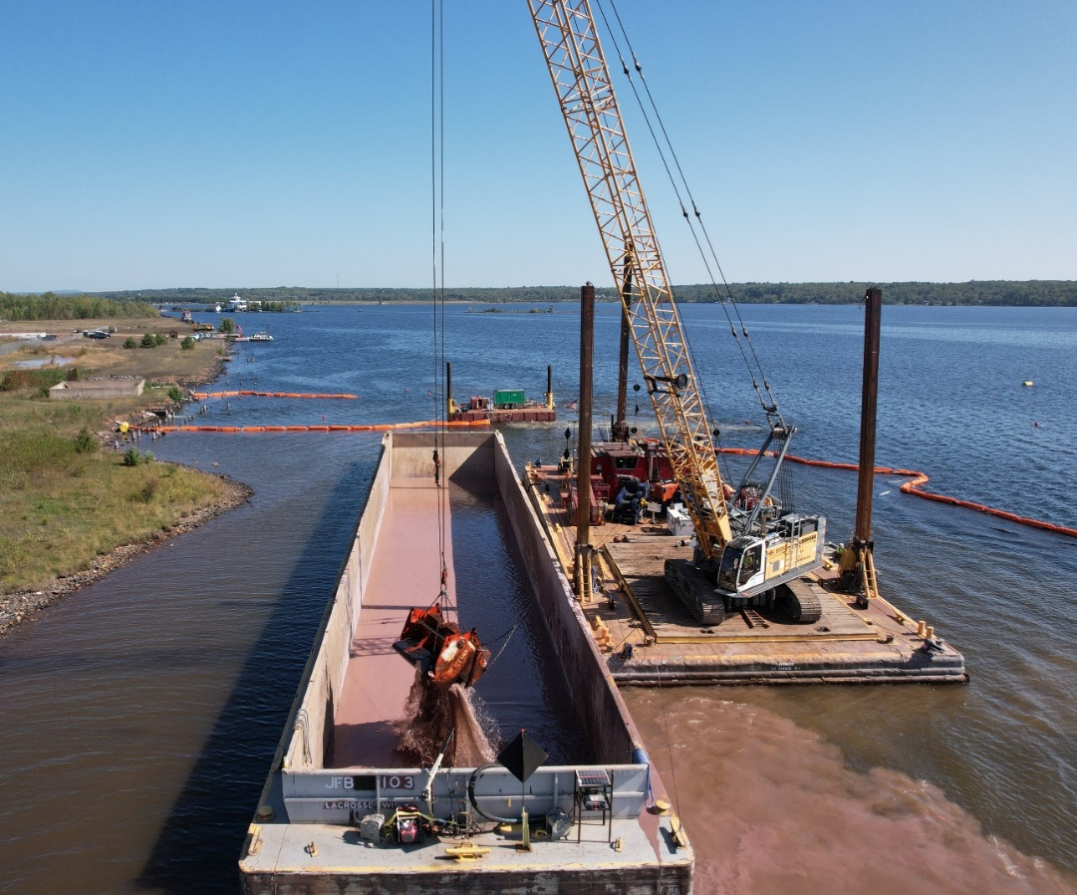
Drum Removal Effectiveness
Post-dredge ROV survey showed that some debris remained on the surface
Production rates:
  11 days planned versus 4.5 actual working removal days (6 days including equipment moves)
    Drum removal and material handling conducted sequentially (not concurrently)
  Removed 1,200 cubic yards (~240 cy/day)
Post-Removal ROV Survey Photograph from Area 1
Debris Removal Operations
Notes:
Post-dredge ROV survey of Area 1 showed that debris remained on the surface (material dropped by the bucket) and debris present in the post-dredge surface (deeper than 1.5-ft below the mudline)
Cycle times ~ 2 minutes compared to 3-5 minutes predicted
Cycle times were not significantly different in deeper water, which was unexpected

Slide 20
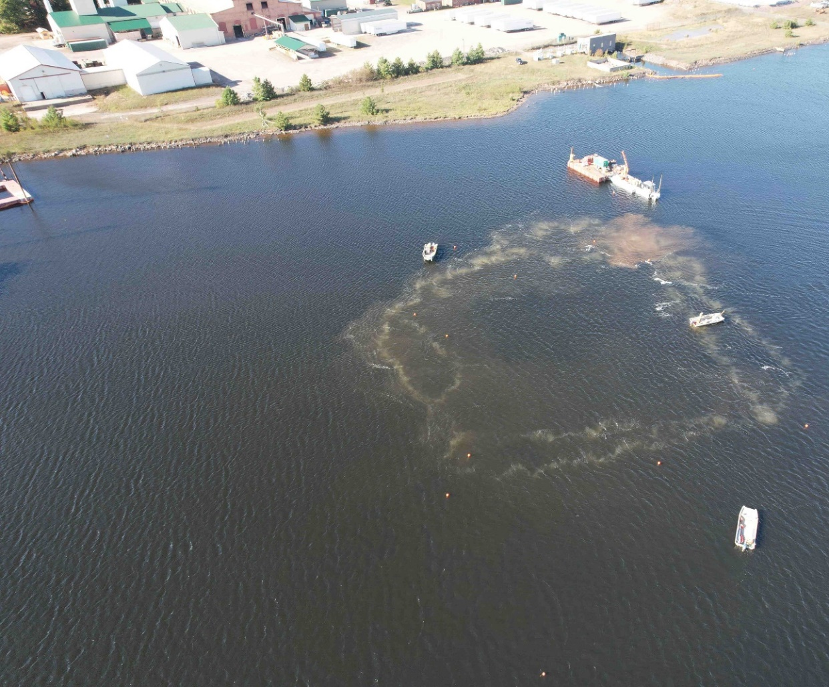
Resuspension Controls
Turbidity curtains were effective at controlling suspended solids
  No exceedances of real-time surface water turbidity criteria detected
  Water column data (dissolved and suspended solids) yet to be interpreted
Bubble curtains were somewhat effective at controlling suspended solids
  Uneven bubble distribution
Bubble Curtain Surrounding Area 3
Notes:
Bubble Curtains:
Bubble curtains were more challenging to install than the turbidity curtains (correct?) but that removal was easier than anticipated
Generated micro-bubbles that appeared to similar to suspended solids.
Does not provide uniform protection, with higher air flow closer to the compressor.

Slide 21
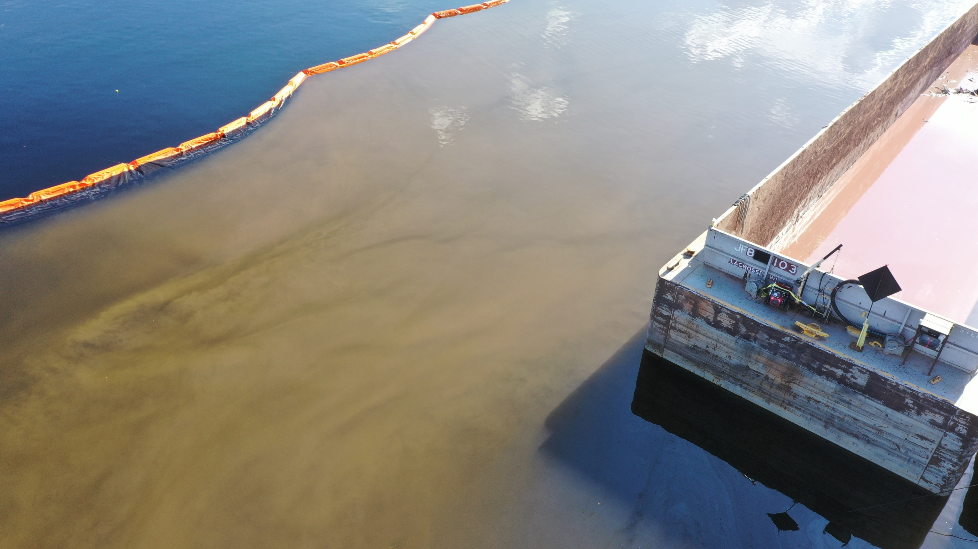
Fixed-Perimeter Turbidity Curtain

Slide 22
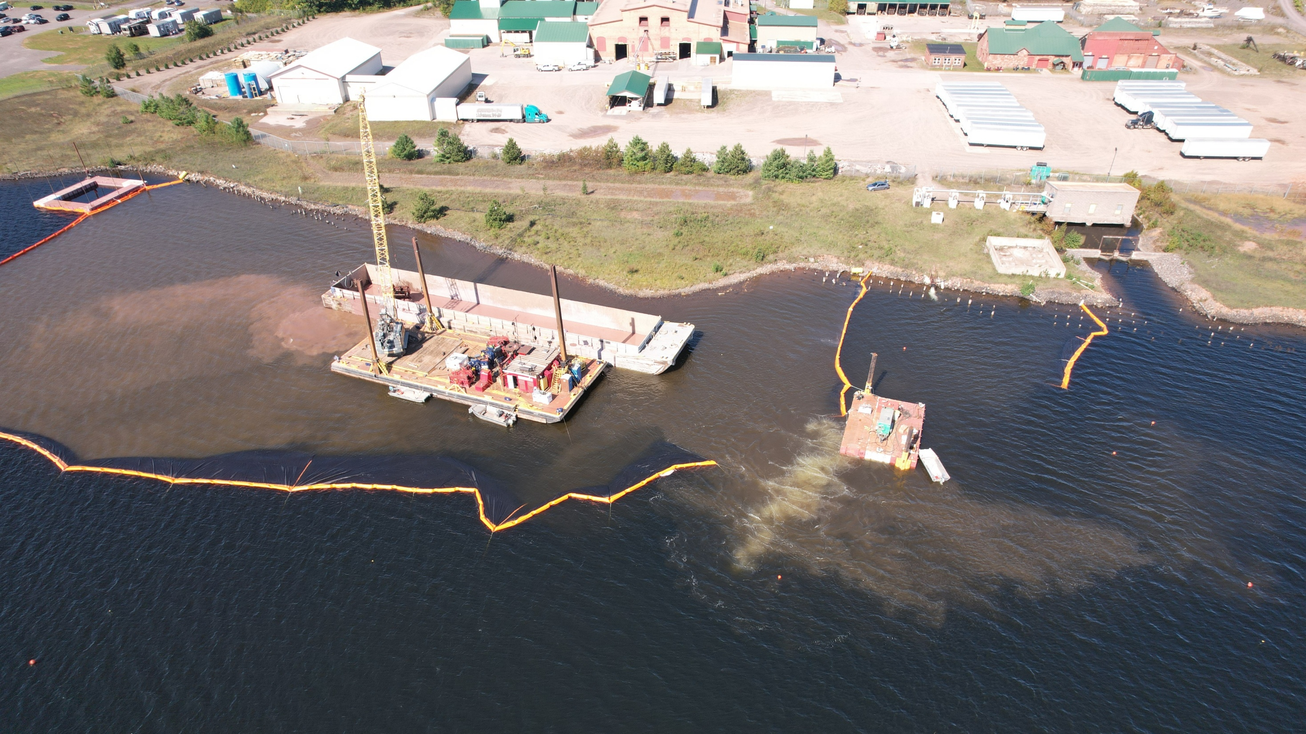
Turbidity from Drum/Debris Removal
Microbubbles from Bubble Curtain
Fixed-Perimeter Turbidity Curtain with Bubble Curtain “Gate”
Notes:
What appears to be turbidity escaping from through the bubble curtain was determined to be micro-bubbles

Slide 23
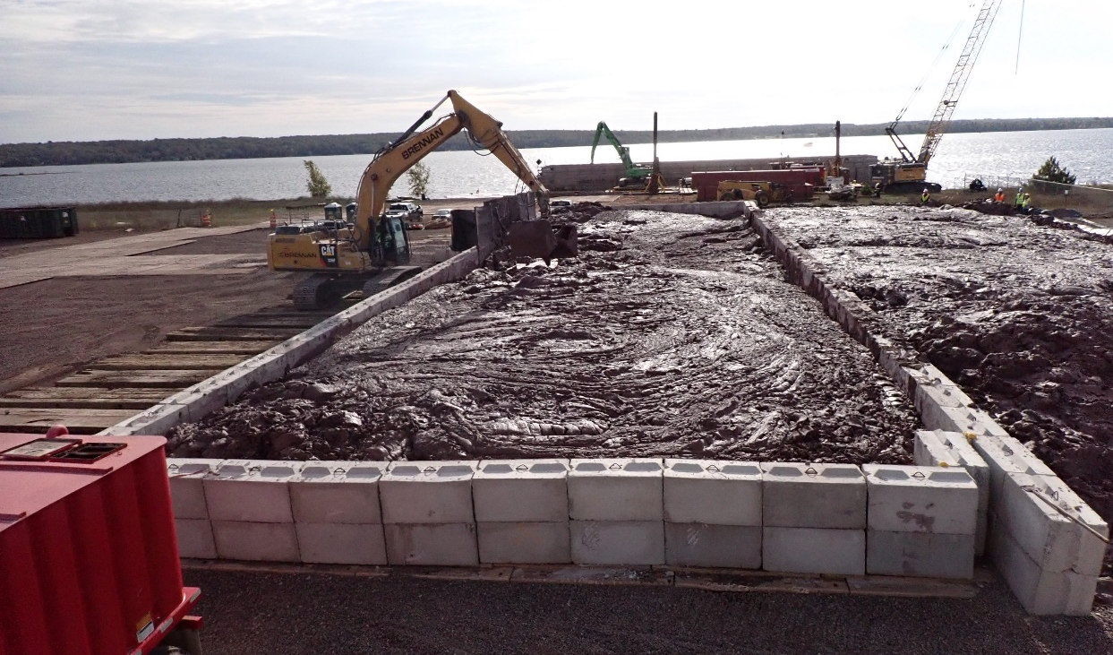
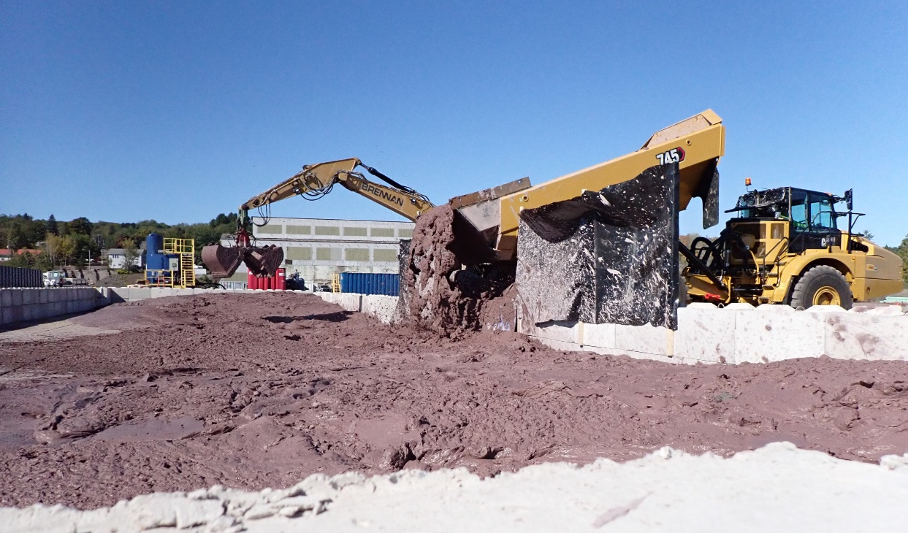
Material Handling
Drums removed from lake were unidentifiable following post-removal handling; separation of sediment and debris not required
Real-time application of flocculants not effective; treatability study may be beneficial
Dewatering amendment dose higher than anticipated because free water could not be decanted
Material Handling Operations
Notes:
Drums/debris did not require separation from sediment - broke down during handling.
No drums were removed intact/no intact drums identified during removal

Slide 24
Next Steps
FFS will include alternatives to evaluate drum removal
Remedial alternatives will be developed with consideration of pilot study results
  Drum removal effectiveness
  Turbidity control effectiveness
  Production rates and costs

Slide 25

Paul
LaRosa, PE
Principal Engineer
plarosa@anchorqea.com

