Slide 1
Modeling Porewater Cleanup Time During Multicomponent Nonaqueous Phase Liquid Dissolution Using a Desorption Approximation
Presented by: Mike Gefell, PG, CPG, Anchor QEA
Collaborators: Ali Meyal, PhD and Deviyani Gurung, PhD, Anchor QEA

Slide 2
Can we predict porewater concentration decreases due to long-term NAPL dissolution in sediment?

Slide 3
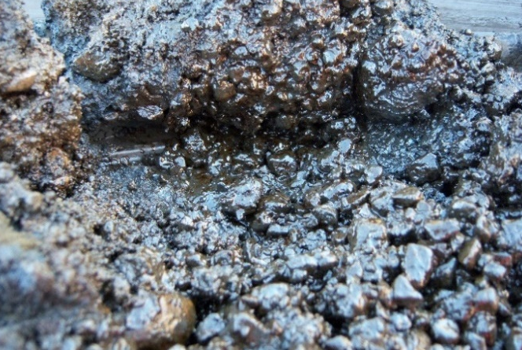
How Much Will Effective Solubility of Key NAPL Components Decrease In 100+ Years?
Sediment treatment caps designed for extensive periods
Chemical loading may decline due to NAPL weathering
We present a new method to model future concentrations
Coarse-grained sediment visibly saturated with NAPL

Slide 4
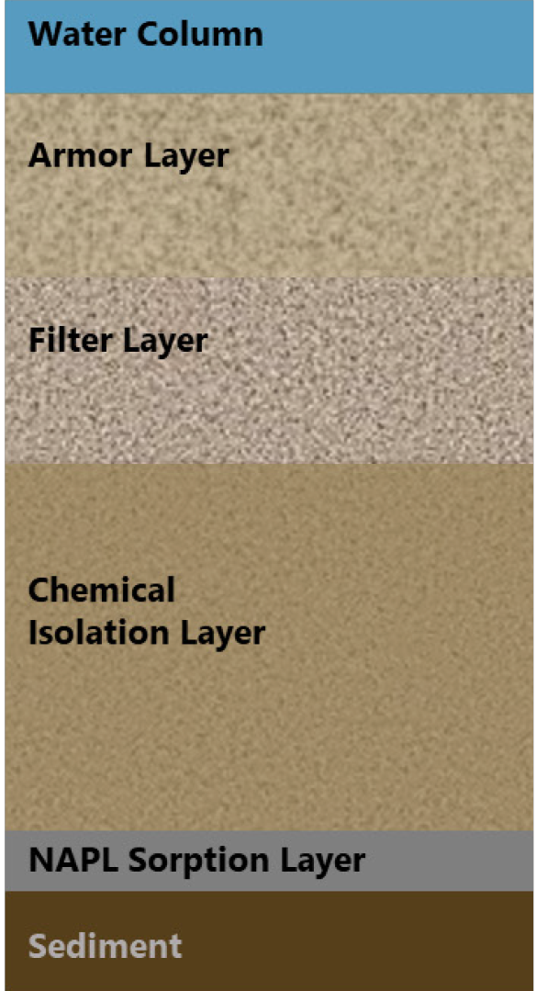
Sediment Cap Design
Typical design assumption for sites with NAPL in sediment
  Porewater loading concentrations remain constant
    But will they really? For 100 years?
Porewater
Flow

Slide 5
Time 0
High Dissolved Concentration for Compound i
Surface Water or Chemical Isolation Layer
Sediment
NAPL
Clean Porewater

Slide 6
Time 1
High Dissolved Concentration for Compound i
Dissolution
Front
Clean Porewater

Slide 7
Time 2
High Dissolved Concentration for Compound i
Dissolution
Front
Clean Porewater

Slide 8
Time 3
Low Dissolved Concentration for Compound i
Clean Porewater

Slide 9
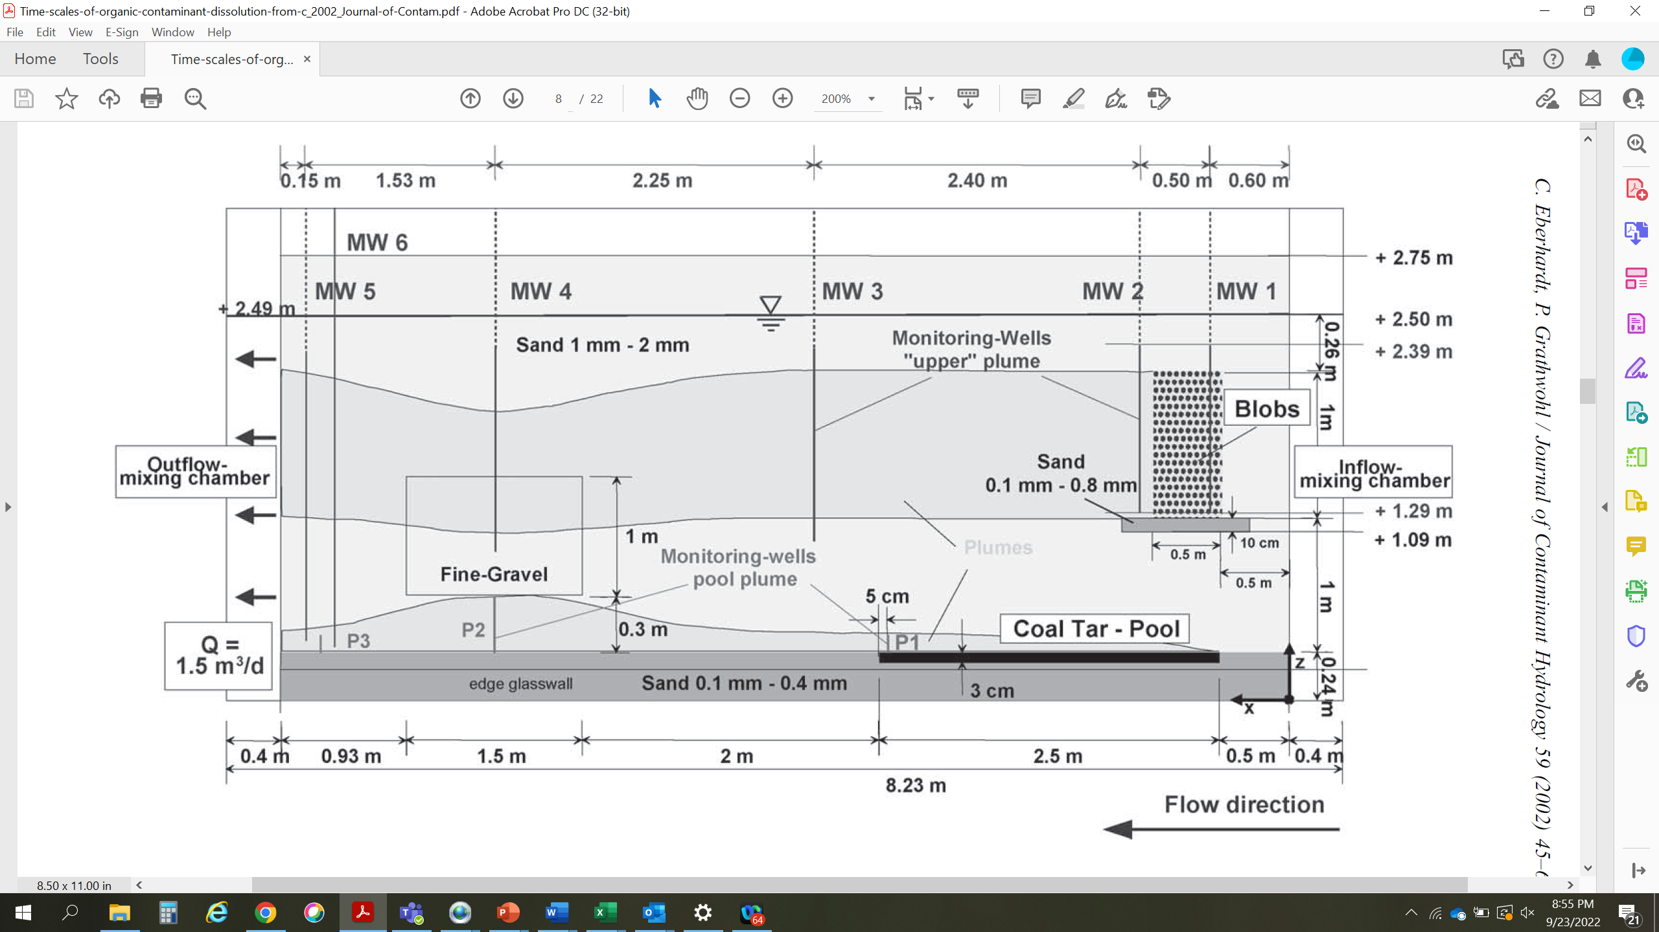
Empirical Coal Tar Dissolution Experiment
4.9% NAPL saturation
Source: Eberhardt and Grathwohl 2002

Slide 10
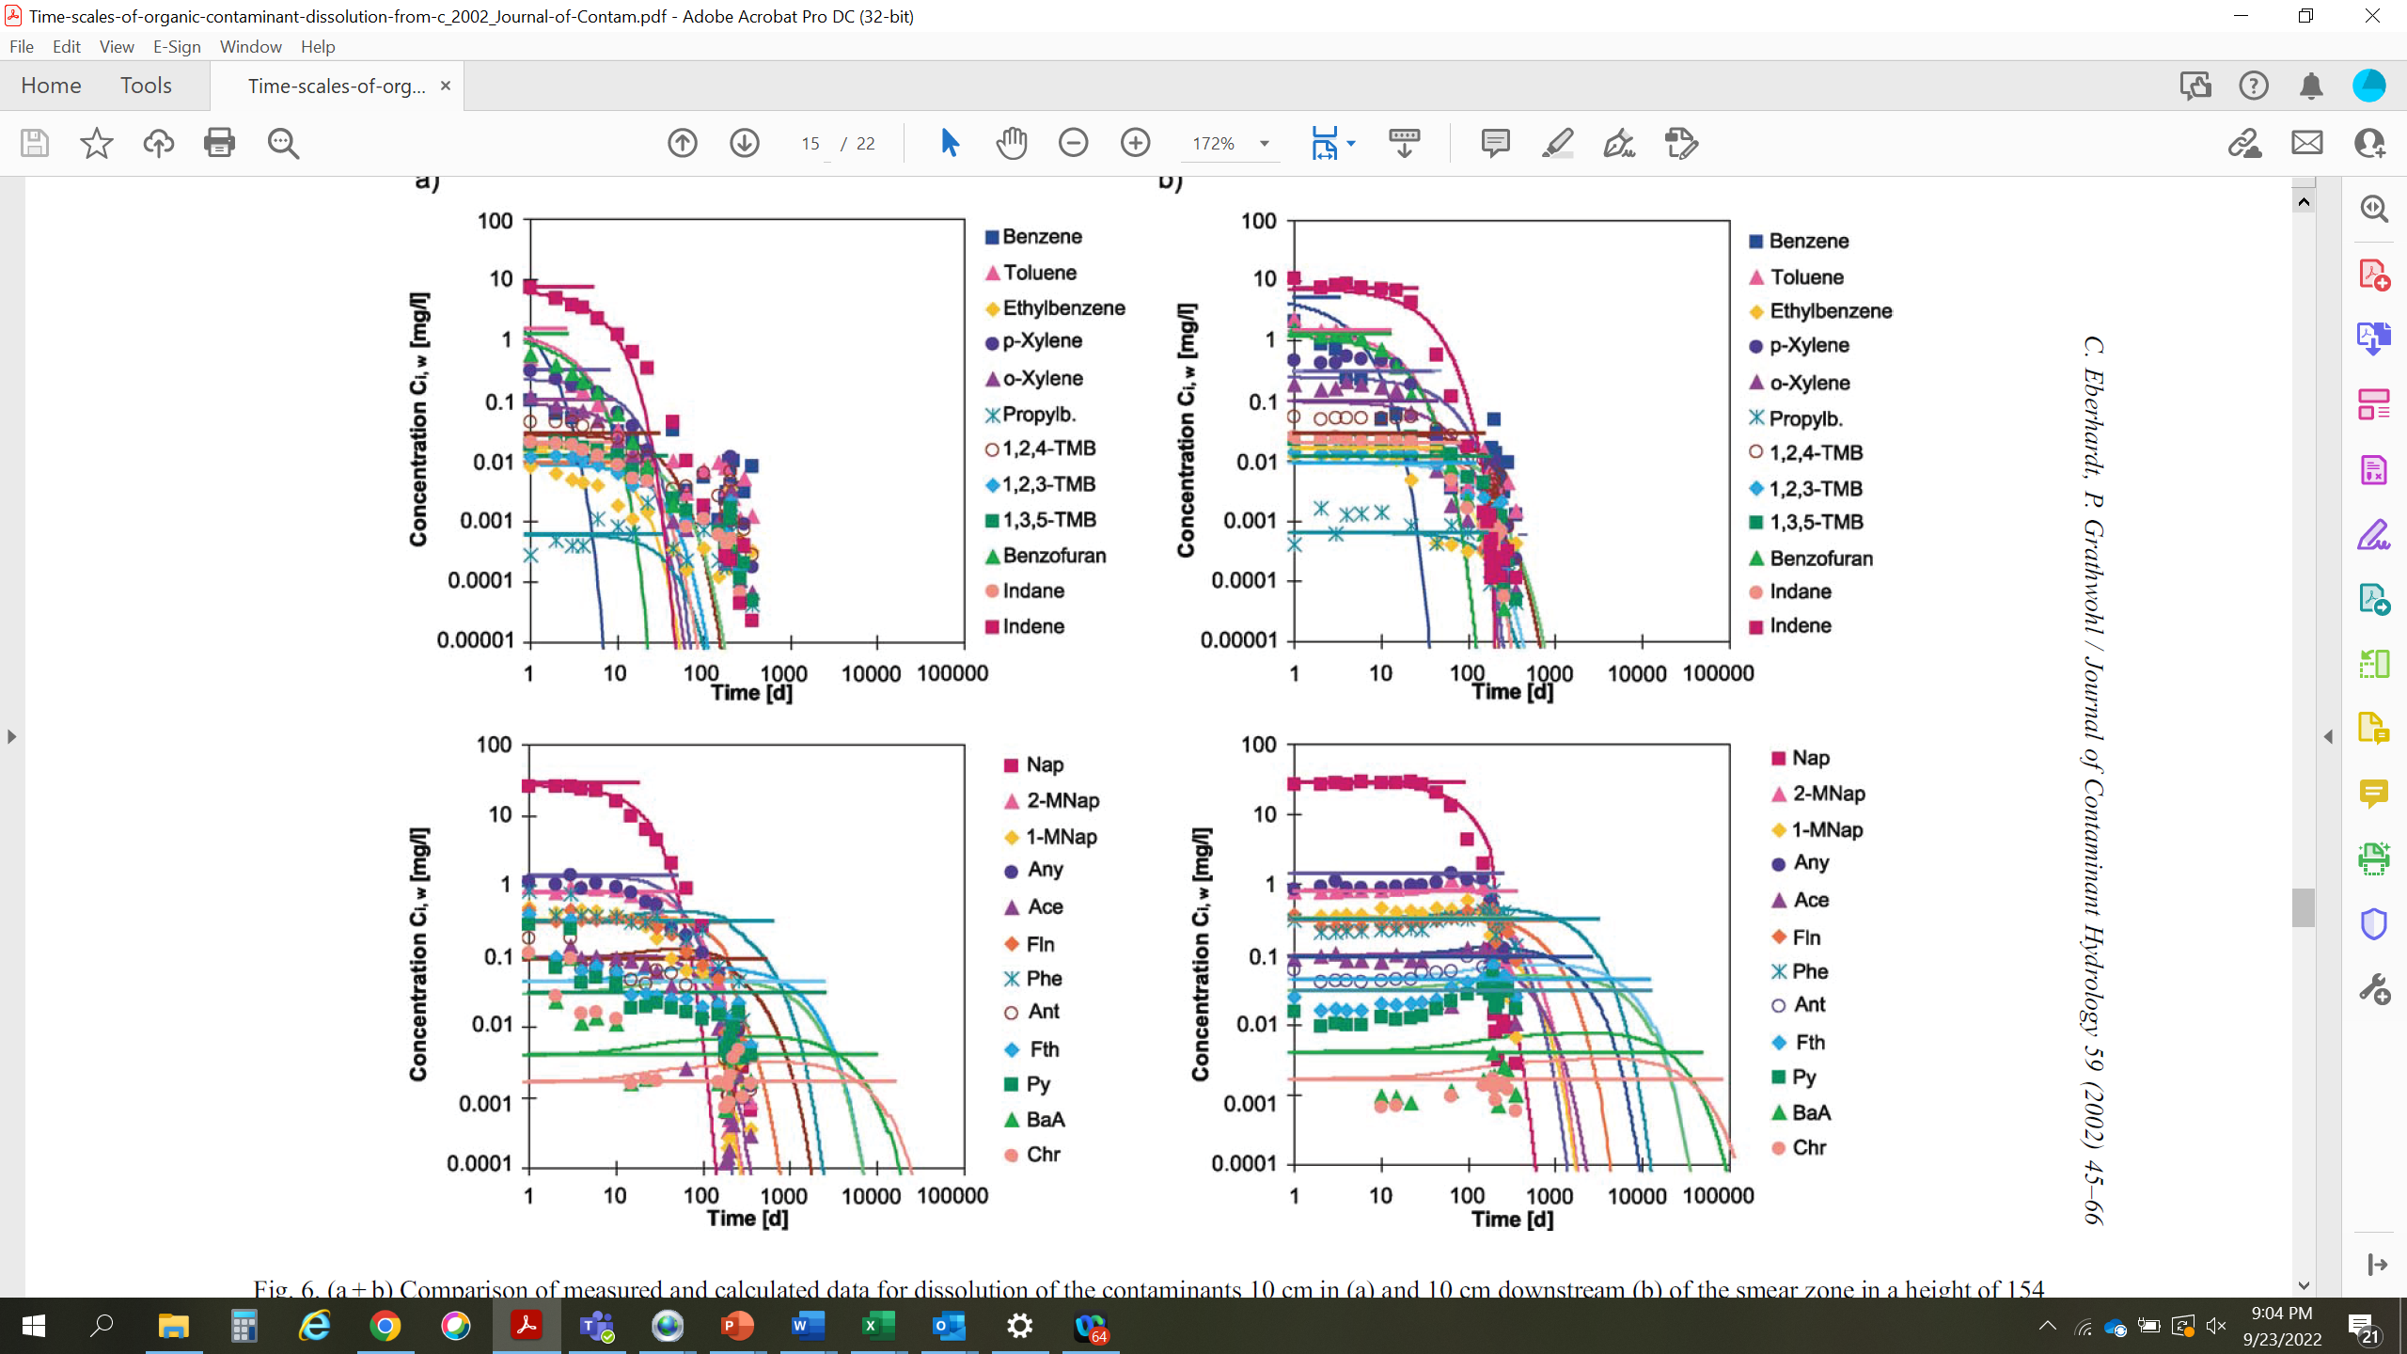
Dissolved Concentrations Versus Time
Downgradient (MW 2)
In NAPL Zone (MW 1)
VOCs
VOCs
PAHs
PAHs
Water travel time through NAPL zone
≤8 hours
Source: Eberhardt and Grathwohl 2002

Slide 11
Dissolution Front Retardation
120 pore volume exchanges before naphthalene decreased downgradient
Retardation of dissolution front (Eberhardt and Grathwohl 2002)
Equation 1: R = 1 + (ρ₀ f_{i,o} n S⁰) / (C_{i,sat} n_{c})
where:
ρ₀ = NAPL density
f_{i,o} = mass fraction of compound i in NAPL
n = total porosity in NAPL zone
S⁰ = NAPL saturation
C_{i,sat} = effective solubility for compound i
n_{c} = effective (water-filled) porosity in the NAPL zone [n(1-S⁰ )]

Slide 12
Innovative Solution (Original, Published)
Standard retardation equation for clean-water front during desorption (standard solute-transport modeling)
Equation 2: R = 1 + (ρ_{b}/n) K_{d}
where:
ρ_{b} = bulk density
n = total porosity
K_{d} = distribution coefficient
Equating (1) and (2)
Equation 3: K_{d} = (ρ₀ f_{i,o} n² S⁰) / (ρ_{b} C_{i,sat} n_{c})
Source: Gefell and Gurung 2023a, 2023b

Slide 13
Numerical Model Setup
1D MT3D model through NAPL zone (1 m long) – 100 cells parallel to flow
Initial dissolved concentration in NAPL zone = C_{i,sat}
K_{d} value used in NAPL zone, zero elsewhere (equilibrium partitioning)
Initial sorbed concentration calculated by model
Other parameters from Eberhardt and Grathwohl (2002)
Model Domain

Slide 14
Model Verification
Downgradient (MW 2)
In NAPL Zone (MW 1)
Indene
Indene
Naphthalene
Naphthalene

Slide 15
Method Refinement
Modified retardation equation for clean-water front during NAPL dissolution
Equation 2’: R = 1 + (ρ_{b}/n_{c}) K_{d}
where:
ρ_{b} = bulk density
n_{c} = effective (water-filled) porosity in the NAPL zone
K_{d} = distribution coefficient
Equating (1) and (2)
Equation 3’: K_{d} = (ρ₀ f_{i,o} n S⁰) / (ρ_{b} C_{i,sat} )

Slide 16
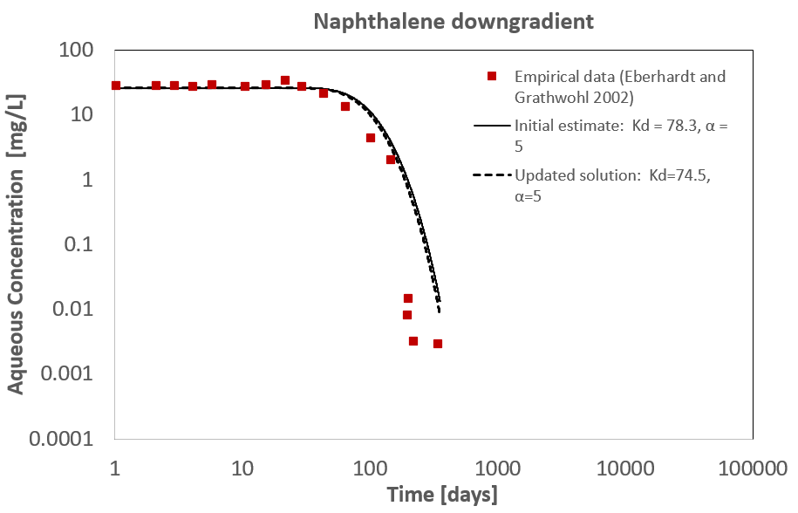
Comparing
Published and Refined
Methods
Refined Method
(Equation 3’)
Published Method
(Equation 3)

Slide 17
Model Example: Cap Loading Concentration and Cumulative Mass for Hypothetical Site (100 Years)
NAPL zone in sediment 15 feet (4.6 meters) thick
Mean NAPL saturation 5%, density 1.05 g/cm³, 1% benzene by mass
Effective solubility 10 mg/L
Sediment porosity 0.5, bulk density 1.3 g/cm³
Three comparative simulations
  1 cm/day seepage with aqueous-phase degradation (150-day half life)
  1 cm/day seepage with no degradation
  ISS (no seepage, diffusion dominated transport, no degradation in ISS zone)

Slide 18
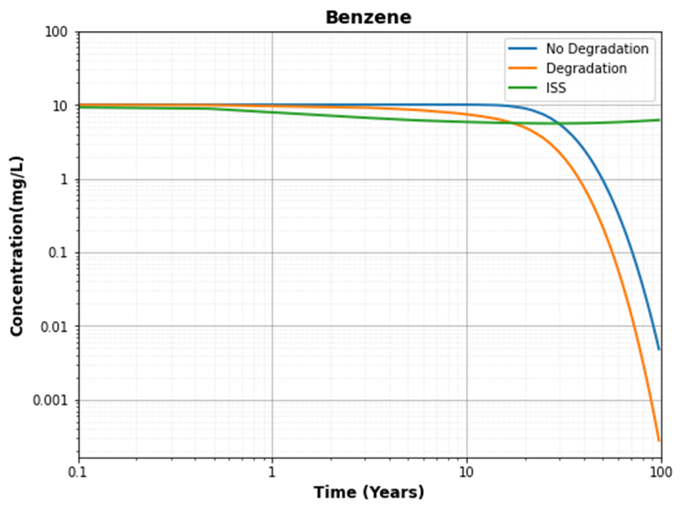
Cap Loading Concentration vs. Time

Slide 19
Cap Loading – Total Benzene Mass in 100 Years (kg/m²)
Simulations with seepage
  With no concentration change (base case): 3.7
  NAPL weathering without degradation: 1.2 (–66%)
  NAPL weathering with degradation in aqueous phase: 0.80 (–78%)
ISS with NAPL weathering, for comparison: 0.054 (–99%)

Slide 20
Cap Loading – Total Benzene Mass in 100 Years (kg/m²)
Simulations with seepage
  With no concentration change (base case): 3.7
  NAPL weathering without degradation: 1.2 (–66%)
  NAPL weathering with degradation in aqueous phase: 0.80 (–78%)
ISS with NAPL weathering, for comparison: 0.054 (–99%)
With NAPL weathering, far less benzene loading than base case assumption

Slide 21
Flow with Degradation (Sensitivity Analysis)
 | Benzene |  | Naphthalene
 | Low | High | Low | High
Mass Fraction in NAPL | 0.00500 | 0.02000 | 0.100 | 0.200
NAPL Saturation | 0.01 | 0.15 | 0.01 | 0.15
Seepage Rate (cm/day) | 0.2 | 5 | 0.2 | 5
Degradation Half Life (days) | 100 | 200 | 100 | 200
Notes: For all simulations – porosity = 0.5, effective solubility (both compounds) = 10 mg/L, bulk density = 1.3 g/cm³.
Dispersivity and diffusion coefficients obtained from literature.

Slide 22
Total Loading Decrease in 100 Years (Percent)
 | Benzene |  | Naphthalene |  | Comments
No concentration change | No change |  | No change |  | 1 cm/day seepage
Sensitivity Analyses
 | Low | High | Low | High
Mass Fraction in NAPL | –88 | –60 | –14 | –7 | 1 cm/day seepage, 150-day half life
NAPL Saturation | –93 | –41 | –4 | –3 | 1 cm/day seepage, 150-day half life
Seepage Rate (cm/day) | –68 | –92 | –9 | –22 | 150-day half life
Degradation Half Life (days) | –82 | –76 | –14 | –7 | 1 cm/day seepage

Slide 23
Parameter Measurement
Collect samples in zones with most notable NAPL presence
NAPL (from well/piezometer or extract from sediment)
  Density and chemical composition (standard analytical methods)
Bulk sediment
  Standard chemical analysis (if no pure NAPL sample available)
  Dean Stark extraction for NAPL saturation
Porewater
  Exclude NAPL during sampling (e.g., porous ceramic filtration)
  Standard chemical analysis

Slide 24
Summary
Dissolution of a relatively soluble compound from a complex NAPL can be simulated equivalent to desorption using a calculated K_{d} value
  Timing of dissolution front
  Concentration decrease over time
Parameters are measurable
Predict porewater quality changes over time
In some cases, can significantly reduce mass and cost of chemical sorbent in cap

Slide 25
Eberhardt, C., and P. Grathwohl, 2002. “Time Scales of Organic Contaminant Dissolution from Complex Source Zones: Coal Tar Pools vs. Blobs.” Journal of Contaminant Hydrology 59:45–66.
Gefell, M.J., and D. Gurung, 2023. “Modeling Dissolution of Soluble Compounds from
Multi-Component NAPL Using a Desorption Approximation.” Groundwater 61(6):879–886.
Gefell, M.J., and D. Gurung, 2023. “Simulating Dissolution of the Most Soluble Compounds from Complex NAPLs Using Equilibrium Partitioning.” Applied NAPL Science Review 11(2).

Slide 26


Mike
Gefell
Principal Scientist
mgefell@anchorqea.com

