Slide 1

Lessons Learned from G Jetty/Jetty 11 Remediation Project
Presented by: Matt Woltman, Anchor QEA
Collaborators: Kyle Pothier, Anchor QEA; Robert Thomas and Michelle Gerard, Public Services and Procurement Canada; Michael Bodman, Department of National Defence

Slide 2
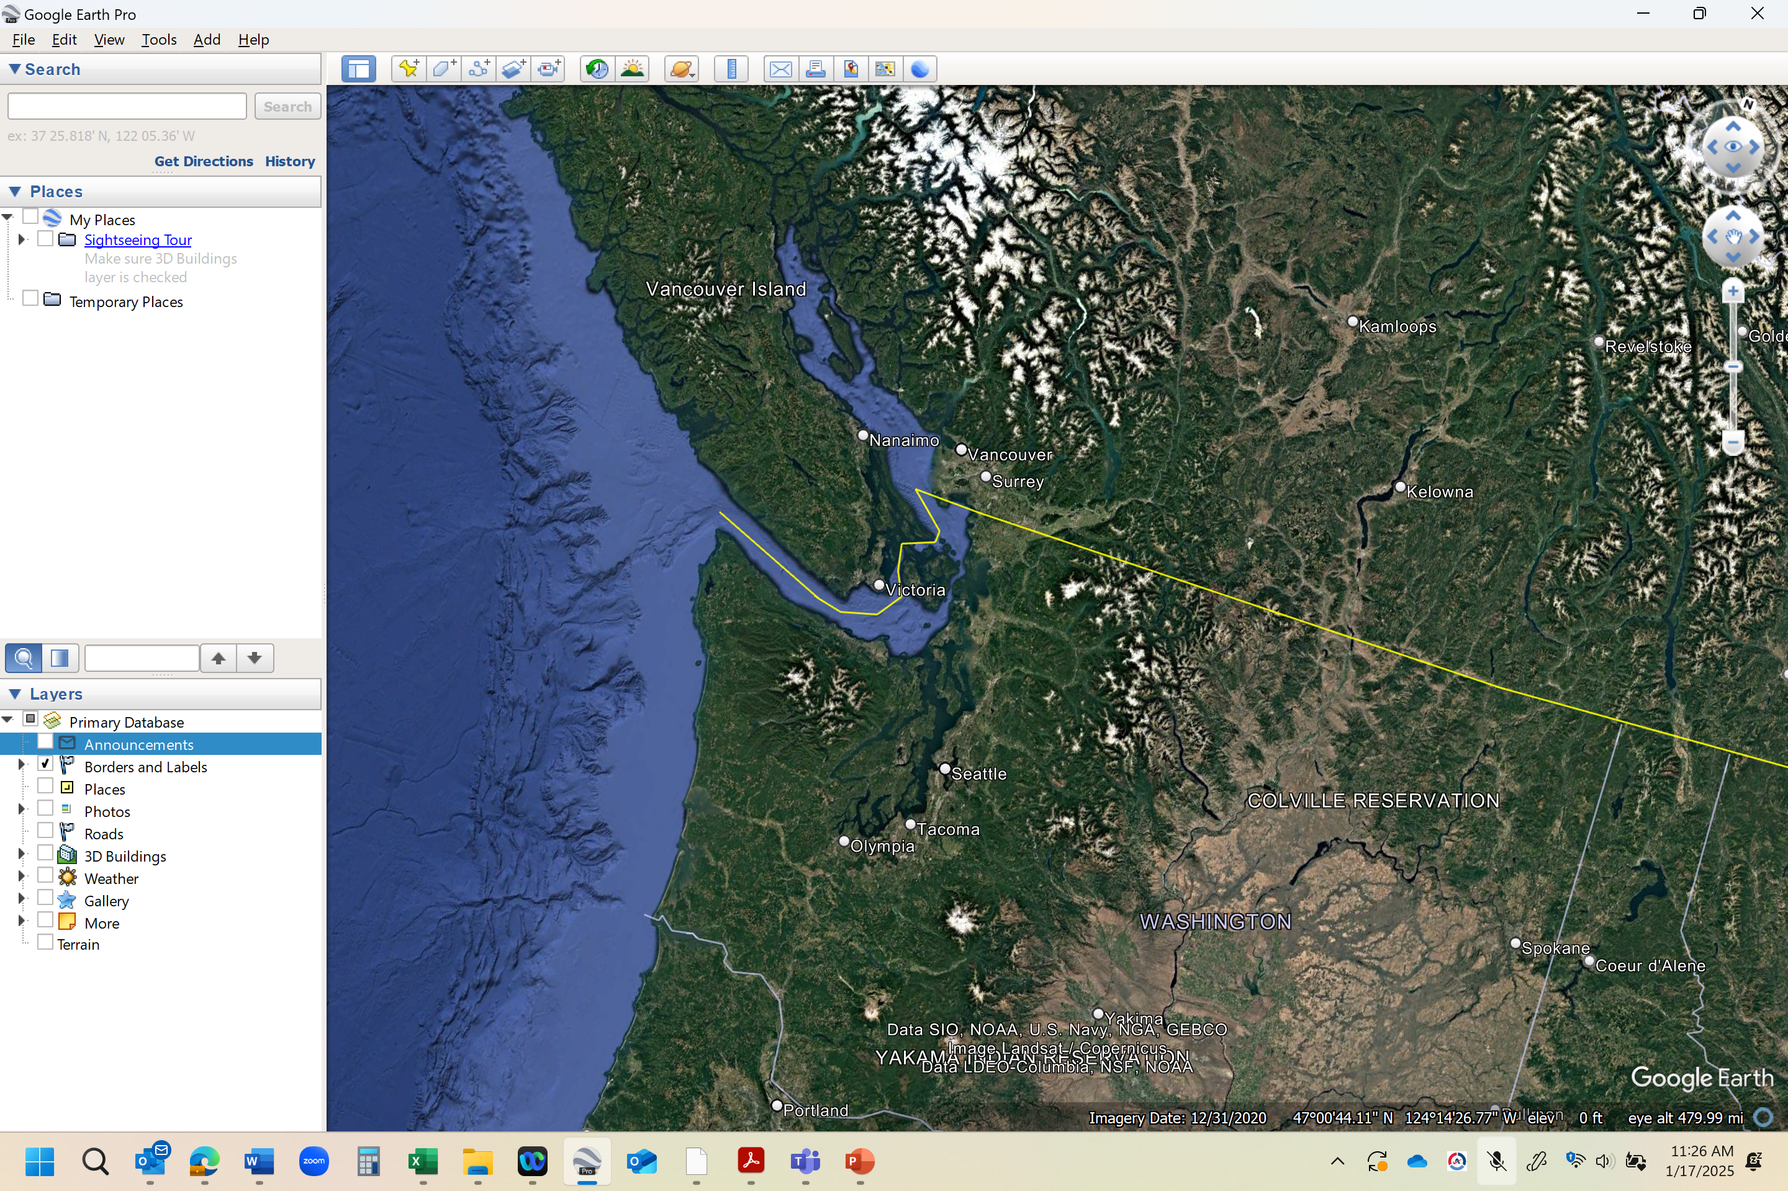
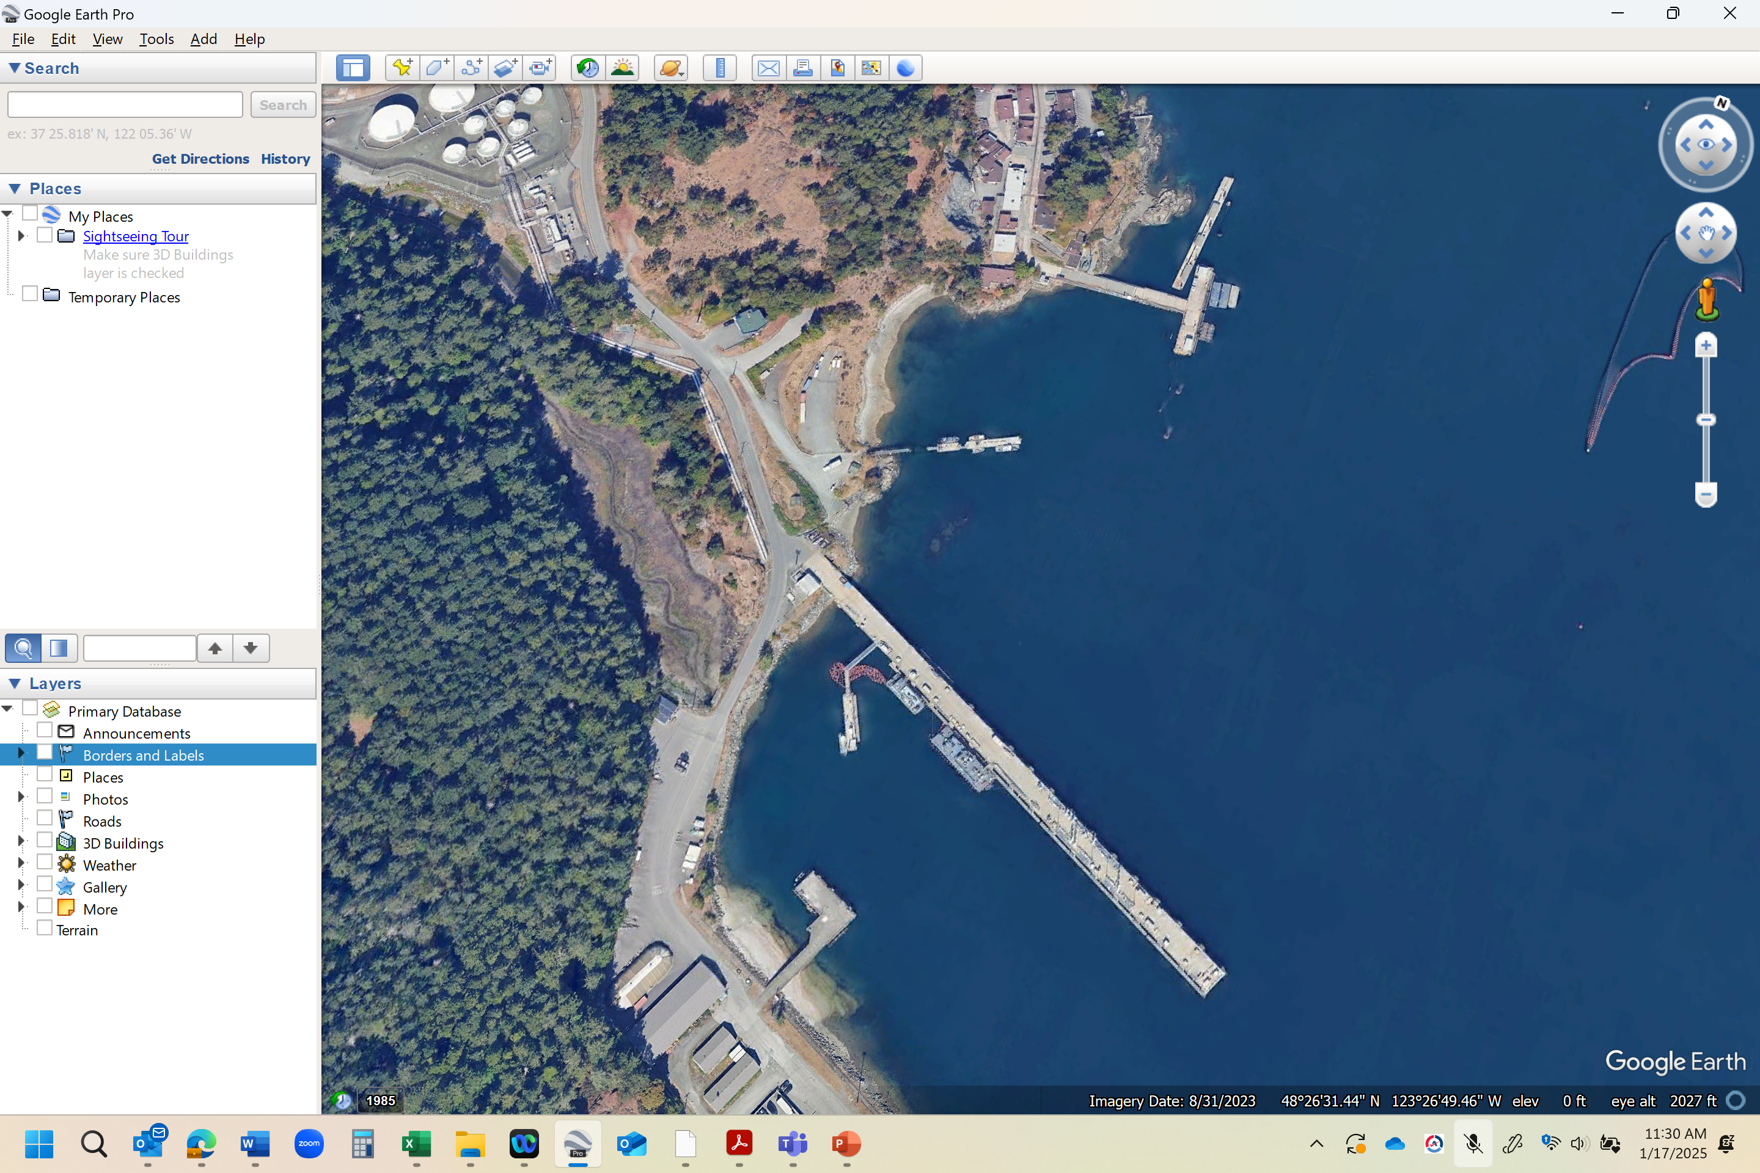
Notes:
In First Nations traditional lands.

Slide 3
Complete a sediment remediation project in an active naval harbour and around aging infrastructure

Slide 4
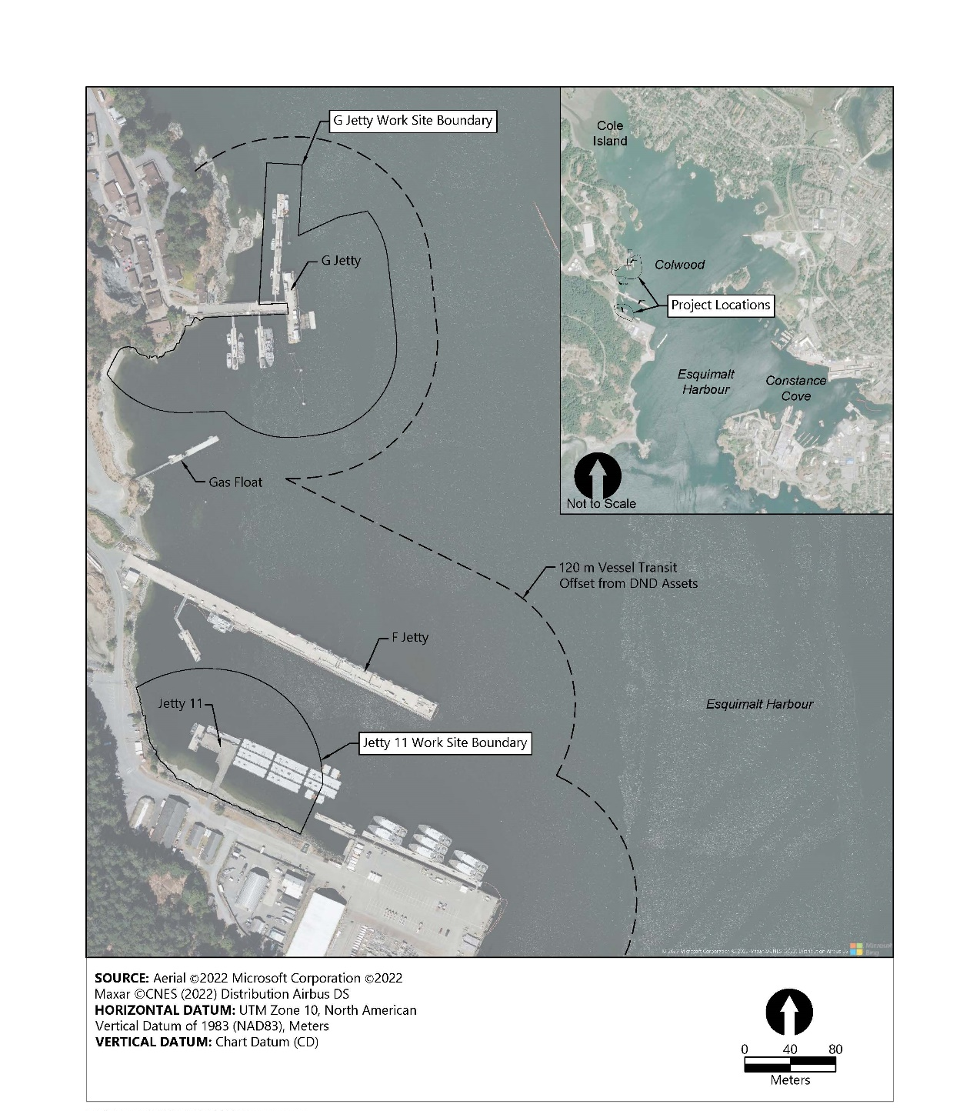
Legacy Contamination
Historical activities included:
Fuel storage and transmission
Ammunition depot
Sand blasting
Boiler ash
Naval activities

Slide 5
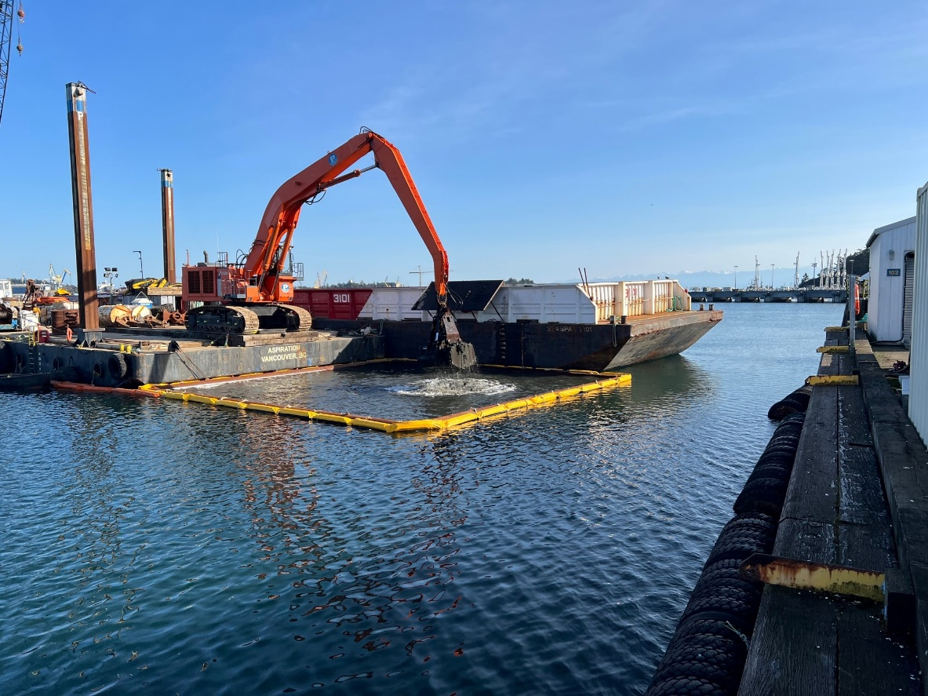
Remedial Design
Small sites, simple approach
Temporary structure relocation and reinstatement
Dredging of ~8,600 m³ of contaminated sediment
Placement of clean backfill in open water, nearshore, and underpier areas

Slide 6

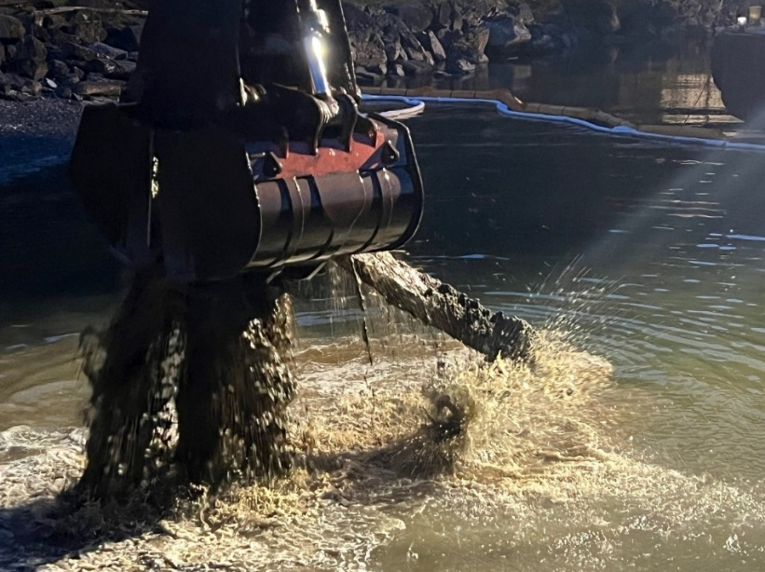



Key Construction Challenges
Unexploded ordinance (UXO)
Active naval harbour
Underpier material placement
Dredging/processing production rates

Slide 7
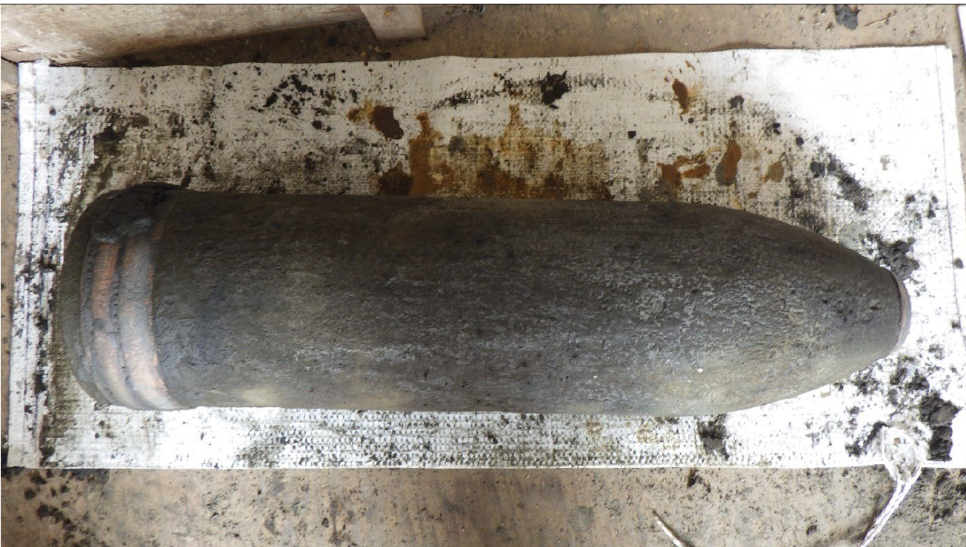
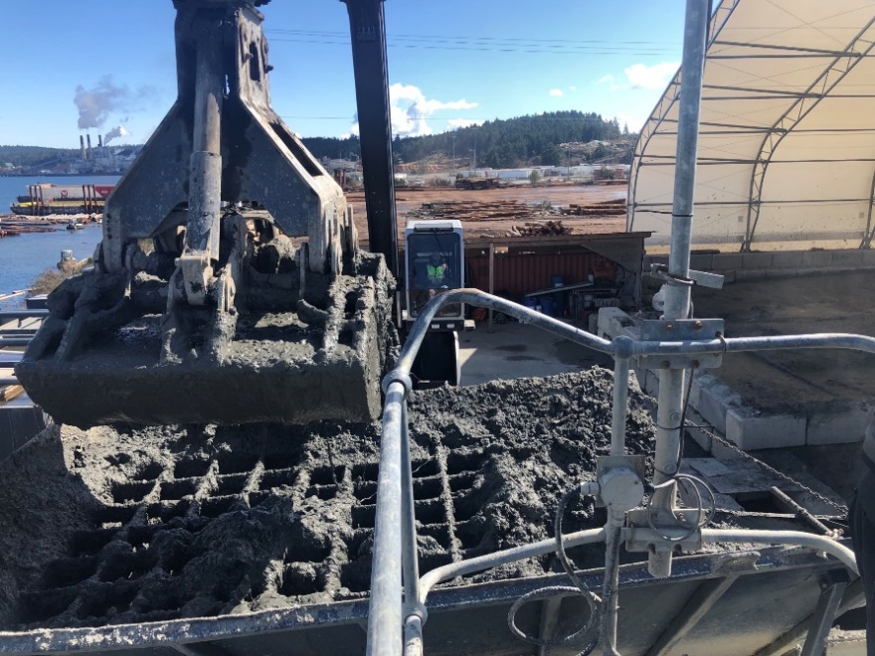
Unexploded Ordinance
Dredged sediment/debris required material processing for UXO screening
UXO Found in Esquimalt Harbour
Sediment Processing Facility
Notes:
UXO also included arch. Finds which adds time.

Slide 8
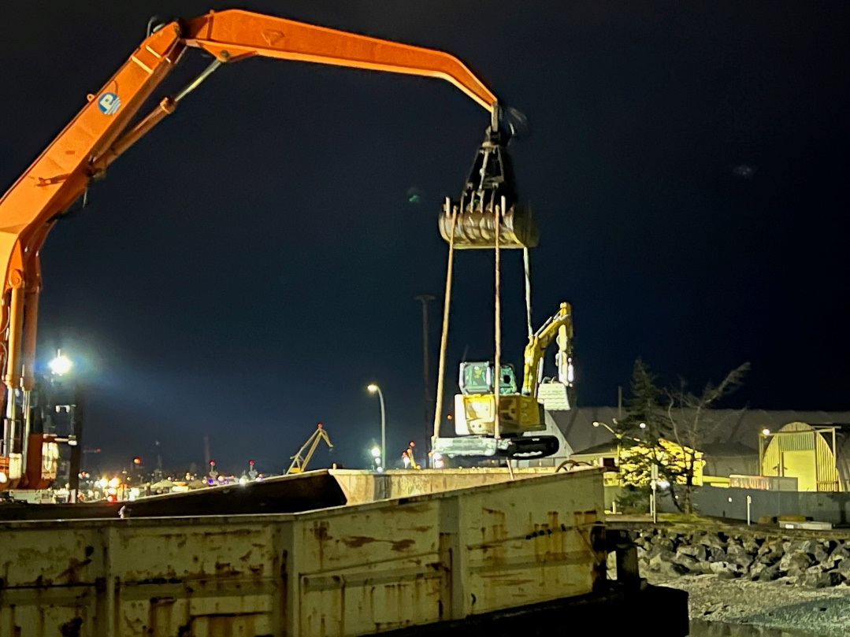
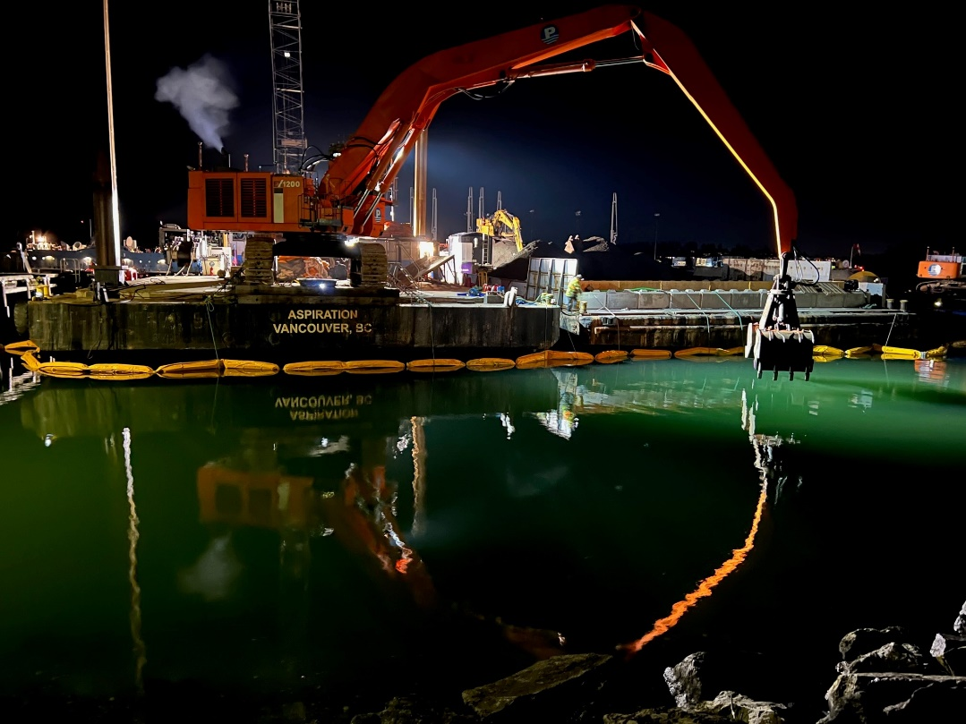
Naval Activity Coordination
Increased naval activities at G Jetty and Jetty 11 during construction, necessitating flexibility and proactive coordination with DND
Notes:
Fleet diving unit training schedule and underwater workshop

Slide 9
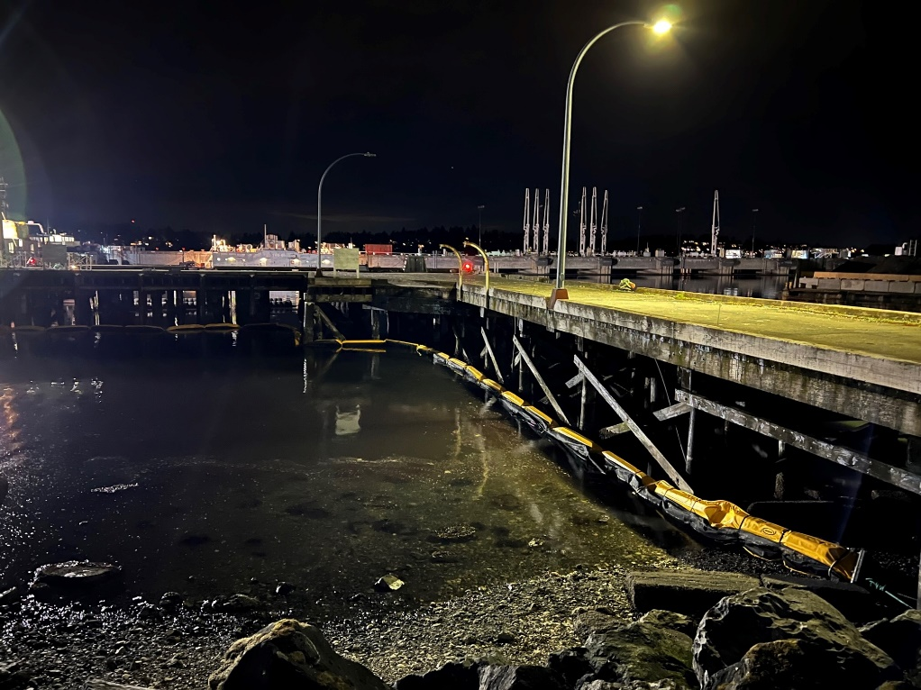
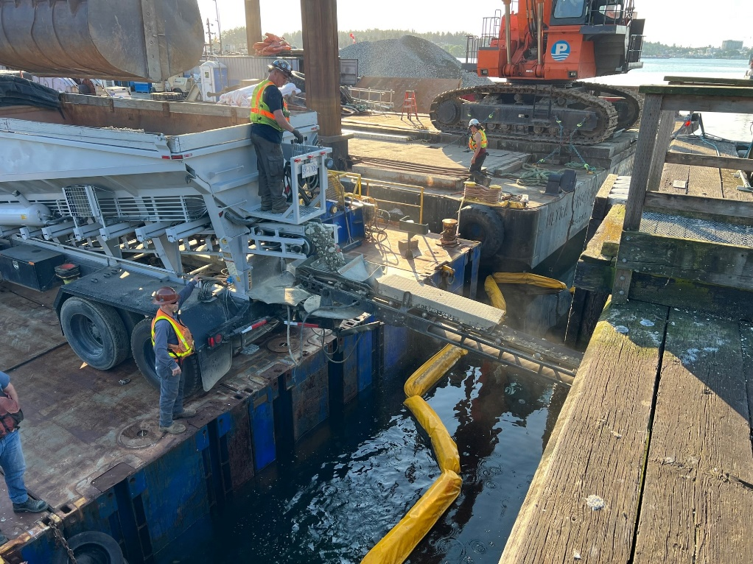
Underpier Material Placement
Existing contamination below structures required complex cap material placement and sequencing

Slide 10


Dredging/Processing Production Rates
Dredging
UXO Processing
Material Placement
Ongoing Naval Use

Slide 11

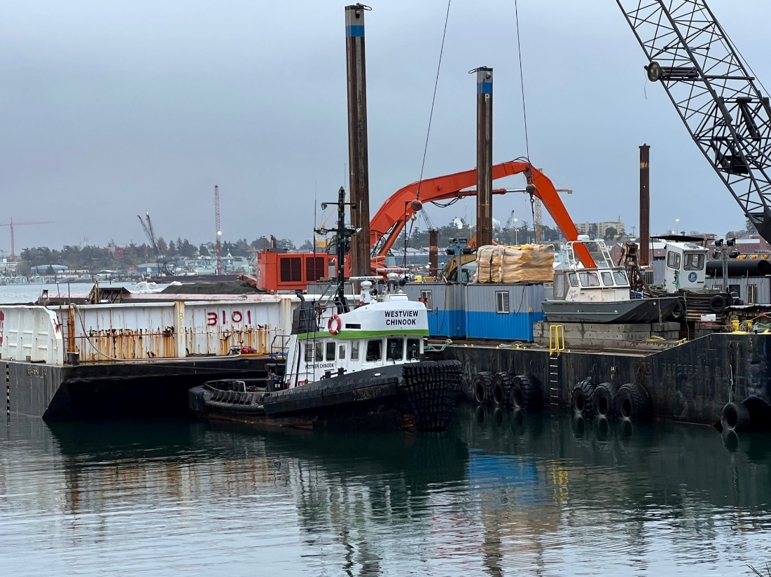




Lessons Learned
Bathymetry Surveys
Schedule Pressures
Equipment Selection
Communication
Unplanned Site Conditions

Slide 12

Bathymetry Surveys
Lacking recent pre-construction survey resulted in:
Increased dredge prism volume
Redesign of project elements during construction
Reassignment of project funds/budget
Lessons Learned:
Maintain recency for baseline surveys
Verify contingency budgets across project funding cycles

Slide 13

Schedule Pressures
Annual funding cycle requires substantial work to be completed by defined dates
Funding limitations halted initial project start
Variations in tender schedule to align project funding availability
Lessons Learned:
Monitor funding capacity before and during project tender
Planning for work across key funding timelines
Consistent project owner communications

Slide 14

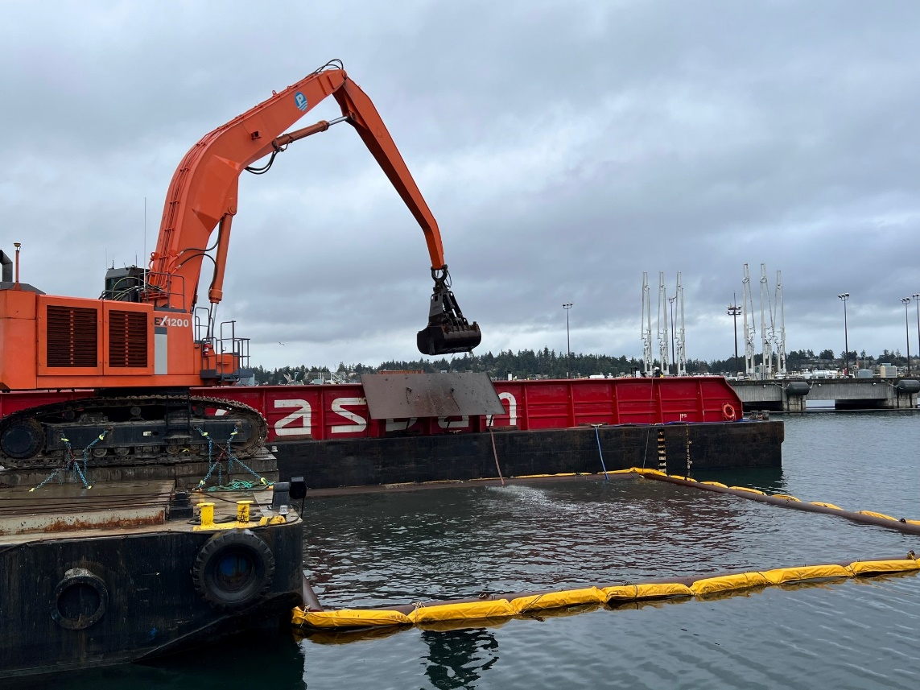
Equipment Selection
Proactive selection of specialized equipment facilitated successful project implementation.
Lessons Learned:
Conduct critical evaluation of project equipment before commencing construction

Slide 15

Communication
Difficulties exchanging information among the construction team (between owners and multiple contractors) in a timely manner
Confusion in project schedule changes
Challenges at off-site facilities
Lessons Learned:
Require additional meetings with all contractors present to increase coordination
Involve project owner to communicate basis for schedule shifts

Slide 16

Unplanned Site Conditions
Marine railway encountered during dredging
Significant timber piling density and large concrete debris
Reduced production rates and schedule impacts
Lessons Learned:
Regular communication with contractors
Assessment and mapping of associated delays
Re-plan critical project elements and adaptive management

Slide 17
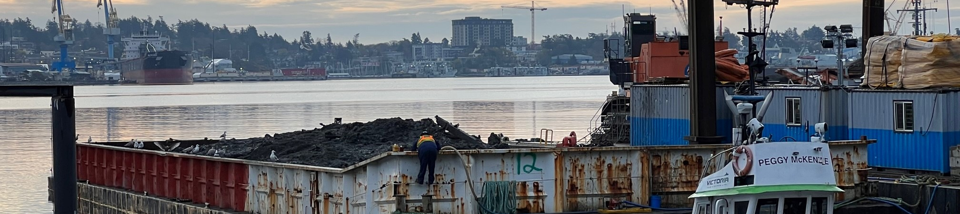
Summary
Complete site understanding is required for effective design
Critical analysis of required equipment can make/break implementation
Contractor and owner flexibility helps resolve issues
Communication is key

Slide 18


Matt Woltman
Principal Engineer
Anchor QEA
mwoltman@anchorqea.com

