Slide 1


A Hybrid Remedy Implementation Case Study for Marsh Restoration in Brunswick Estuary, Georgia, USA
Presented by: Mark Reemts, PE, Anchor QEA
Collaborators: Ram Mohan, PE, PhD and Randy Brown, Anchor QEA
Prashant Gupta and Richard Galloway, Honeywell International Inc. Tim Donegan, PE and Mike Marrone, Sevenson Environmental Services, Inc.

Slide 2
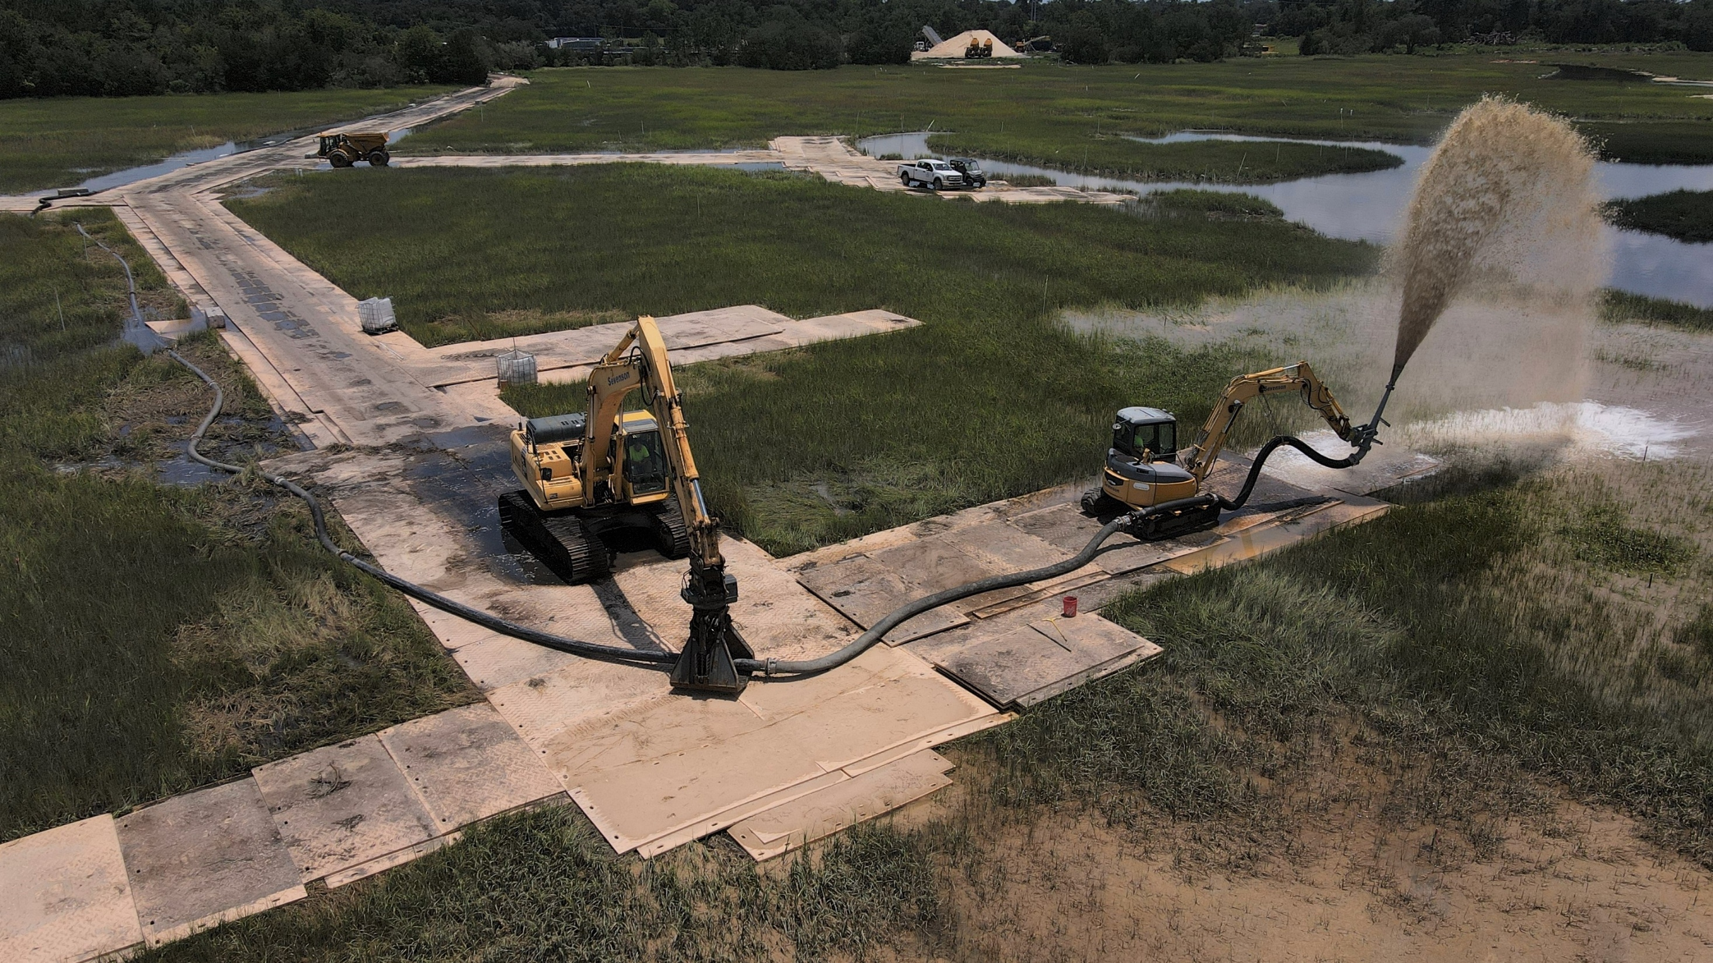
Thin Layer Cover Application within the Brunswick Marsh

Slide 3
How to effectively implement a remedy in sensitive marsh habitat while minimizing marsh impacts?

Slide 4




36,000 cy of dredging marsh creeks
18-inch removal across 11 acres
TSCA and non-TSCA sediment
Remedy Summary
24,000 cy of sand backfill to restore creeks
12-inch cover
Thin Layer Cover over 11 acres of marsh
6-inch target placement
Restoration of disturbed areas
Clean fill placement and replanting of marsh access roads

Slide 5
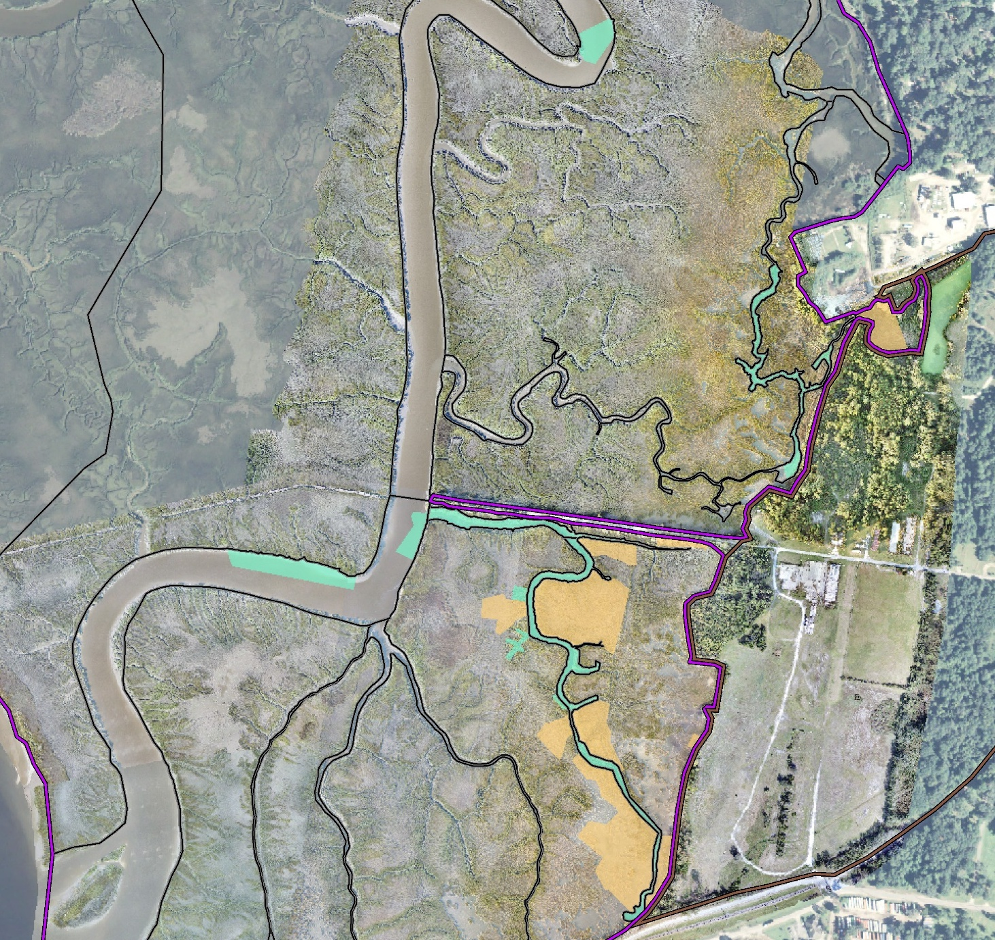
Site Layout
Purvis
Creek
Dredging and Backfill
Offloading Area, Crew Dock
Domain 3
Creek
Thin Layer Cover
Temporary Flow Control Structure
Trailers
and Parking
Pilot Study Area (Previously Completed)
LCP Ditch
Support Areas
Eastern
Creek
Temporary Flow Control Structure
Sediment Processing Pad
TLC Slurry Equipment, Backfill Stockpiles

Slide 6
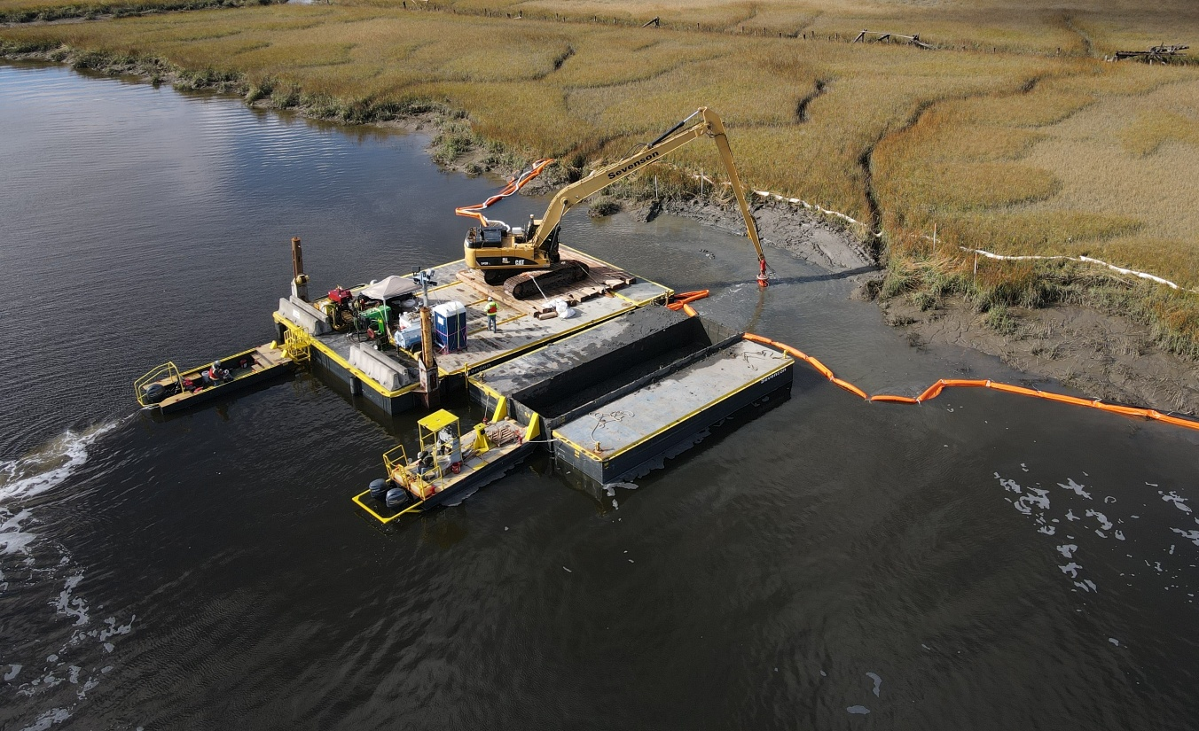
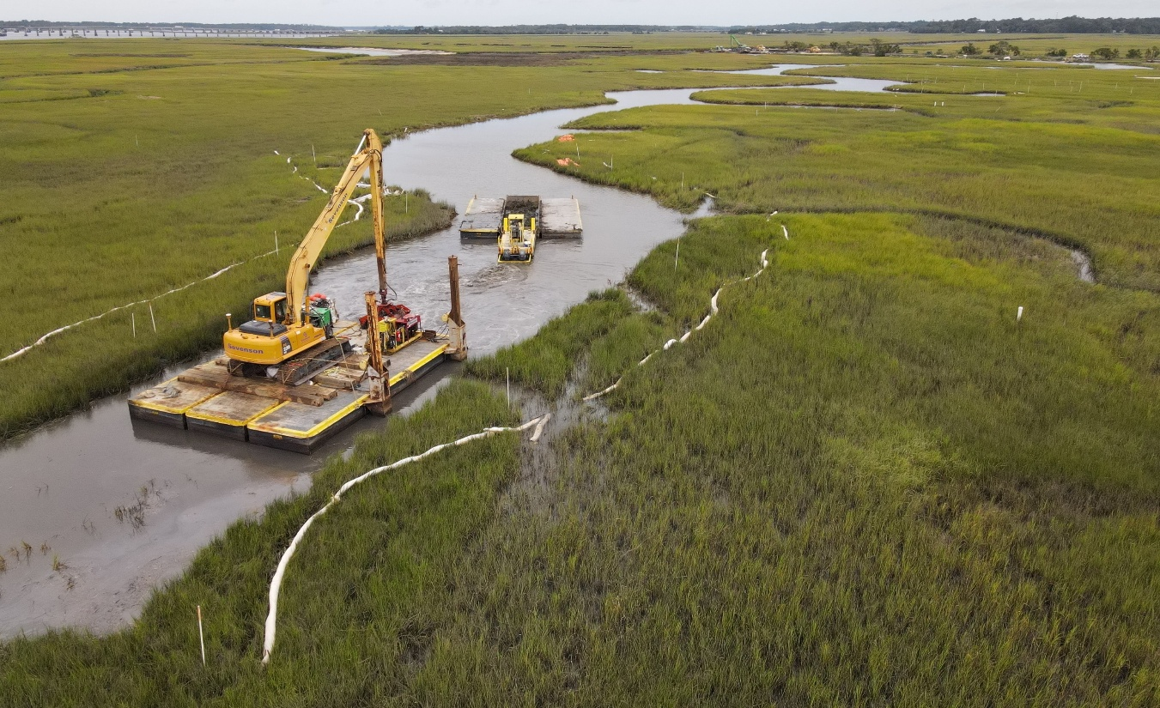
Floating Access – Dredging and Backfill
Standard floating platform with long reach excavator
Used for work in Purvis Creek and majority of side channels
Reconfigured for narrow access areas in creeks

Slide 7
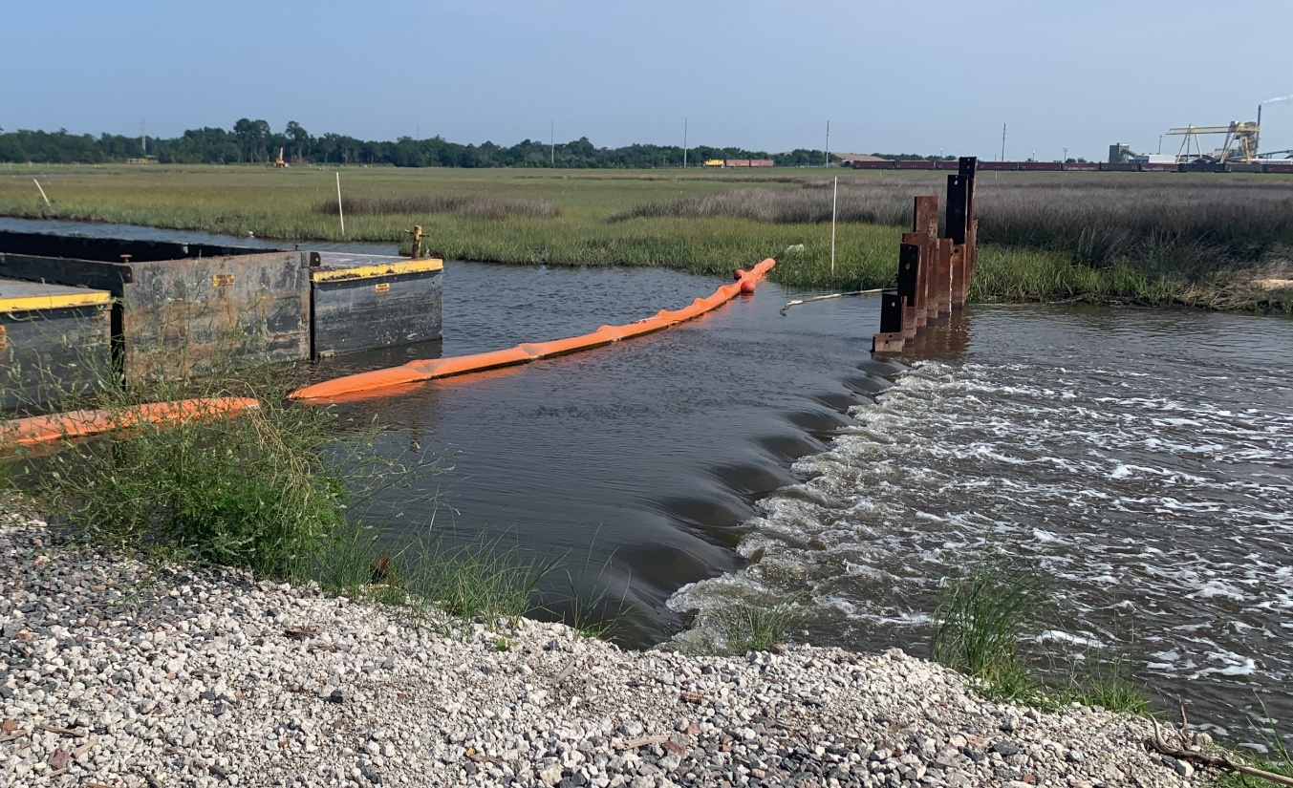
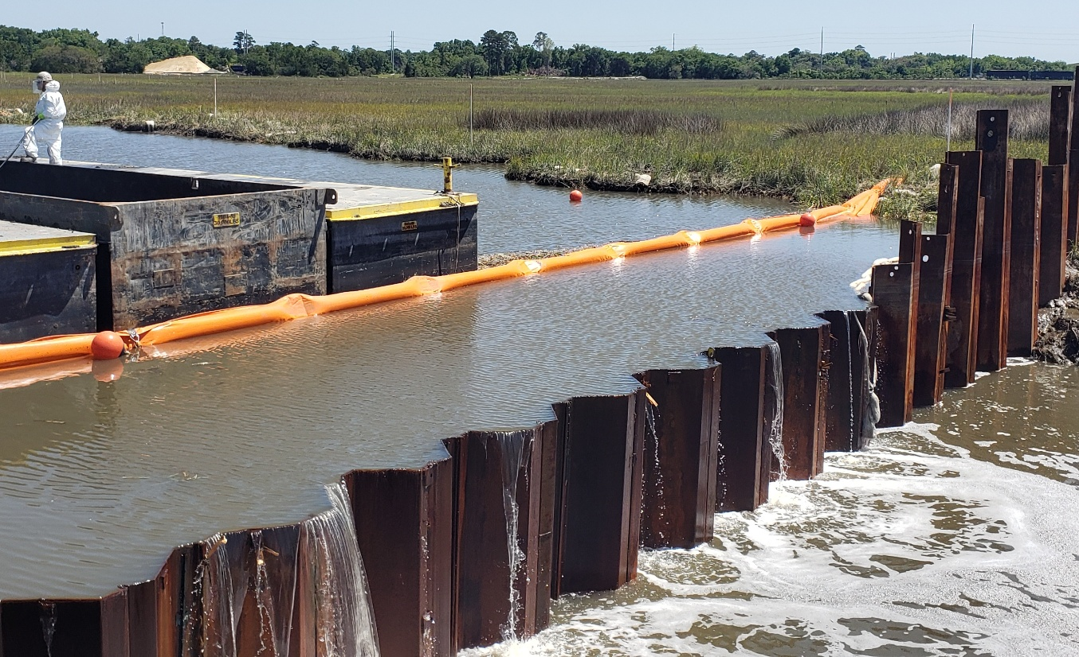
Temporary Flow Control Structure
Estuary experiences large tidal swings (7+ feet), fully dewatering the side channels
Temporary sheet pile structure retained water within the channels, allowing tidal exchange but increasing draft
Provided turbidity control during dredging operations

Slide 8
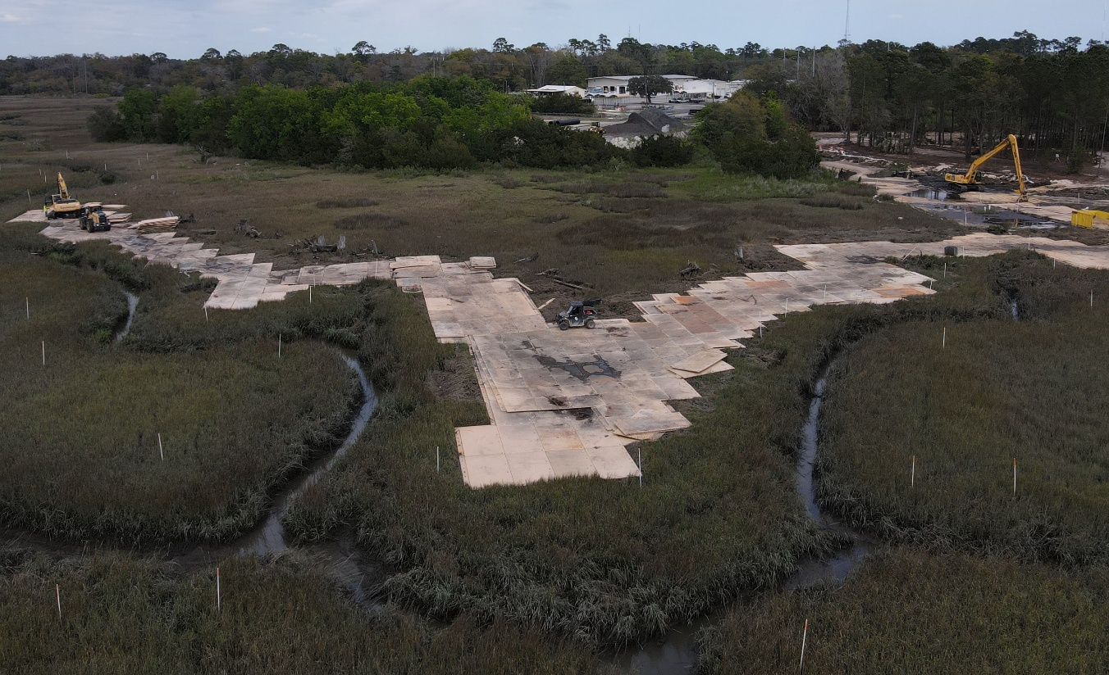
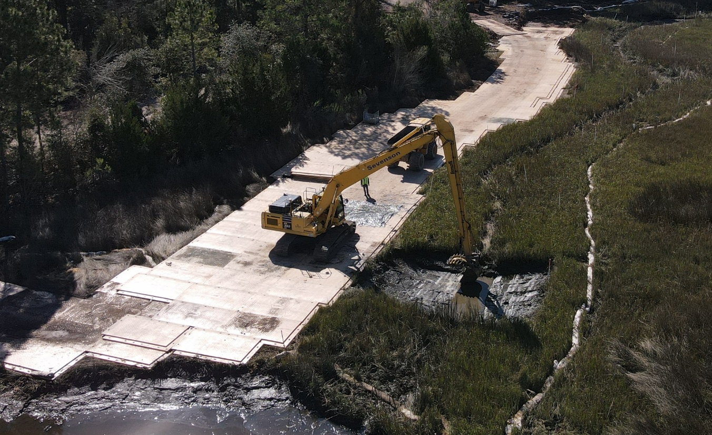
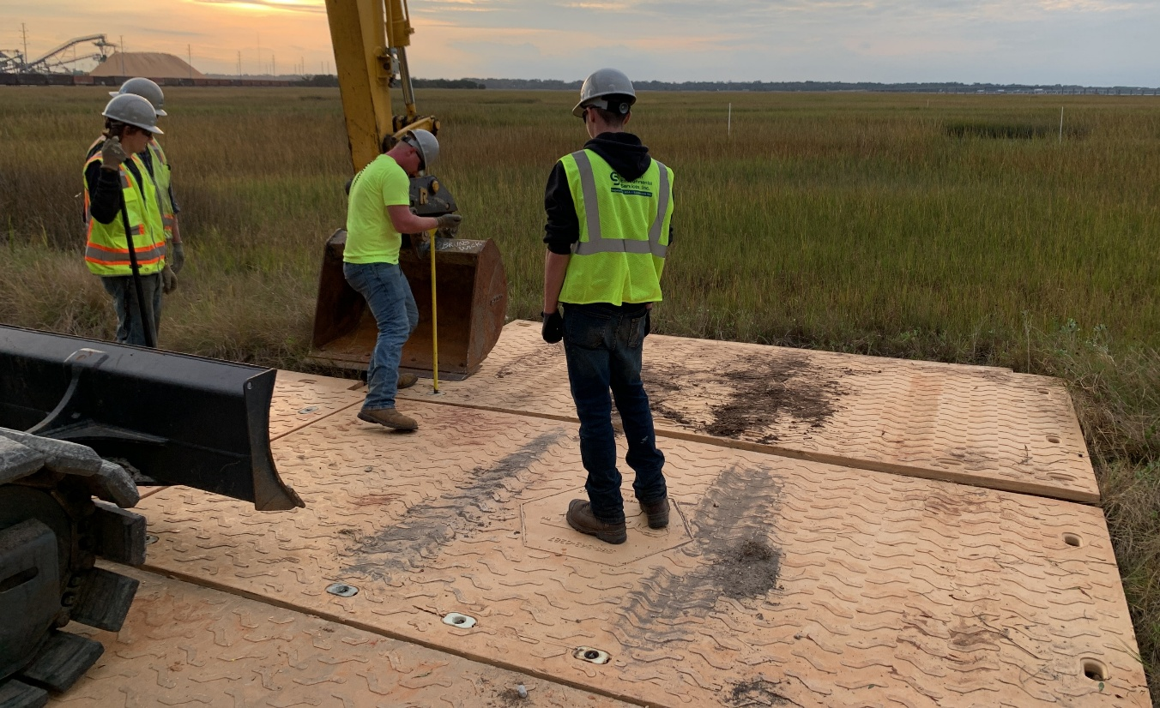
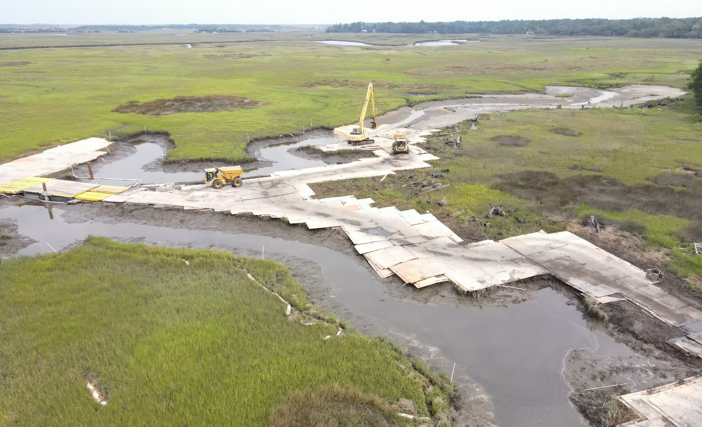
Mat Access – Dredging, Backfill, and TLC
Temporary HDPE mat roadways constructed for access within the marsh
Crossings and extents limited where possible to reduce impact
Access roads restored following remedy implementation

Slide 9
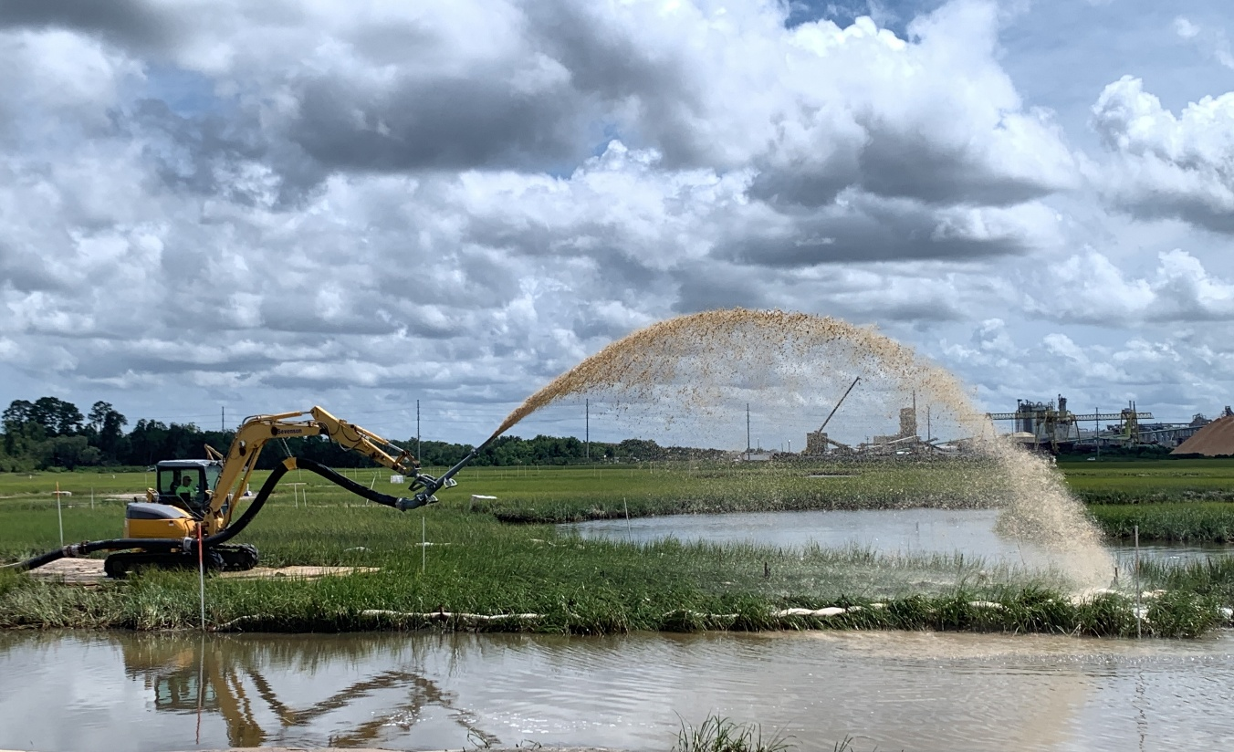
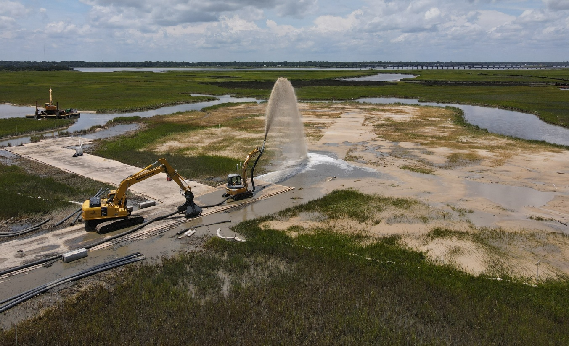
Thin Layer Cover Application
Full scale placement design was supported by data and observations from the pilot study
Sand material allowed ease of placement by rainbowing material
Real-time verification combined with thin lift application prevented overplacement

Slide 10
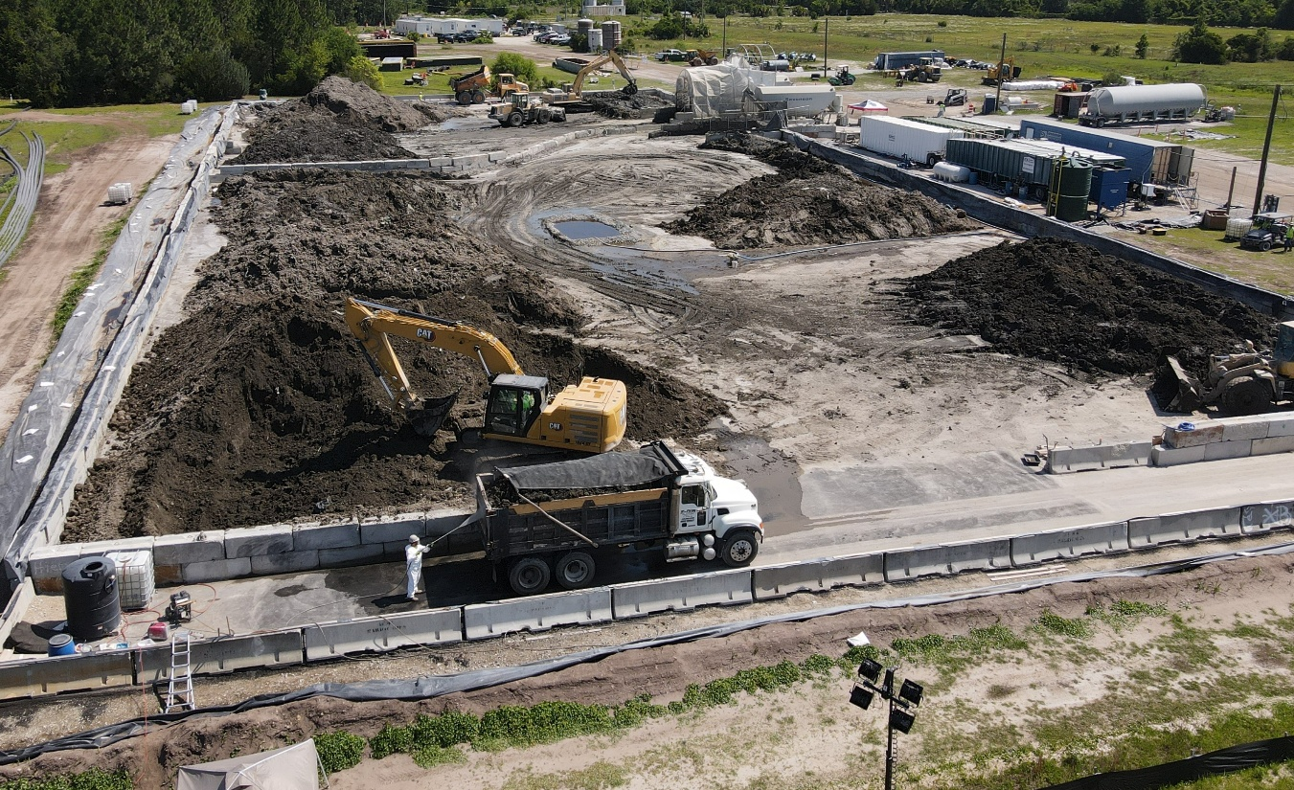
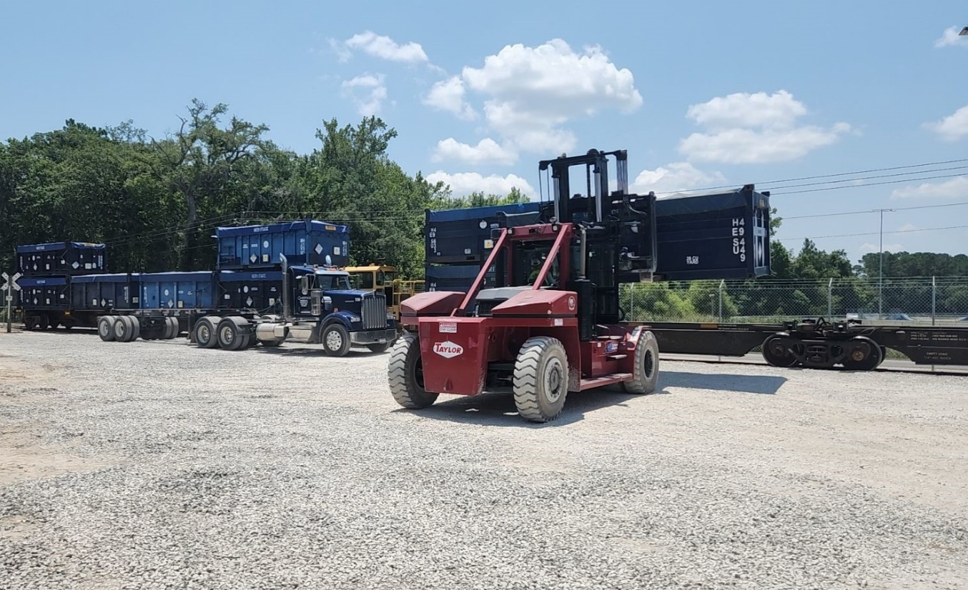
Processing and Disposal
Sediment processing area separated into TSCA and
non-TSCA footprints
Stabilized with Portland cement
Non-TSCA hauled by triaxle trucks
TSCA loaded to intermodal containers for rail shipment

Slide 11
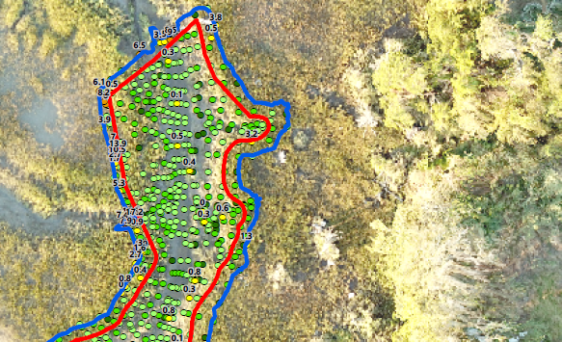
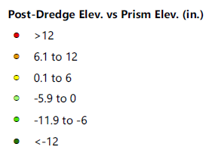

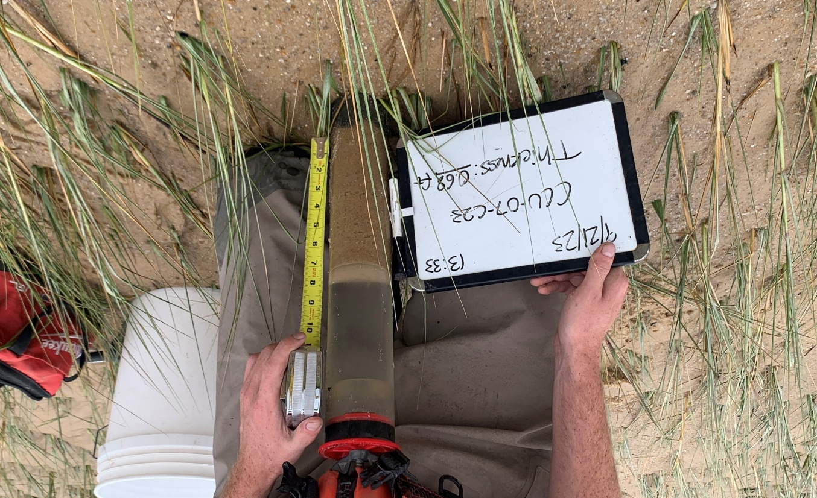
Verification
Dredging and backfill confirmed by pre-dredge, post-dredge, and post-backfill survey
  Single-beam for larger channel system with added topographic survey
  Transects and clustered topographic survey for smaller channels
Thin layer cover utilized grade stakes for QC verified by cores

Slide 12
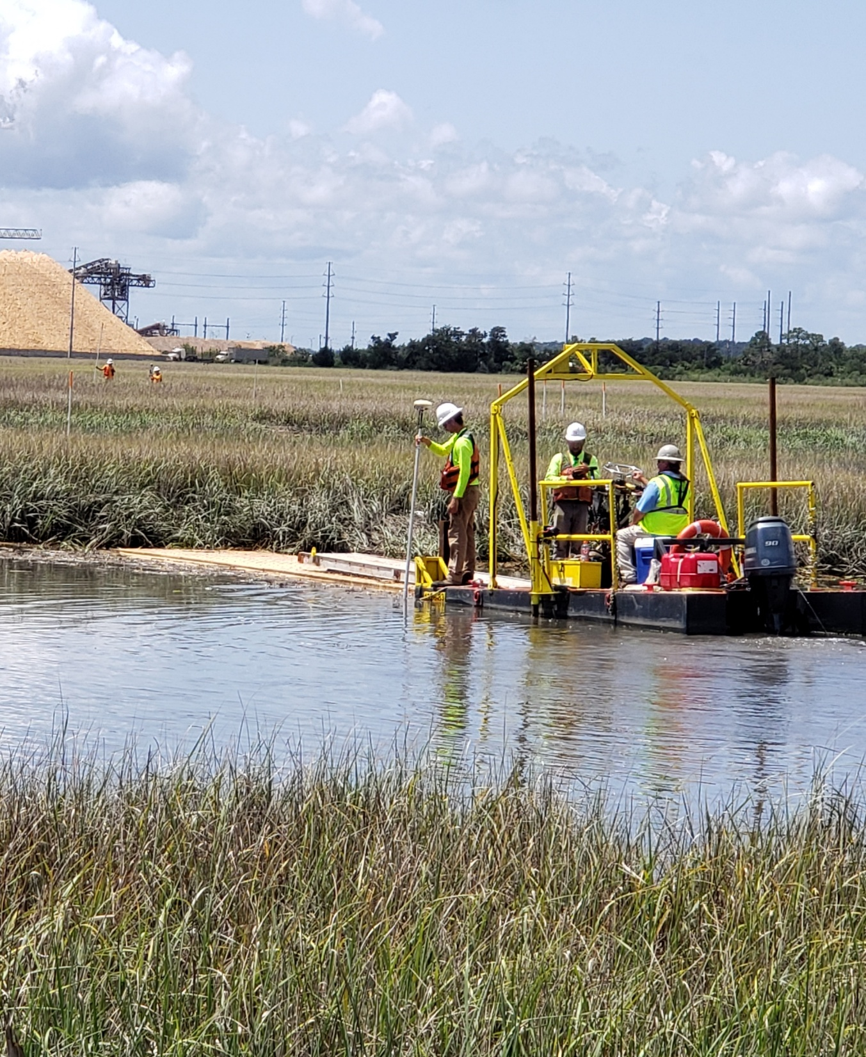
Lessons Learned –
Survey
Survey required modifications during implementation
Topographic survey methods were necessary to capture elevation detail of certain areas
Full time survey allowed quick turnaround for verification and continued production

Slide 13
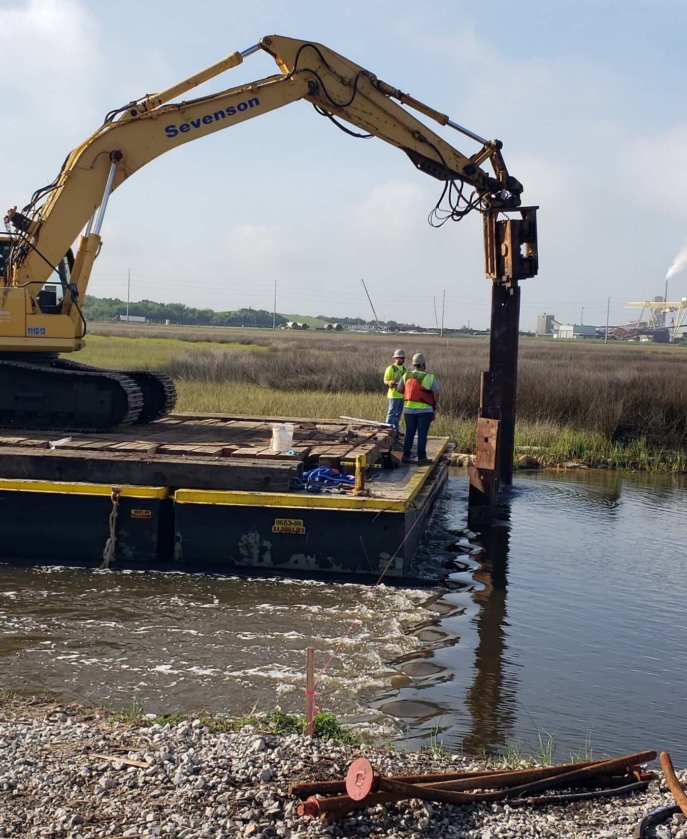
Lessons Learned –
Water Level Management
Temporary flow control structure significantly increased production capability of floating equipment
Reduced marsh impact by increasing floating access and reduced resuspension risk

Slide 14
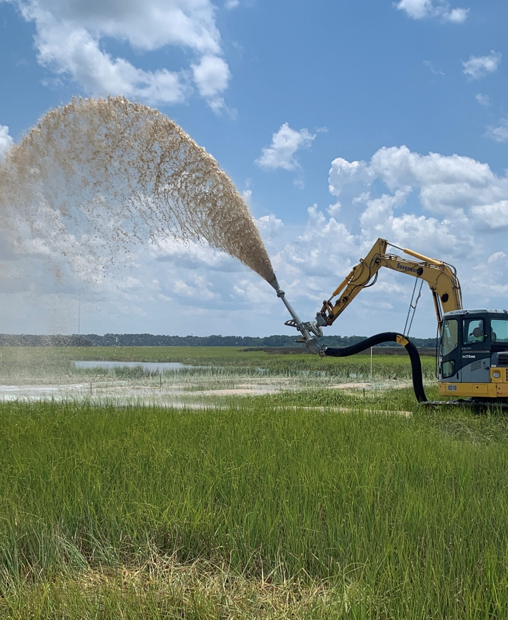
Lessons Learned – Thin Layer Cover
Material selection removed clogging risk
Custom nozzle provided good spray distance and spread
Application style matters—thinner lifts allowed more control, less impact to existing grasses

Slide 15
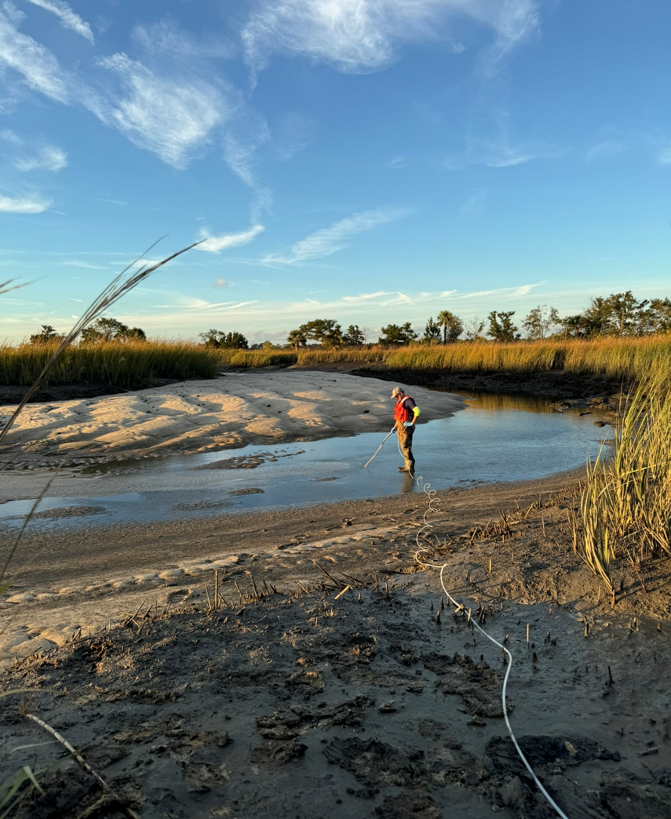
Long-Term Monitoring
Initial program for years 1, 3, and 5 after construction completion
Sediment analytical, benthic community, vegetation reestablishment, water quality, fish tissue
First event completed December 2024, results pending

Slide 16
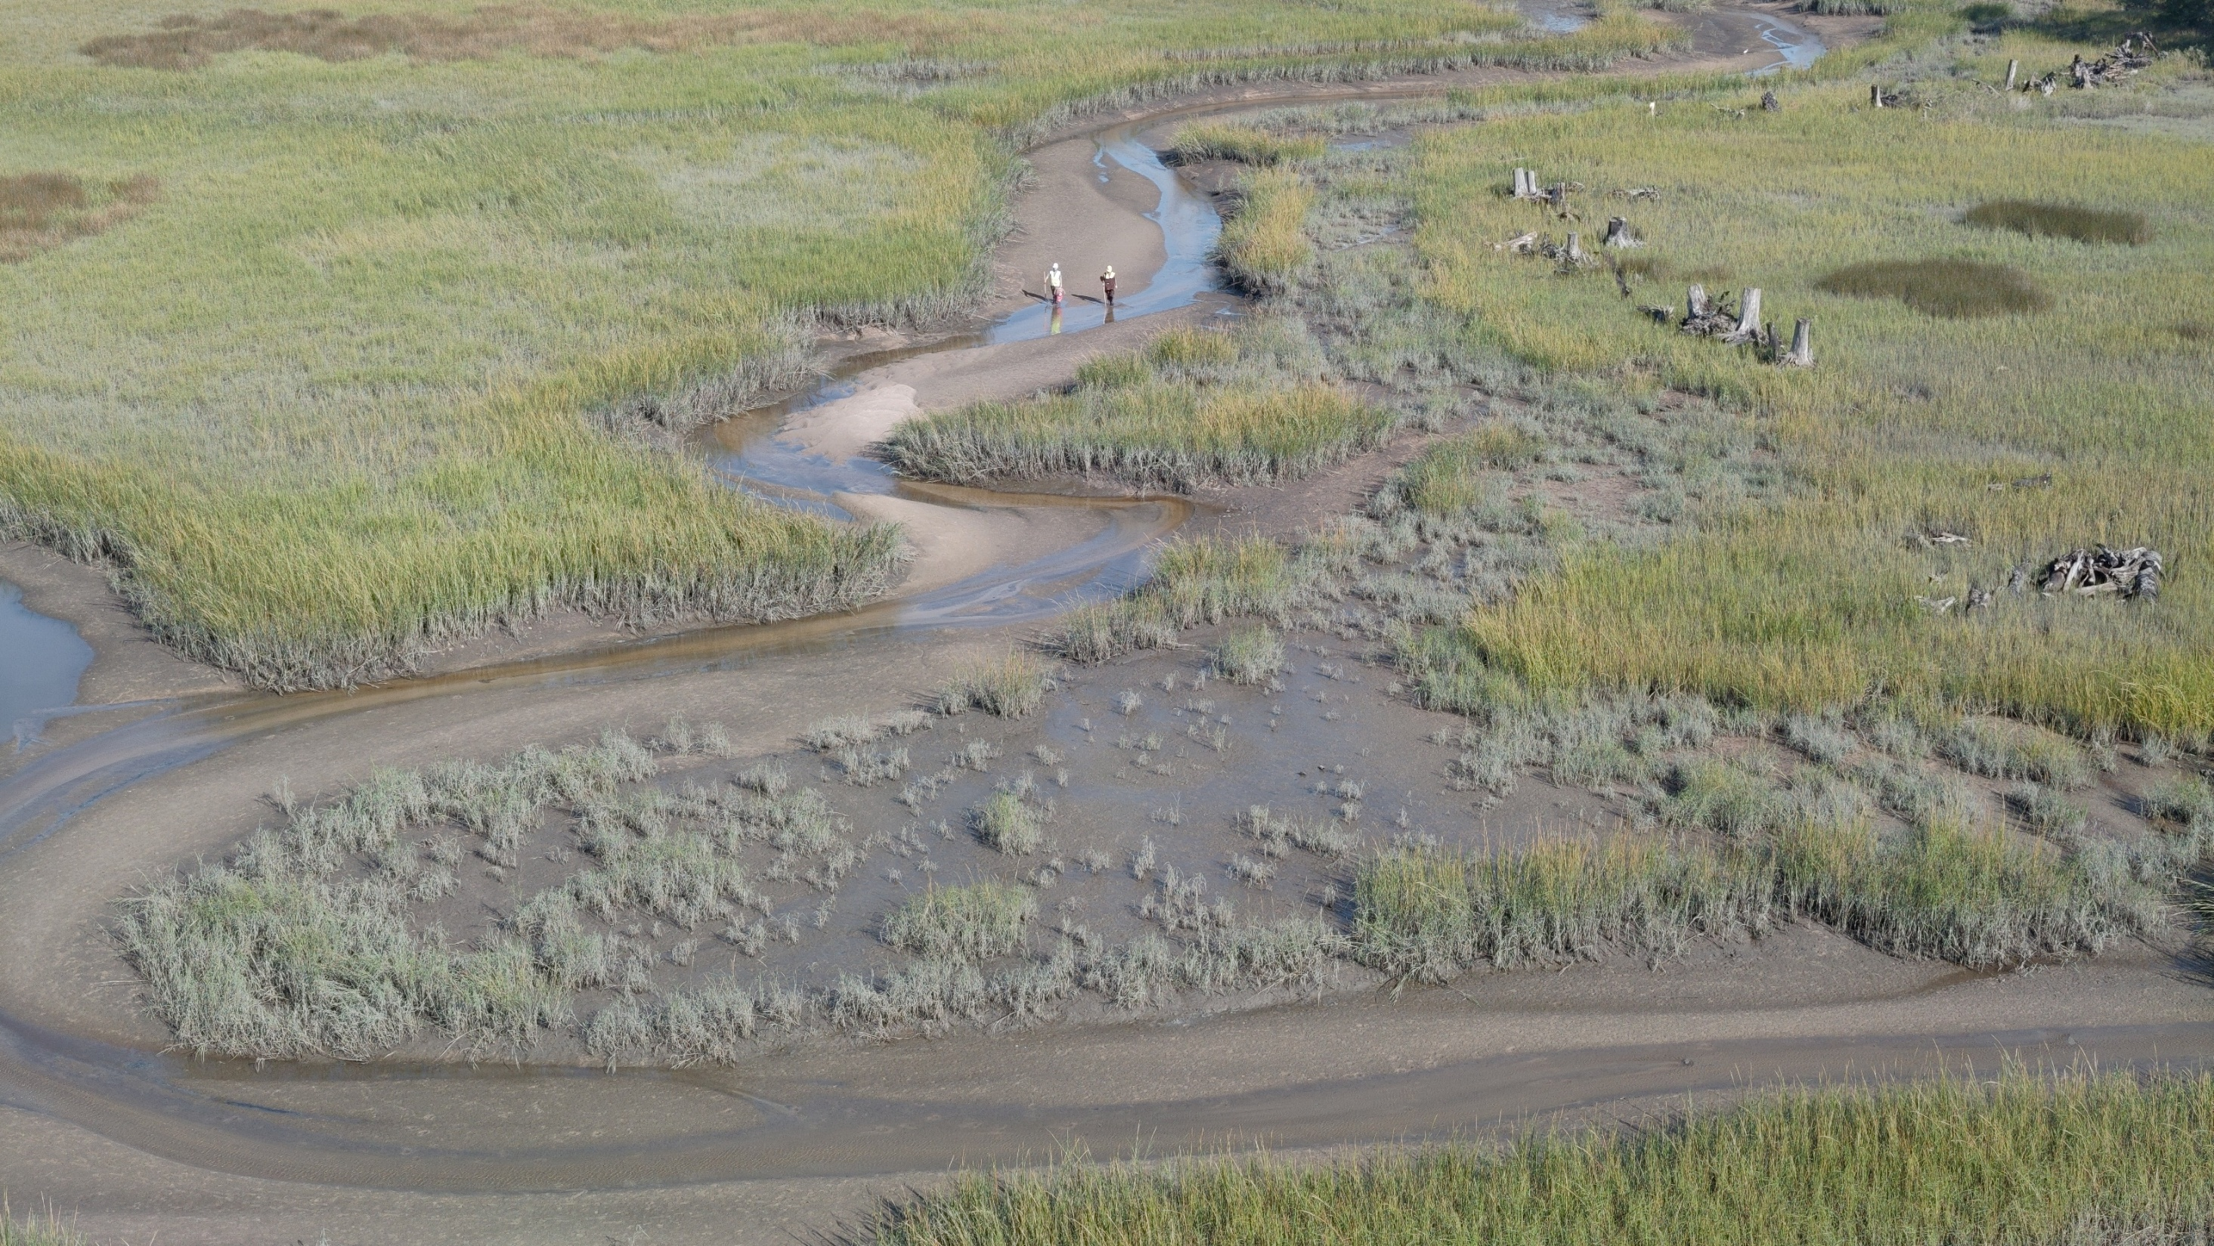
Example Mat Access Road One Year Recovery, October 2024

Slide 17
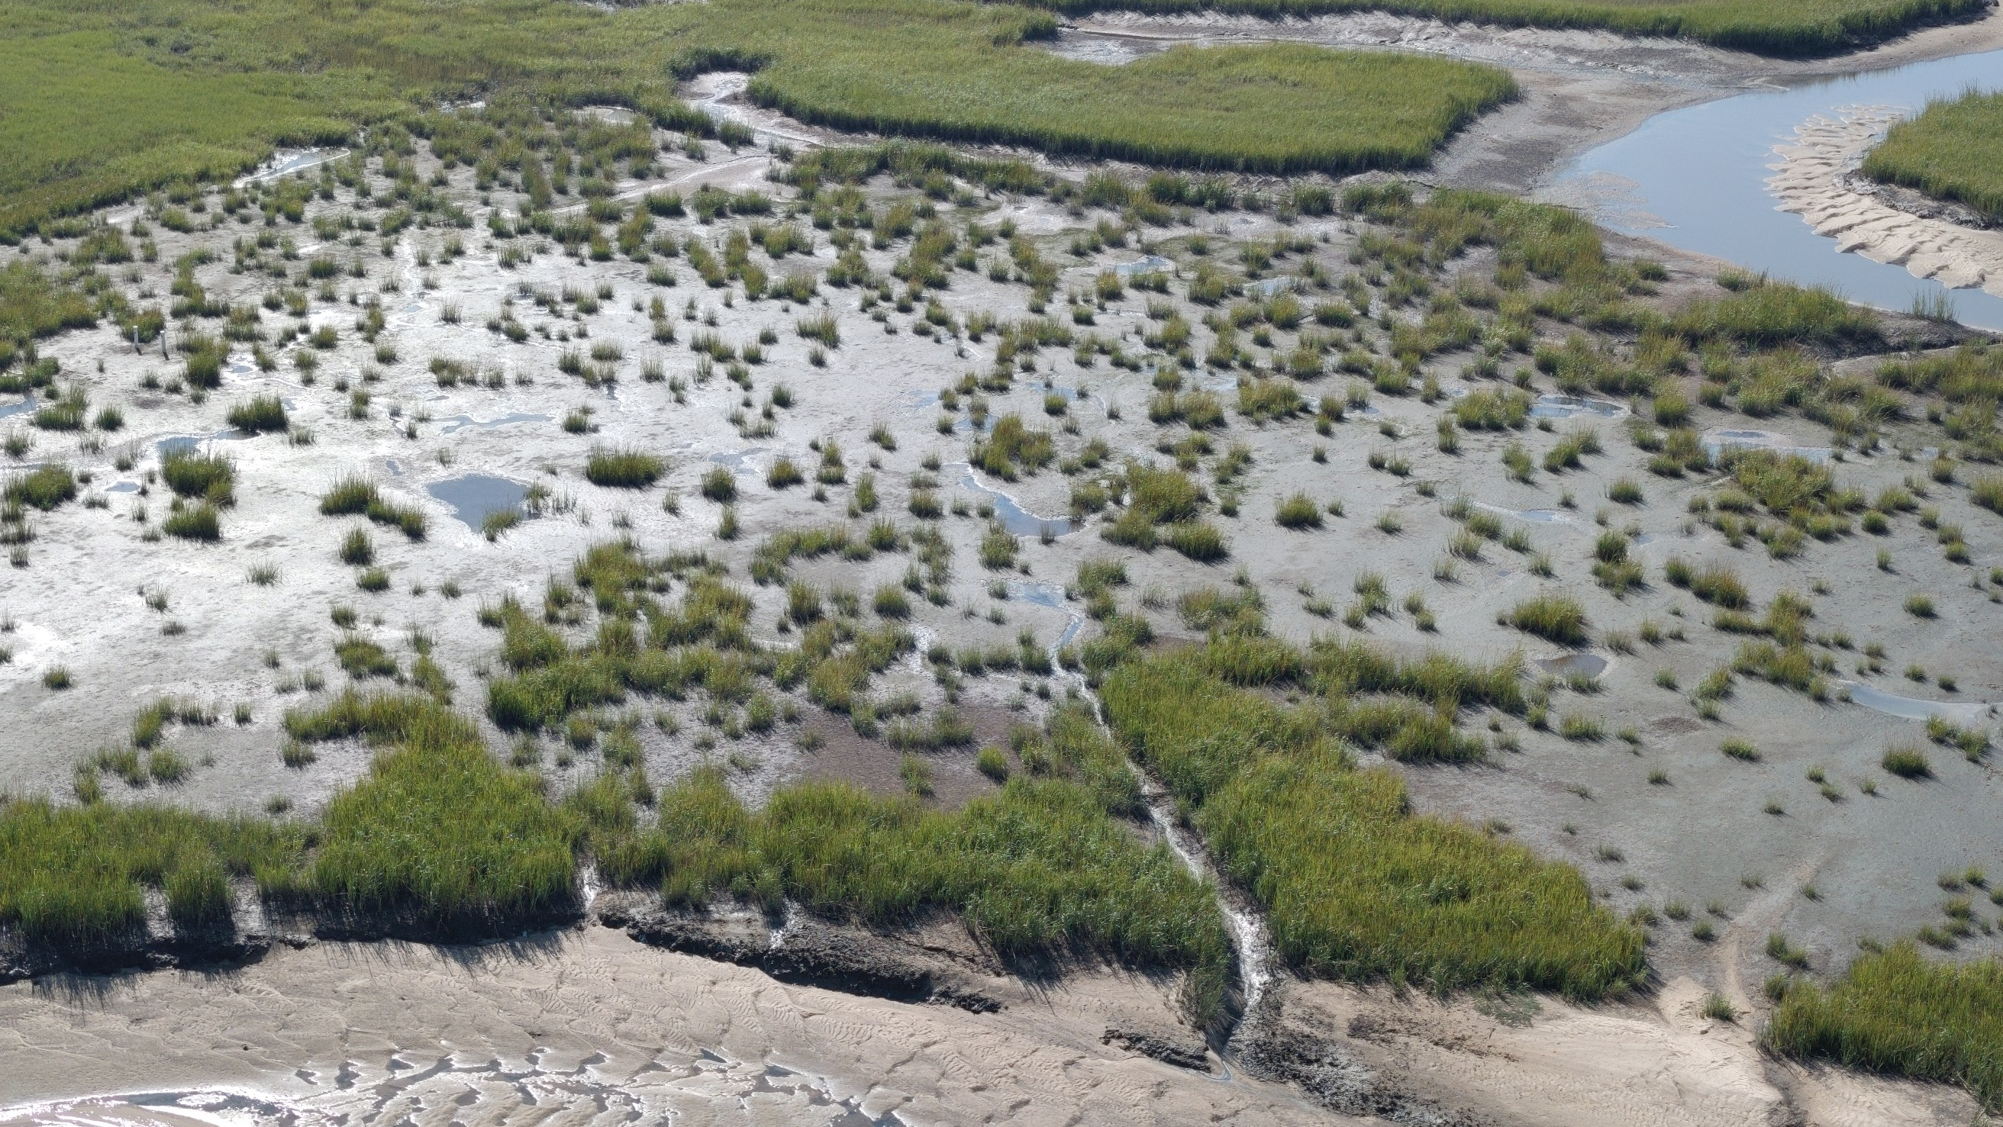
Example Thin Layer Cover One Year Recovery, October 2024
Figure 12: Mat access road recovery, Oct 2024

Slide 18
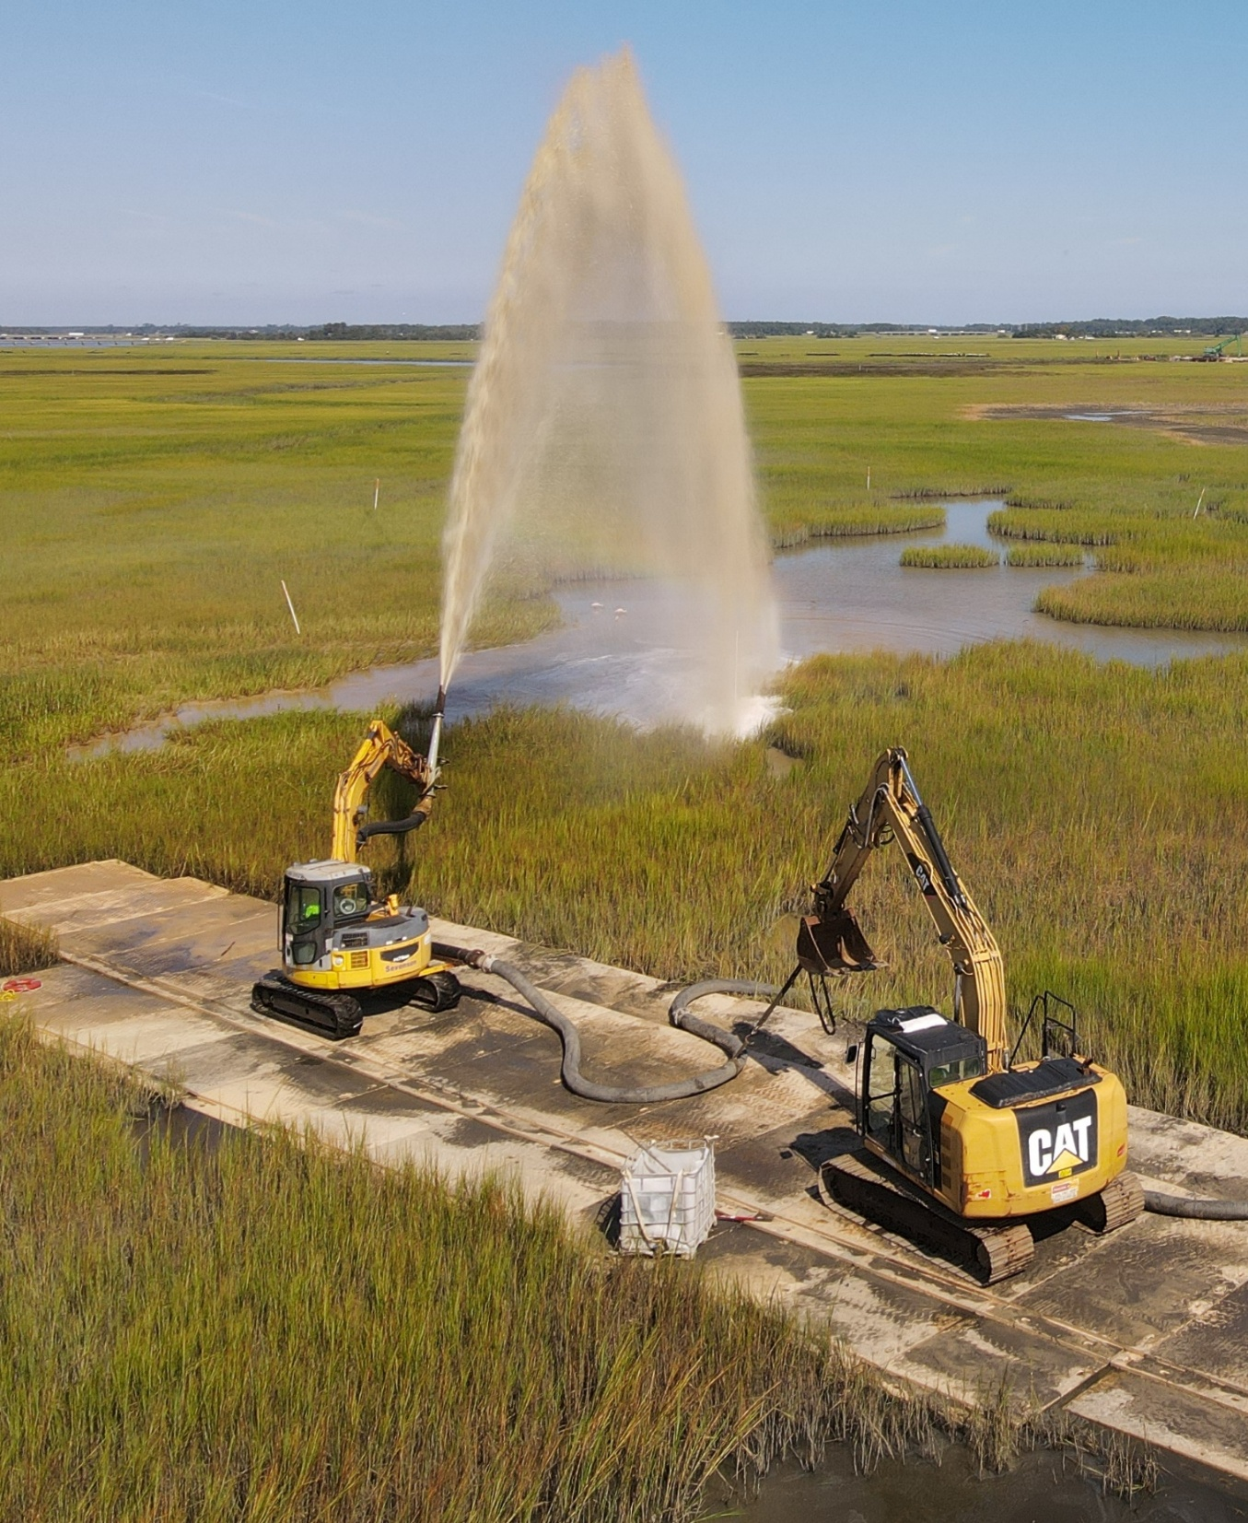
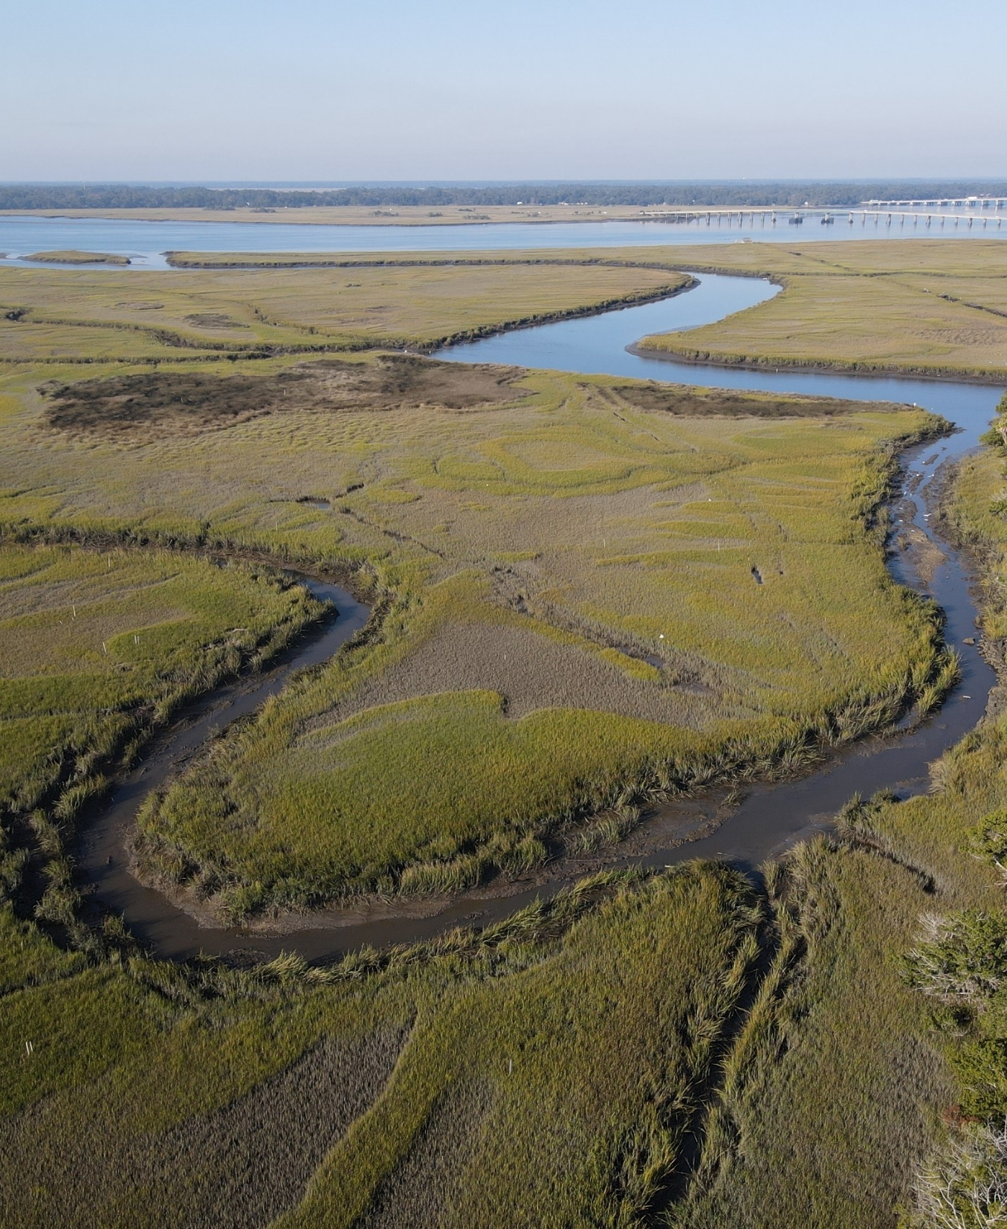
Summary
Total 30,655 cy non-TSCA and 5,645 cy TSCA material removed
Lessons learned from pilot study and during implementation applied to improve construction and reduce marsh impact
Remedy completed on schedule, on budget
Initial marsh recovery progressing

Slide 19
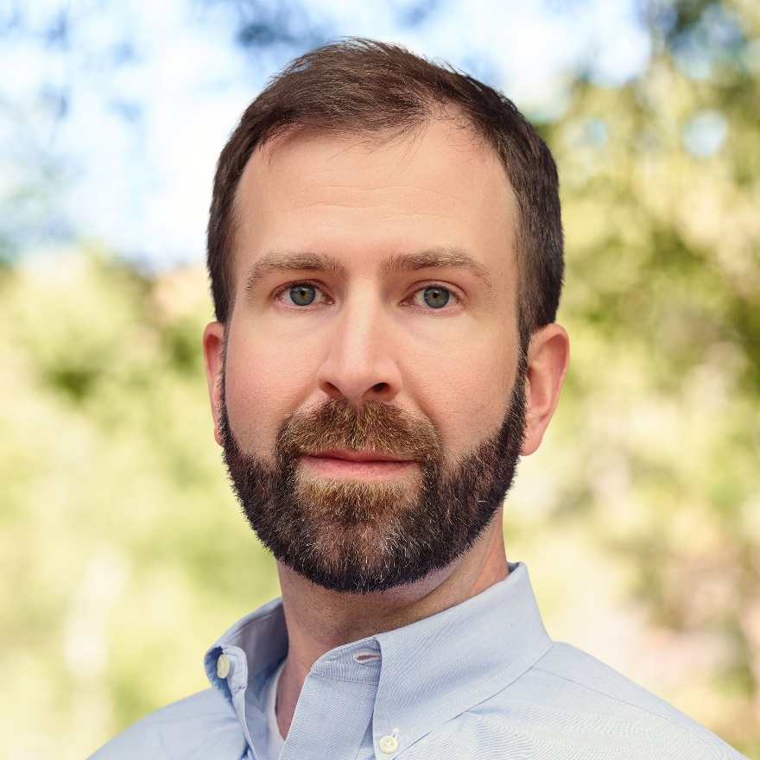

Mark Reemts, PE
Principal Engineer Anchor QEA
mreemts@anchorqea.com

