Slide 1

Integrating Geostatistical Interpolation Methods and Site Conditions to Define Remedial Action Areas for the Lower Duwamish Waterway Upper Reach
Presented by: Katy Gross, PE, Anchor QEA
Collaborators: John Laplante and Tom Wang, Anchor QEA
Craig Hanson, Windward Environmental, LLC
Jeff Stern and Debra Williston, King County
Allison Crowley; Pete Rude; and Dave Schuchardt, City of Seattle
Joe Flaherty and Ken Nogeire, Boeing

Slide 2
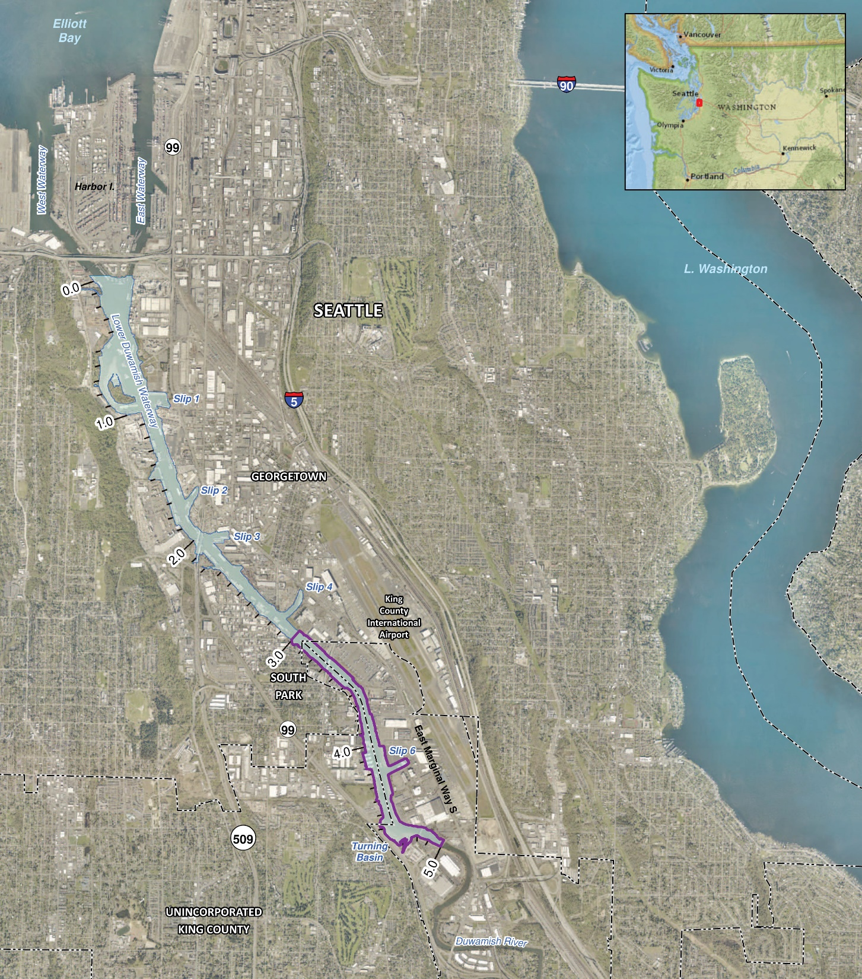
Project Area
Superfund Site in Seattle, Washington
5-mile-long channelized waterway
Designed and constructed by upper, middle, and lower reaches
Upper Reach from river miles 3.0 to 5.0

Slide 3
Chemicals of Concern
PCBs
  Account for nearly 90% of contaminated sediment area in the LDW upper reach
  Focus of geostatistical interpolation (indicator kriging) and uncertainty analysis
Other COCs
  Metals, PAHs, SVOCs, dioxins/furans account for ~10% of contaminated area
  Other COCs interpolated separately using simpler method (Thiessen polygons)

Slide 4
Complex Suite of Remedial Action Levels
Surface Sediment (0–10 cm)
  Remedial Action Level (RAL) for PCBs = 12 mg/kg-OC
Subsurface Sediment (0–45 cm, 0–60 cm)
  RALs for PCBs = 12, 65, or 195 mg/kg-OC, depending on:
    Intertidal vs. subtidal areas
    Shoaling areas in Federal Navigation Channel
    Recovery Categories (natural recovery potential)
Organic carbon-normalization

Slide 5
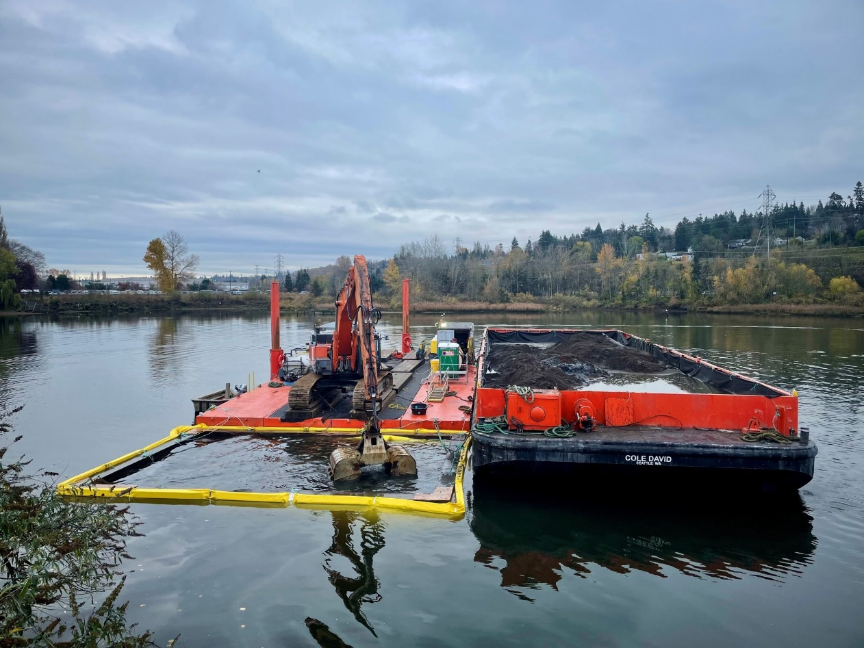
Presentative Overview
Interpolation
  Reducing uncertainty in defining areas with RAL exceedances through interpolation methods and phased data collection
Engineering considerations
  Overlaying engineering factors to develop Remedial Action Areas
Start of construction (November 2024)
Credit: ldwg.org

Slide 6
Interpolation

Slide 7
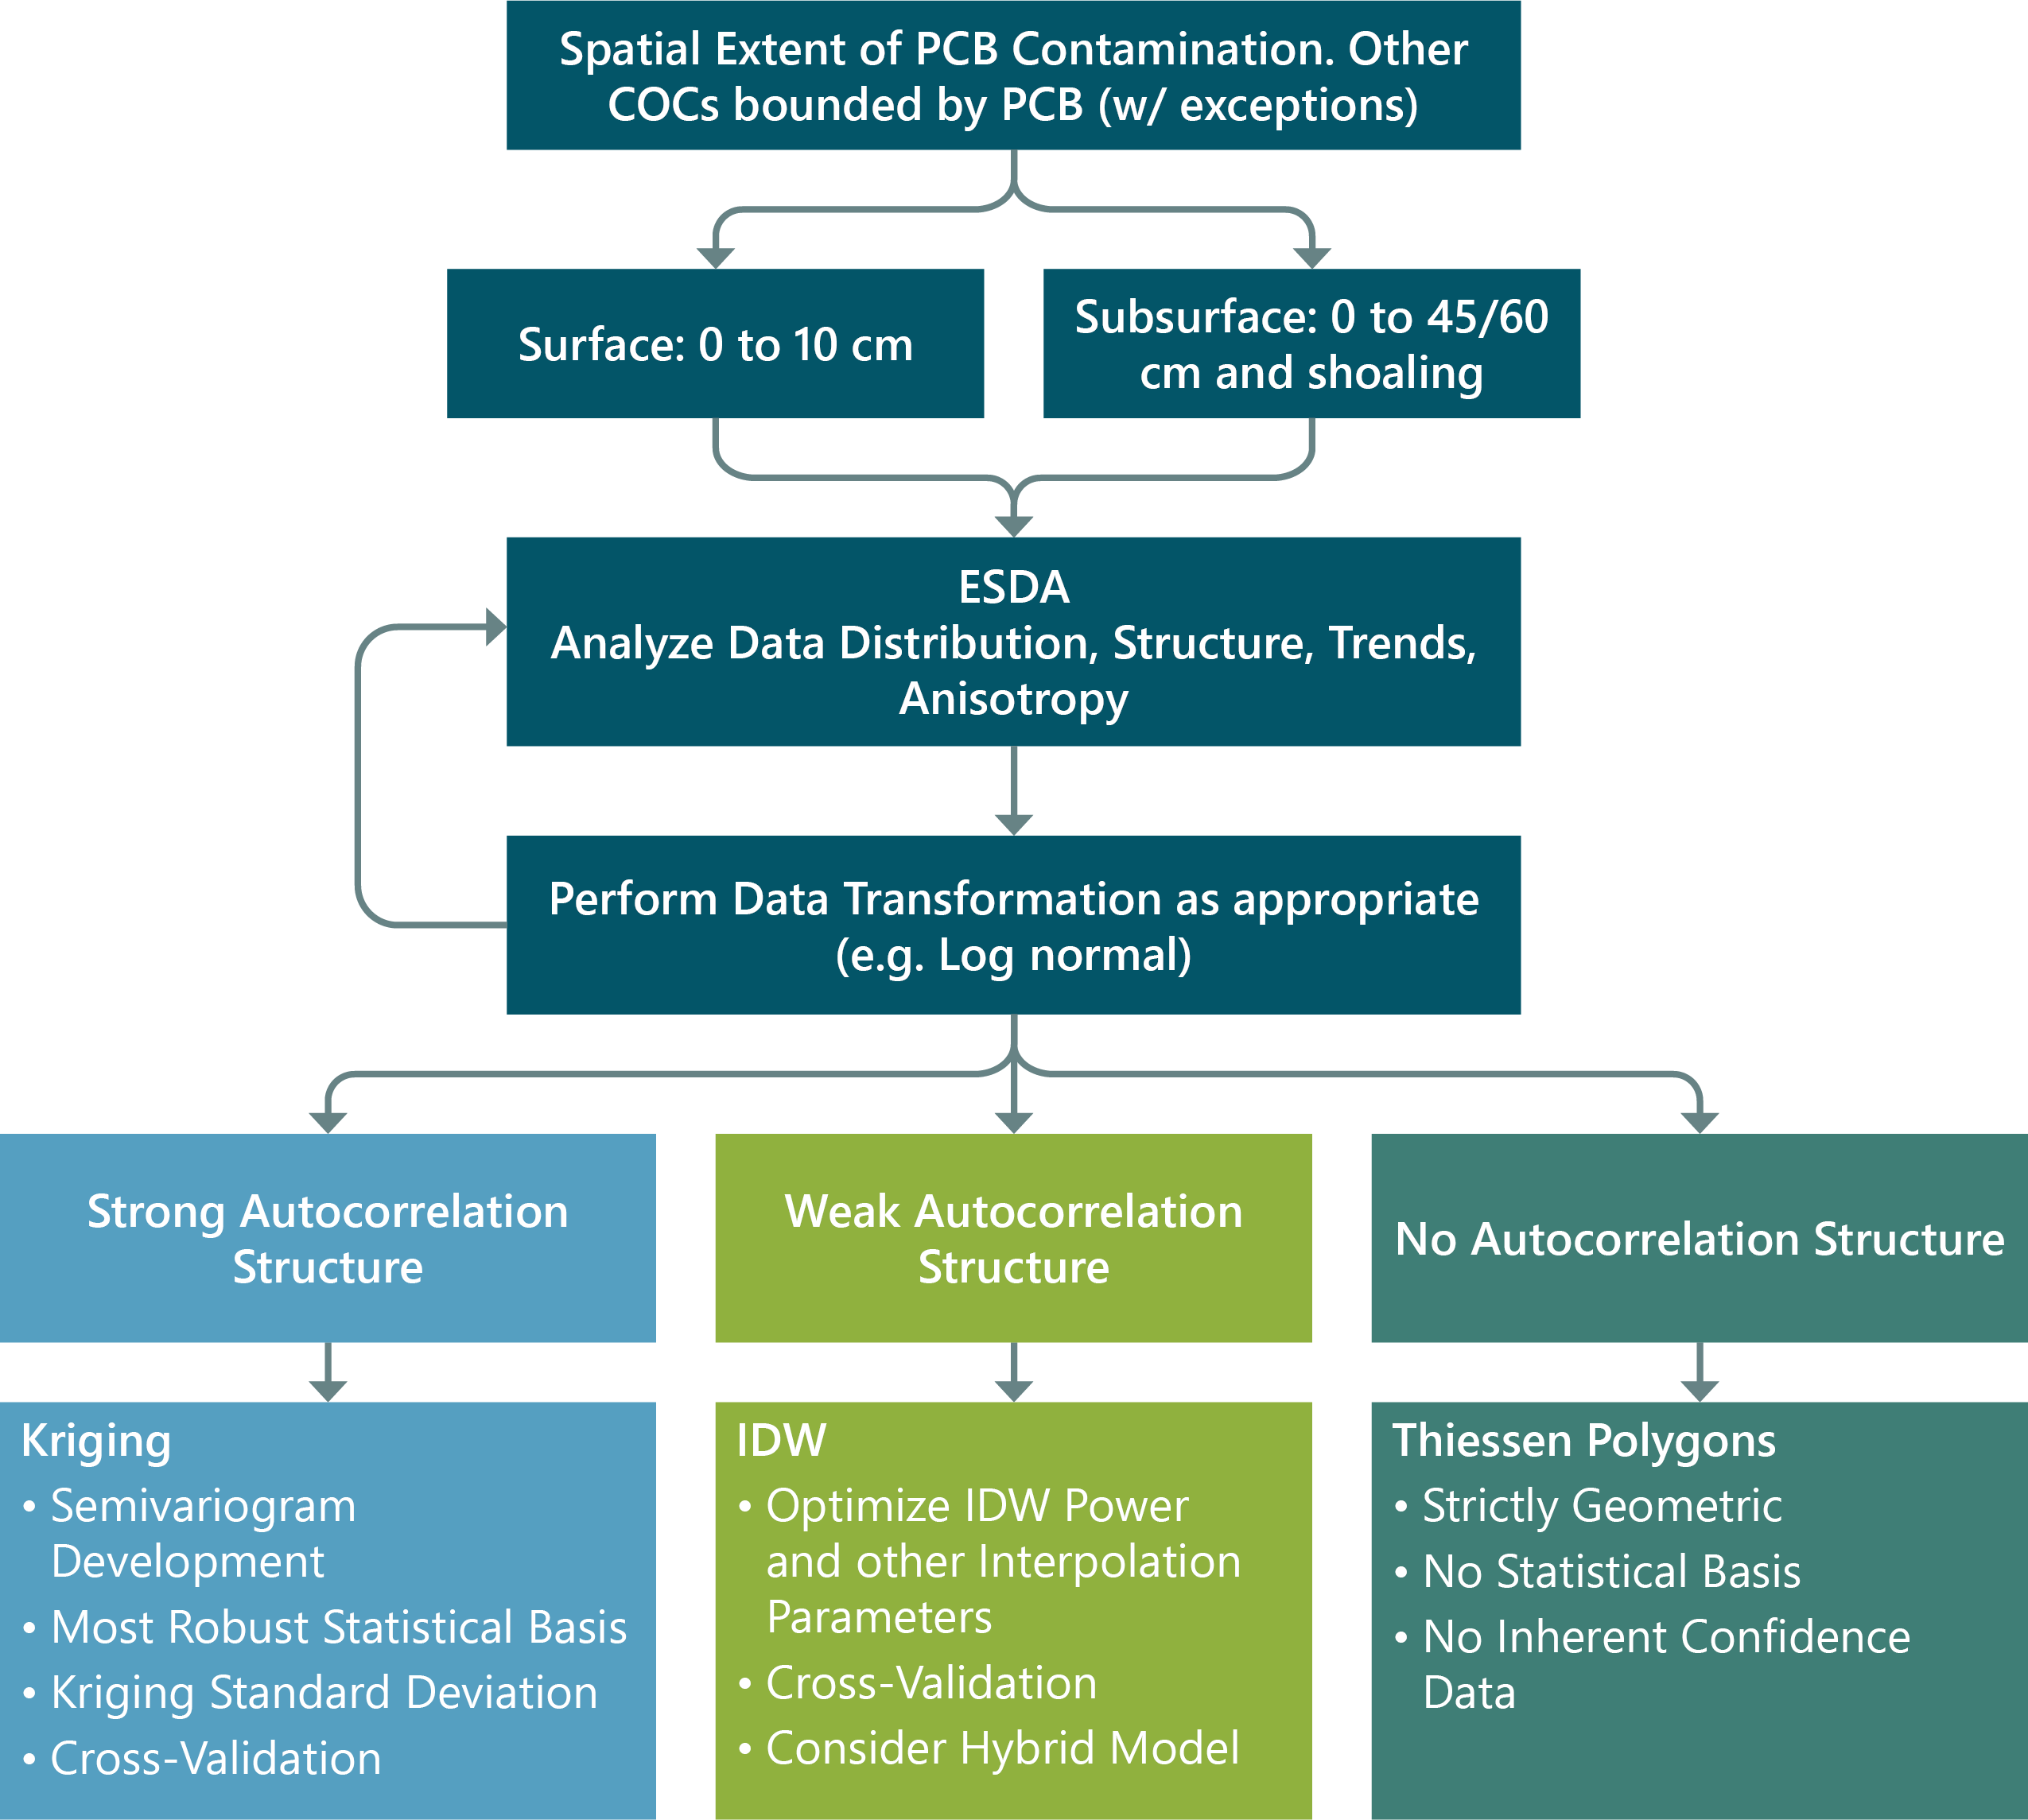
Selection of Interpolation Method
Methods considered:
  Kriging
    Ordinary
    Indicator
  Inverse Distance Weighting
  Thiessen Polygons

Slide 8
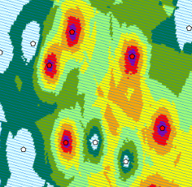
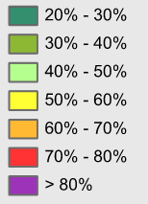
Selection of Interpolation Method (cont.)
Indicator kriging (IK) selected for PCBs
  Has the advantage of mapping probabilities of RAL exceedances
Thiessen polygons used to interpolate areas of other contaminants with RAL exceedances
PCB indicator kriging probability of RAL exceedance in sediment

Slide 9
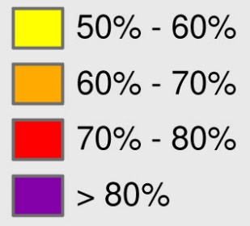
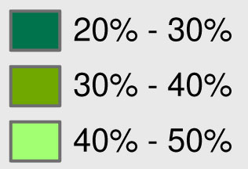
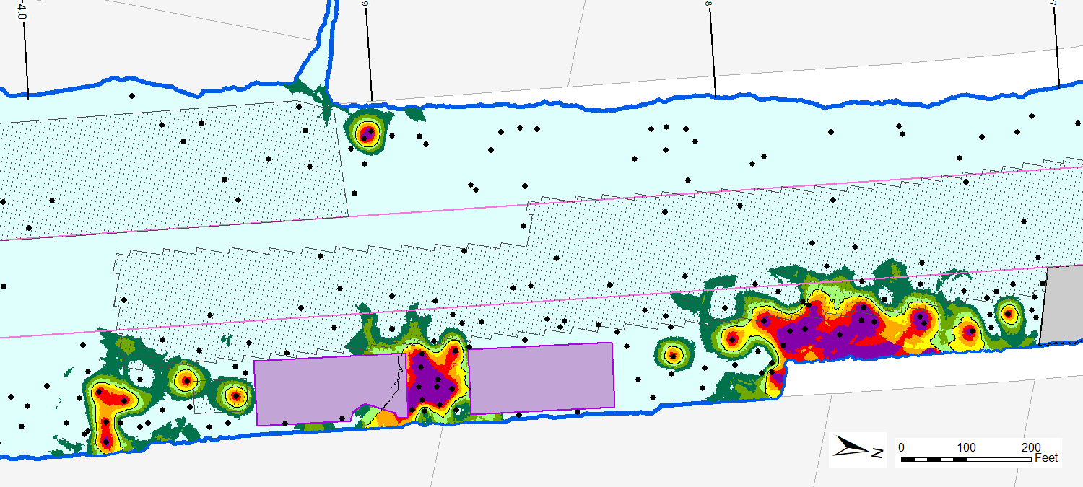
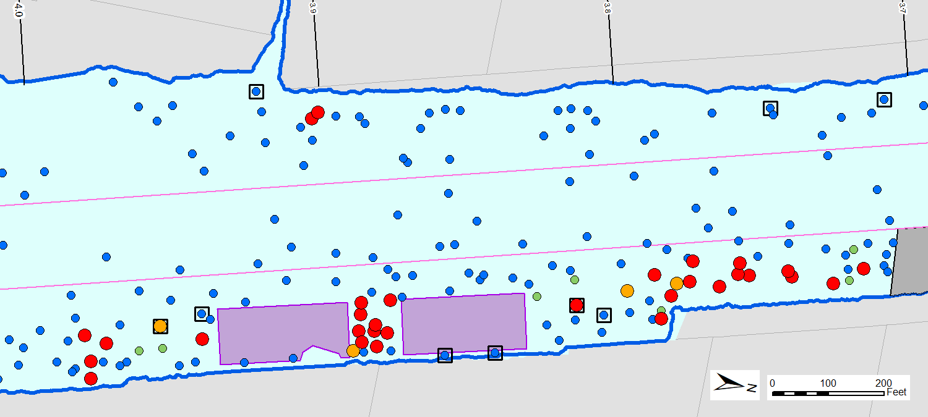
Surface PCB Indicator Probability
RAL Exceedance
Probability
Tar-Like
Material
P a r k
W a t e r f r o n t

Slide 10
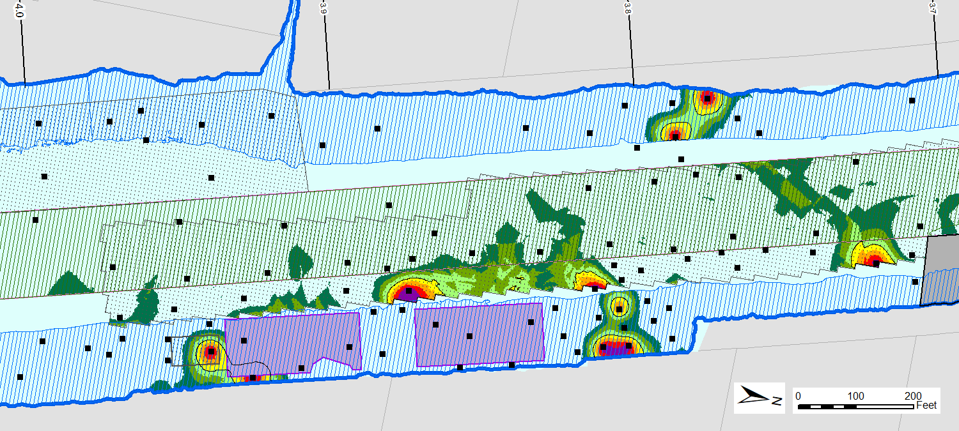
Subsurface PCB Indicator Probability
RAL Exceedance
Probability
Tar-Like
Material
P a r k
W a t e r f r o n t

Slide 11
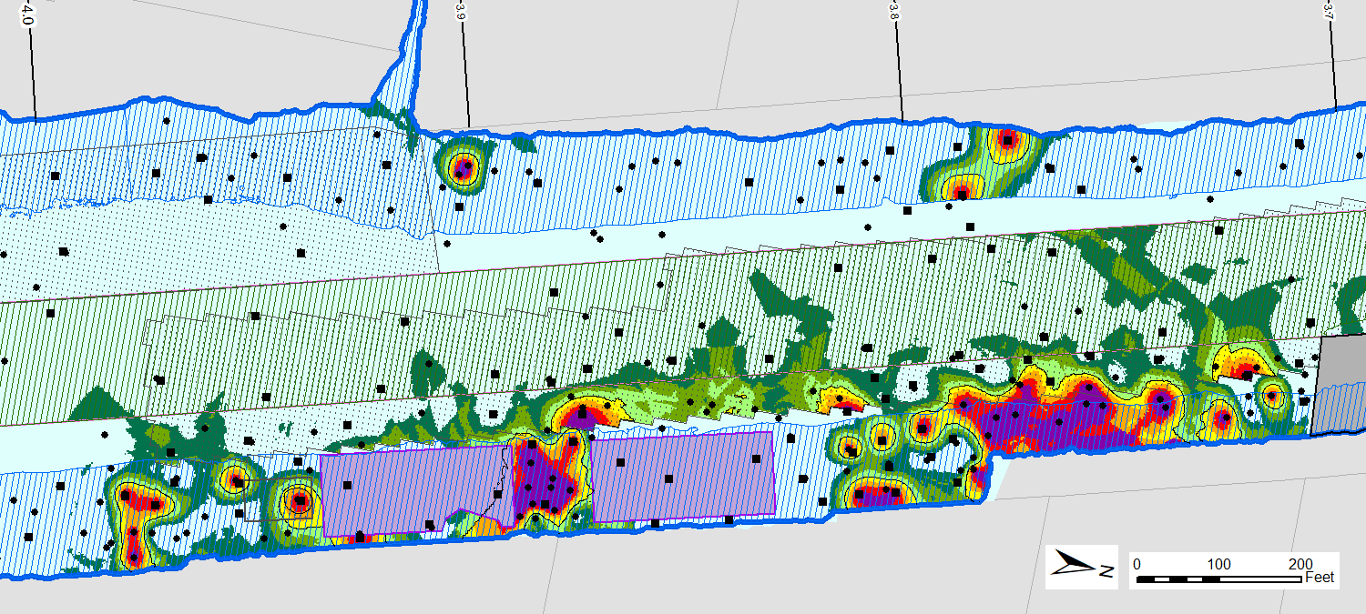
Combined PCB Indicator Probability
RAL Exceedance
Probability
Tar-Like
Material
P a r k
W a t e r f r o n t

Slide 12
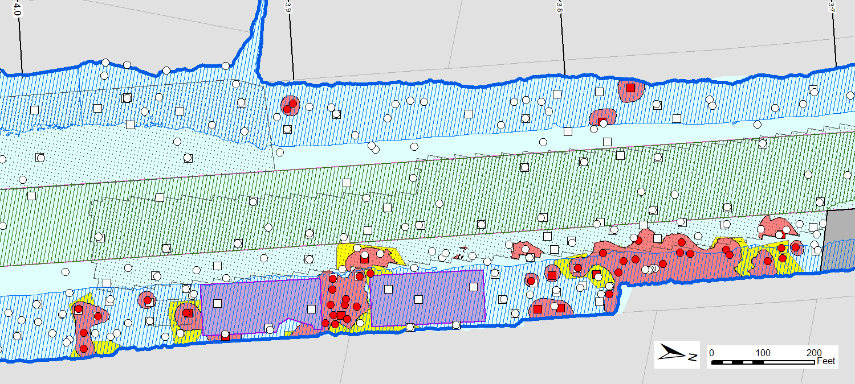
Combined PCBs + Other COCs
RAL Exceedance Areas
PCBs
(50% Indicator Probability)
Other COCs
(Thiessen Polygons)
Tar-Like
Material
P a r k
W a t e r f r o n t

Slide 13
Phased Data Collection
Data collected in three PDI phases to refine geostatistical interpolation after each phase and better identify data gaps to inform subsequent data phases
  Phase I: Define horizontal extents
  Phase II: Refine horizontal extents, vertical data collection, and engineering data
  Phase III: Address design data gaps and increase confidence level

Slide 14
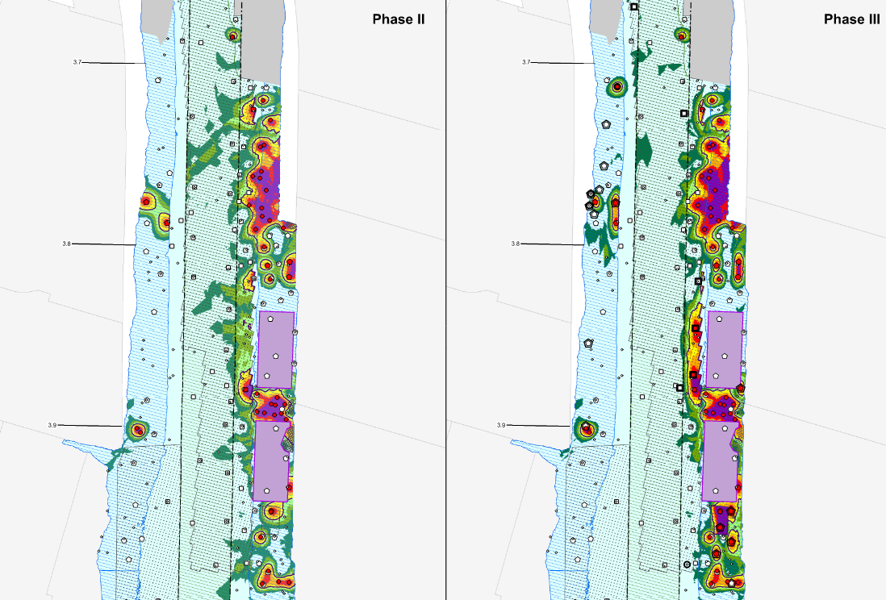

Slide 15
Engineering Considerations

Slide 16
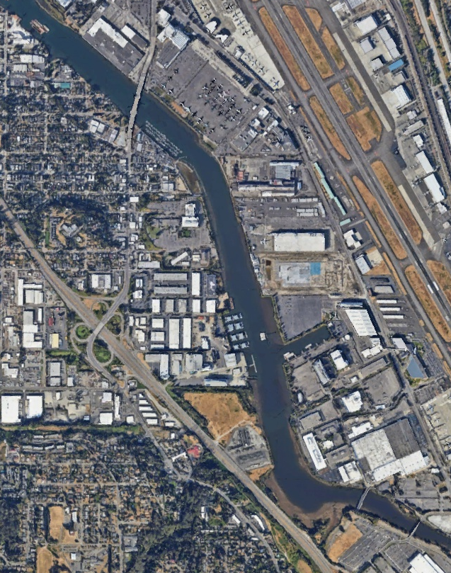
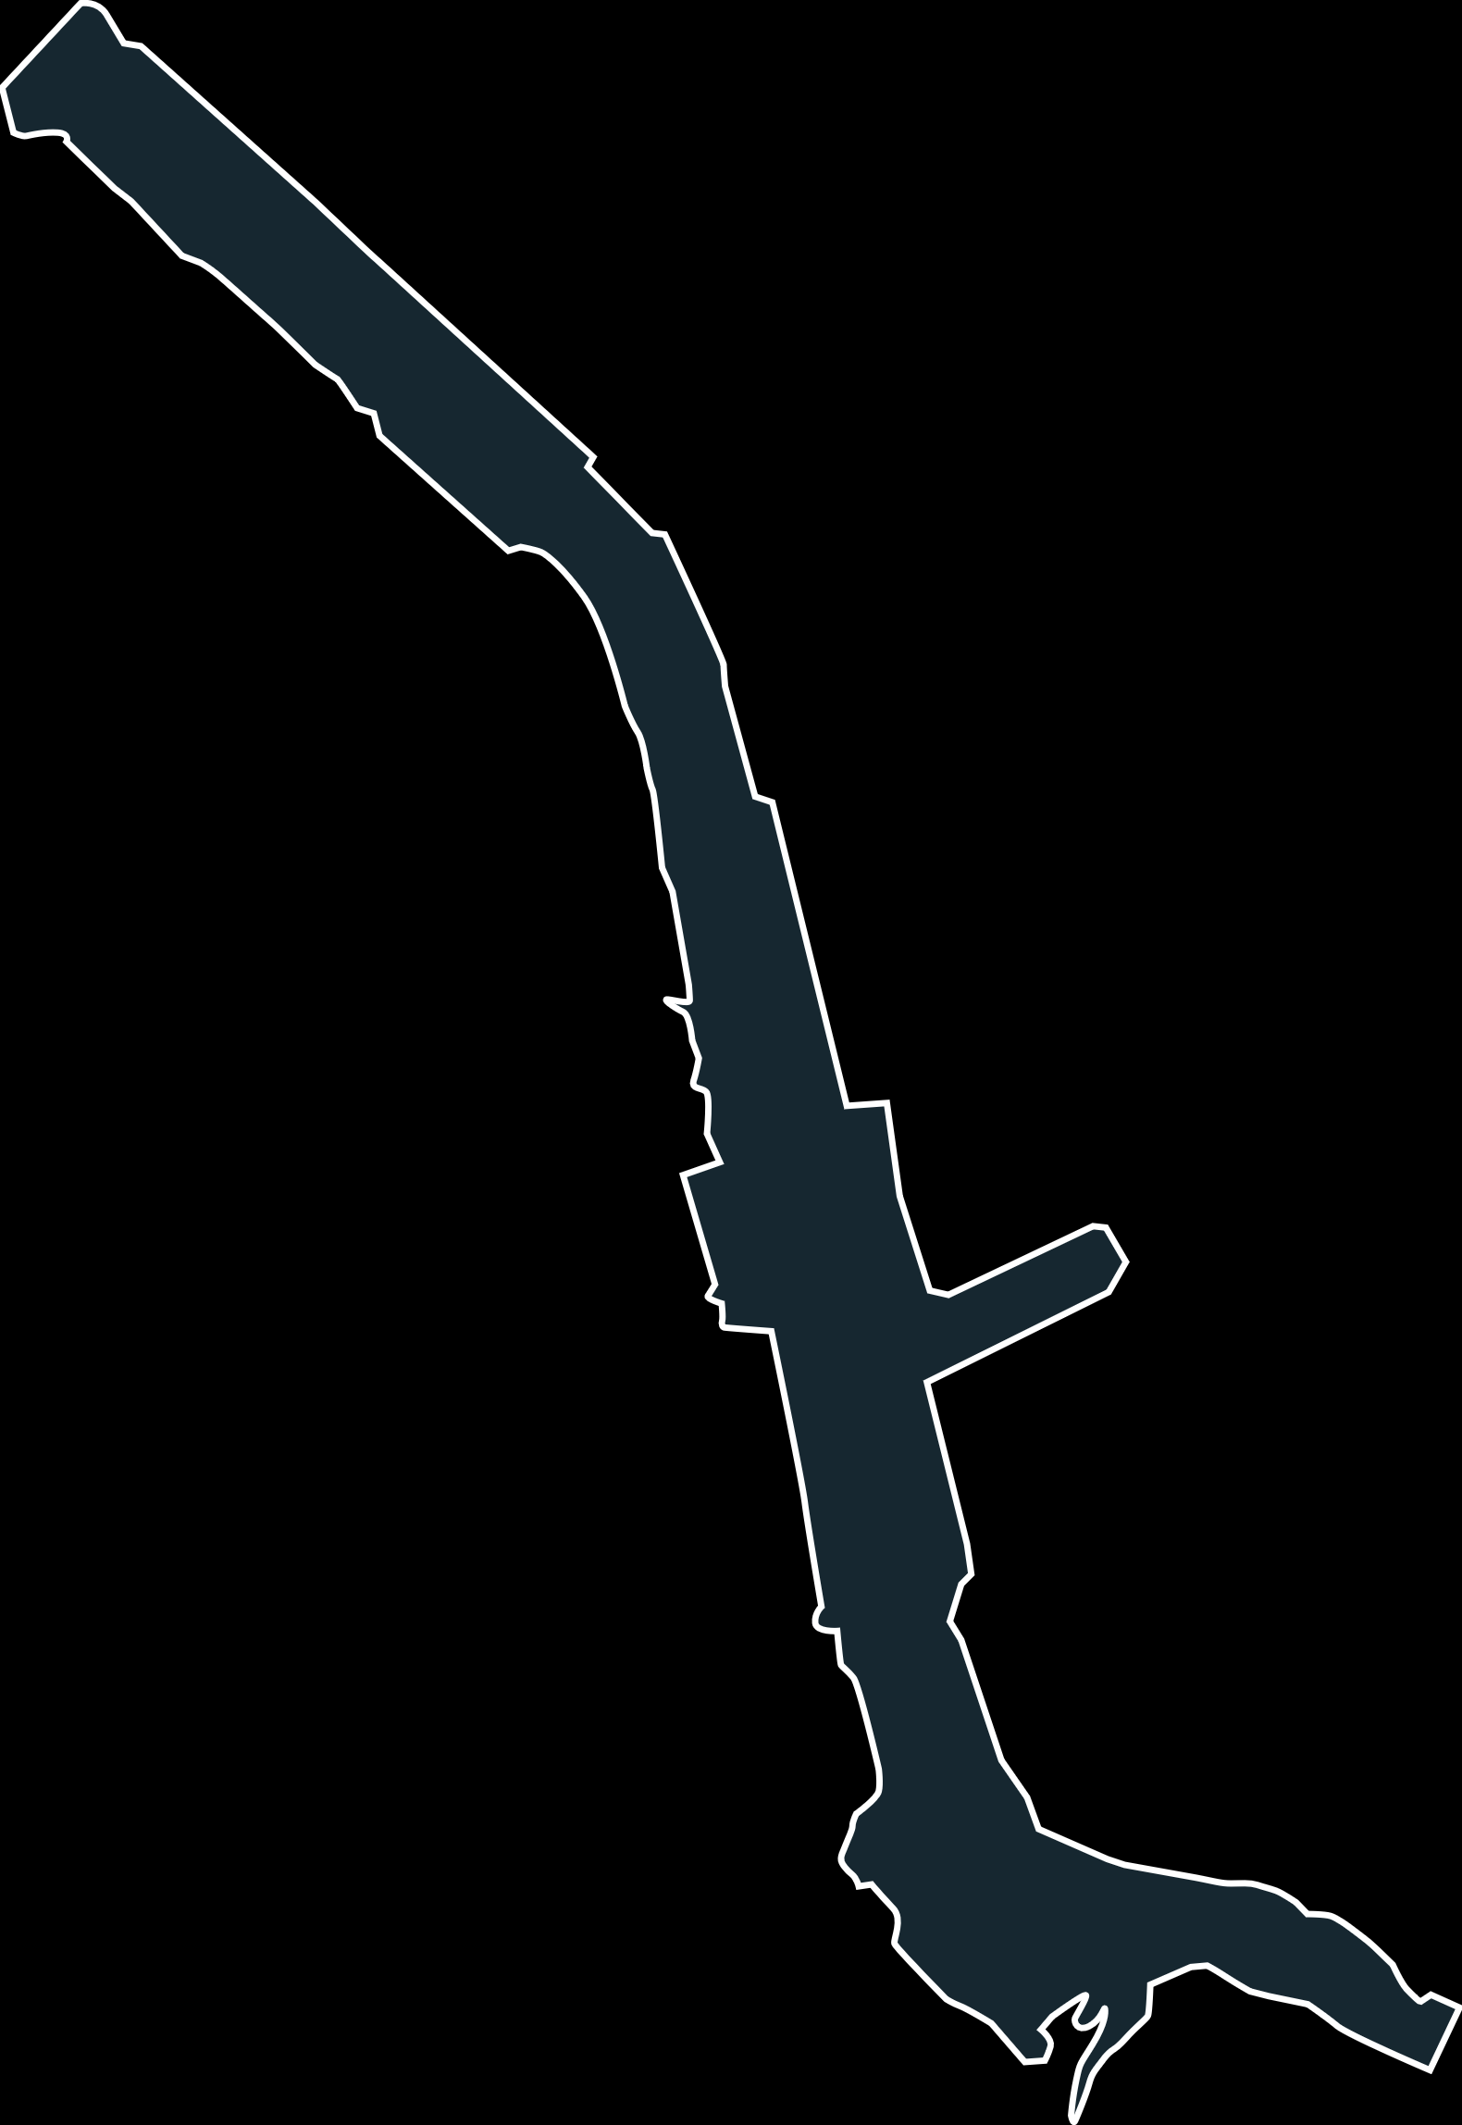
Remedial Action Area Development
Geometry
Site physical conditions
Operational and administrative considerations
Review of data interpolation uncertainty
Constructability and recontamination risk minimization

Slide 17
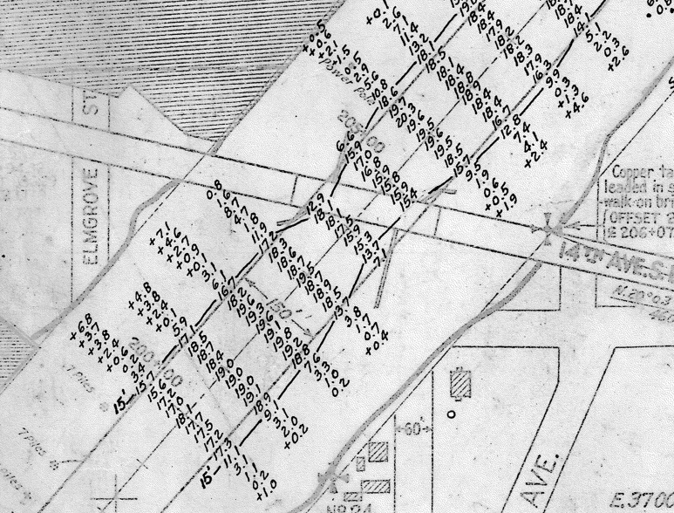
Development of RAAs: Site Conditions
Geotechnical stability
Offsets from structures, utilities
Historical dredging
Historical dredging bathymetry data from 1958 dredging event by USACE

Slide 18
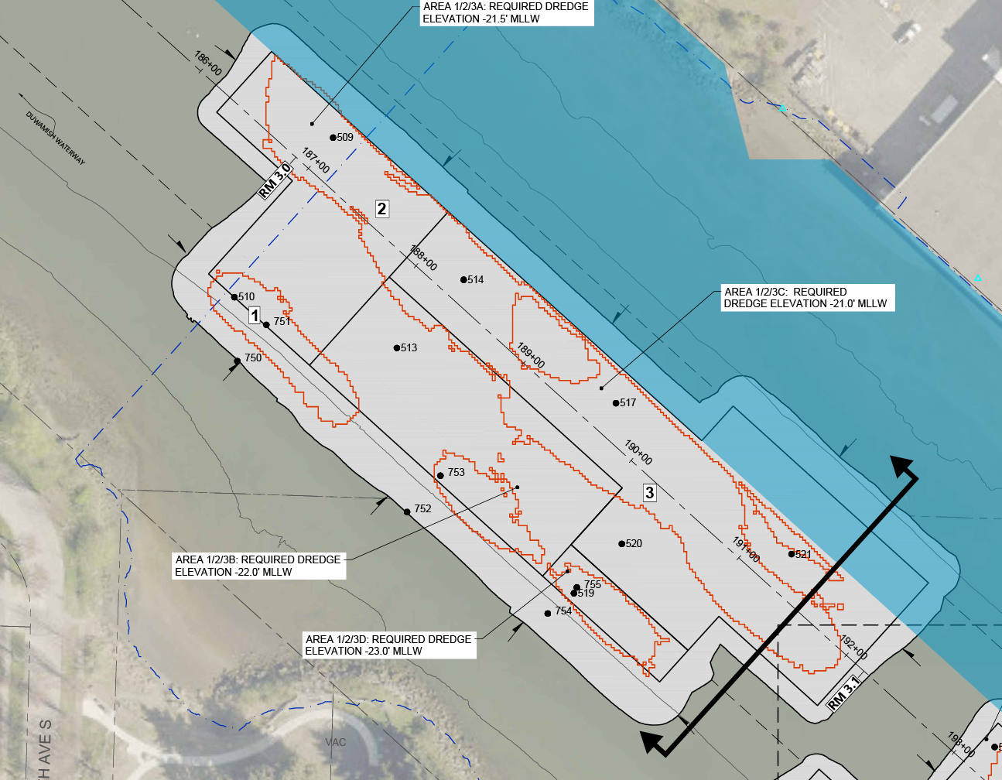
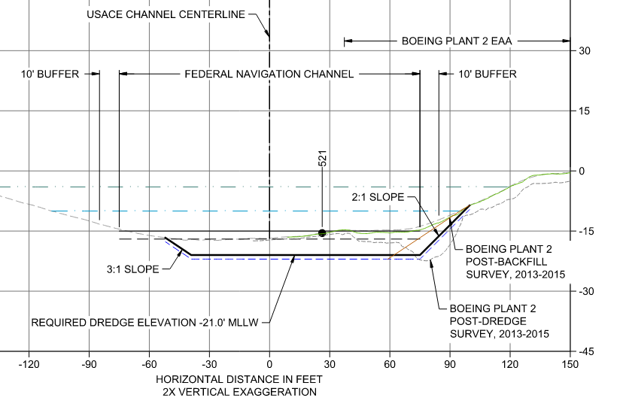
Development of RAAs: Operational/Administrative
EAAs, Ecology-Led Upland Cleanups, Habitat Areas, ROD Requirements
Cross section with dredge prism compared to early action area dredging as-built

Slide 19
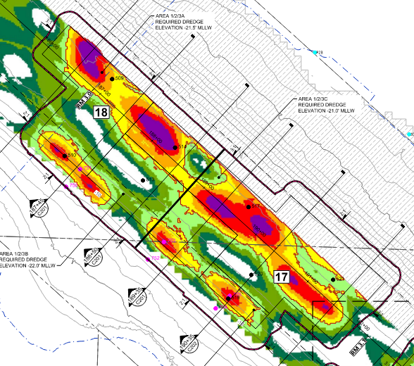
Development of RAAs: Interpolation Uncertainty

Slide 20
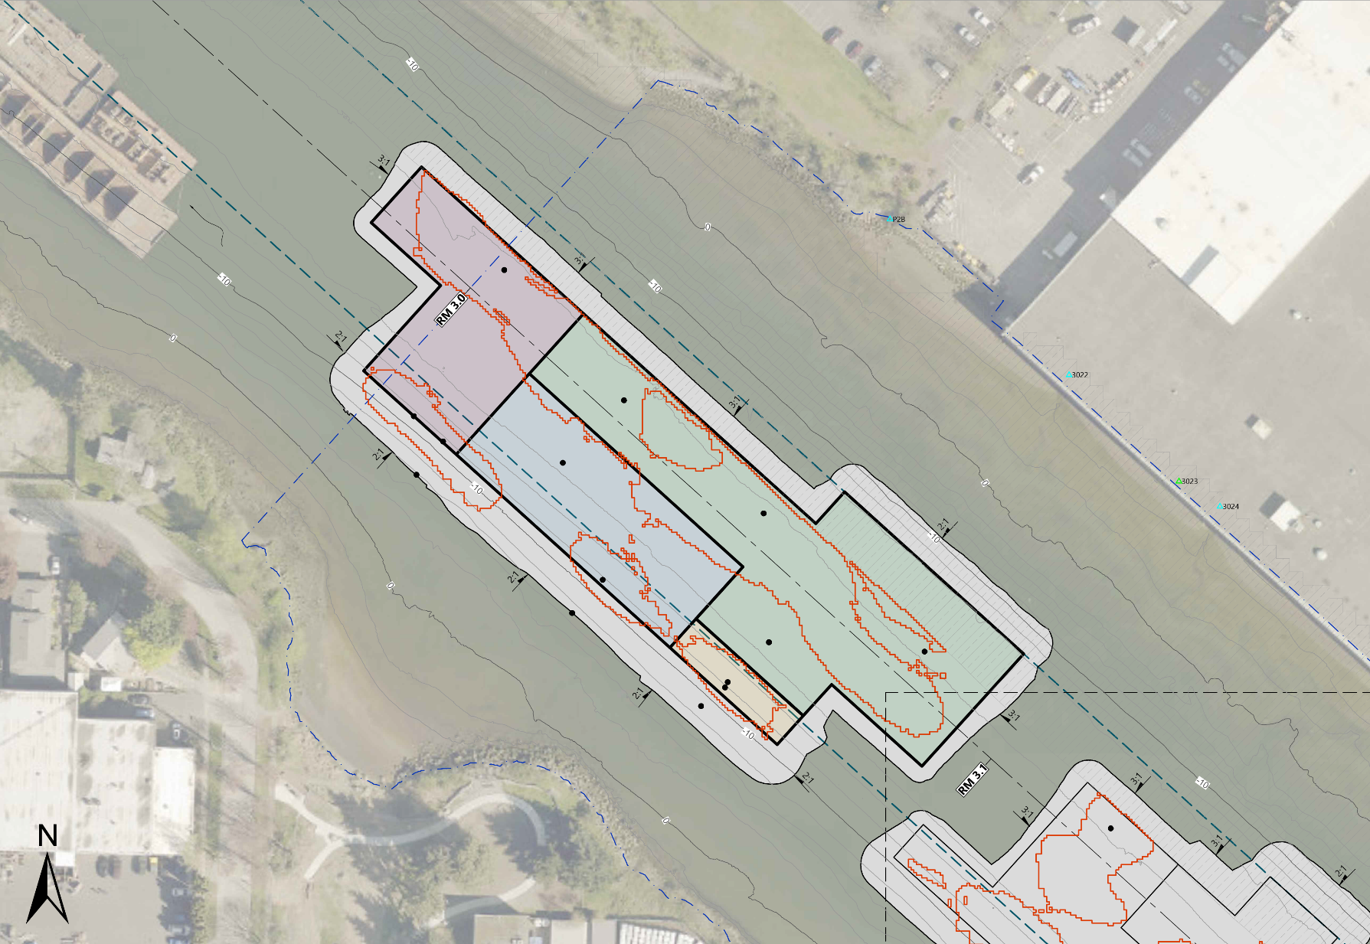
Development of RAAs: Constructability and Recontamination Risk Minimization
Area A: Required Dredge Elevation –21.5’ MLLW
Dredge Sideslope
Area C: Required Dredge Elevation –21.0’ MLLW
Area B: Required Dredge Elevation –22.0’ MLLW
Area D: Required Dredge Elevation –23.0’ MLLW

Slide 21
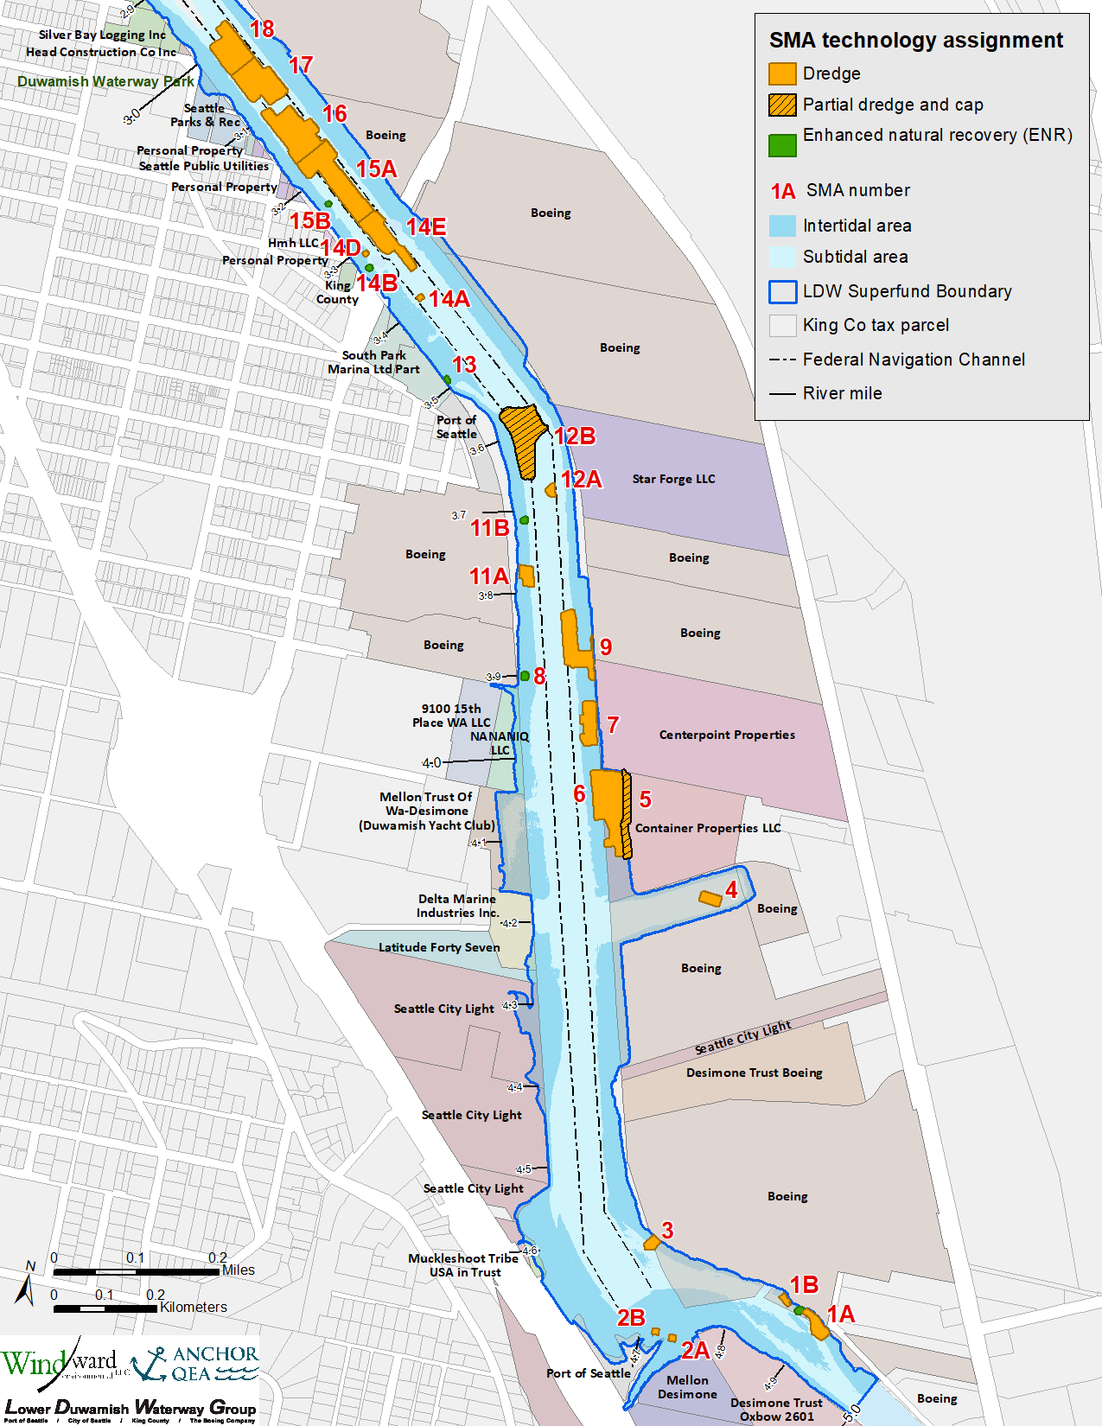
Geostatistical interpolation is a powerful tool that can be integrated with phased PDI data collection and traditional engineering design considerations to manage uncertainty
Interpolation
  Areas with RAL exceedances = 7.6 acres
Engineering considerations
  Remedial Action Areas = 15.1 acres

Slide 22
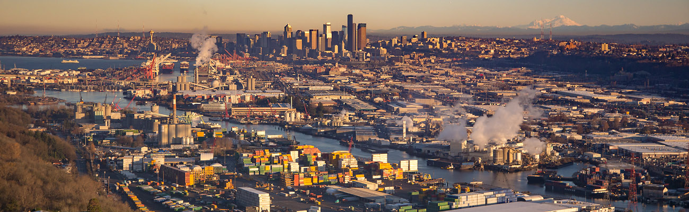
Questions?

Slide 23
Anchor QEA and Windward, 2022. Pre-Design Investigation Data Evaluation Report for the Lower Duwamish Waterway Upper Reach. Final. Submitted to EPA July 15, 2022.
Anchor QEA and Windward, 2024. 100% Remedial Design Basis of Design Report: Appendix A – Pre-Design Investigation Phase III Data Report for the Lower Duwamish Waterway.
EPA, 2014. Record of Decision. Lower Duwamish Waterway Superfund Site. U.S. Environmental Protection Agency Region 10. November 2014.

Slide 24


Katy
Gross, PE
Managing Engineer
kgross@anchorqea.com

