Slide 1
Can Buried Contamination Remain in Place? A Multiple-Lines-of-Evidence Approach to Evaluating Physical and Chemical Stability
Presented by: Julia Fitts, LG, Anchor QEA
Collaborators: Amanda Shellenberger, PE; Deirdre Reidy; and
Eli Patmont, Anchor QEA
Notes:
Hi, I’m Julia Fitts with Anchor QEA and I’m here to talk about a MLOE approach the Port of Portland used to evaluate whether buried sediment contamination can stay in place.

Slide 2
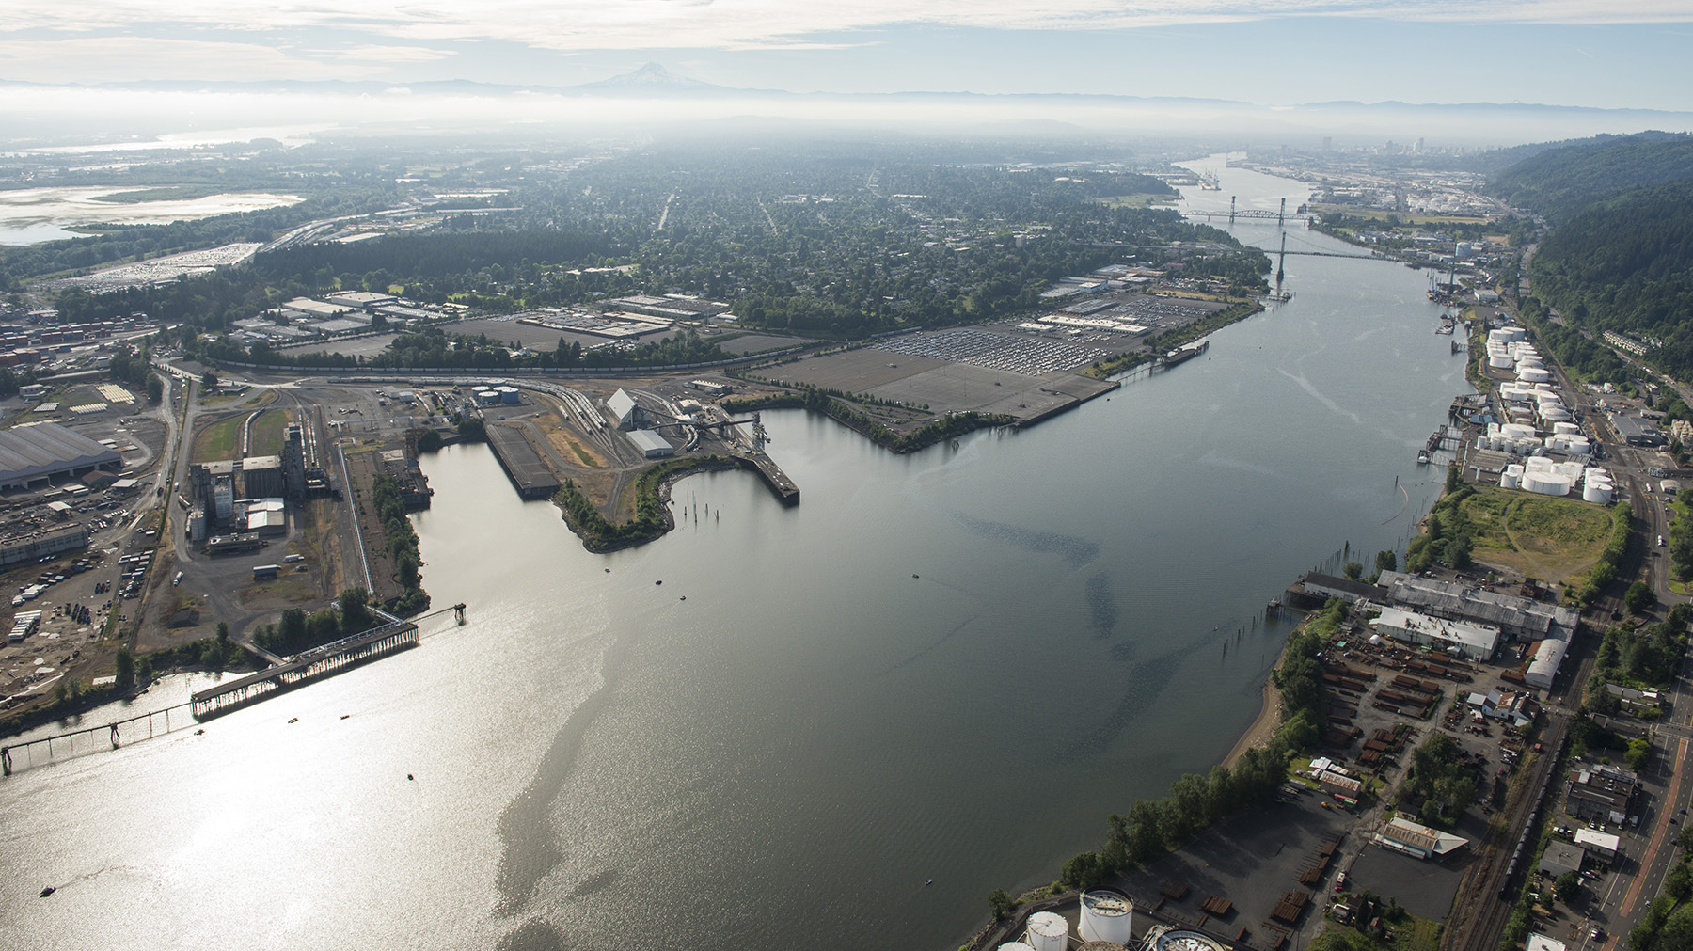
Figure 1: Port of Portland Terminal 4
Figure 1: Port of Portland Terminal 4
Notes:
The Port of Portland is designing a sediment remedy at its Terminal 4 marine facility in Portland, Oregon, which is shown here in the center of this photograph. The T4 site is part of the larger Portland Harbor Superfund site and is located on the east bank of the Willamette River between river miles 4.2 and 5.0. EPA issued a Record of Decision for the Portland Harbor Superfund Site in 2017.

Slide 3
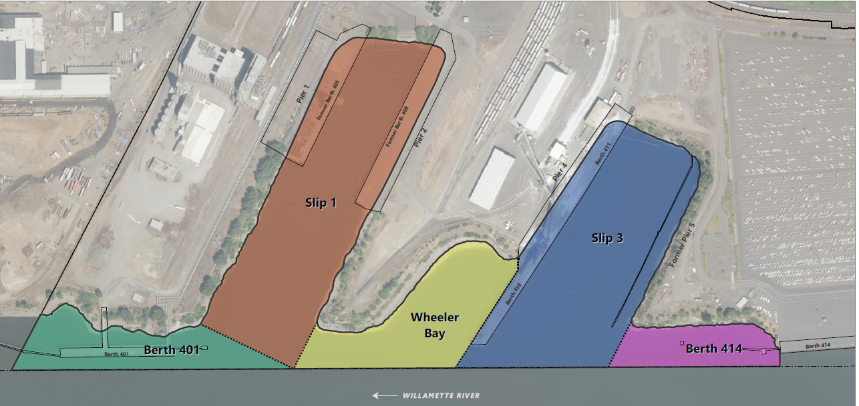
Terminal 4 – Portland Harbor Superfund Site
Figure 2. T4 Site
Notes:
The T4 Site consists of the following site subareas:
• Berth 401 and Berth 411 face the nav channel and are used by deep draft ocean-going vessels. This berth is regularly maintenance dredged
- Slip 1 is currently inactive with no existing water-dependent use, and future use may include barge use.
• Wheeler Bay is a shallow bay with no existing or anticipated future water-dependent use.
• Slip 3 includes Berths 410 and 411 on its north side; these berths are the main sites of active marine operations, serving deep-draft oceangoing vessels 80% of the year and these berths are regularly maint dredged. The south side of Slip 3 is inactive.
Historical industrial operations, including pencil pitch offloading, ore transloading and petroleum seepage from upland fuel pipelines, contributed to contamination observed in site sediments. The primary Site COCs include PAHs, PCBs, D/Fs and total pesticides DDx.

Slide 4
Objective: Delineate Sediment Management Areas (SMAs)
Compare Sediment Concentrations to RALs/PTW
Core Is Outside SMA
No
Buried Contamination Evaluation
Physical stability
Chemical stability
Do buried contaminated sediments have potential to be exposed?
No
Surface
Sediment Above RAL/PTW?
No
Subsurface
Sediment Above
RAL/PTW?
Yes
Yes
Yes
Include Core in SMA
Notes:
The Portland Harbor ROD identifies the sediment remedial action levels (RALs) for a subset of contaminants of concern (COCs) to focus the remedy
Sediment Management Areas, or SMAs, are areas where active remediation is required to achieve the RAOs
SMAs are defined using the process shown on this flow chart. As you can see, surface sediment (defined as sediment in the top 30cm) with concentrations above the RALs/PTW are automatically included in an SMA.
For areas where surface sediment is below RALs/PTW but subsurface sediment exceeds, there is a process to assess whether buried contamination could be exposed.
According to EPA’s Buried Contamination Guidelines for the Portland Harbor Site (released in 2022), to leave buried contamination in place, conservative physical and chemical stability evaluations must show that the buried contamination will not impact future RAO achievement.
These evaluations, and the process we used at T4, is the focus of my talk today.

Slide 5
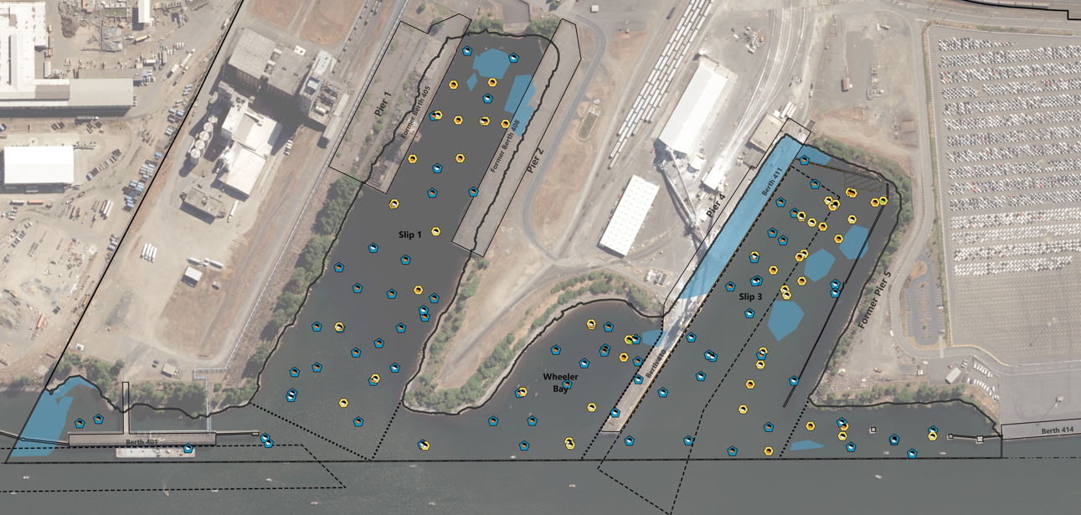

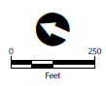
Buried Contamination
Figure 3. Locations with Buried Contamination
Notes:
Surface SMAs are the light blue areas. These are areas where surface sediment concentrations exceed a RAL or PTW threshold.
Subsurface sediment core locations are shown as the circles – the blue symbols are locations with NO buried contam.
The yellow symbols represent cores with buried contam (i.e., one or more subsurface interval exceeds a RAL or PTW).
Sediment stability is a particularly important issue at T4 given that natural recovery has been observed throughout the T4 Site, resulting in multiple areas of buried contamination. Out of 148 subsurface core locations collected within the T4 Site, 57 cores contain buried contamination located outside of a surface SMA.
As you can see, if all buried contam was included in the SMAs, they would be significantly larger. So, which ones need to be included in active remedial areas or SMAs?

Slide 6




Identify locations with buried contamination
Sediment Stability Evaluation
Evaluate physical stability
Evaluate chemical stability
Consider uncertainty in the evaluations
Notes:
The steps to the sediment stability evaluation are shown here. We’ve already identified the locations with buried contam, so next we’ll talk thru the lines of evidence approach for assessing the phys & chem stability, including a consideration of the uncertainty in these evaluation.

Slide 7
Physical Stability Evaluation
Evaluate the potential for exposure of buried contamination due to disturbances from:
  Large flood events (100-year event)
  Wind- and vessel-generated waves
  Vessel propwash
  Earthquakes and slope instability
  In-water construction or maintenance activities
  Impacts of climate change and other anthropogenic impacts expected due to current or future site uses
Notes:
EPAs Buried Contam Guidelines provide a framework for sed stability evaluations using a lines of evidence approach that considers uncertainty in the evaluations when determining whether buried contam may be exposed in the future. This list includes the potential sediment disturbance mechanisms which could undermine sediment phys stability and result in exposure of buried contam. We’re going to touch on most of these evaluations that were performed at the T4 site.
USEPA recommends parties determine physical stability consistent with processes outlined in the Technical Guidelines on Performing a Sediment Erosion and Deposition Assessment (SEDA) at Superfund Sites (USACE 2014) and evaluate chemical stability using chemical fate and transport modeling. A SEDA involves using a systematic approach that identifies the processes and mechanisms that might result in erosion; determines the most appropriate methods to use in assessing sediment resuspension, transport, and deposition; and quantifies sediment resuspension and deposition rates under varying flow conditions.

Slide 8
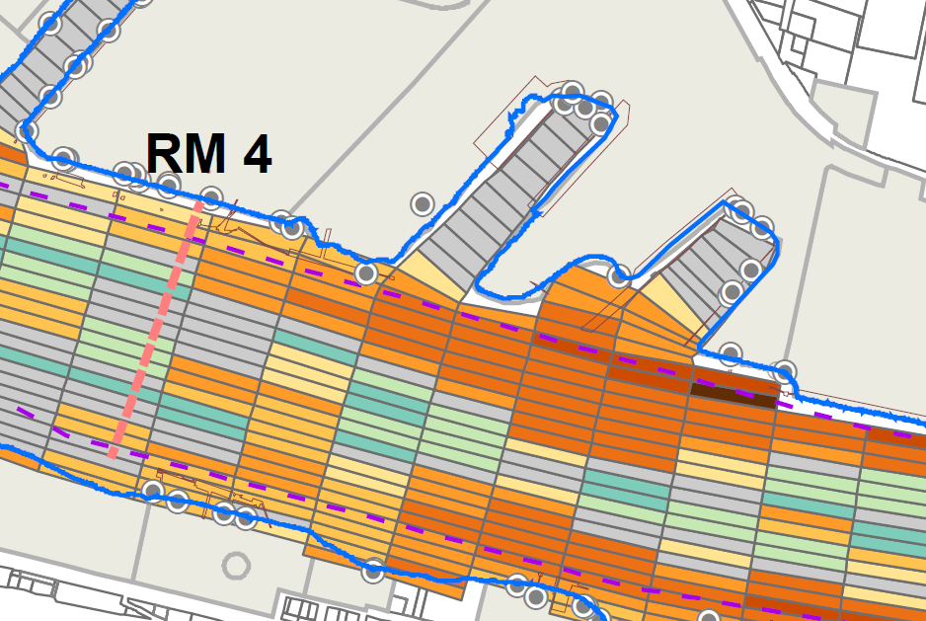
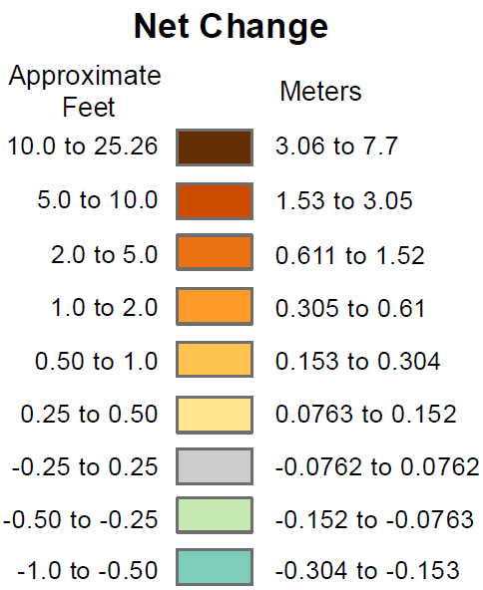
Large Flood Events (100-Year Events)
Deposition
No net change
Scour
Map 3.1-8a from Final Portland Harbor RI (EPA 2016)
Figure 4. Net Change Predicted During Large Flood Events
Notes:
In the PH RI, sediment disturbance during extreme flood events was predicted using a range of high-flow modeling simulations; the results of which you can see on the figure here.
In this figure, grey represents areas where negligible to no net change is expected
blue/green cells are areas where flood scour is predicted and the yellow and orange cells represent areas where net deposition is predicted during an extreme flood event.
As you can see here, much of the T4 site is represented by either no net change or deposition during large flood events.
In addition to using modeling predictions like these, sediment stability during high-flow events is further supported by direct observations of sediment conditions following the last major flood event in the Willamette River in 1996, which did not identify any areas of significant flood scour.

Slide 9
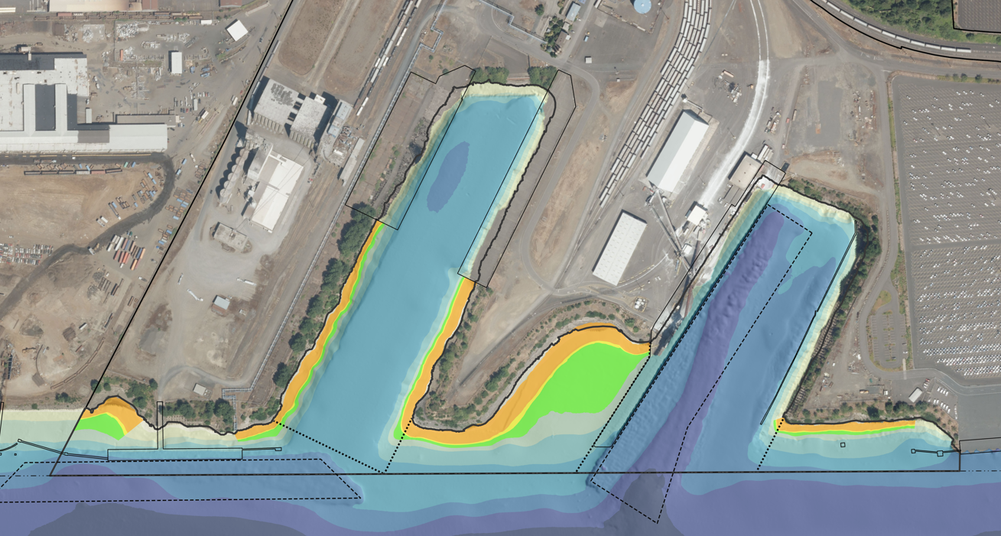
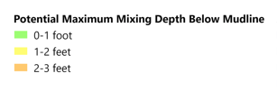

Wind- and Vessel-Generated Waves
Figure 5. Maximum Mixing Depth Due to Wind- and Vessel-Generated Waves
Notes:
Another line of evidence is the site-specific analysis of wind and vessel-generated waves which can lead to sediment disturbance and mixing.
This analysis uses modeling to predict the maximum disturbance depth during a range of conservative conditions, including extreme wind events and low water river conditions.
An example of this analysis is shown on this figure, which shows bathymetry in blue and potential maximum mixing depths in green, yellow and orange.
As expected, the effects of wind waves and vessel wakes are greater in shallower areas (see WB) and are largely a function of water level and wave height.
It’s also important to note that, even in areas subject to wind wave action - there can still be deposition – and this analysis is just a prediction of disturbance depth under conservative conditions and water depths.

Slide 10
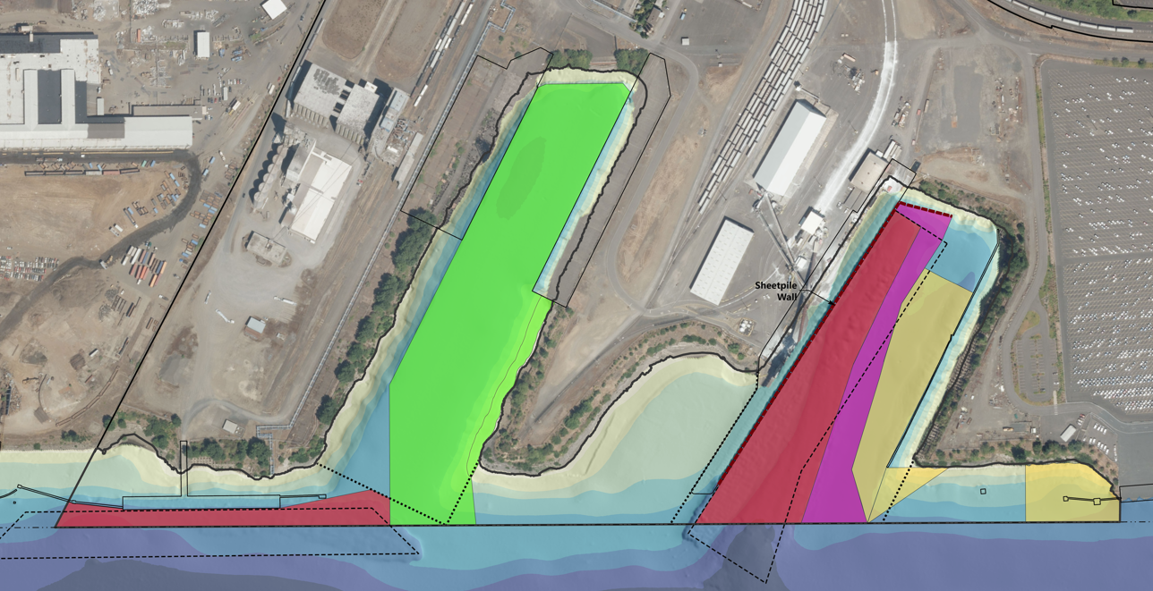
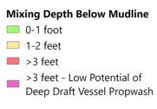
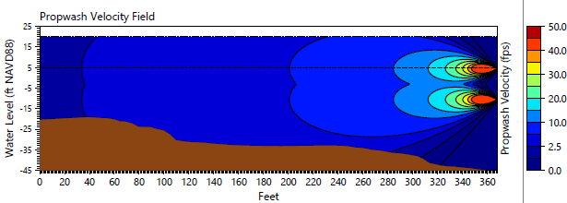
Vessel Propwash
Evaluation of potential erosion from propwash based on
  Site-specific vessels and vessel operating data
  Water depth
  Sediment grain size and corresponding thresholds of sediment motion
Figure 6. Propwash Mixing Areas and Depths
Figure 7. Propwash Model Output
Notes:
Another line of evidence is the evaluation of sediment disturbance due to vessel propwash.
Similar to the evaluations we just discussed, propwash analyses use modeling to predict propwash forces and the maximum disturbance depth using a range of site-specific vessels and prop sizes, vessel operating information (horsepower, docking orientations), site bathymetry, and surface sediment GS characteristics.
At Terminal 4, for example, we found that certain site areas were subject to potential disturbance from propwash.
As expected, these include active berth areas used for deep-draft vessels and zones where tugboats maneuver those vessels. Outside of those areas, the maximum predicted sediment disturbance depth was typically 1 to 2 feet.
One important thing to consider in these analyses is that the max depth of disturbance doesn’t necessarily equal the max depth of EROSION.
This is because prop wash doesn't just scour down to that maximum depth. In many instances, it can result in mixing and – depending on how sheltered the area is, redeposition.

Slide 11
Other Physical Stability Evaluations
Earthquakes
Slope instability
In-water construction or maintenance activities
Climate change resiliency
Current and future site uses
Notes:
As noted in EPA’s guidance there are several physical stability evaluations that serve as important lines of evidence in the buried contamination analysis, which are listed here. In the interest of time, I’m not going to talk further about these.

Slide 12
Uncertainty Considerations
EPA’s Buried Contamination Guidelines provide the general framework for physical stability evaluations using a lines-of-evidence approach
There is a potential of compounding conservativism when using worst-case assumptions and overly conservative assumptions in modeling evaluations
A weight-of-evidence approach that also includes empirical data can be used to obtain a balance of appropriate and realistic uncertainty in these evaluations
Notes:
As we discussed for a few examples, many of these evaluations include conservative assumptions (such as propwash evaluations using tugboat prop forces at 100% power at low water conditions, which is unrealistic.
This can compound across the diff evaluations and may result in overly conservative predictions of the sediment disturbance depth.
One way to strike a balance is to include empirical (or site specific) data – and ask ourselves, “are we actually seeing sediment disturbance at these depths at our site?’
So that’s what we did next.

Slide 13
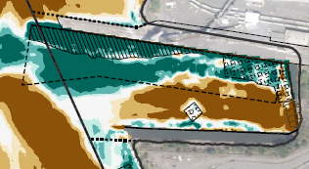

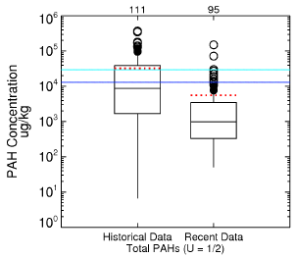
Empirical Lines of Evidence
Bathymetric change
  Identified areas with consistent deposition or erosion over time
Sediment data
  Recent versus historical surface sediment concentrations
  Subsurface sediment core profiles
  Depth and elevation of exceedance
  Statistical evaluation of contaminant trends
Notes:
Some examples of empirical lines of evidence include an evaluation of bathymetric change and site sediment data.
Comparing bathymetric surveys from multiple years can identify areas with consistent deposition or erosion (and not just net dep or erosion) which should be considered in stability analyses.
One thing we saw in this example (which is not uncommon) is that propwash and net deposition can occur in the same areas.
Site sediment data are also an important consideration.
Documenting natural recovery, specifically, decreasing sediment concentrations over time, is a primary line of evidence for sediment stability.
When u think about it, it makes sense that – if subsurface contamination is being disturbed and exposed, you won’t see a clear trend of natural recovery in sediment concentrations.
To assess whether natural recovery is occurring, you can perform a statistical evaluation of sediment trends, such as recent versus historical surface sediment concentrations
You can also look at vertical chemical core profiles to see if there’s a pattern of decreasing concentrations or evidence of mixing.

Slide 14

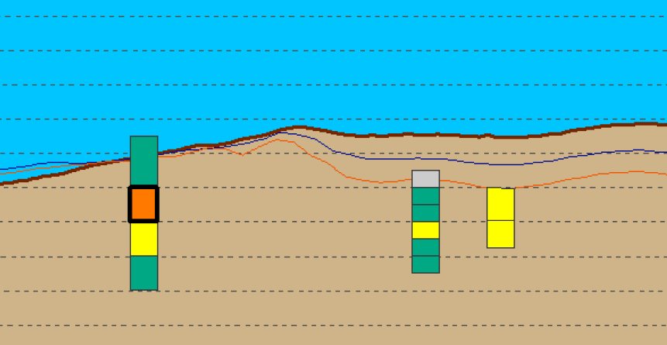
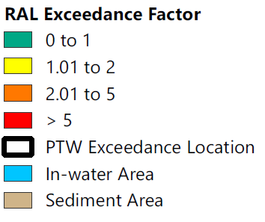
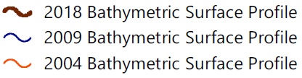
Buried Contamination Example
Area of consistent, net deposition
Notes:
To further illustrate this point, here is an example of a cross section of a few sediment cores with RAL exceedances shown in yellow and orange.
There are different bathymetric surface profiles are also shown by the red, blue and brown lines. In this example, some site areas show consistent elevations over time whereas others show consistent, net deposition.
In these areas, the physical stability of buried contamination can be further evaluated using more recent core data to document the current depth of exceedances and whether natural recovery is occurring.
This type of empirical site data, used as part of a weight of evidence approach, is important to understanding and balancing how realistic the other stability evaluations are.

Slide 15
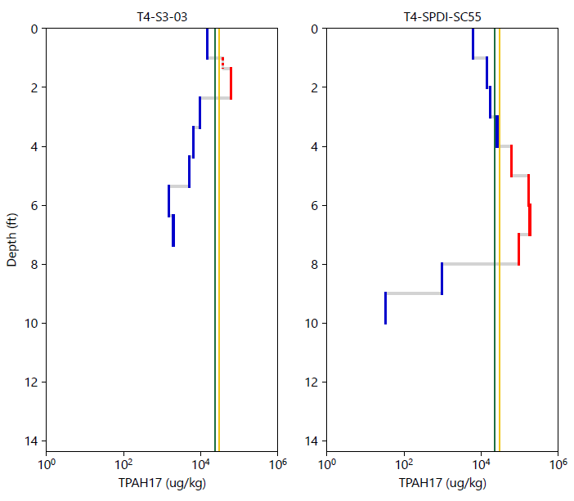

Collocated
Core Profiles
2006 Core
2023 Core
Non-detect
Detect under RAL and PTW
Detect over RAL or PTW
CUL
RAL
PTW Highly Toxic Threshold
Notes:
As a companion to that BC example, I also wanted to show a couple of collocated core profiles, in this case showing tPAH conc on the x axis and depth on the y axis. What you can see here are TPAH concentrations exceeding the RAL (shown as the red segments) and below the RAL (shown as blue segments), As part of the sed stability eval, we reoccupied some older core locations to verify whether BC remained in place and was phys stable. The newer core, on the R, shows deeper BC which provides additional empirical evidence of sed stability over time.

Slide 16
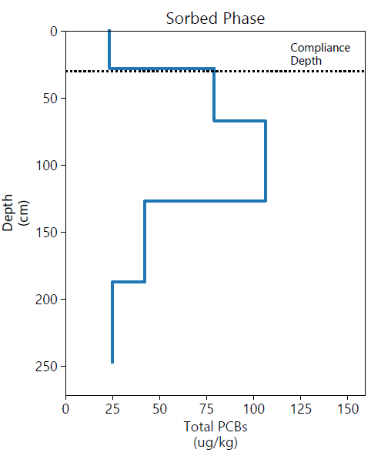
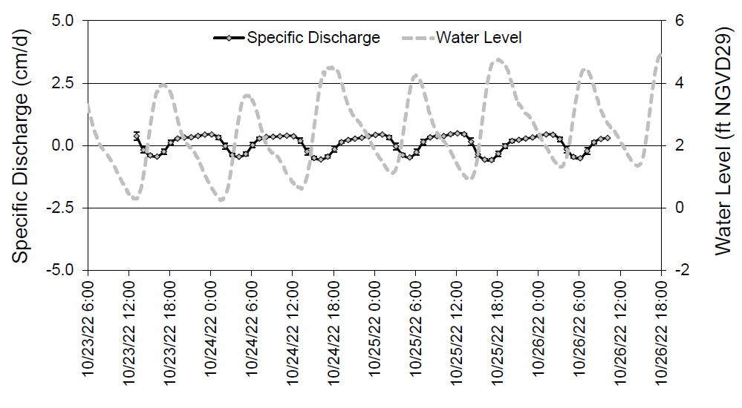
Chemical Stability Evaluation
Dissolved phase contaminant transport modeling used to quantify the migration potential of COCs via porewater to surface sediment within 100 years
Seepage meters used to characterize groundwater seepage rates
Collection of collocated sediment and porewater samples to calculate
site-specific partition coefficients
Notes:
Moving onto the chemical stability evaluation, which was performed to identify whether buried contam has the potential to recontaminate surface sediments to an actionable level in 100 years), thru dissolved phase migration.
To do this, dissolved phase contaminant fate and transport modeling was used to quantify the migration of COCs via porewater to surface sediment within a 100-year timeframe at locations with buried contam. We performed this modeling at all 57 core locations with BV that are located outside of a surface SMA.
To support the modeling, we used seepage rates calculated from site-specific seepage meter data and site-specific partition coefficients calculated for each COC from paired porewater and sediment samples.

Slide 17
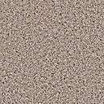
Chemical Fate and Transport Modeling
The CapSim modeling included
  Dynamic (time variable) modeling of COC concentrations
  Dispersion, diffusion, bioturbation, and porewater exchange at the sediment/water interface
  Site-specific contaminant depth profiles and sediment properties with depth
  Site specific partition coefficients and seepage rates
Surface Water
Sedimentation
Erosion
Surface Exchange
Sediment
Bioturbation
Partitioning
Sorbed
Phase
Porewater
Dissolved
Phase
Advection
(Groundwater Flux)
Diffusion and
Dispersion/
Tidal Mixing
Reactions
Notes:
1-D numerical modeling was conducted using CapSim which includes
time-variable modeling of contam concentrations throughout the sediment column
Multiple sediment processes
Site-specific contaminatnt depth profiles and sediment properties (such as OC content and porosity) with depth
Site specific partition coefficients and seepage rates
Conservatively, biodegradation and sed deposition, which are known ongoing processes at the site, were not included in this modeling evaluation.

Slide 18
Modeling Approach and Considerations
All COCs measured in each core were simulated
Core depth profiles adjusted for sedimentation/erosion since collection (based on current bathymetry)
Evaluated model-predicted results for surface sediment in 100 years
  Are concentrations predicted to exceed RAL or PTW thresholds?
  Are concentrations predicted to increase by a magnitude greater than the sediment CUL?
Notes:
Surface sediment concentrations currently exceed long-term CULs for some chemicals or locations. Therefore, the criteria for evaluating whether site COCs at depth have
the potential to recontaminate surface sediments through dissolved phase migration to a level that would prevent achievement of the remedial action objectives in the future (i.e., 100 years) were based on how much it increased over the 100-year simulation.
The surface sediment concentrations at Year 0 (measured) were compared to the
surface sediment concentrations at Year 100 (predicted), and locations within the
magnitude of the CUL (or PQL in the case of D/F) were removed from the screening and
deemed chemically stable.

Slide 19
Additional Lines of Evidence
Based on modeling results, chemically unstable core locations were further evaluated using additional lines of evidence
  Age of data
  Magnitude of exceedance
  Bathymetric change over time (net deposition/erosion since sample collection)
  Collocated or nearby sediment data
  Evidence of natural recovery
  Spatial scale of applicable CULs
Notes:
As a final step in the chemical stability evaluation, once we determined thru modeling which locations were predicted to exceed w/in 100 years, we evaluated those locations against a few additional lines of evidence that are listed here.
Age of the data – many of the exceedances we saw are from cores that were collected 20+ years ago and are not observed at the same magnitude or depth in more recent sampling
That also related to bathymetric change due largely to deposition, as most of T4 is net depositional

Slide 20
Preliminary Results
A majority of T4 sediments – including areas with buried contamination outside of surface sediment SMAs- are physically and chemically stable, as evidenced by:
  High overall sedimentation rates
  Robust natural recovery processes
  Contaminant attenuation during groundwater transport
Notes:
In general, a majority of T4 sediments – including areas with buried contamination outside of surface sediment SMAs- are physically and chemically stable, as evidenced by:
High overall sedimentation rates as evidenced by bathymetric surveys over the past 15+ years
Robust natural recovery processes observed in dozens of sediment cores collected onsite over the past 20+ years
Contaminant attenuation during groundwater transport
and would be amenable to MNR or enhanced MNR in areas outside of active remediation areas (SMAs)

Slide 21
Summary
To evaluate the stability of buried contamination at T4, a multiple-lines-of-evidence approach was used that included both modeling and empirical data
This approach allows for a balance of appropriate and realistic uncertainty and avoids compounding conservatism when using
worst-case assumptions in the modeling evaluations

Slide 22


Julia
Fitts, LG
Principal Scientist
jfitts@anchorqea.com

