Slide 1
Use of Radiocarbon Data to Evaluate Sources of Carbon Driving Gas Ebullition in Newtown Creek
Presented by: Grace Weatherford, PE, Anchor QEA
Collaborators: Ann McNichol, PhD, Woods Hole Oceanographic Institute;
and David Glaser, PhD; Stu Messur; and Amy Corp, Anchor QEA

Slide 2
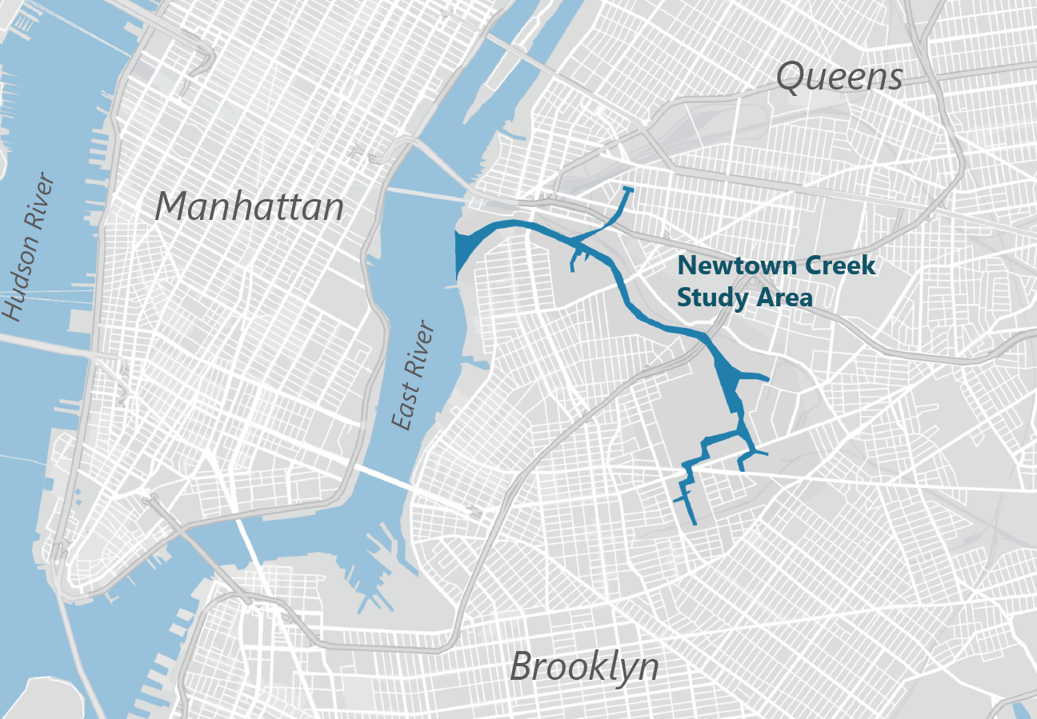
Newtown Creek
Dead-end tidal tributary to the East River located between the boroughs of Brooklyn and Queens, New York
Listed on the National Priorities List as a CERCLA (i.e., Superfund) site in 2010
Long history of municipal and private/industrial discharges and releases (such discharges comprise the largest source of freshwater flow)

Slide 3
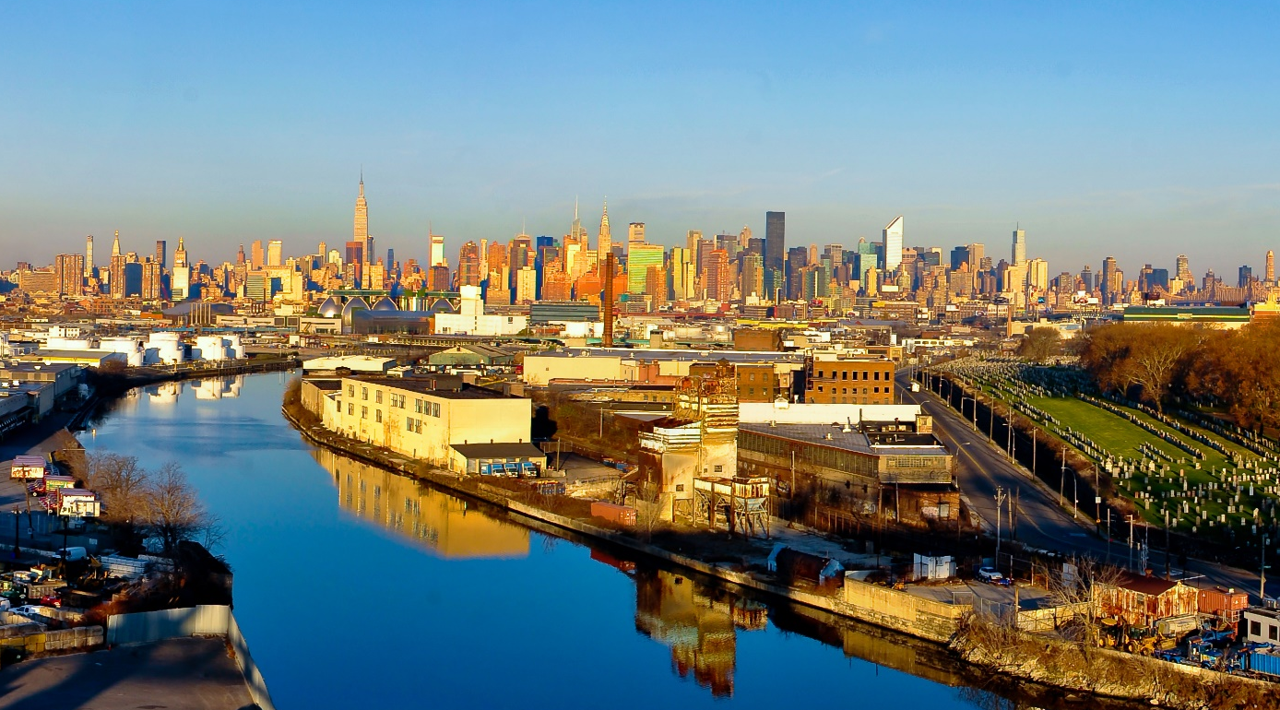
Photograph by Bill Rhodes
Photograph by Bill Rhodes
Notes:
Add Newtown photo here

Slide 4
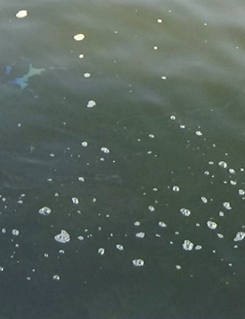
Ebullition
Gas ebullition was evaluated during the Newtown Creek Remedial Investigation/Feasibility Study (RI/FS)
Gas (mostly methane) is formed in sediments by the anaerobic degradation of labile organic carbon (e.g., methanogenesis)
Gas ebullition results when enough gas is formed that it can nucleate to form bubbles, grow, fracture the sediment, and escape to the overlying waterbody
Apparent ebullition at Newtown Creek

Slide 5
What are the sources of carbon driving ebullition at Newtown Creek?

Slide 6
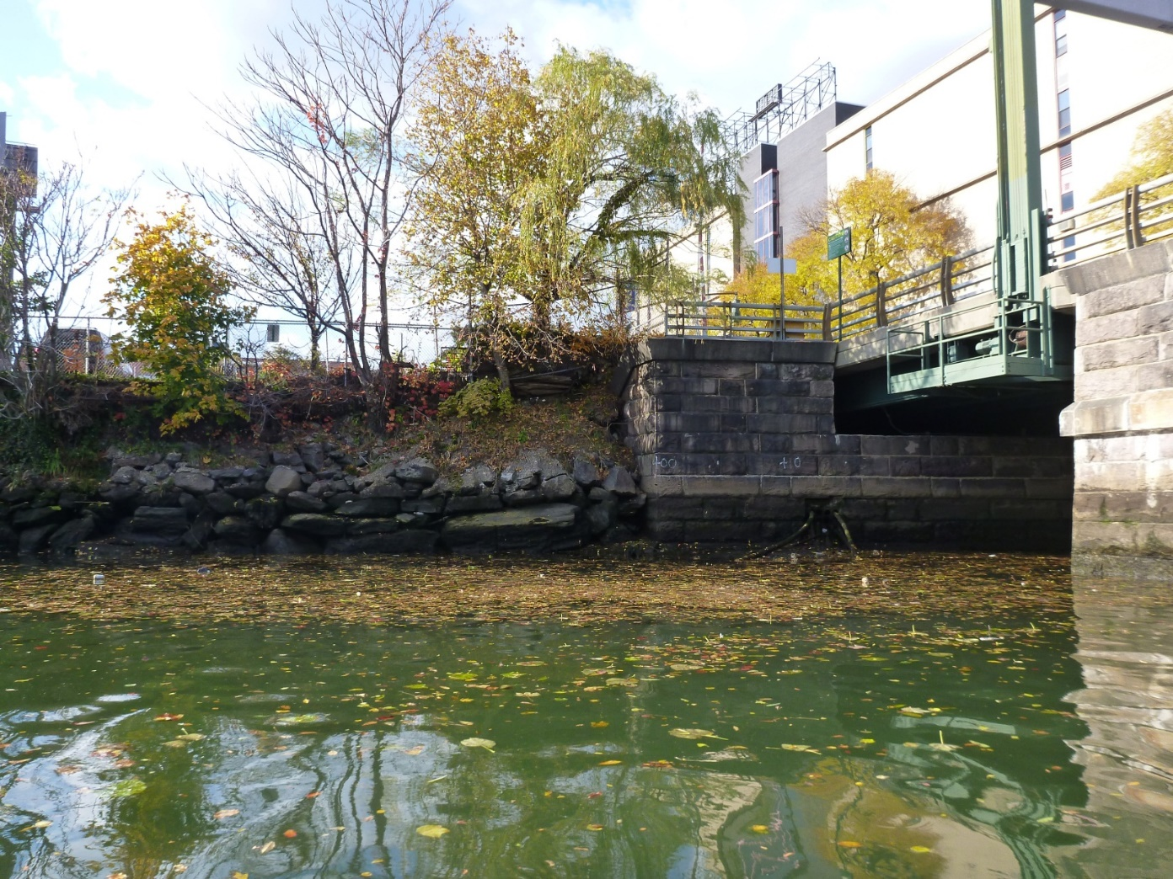
Sources of Carbon in Newtown Creek Sediment
Discharges of organic-rich materials (e.g., fecal matter and other anthropogenic organic matter from point source discharges, including combined sewer overflows [CSOs])
Other labile organic contaminants (e.g., unweathered nonaqueous phase liquid [NAPL])
Naturally occurring aquatic vegetation and organisms

Slide 7
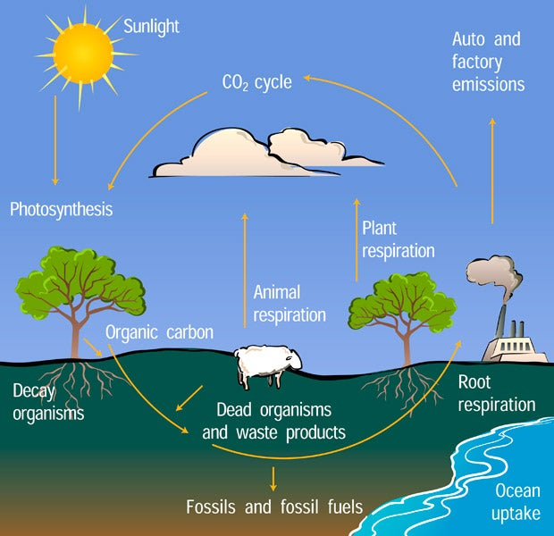
Radiocarbon (Carbon-14)
Carbon-14 (¹⁴C) is created in the atmosphere and taken up by living organic matter
  ¹⁴C in terrestrial organisms mirrors atmospheric ¹⁴C‐CO₂
  ¹⁴C in aquatic organisms mirrors ¹⁴C‐dissolved inorganic carbon (DIC) in water
When organisms die, interaction with the environment ceases and ¹⁴C decays
  Half-life of ¹⁴C is 5,730 years
  Material greater than approximately 60,000 years old (fossil or ancient carbon) has no detectable ¹⁴C
Carbon Cycle Diagram
Source: University Corporation for Atmospheric Research

Slide 8
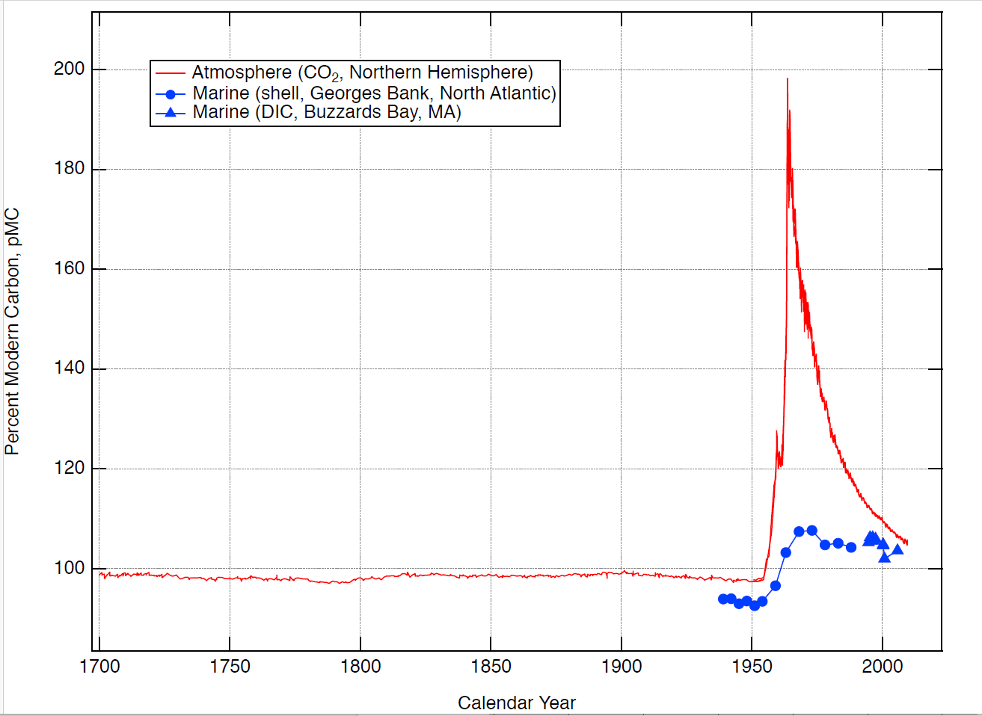
Present-day Carbon-14
Is a Mixture
Bomb¹⁴C
Present-day
Atmospheric ¹⁴C
Pre-bomb Atmospheric ¹⁴C
Note: Radiocarbon content is reported as percent modern carbon (pMC) relative to a standard that represents 1950 atmospheric conditions (pre‑atmospheric nuclear weapons testing)
Present-day
Marine ¹⁴C
Pre-bomb Marine ¹⁴C
Sources: Hua et al. 2013; Levin et al. 2010; Weidman and Jones 1993

Slide 9
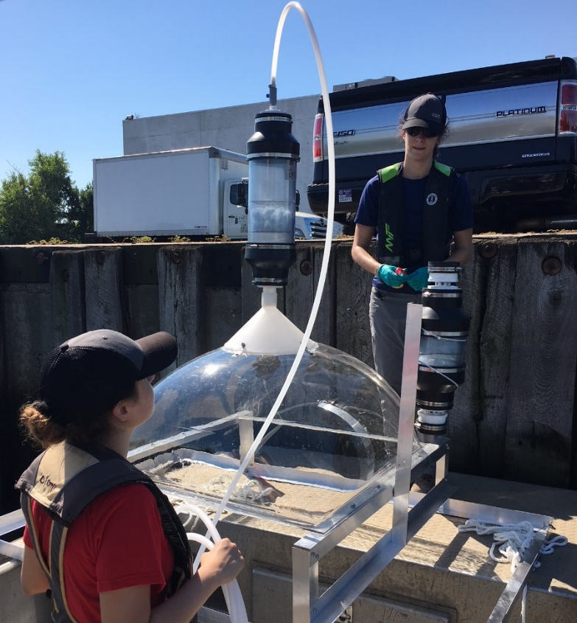

Newtown Creek Data Collection
Flux chambers were installed in locations where ebullition had been observed
Gas samples were collected daily during
spring tide events in July and October 2018
Samples were analyzed for ¹⁴C-CO₂ and
¹⁴C- methane (CH₄)
In two locations,¹⁴C was measured in collocated sediment samples

Slide 10
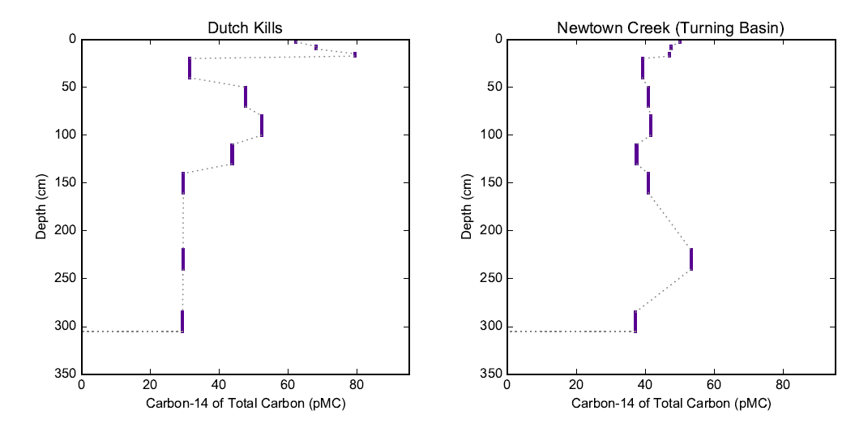
Carbon-14 Results in Sediment Samples
Sediment Samples | ¹⁴C - Total C (pMC) 0 to 17.5 cm | ¹⁴C - Total C (pMC) >17.5 cm
Arithmetic average | 59 | 40
Range | 47 to 79 | 29 to 53

Slide 11
Carbon-14 in Discharges
CSO samples collected during the Newtown Creek RI/FS were not analyzed for ¹⁴C
Studies (from the literature) conclude that municipal sewage contains a mixture of modern and fossil carbon
  Arithmetic average was calculated from 13 samples collected at
  8 facilities between 1998 and 2013
¹⁴C-DOC (pMC) | Nara et al. 2010 | Law et al. 2013 | Tseng et al. 2016 | Combined
Arithmetic average | 86 | 90 | 95 | 91
Range | 79 to 92 | 87 to 93 | 76 to 105 | 76 to 105
Note: ¹⁴C in one sample measured 150 pMC. Law et al. attributed this to the release of artificial ¹⁴C tracer waste.

Slide 12
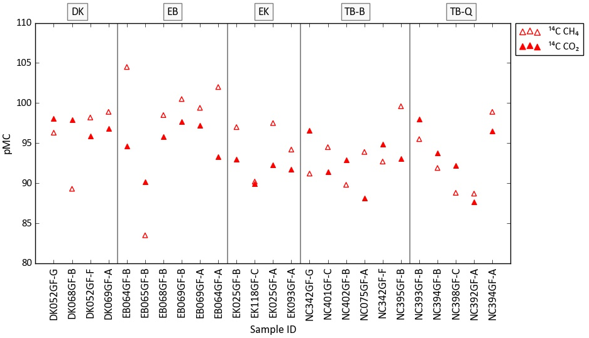
Carbon-14 Results in Ebullition Gas Samples
Gas Samples | ¹⁴C of CH₄ (pMC) | ¹⁴C of CO₂ (pMC)
Arithmetic average | 95 | 94
Range | 84 to 105 | 88 to 98

Slide 13
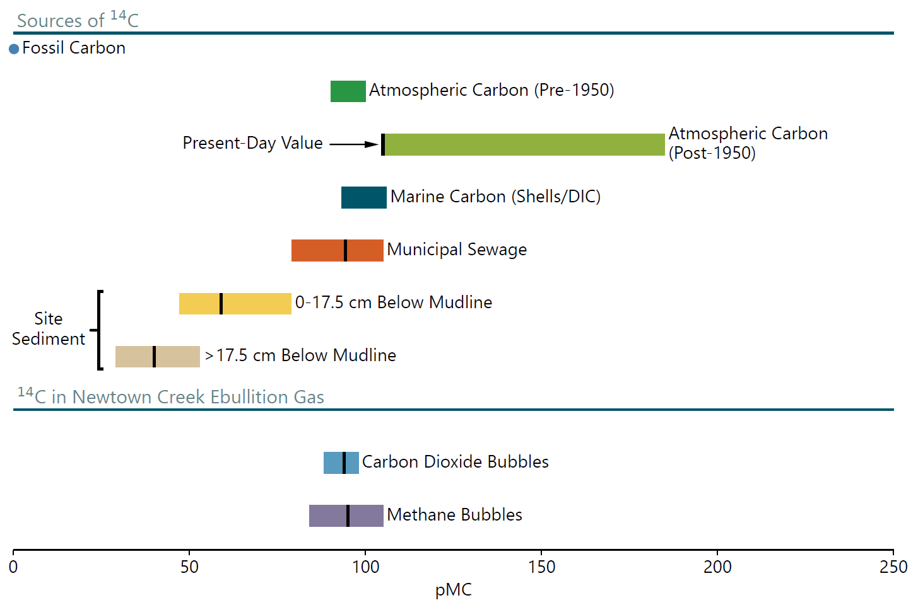
Summary of Carbon-14 Values
Note: Average value shown with vertical bar.
Sources: Hua et al. 2013; Levin et al. 2010; Weidman and Jones 1993; Law et al. 2013; Nara et al. 2010; Tseng et al. 2016

Slide 14
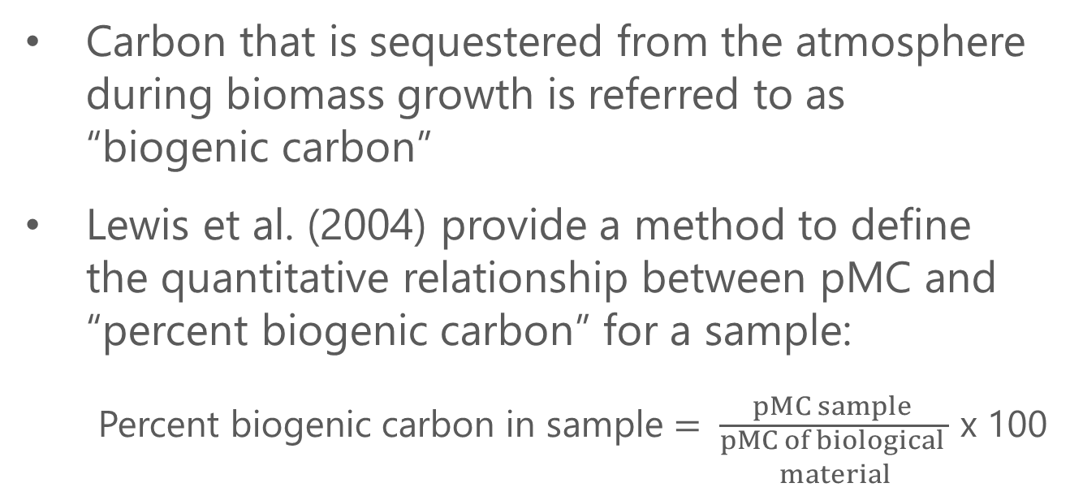
Approach for Quantifying Biogenic Carbon
Carbon that is sequestered from the atmosphere during biomass growth is referred to as
“biogenic carbon”
Lewis et al. (2004) provide a method to define
the quantitative relationship between pMC and “percent biogenic carbon” for a sample:
Percent biogenic carbon in sample $= \frac{pMC sample }{\begin{aligned}pMC of biological \\ material\end{aligned}}$ x 100
Carbon Cycle Diagram
Source: University Corporation for Atmospheric Research
Sources: Lewis et al. 2004; Hua et al. 2013; Levin et al. 2010; Weidman and Jones 1993

Slide 15
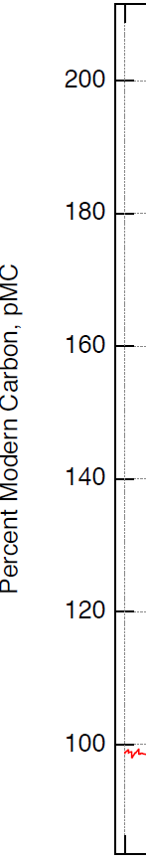
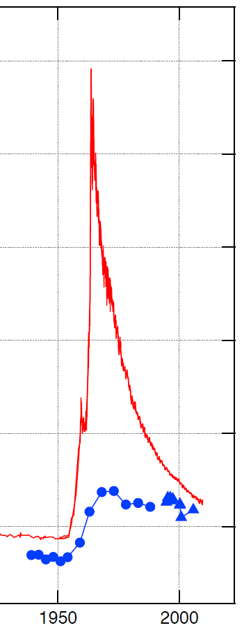


Percent Biogenic Carbon in Ebullition Gas
pMC in Newtown Creek ebullition gas samples is 95 (arithmetic average)
pMC of biological material for
the past 50 to 100 years is estimated as 105 to 125
Percent biogenic carbon of Newtown Creek ebullition gas is 76% to 90%
Gas Samples | ¹⁴C (pMC)
Arithmetic average | 95
Range | 84 to 105
$76\%=\frac{95}{125}$ x 100
$90\%=\frac{95}{105}$ x 100
Sources: Lewis et al. 2004; Hua et al. 2013; Levin et al. 2010; Weidman and Jones 1993; Lardie Gaylord et.al. 2019

Slide 16
Relative Contributions of Carbon Sources to Ebullition in Newtown Creek
Carbon Sources | Contribution
Aquatic organisms Discharges of organic-rich materials (e.g., such as fecal matter from CSOs) | 76% to 90%
Fossil fuels (e.g., petroleum and coal) released in historic spills Discharges containing oils | 10% to 24%

Slide 17
(Cont..)
Ebullition gas generation at Newtown Creek is mainly driven by biogenic sources and, to a lesser extent, fossil carbon.

Slide 18
Hua, Q., M. Barbetti, and A. Rakowski, 2013. “Atmospheric Radiocarbon for the Period
1950–2010.” Radiocarbon 55(4).
Lardie Gaylord, M.C., B.E. Longworth, K. Murphy, C. Cobb, and A.P. McNichol, 2019. “Annual Radiocarbon Measurements in a Century-Old European Beech Tree (Fagus sylvatica) from Coastal Northeastern North America.” Nuclear Instruments and Methods in Physics Research Section B: Beam Interactions with Materials and Atoms 456:264–270.
Law, Y., G.E. Jacobsen, A.M. Smith, Z. Yuan, and P. Lant, 2013. “Fossil Organic Carbon in Wastewater and Its Fate in Treatment Plants.” Water Research 47(14):5270–5281.
Levin, I., T. Naegler, B. Kromer, M. Diehl, R.J. Francey, A.J. Gomez-Pelaez, L.P. Steele, D. Wagenbach, R. Weller, and D.E. Worthy, 2010. “Observations and Modelling of the Global Distribution and Long‐Term Trend of Atmospheric ¹⁴CO₂.” Tellus 62(1):26–46.
Lewis, C.W., G.A. Klouda, and W.D. Ellenson, 2004. “Radiocarbon Measurement of the Biogenic Contribution to Summertime PM-2.5 Ambient Aerosol in Nashville, TN.” Atmospheric Environment 38(35):6053–6061.

Slide 19
Nara, F.W., A. Imai, K. Matsushige, K. Komatsu, N. Kawasaki, and Y. Shibata, 2010. “Radiocarbon Measurements of Dissolved Organic Carbon in Sewage-Treatment-Plant Effluent and Domestic Sewage.” Nuclear Instruments and Methods in Physics Research Section B: Beam Interactions with Materials and Atoms 268(7–8):1142–1145.
Tseng, L.Y., A.K. Robinson, X. Zhang, X. Xu, J. Southon, A.J. Hamilton, R. Sobhani, M.K. Stenstrom, and D. Rosso, 2016. “Identification of Preferential Paths of Fossil Carbon Within Water Resource Recovery Facilities via Radiocarbon Analysis.” Environmental Science and Technology 50(22):12166–12178.
Weidman, C.R., and G.A. Jones, 1993. “A Shell‐Derived Time History of Bomb ¹⁴C on Georges Bank and Its Labrador Sea Implications.” Journal of Geophysical Research 98(C8)14577–14588.

Slide 20

Grace Weatherford
Senior Managing Environmental Engineer
gweatherford@anchorqea.com
971.409.7313

