Slide 1
Lauritzen Channel, California: 35 Years of Pre- and Post-Dredge Monitoring
Presented by: Erik Naylor, Anchor QEA
Collaborators: Clay Patmont, Anchor QEA
Richard Luthy, Stanford University
Jason Condor and Wendy Hovel, Geosyntec
Rick Bodishbaugh, Exponent
Notes:
18 minutes to make it through 35 years! Here we go!
I’m providing an overall summary of a refined conceptual site model – that’s really built on the hard technical work done by these folks.
Richard Luthy and YeoMyoung Cho with Stanford University especially have really done a lot of work on this project – collaborative effort to try and figure this site out. He is presenting later this afternoon at 4:45 under the B7 Hydrodynamics and Sediment Transport Platform and will be discussing Evaluation of a Blended Cover with Activated Carbon for In Situ stabilization of DDx/Dieldrin in Sediment.
Rick had a post yesterday called Risk Assessment as a Tool to Focus Sediment Remediation at a Mature Superfund Site that is also about this project. Hopefully you had a chance to catch Rick!

Slide 2
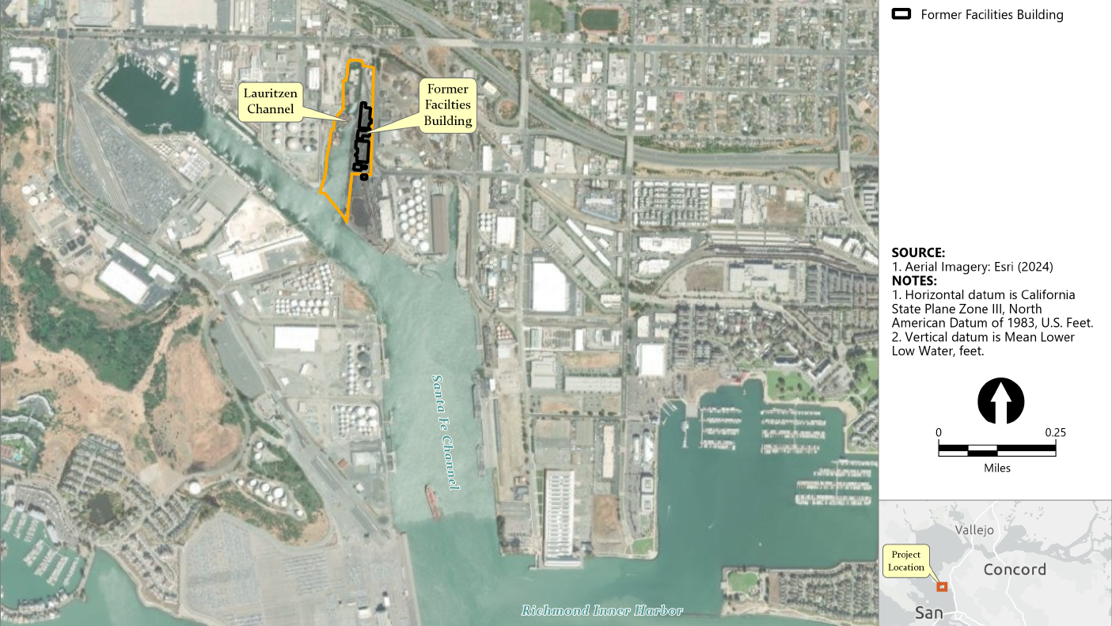
Francisco
Notes:
The Lauritzen Channel (Channel) is a 4-hectare navigation waterway within Richmond Harbor of San Francisco Bay, California, and part of the United Heckathorn Superfund Site (Site).
In the 1940s, the U.S. Government used the Channel for shipbuilding, as well as leased the uplands area to pesticide formulators until it sold the Site in 1949. From 1949 to the mid-1960s, technical grade pesticide, including DDT, continued to be formulated and packaged in nearshore areas of the Site.
From 1967 to 1980, the Site was used as scrap storage, and since the 1980s, a dry bulk-cargo shipping terminal has operated along the Channel.
Environmental monitoring of the Channel that began in the 1980s identified locally elevated contaminant concentrations of DDT in fish and shellfish tissue, which led to actions.

Slide 3
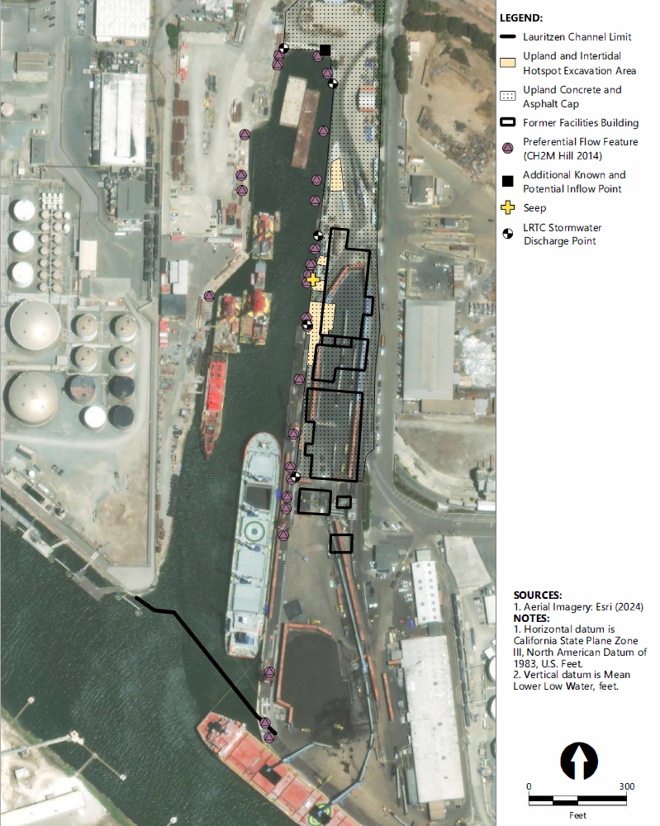
Cleanup Actions
Investigation/early action (1989–1993)
  Initial monitoring
  3,500 cy hotspot nearshore soils and intertidal sediments removed
Record of Decision (ROD; 1994)
Remedial actions (RA; 1996–1999)
  108,000 cy young bay mud dredging
  Upland and sediment capping
Long-term monitoring (1998–2023)
Notes:
In the early 1990s 3,500 cy of hotspot soils and sediments that contained part-per-thousand DDT were excavated from nearshore upland and intertidal areas of the Site. The interim cleanup goal for that action was 100 mg/kg for DDT.
In 1994, the Record of Decision for Site cleanup was issued, establishing sediment and surface water remediation levels (590 ug/kg DDT for sediment; 0.59 ng/L DDT and 0.14 ng/L dieldrin for surface water) and requiring dredging of all soft sediment (Young bay mud) from the Channel. In 1996 and 1997, approximately 108,000 cubic yards of contaminated soft sediment were dredged from the Channel and disposed at off-site landfills. EPA verified removal effectiveness by inspecting dredge buckets and advancing post-dredge confirmation cores.
½ foot layer of clean sand was placed over dredged area
An impermeable cap was constructed over the northern have of the uplands, followed by long-term operation and maintenance
From 1998 to 2023, robust post-dredge monitoring including sediment, surface water, and fish/shellfish tissue chemical analyses was performed to evaluate remedy effectiveness.
Since initial monitoring revealed that prior remediation levels specified in the ROD were not being achieved, several follow-on source identification studies were conducted.
Supplemental:
In 2015 a Draft FFS established RAOs targeting DDx and Dieldrin specifically. Most of the alternatives included redredging most of the Lauritzen Channel, augmented by capping and in situ treatment of the shoreline embankment and other areas
Tissue:
Total DDx: 120 µg/kg
Dieldrin: 2.5 µg/kg
Sediment:
Total DDx: 400 µg/kg
Dieldrin: 4.3 µg/kg
Surface Water:
Total DDx: 0.22 nanograms per liter (ng/L)
Dieldrin: 0.054 ng/L

Slide 4
How can we use 35 years of pre- and post-RA monitoring data to refine the original conceptual site model used to develop the ROD, particularly with respect to source control?
Notes:
Essentially, the dredging did not achieve ROD cleanup objectives and there appear to be ongoing sources that need to be controlled.
We are still learning about this site and collecting data and information, but over the past 35 years we’ve learned a lot about the site through ongoing monitoring, focused source investigations, and refinement of older data (i.e. high-res pesticide analysis and passive sampling techniques are much better today), to assess remedy effectiveness.

Slide 5






Pre- and post-RA trends
Lines of Evidence Informing Conceptual Site Model
Sediment erosion and deposition assessment
Sediment porewater evaluations
Contaminant mass balances
Spatial patterns of contaminant concentrations
Chemical fingerprinting
Notes:
Key lines of evidence informing a refined understanding of source control and the overall remedy effectiveness evaluation have included the following:
1) pre- and post-dredging trends of fish/shellfish tissue contaminant concentrations and sediment concentrations
2) sediment erosion and deposition assessment
3) sediment porewater flux evaluations
4) contaminant mass balances within the Channel
5) spatial patterns of contaminant concentrations within the Channel
6) chemical fingerprinting

Slide 6
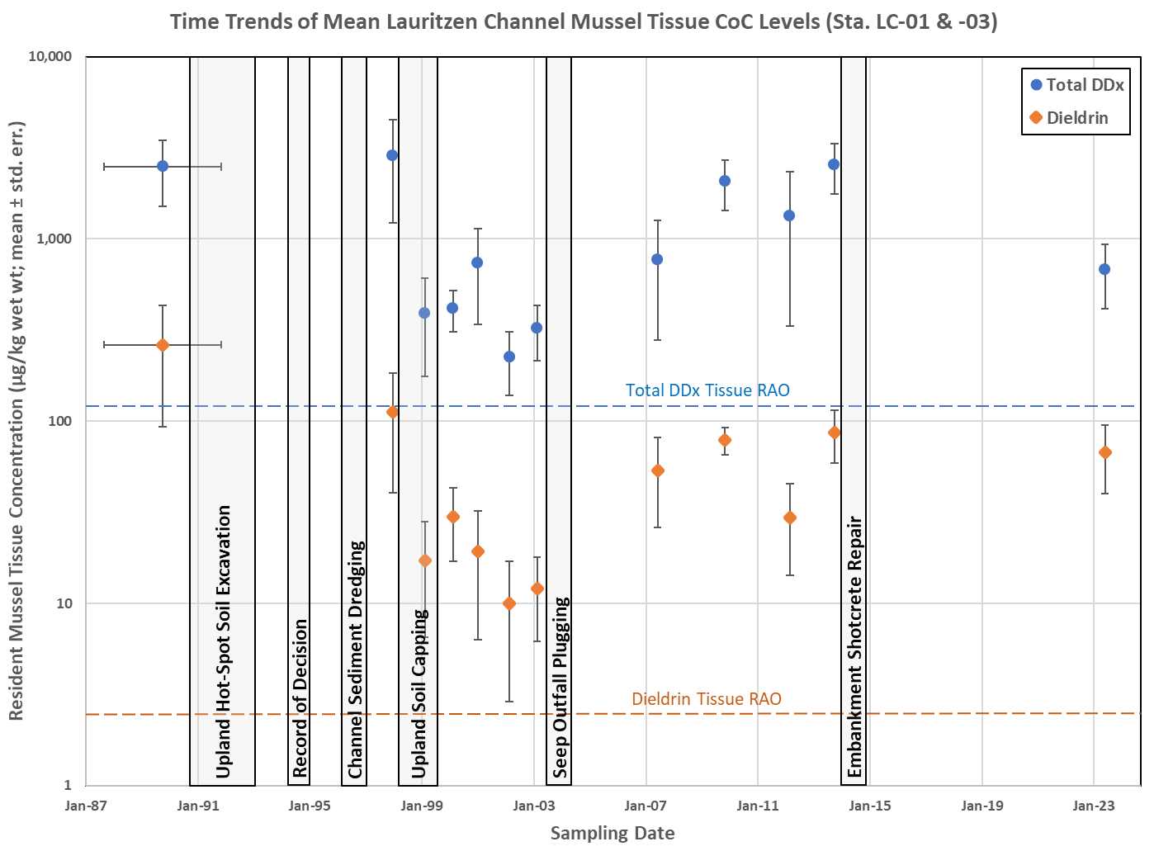
Pre- and Post-RA Tissue Temporal Trends
Time Trends of Mean Lauritzen Channel Resident Mussel Tissue Contaminant Levels
Notes:
We have an excellent historic record of resident mussels. Goal of dredging was to reduce bioaccumulation, there is no consistent pattern demonstrating that goal was achieved.
From 1986 to 2023, total DDx and dieldrin concentrations in resident blue mussels (Mytilus edulis) were monitored at two locations along the shoreline embankment. Mussels are a commonly used biomonitoring species because of their wide geographic distribution, large populations, sessile nature, and high filtering rates.
Mussels were typically collected at an elevation of approximately +1 feet Mean Lower Low Water on abandoned pilings and deck structures (Kohn and Evans 2004, CH2M Hill 2015).
The figure summarizes temporal trends of total DDx and dieldrin concentrations in mussel tissue over the 37-year monitoring period. While concentrations may have temporarily declined between 1999 and 2003 (shortly after upland soil capping), no statistically significant (P>0.1) long-term decline in total DDx and dieldrin concentrations is evident over the 1986 to 2023 period of record.
Tissue RAOs in 2015 draft FFS
Total DDx: 120 µg/kg
Dieldrin: 2.5 µg/kg

Slide 7
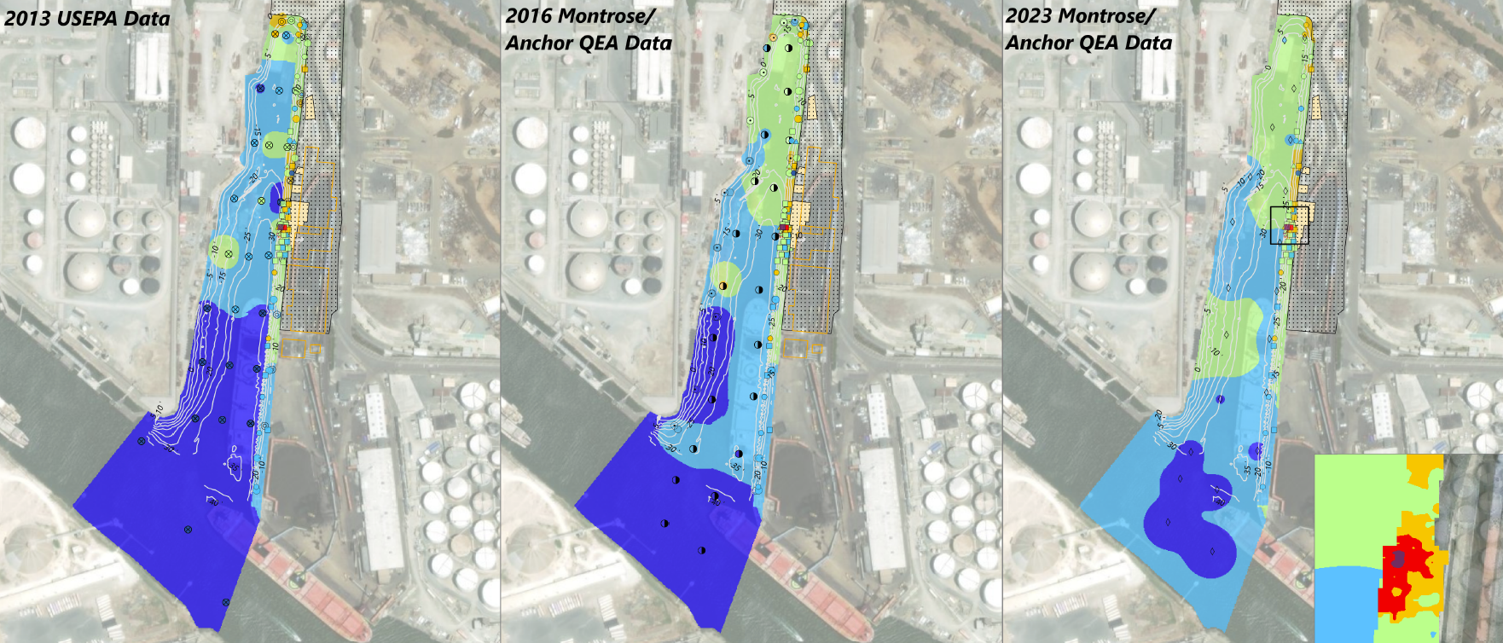
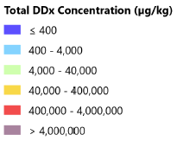
Sediment Temporal “Trend”
Interpolated Total DDx Sediment Concentrations
Notes:
We have less of a historical record when it comes to sediment collected throughout the channel, relative to mussel tissue.
The figures summarizes interpolated sediment concentration data from 2013 to 2016 to 2023 that were supplemented with sediment data collected during Phase I and Phase II Source Investigations conducted by Pacific Northwest National Laboratory on behalf of EPA (Kohn and Evans, 2002 and 2004) from along the eastern embankment in the intertidal zone adjacent to the former facility that were not historically removed and have documented concentrations of DDx in some cases greater than 4,000,000 ug/kg (hot spot).
The embankment is very steep and in poor condition – photos to come. Adjacent to former facility, upland hotspot/intertidal removal, and upland cap area.
The Phase 2 investigation by PNNL in 200x concluded that the hot spot under the north end of the Levin pier and the seep at T‐8.5 were the sources that were most likely contributing to high DDT concentrations detected in mussels collected from nearby pilings.
590 ug/kg DDT for sediment
Sediment draft FFS RAOs
Total DDx: 400 µg/kg
Dieldrin: 4.3 µg/kg

Slide 8
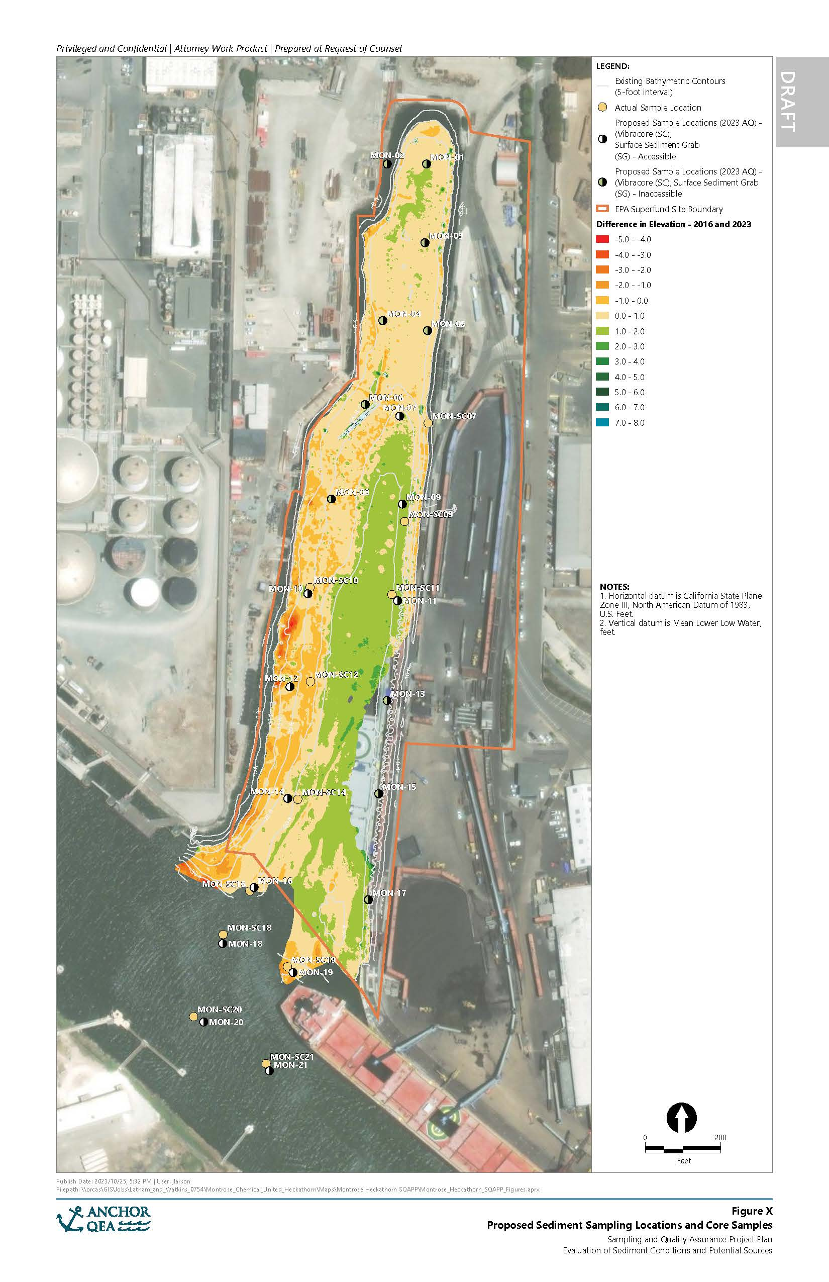
Sediment Erosion and Deposition Assessment
Difference in Elevation –
2016 and 2023
northern head
2.5 cm/yr northern head
3.7 cm/year east/central channel
-0.3 cm/year west side
Annualized rate of 2 cm/year for the entire Channel
east/central channel
west side
Notes:
Site bathymetry was updated in 2023 and compared against the 2016 bathymetry to further refine and confirm sedimentation rates observed in the sediment traps.
A sedimentation rate of 2.5 cm/year was determined in the northern head, -0.3 cm/year in the west side, and 3.7 cm/year in the east/central channel area.
The annualized rate of gross sediment accumulation observed in the bathymetry comparison averaged 2.0 cm/year for the entire Channel.
These sedimentation rates are consistent with those developed by sediment traps, previous bathymetrical survey analysis, and radioisotope geochronology analyses.

Slide 9
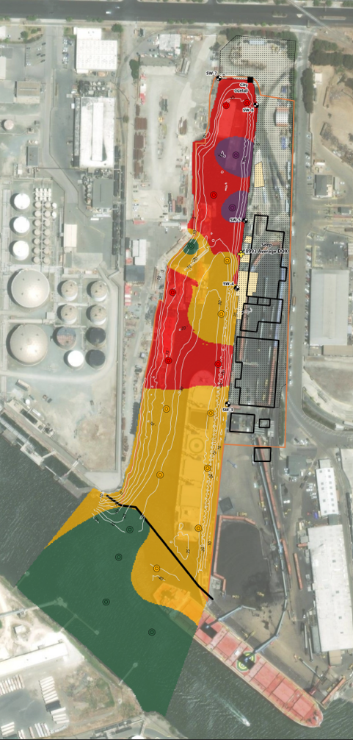
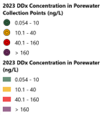
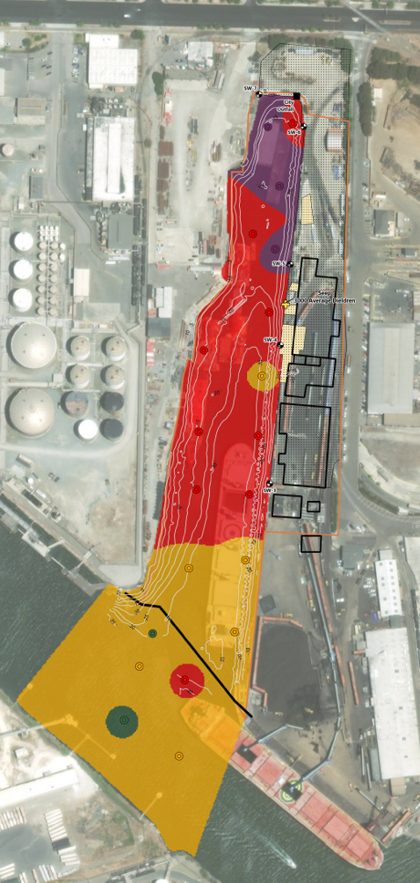
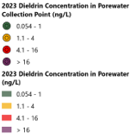
Sediment Porewater Evaluations
DDx
Dieldrin
Notes:
We have even less of a historical record when it comes to porewater, but the data collected recently is still incredibly insightful and helps CSM refinement.
These figures show interpolated porewater concentrations for DDx (left) and dieldrin (right) using the 2023 porewater data.
Passive sampling studies were conducted by the Massachusetts Institute of Technology (MIT) in 2012 and 2013 to quantify the flux of total DDx from surface sediment porewater to the overlying surface waters of the Lauritzen Channel (Gschwend and Burgess 2012; Gschwend 2014).
These 2023 passive samplers were deployed (0 to 10 cm) and analyzed at the Site by Geosyntec in 2023 (Geosyntec 2024) and afford a refined understanding of flux rates. Freely dissolved concentrations of total DDx and dieldrin measured in 2023 have not changed substantially since the MIT 2012 and 2013 passive sampling studies, but the addition of the 2023 data refines the estimates.
Supplemental:
ROD remediation goal of 0.59 ng/L for DDT
Surface Water – draft FFS RAO
Total DDx: 0.22 nanograms per liter (ng/L)
Dieldrin: 0.054 ng/L

Slide 10
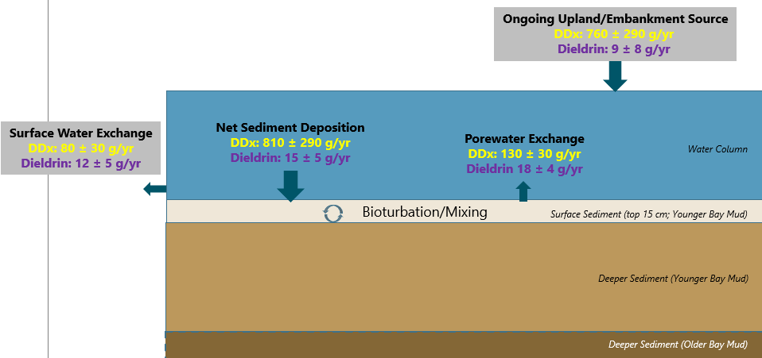
Current Contaminant
Mass Balance
Notes:
This is a mass balance of present-day total DDx inputs and outputs to the Lauritzen Channel— originally constructed based on data collected and evaluated by USEPA in a draft 2015 FFS (CH2M Hill 2015) and now supplemented with 2016 (Anchor QEA 2017) and 2023 Site characterization data (Anchor QEA and Geosyntec).
Sediment appears to be a net sink for DDx from surface water. Dieldrin is perhaps closer to equilibrium. The ongoing upland/embankment source is calculated by the difference from the characterized inputs (porewater exchange) and outputs (net sediment deposition and surface water exchange). That difference leaves us with 760 g/yr (+/- 290g) of ongoing upland/embankment sources of DDx
These mass fluxes area means +/- standard error. (ongoing source mean including first error uncertainty analysis)
Supplemental information:
A total DDx and dieldrin deposition flux into the Lauritzen Channel were calculated using the average concentration of total DDx measured in 2023 surface sediment samples for each area (northern head, west side, east/central channel) of the Lauritzen Channel, average sedimentation rates, and correcting for sediment density. The refined estimate of ongoing total DDx deposition flux into the Lauritzen Channel is approximately 810+/-290 g/year
Based on the 2023 measured porewater it is estimated that approximately 130 +/- 30 g/year of total DDx are currently being released from surface sediments of the Lauritzen Channel into the overlying surface water. This flux estimate is much lower than current total DDx deposition rate, revealing that sediments in the Lauritzen Channel are a primary net sink for ongoing total DDx inputs and indicating that sediments are not a net source of total DDx into surface water of the Lauritzen Channel
The 2023 passive sampling data were also used to characterize the rate of exchange of dissolved total DDx between the Lauritzen Channel and the Santa Fe Channel. The net dissolved transport by tidal exchange was estimated by multiplying the tidal exchange discharge with the difference between surface water total DDx concentrations in the Lauritzen Channel and Santa Fe Channel. The tidal exchange discharge for the Lauritzen Channel was reported in the draft FFS (CH2M Hill 2015). Surface water total DDx concentrations in the Lauritzen Channel were measured by Geosyntec at the mouth of the Lauritzen Channel. Surface water total DDx concentrations in the Santa Fe Channel were based on regional background areas of the Santa Fe Channel. This results in an estimated 80 +/- 30 g/year of dissolved DDx transported out of the Site

Slide 11
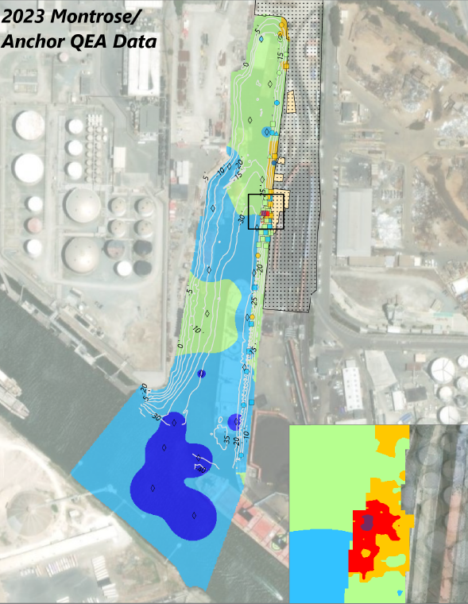
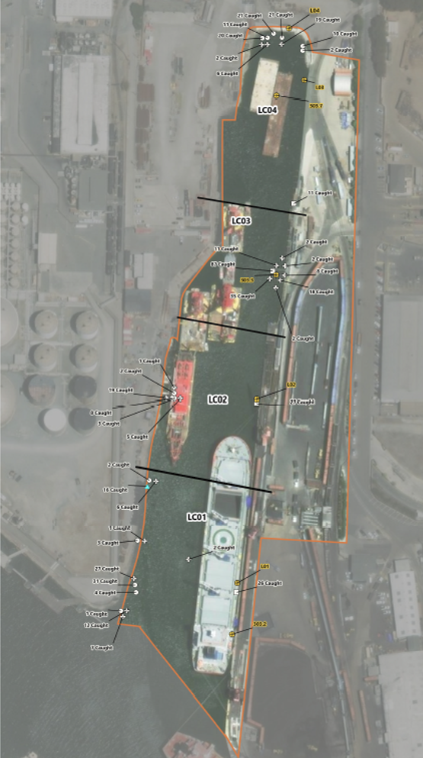
Spatial Patterns of Contaminant Concentrations
DDx in soil
DDx sediment interpolation
DDx porewater interpolation
Mussel tissue sampling locations
Notes:
X marks the spot. 2023 interpolated surface sediment on the left, 2023 interpolated porewater in the middle, sampling location of resident mussels discussed earlier on the right. Sampling location of mussels also corresponds with highest concentrations observed in other fish tissue. All adjacent to the former United Heckathorn facility and hot spot excavation areas.
There is recent data collected that points to the northern head as an ongoing source. These data include observed during Annual Cap monitoring which revealed two seeps in the eastern embankment/northern head embankment area with concentrations of DDx up to 936,700 pg/L – correspond approximately with porewater hotspots. Recent uplands soil data collected to support railroad development in an easement with surface soil concentrations up to 4,580 ug/kg DDx.

Slide 12
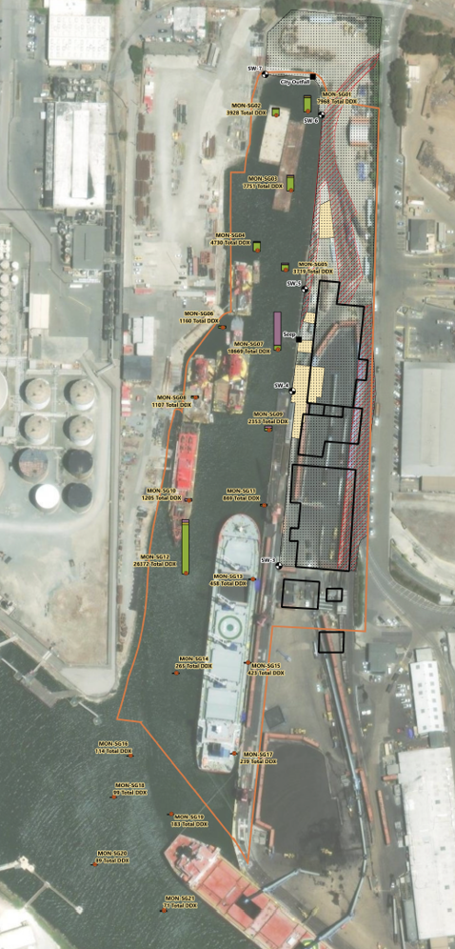

Chemical Fingerprinting – DDx in Surface Sediment
DDT degrades in the aquatic environment to DDD and DDE
High percentage of DDT to total DDx indicative of “fresh” source
Low percentage of DDT to total DDx indicative of old and weathered DDT
Notes:
We keep talking about sum DDx, but we can also learn by examining DDx constituent ratios. “Fresh” DDT (indicative of an ongoing upland source – oxic environment) is more prevalent in the area adjacent to the former facility where all our big red arrows point.
Supplemental information:
DDT naturally degrades in the aquatic environment through various physical, chemical, and biological processes (Horsak et al. 2006). The degradation rate is variable and dependent on several factors, including pH, dissolved oxygen, and temperature. The primary environmental degradation pathway of DDT is via reductive dechlorination to either 2,4’ or 4,4’ dichlorodiphenyldichloroethane (DDD) or dichlorodiphenyldichloroethylene (DDE).
DDT can undergo degradation under both aerobic and anaerobic conditions; however, degradation is much more rapid in low oxygen, reductive sediment environments, compared to the more highly oxygenated conditions typically found in upland soils. Therefore, material that has been recently released or transported from an upland source will likely have a greater percentage of DDT relative to DDD and DDE when compared to sediments that have been in the marine environment for decades.
For reference, technical-grade DDT, which was used to formulate commercial pesticides and is presumed to be the parent mixture released at the Site, typically contained 65% to 80% active 4,4’‑DDT (Metcalf 1995).

Slide 13
Shoreline Characteristics
Example of shoreline conditions that coincide with spatial patterns of contaminant concentrations
Shoreline seep
Notes:
These photos are examples of the shoreline by former facility.
No soft sediments. Harder materials, broken shotcrete, steep areas, hard for removal.
Percent levels of DDT in this area have been recorded in the past and high concentrations remain as access for removal was difficult, particularly in the intertidal area.
2003 Broken Concrete Outfall Pipe Sediment and Seep Sampling - EPA Plugged Outfall Later in 2003 But Seep Likely Representative of Ongoing Sources within a Larger Area of the Embankment
Seep discharge
Total DDX: 9,000 ng/L (15,000 times remediation goal)
Dieldrin: 2,900 ng/L (21,000 times remediation goal)
Seep contained in-line sediment total DDx concentrations of approximately 3,600,000 µg/kg (6,200 times remediation goal. Dieldrin: 22,000 µg/kg
Between June and August 2023, a series of visual, photographic, diver, and geophysical surveys were conducted within the Channel to further investigate potential sources of COCs. Photographic documentation of the eastern, western, and northern banks of the Channel during the 2023 survey efforts demonstrates that the Site contains numerous uncapped pipes, debris, exposed embankments with degraded/broken shotcrete, riprap, active outfalls, degraded creosote piles, and decomposing structural elements.

Slide 14
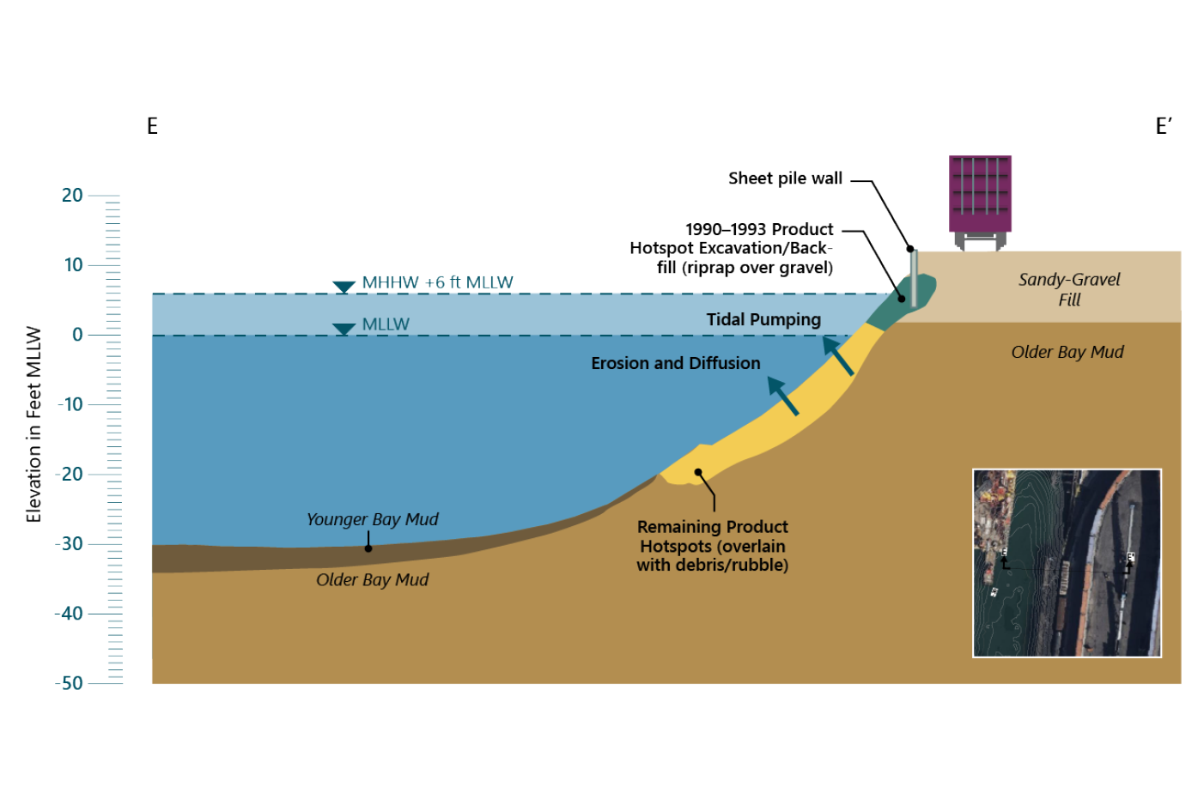
Updated Conceptual Site Model
Erosion
Seepage
Notes:
This figure represents the updated CSM using the lines of evidence that we’ve discussed.
There was removal that occurred previously with a cleanup goal of 100 mg/kg (much higher than sediment goals), but full removal was not achieved in the intertidal zone and subtidal zones. These areas are overlain with rubble/debris and are on a steep slope (to scale). Area in yellow was not removed and concentrations have been documented (by Kohn and Evans) to be greater than 4,000 mg/kg DDT in localized areas - and the source most likely contributing to high DDT concentrations in mussels nearby.
The presence of ongoing sources is supported by all lines of evidence and the concentration distributions point to the eastern embankment adjacent to former United Heckathorn facility and up into the northern head.
Likely other ongoing upland sources including erosion of contaminated soils and seepage of contaminated groundwater.
These pathways supported by recent upland soil data and seepage data.
Younger bay mud that was once thought to be the ongoing source, appears to be a sink, not a source.

Slide 15
Continuing embankment/upland sources have been identified
Further source evaluations and supplemental RA planning are necessary to address ongoing sources
Notes:
While successful in removing hotspot material and reducing some sources to the channel, the original remedy did not function as designed and mussel tissue concentrations have not been reduced
Previous CSM was that younger bay mud was source. 35 years of data has refined the CSM and demonstrate that areas of the embankment are sources and that the younger bay mud actually acts as a sink, rather than a source
Ongoing sources need to be more carefully evaluated to develop an effective source control plan prior to any supplemental remedy design and implementation.

Slide 16
Anchor QEA, 2017. Data Summary Report, Former United Heckathorn Site, Richmond, California. Prepared for Latham & Watkins LLP and Montrose Chemical Corporation. January 2017.
Anchor QEA, 2024. Data Summary Report Sediment Sampling. Prepared for Montrose Chemical Corporation of California, Inc. February 2024.
Anchor QEA, 2024. 2023 In-Water Reconnaissance of Potential Shoreline Contamination Sources and Conveyances. Prepared for Montrose Chemical Corporation of California, Inc. March 2024.
CH2M Hill, 2014. Source Identification Study Report, United Heckathorn Superfund Site. Prepared for U.S. Environmental Protection Agency Region 9. March 2014.
Gschwend, P., and R. Burgess, 2012. Application of Passive Samplers to Assess Dissolved DDTs in the Lauritzen Channel at the United Heckathorn Site in Richmond Harbor, San Francisco Bay. Cambridge, Massachusetts: Massachusetts Institute of Technology.
Gschwend, P.M., 2014. Application of Polyethylene (PE) Passive Samplers to Assess DDTs in the Lauritzen Channel at the United Heckathorn Site in Richmond Harbor, San Francisco Bay, Cambridge, Massachusetts: Massachusetts Institute of Technology. February 2014.
Kohn, N.P., and T.J. Gilmore, 2001. Field Investigation to Determine the Extent of Sediment Recontamination at the United Heckathorn Site, Richmond, California. Prepared for the U.S. Environmental Protection Agency. PNNL-13730. November 2001.
Kohn, N.P. and N.R. Evans, 2002. Phase I Source Investigation, Heckathorn Superfund Site, Richmond, California. Prepared by Battelle for the U.S. Environmental Protection Agency. PNNL‐14088. December.
Metcalf, R., 1995. “Insect Control Technology.” Kirk-Othmer Encyclopedia of Chemical Technology. Editors, J. Kroschwitz and M. Howe-Grant. New York: Wiley.
USEPA, 1994. EPA Superfund Record of Decision: United Heckathorn Site, Richmond, CA, 10/26/1994. EPA/ROD/R09-95/121. October 1994.

Slide 17
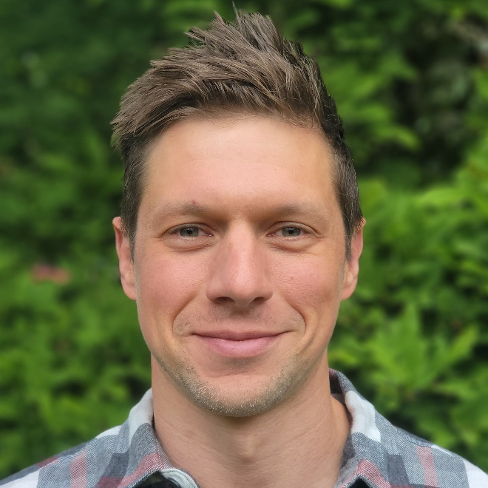

Erik
Naylor
Managing Scientist
enaylor@anchorqea.com

