Slide 1
Activated Carbon Cap Amendments: Example of a Site-Specific Sorption Study to Reduce Uncertainty in Cap Design
Presented by: Deirdre Reidy, Anchor QEA
Collaborators: Kevin Russell, Masa Kanematsu, and Billie-Jo Gauley, Anchor QEA
Notes:
Title Page: Anchor QEA presenter

Slide 2



Overview
River adjacent to a former manufactured gas plant (MGP) in the northeast
Design challenges associated with the stability of a shoreline structure
Chemicals of concern include polycyclic aromatic hydrocarbons (PAHs) (including non-aqueous phase liquid [NAPL]) and benzene, toluene, ethylbenzene, and xylene (BTEX) (specifically benzene)
Notes:
Dredging more than a few feet poses risk to the structural integrity of the wall
Capping identified as the remedy, but the cap needs to remain thin to limit the amount of dredging required to fit the cap and maintain the existing grade

Slide 3
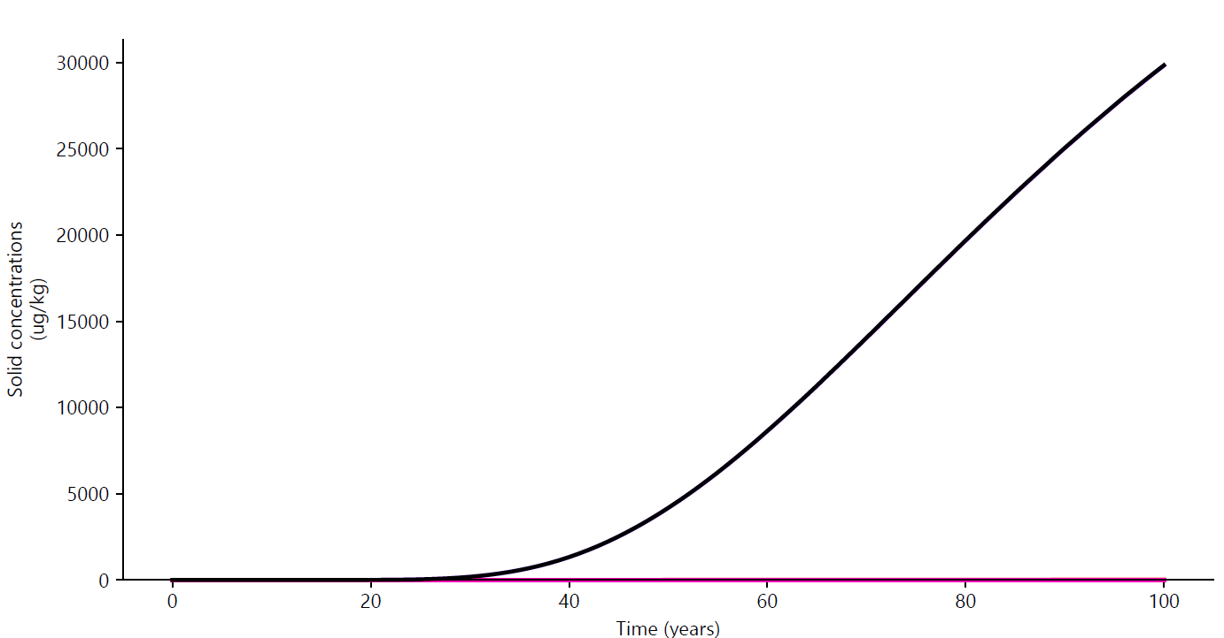




Cap Design to Address PAH Contamination in Sediment
Cap design to address PAHs alone
30
Target TPAH Concentration
Water Column
25
Armor/Filter Layer
20
Naphthalene is
the design driver
Solid-Phase Concentration
in Bioturbation Zone (mg/kg)
Chemical Isolation Layer
60 cm Sand
+ 9% by Weight GAC
15
15 of 16 PAHs
remain, approximately 0 ppm for 100-plus years
10
5
NAPL Sorption Layer
0
Sediment
0
20
40
60
80
100
Years
Not to scale.

Slide 4
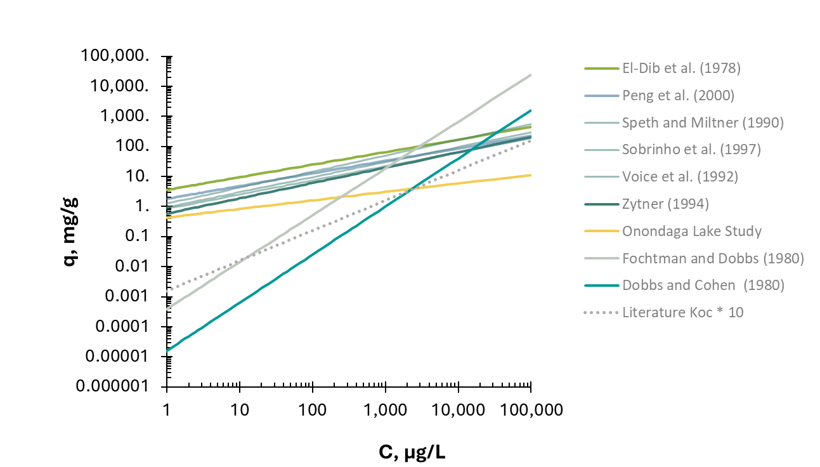
Published Benzene Freundlich Isotherms Vary Greatly
Benzene
Benzene
Equilibrium Concentration on Solid
(q_{e}, mg/g)
Benzene
Equilibrium Concentration in Solution
(C_{e}, µg/L)
Notes:
Additional challenge slide if more in-depth discussion is needed
For some contaminants, such as PAHs, Freundlich isotherm parameters reported in literature are fairly consistent and can often reliably be used for cap design.
For other compounds, Freundlich isotherm parameters reported in the literature may be limited (or nonexistent) and can span a large range, making it difficult to rely on them; this was found to be the case for BTEX

Slide 5
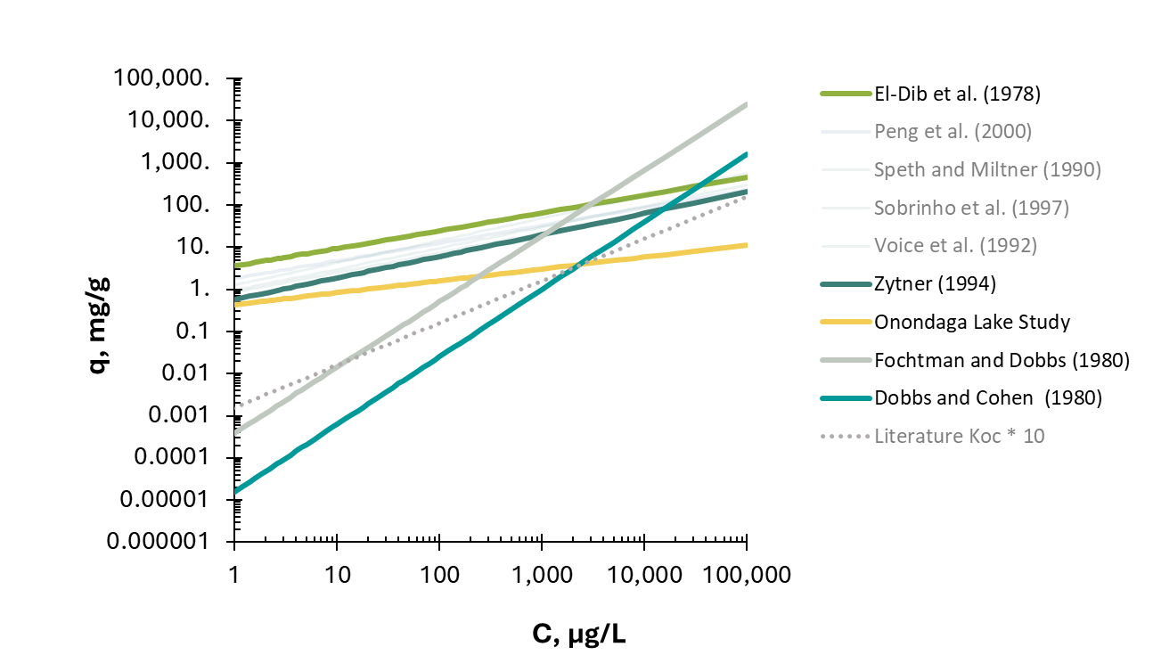
Published Benzene Freundlich Isotherms Vary Greatly
Benzene
Equilibrium Concentration on Solid
(q_{e}, mg/g)
Equilibrium Concentration in Solution
(C_{e}, µg/L)
Notes:
Additional challenge slide if more in-depth discussion is needed
For some contaminants, such as PAHs, Freundlich isotherm parameters reported in literature are fairly consistent and can often reliably be used for cap design.
For other compounds, Freundlich isotherm parameters reported in the literature may be limited (or nonexistent) and can span a large range, making it difficult to rely on them; this was found to be the case for BTEX

Slide 6
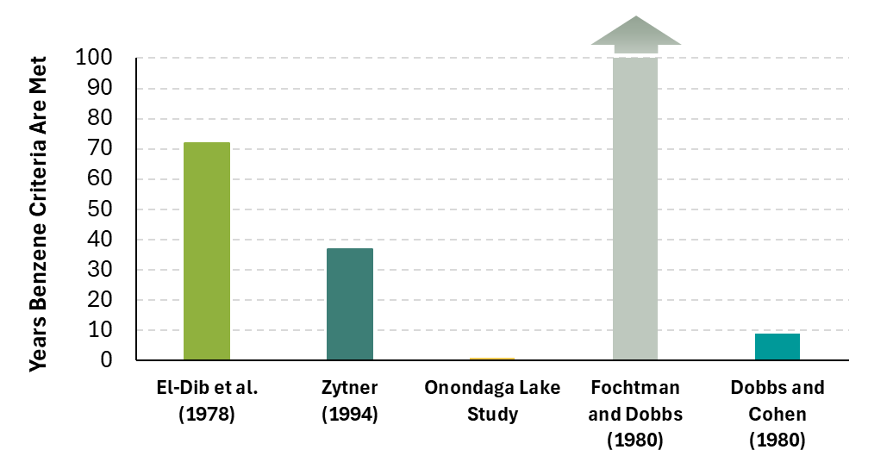
Significant Uncertainty in Cap Design Due to a Limited Understanding of BTEX Isotherms
Cap design to address PAHs alone
Cap Service Life for
Dissolved-Phase PAHs
Water Column
Armor Layer
Chemical Isolation Layer
60 cm Sand
+ 9% by Weight GAC
NAPL Sorption Layer
Sediment
Not to scale.
Notes:
Initial cap design modeling for the site was conducted for the full range of Freundlich isotherm parameters identified from the literature.
This resulted in a large range of initial cap design configuration, ranging from a very thick cap with a large quantity of activated carbon (which would not even be feasible to construct at the site) for the most conservative assumption to a much more modest cap design at the other end of the literature range.

Slide 7

Uncertainty in Cap Design
Cap design to address PAHs alone
+ Benzene
(Fochtman and Dobbs [1980])
+ Benzene
(Zytner [1994])
+ Benzene
(Onondaga Lake Study)
Water Column
Armor/Filter Layer
Chemical Isolation Layer
60 cm Sand
+ 9% by Weight GAC
60 cm Sand
+ 9% by Weight GAC
180 cm Sand
+ 13% by Weight GAC
180 cm Sand
+ 35% by Weight GAC
NAPL Sorption Layer
Sediment
Not to scale.

Slide 8
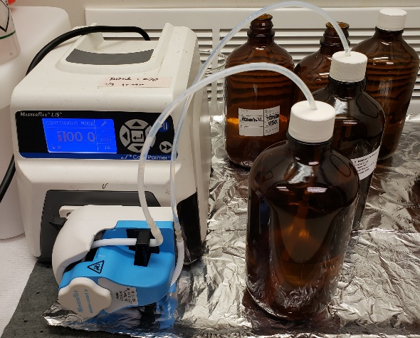
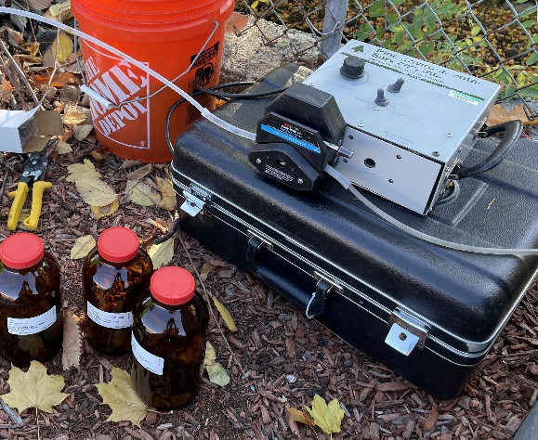
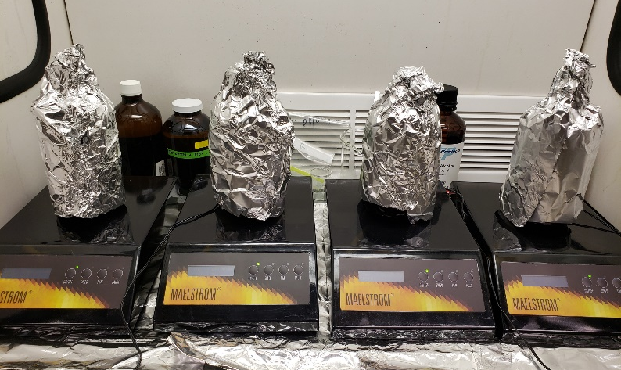
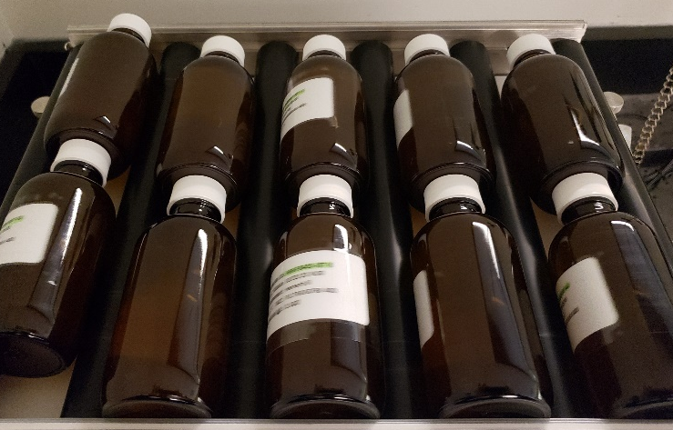
Site-Specific Adsorption Isotherm Study
Groundwater collected from the site was used in laboratory tests to identify an amendment that would effectively adsorb BTEX compounds
Freundlich isotherm parameters for BTEX in site groundwater were measured for three candidate amendment materials:
  2 GAC amendments
  1 PAC amendment
Notes:
Groundwater contains other chemicals, including PAHs, so competitive sorption is important.

Slide 9
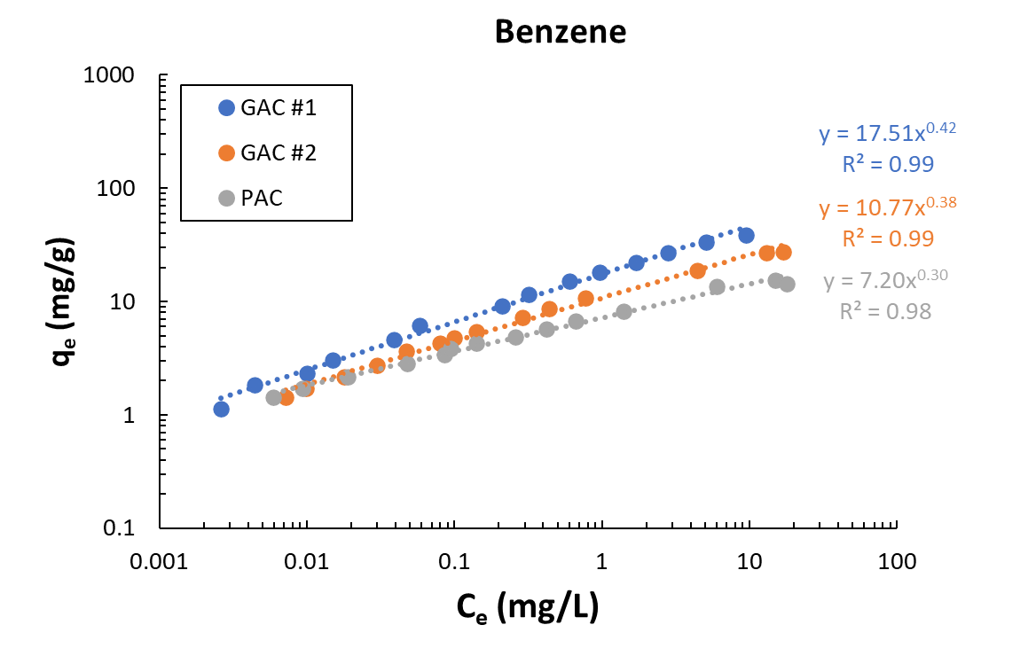

Isotherm Study Results: Benzene
$$q_{e}=K_{f}{\left(C_{e}\right)}^{1/n}$$
Equilibrium Concentration on Solid
(q_{e}, mg/g)
Equilibrium Concentration in Solution
(C_{e}, mg/L)
Kinetic studies performed and equilibrium reached within 24 hours for the PAC and GAC.
Notes:
Give plug to Keegans’ talk

Slide 10
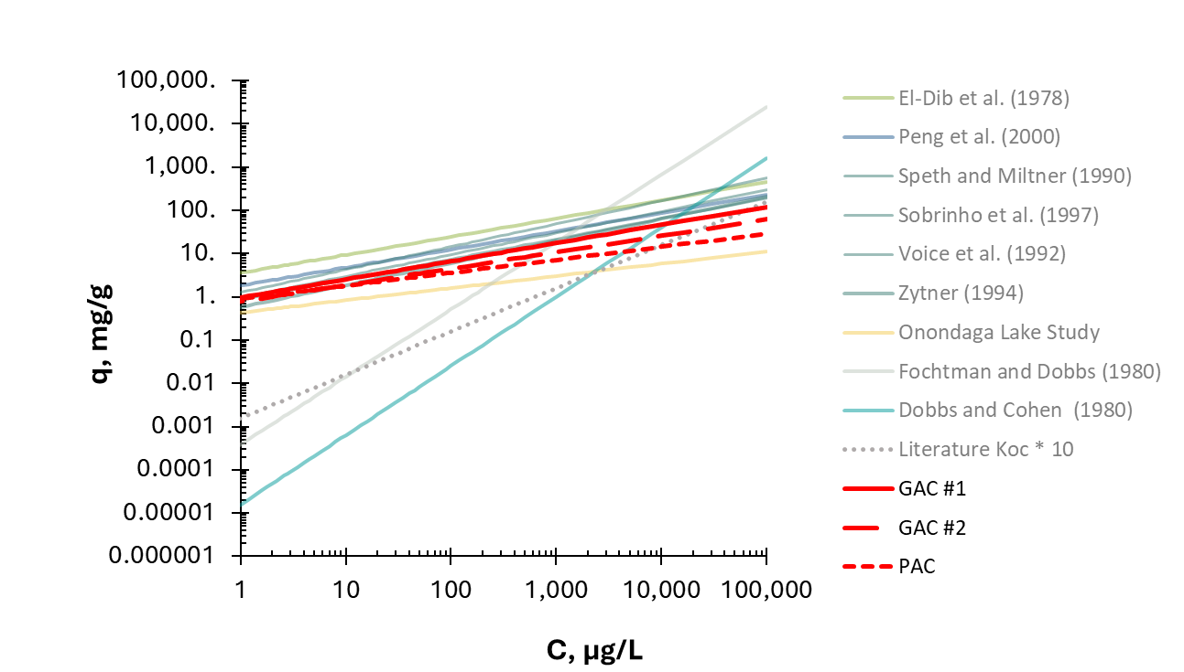
Site-Specific Isotherms Compared with Literature
Benzene
Equilibrium Concentration on Solid
(q_{e}, mg/g)
Equilibrium Concentration in Solution
(C_{e}, µg/L)
Notes:
Additional challenge slide if more in-depth discussion is needed
For some contaminants, such as PAHs, Freundlich isotherm parameters reported in literature are fairly consistent and can often reliably be used for cap design.
For other compounds, Freundlich isotherm parameters reported in the literature may be limited (or nonexistent) and can span a large range, making it difficult to rely on them; this was found to be the case for BTEX

Slide 11
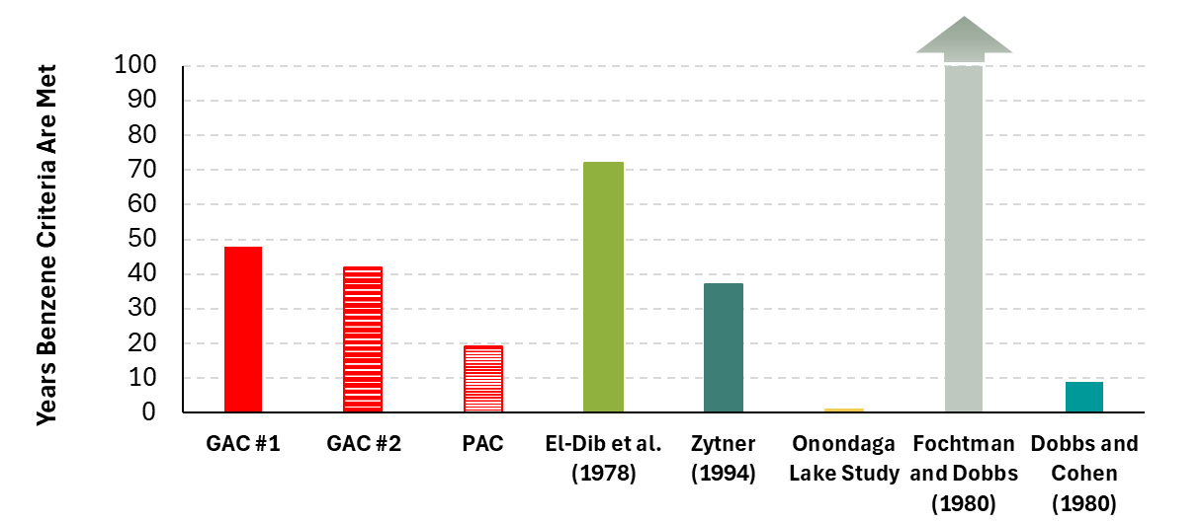
Resolved Uncertainty in Cap Design
Cap Service Life for
Dissolved-Phase PAHs
Notes:
Initial cap design modeling for the site was conducted for the full range of Freundlich isotherm parameters identified from the literature.
This resulted in a large range of initial cap design configuration, ranging from a very thick cap with a large quantity of activated carbon (which would not even be feasible to construct at the site) for the most conservative assumption to a much more modest cap design at the other end of the literature range.

Slide 12
Greater Confidence in Cap Design
Cap design to address PAHs and BTEX (not to scale)
Amendment dose significantly reduced compared with conservative literature-based value
  Conservative value based on literature: 35% by weight GAC
  GAC dose based on site-specific isotherm: 17% by weight GAC
Would have under-designed the cap if the midrange value based on literature (13% by weight GAC) had been used
Armor/Filter Layer
Chemical Isolation Layer
180 cm Sand
+ 17% by Weight GAC #1
Sediment Source
Notes:
Performing isotherm study doesn’t mean you’ll get the results you’ll want. But it may mean you get an accurate picture of what’s going on and you can think more about it.

Slide 13
Lessons Learned
In general, conservative assumptions can be used when we do not have
site-specific data
  When dealing with less-mobile contaminants, a conservative assumption may be appropriate
  For more mobile chemicals, such as benzene, conservative assumptions could lead to significantly overdesigned and costly caps
Site-specific studies conducted to better characterize unknown parameters or reduce uncertainties
Site-specific studies can be beneficial, but results do not always lead to a reduction in amendment needs or save money

Slide 14


Deirdre
Reidy
Senior Manager
dreidy@anchorqea.com

Slide 15
Dobbs, R.A., and J.M. Cohen, 1980. Carbon Adsorption Isotherms for Toxic Organics. EPA/600/8-80-023.
El-Dib, H.A., A.S. Moursy, and M.I. Badaway, 1978. “Role of Adsorbents in the Removal of Soluble Aromatic Hydrocarbons from Drinking Waters.” Water Research 12:1131–1137.
Fochtman, E.G., and R.A. Dobbs, 1980. “Adsorption of Carcinogenic Compounds by Activated Carbon” in Activated Carbon Adsorption of Organics from the Aqueous Phase, Vol. I. I.H. Suffet and M.J. McGuire, editors. Ann Arbor, Michigan: Ann Arbor Science Publishers, Inc.
Parsons and Anchor QEA, 2012. Onondaga Lake Capping, Dredging, Habitat and Profundal Zone (Sediment Management Unit 8) Final Design. Prepared for Honeywell Inc. March 2012.
Peng, J., W. Cui, G.W. Wilson, and W. Lin, 2000. “Determining Granular Activated Carbon Adsorption Isotherms of Benzene as a Volatile Organic Compound.” Water Quality Research Journal 35:219–230.
Sobrinho, J., L.T. Thiem, and E.A. Alkhatib, 1997. “Benzene Removal by PAC in Jet Flocculation System.” Journal of Environmental Engineering 123:1011–1018.

Slide 16
Speth, T.F., and R.J. Miltner, 1990. “Adsorption Capacity of GAC for Synthetic Organics.” Journal of American Water Works Association 82:72–75.
Voice, T.C., D. Pak, X. Zhao, J. Shi, and R.F. Hiskey, 1992. “Biological Activated Carbon in Fluidized Bed Reactors for the Treatment of Groundwater Contaminated with Volatile Aromatic Hydrocarbons.” Water Research 26:1389–1401.
Zytner, R.G., 1994. “Sorption of Benzene, Toluene, Ethylbenzene, and Xylenes to Various Media.” Journal of Hazardous Material
38:113–126.

