Slide 1
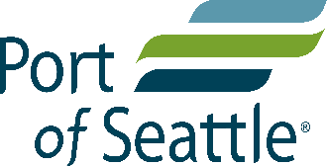
Habitat Restoration Within Two Seattle Superfund Sites
Presented by: Dan Berlin, PWS, Anchor QEA
Collaborators: Julia Fitts; Michelle Havey, Anchor QEA
Joanna Florer; Brick Spangler; Kathleen Hurley;
and Jon Sloan, Port of Seattle

Slide 2
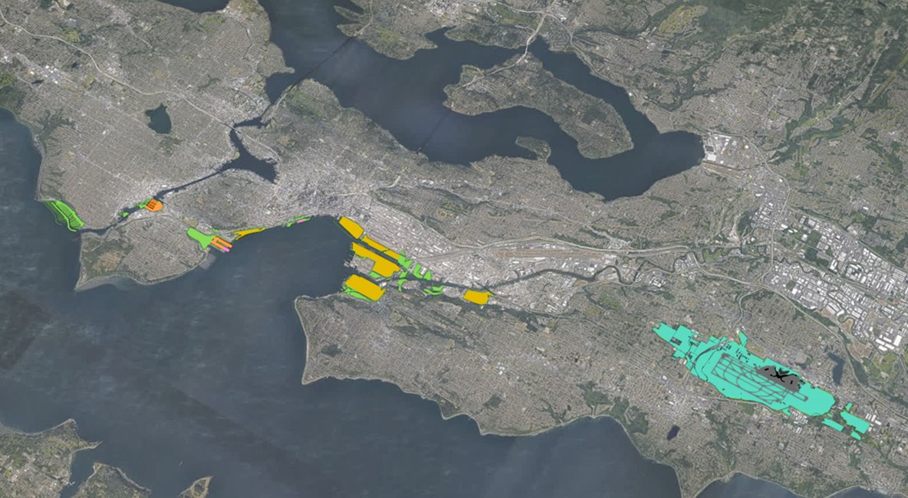
Port of Seattle Mission
Green-Duwamish River
To promote economic opportunities and quality of life in the region by advancing trade, travel, commerce, and job creation in an equitable, accountable, and environmentally responsible manner.
Notes:
The Port of Seattle’s mission is to promote economic opportunities and quality of life in the region by advancing trade, travel, commerce and job creation in an equitable, accountable and environmentally responsible manner. The port’s assets include Seattle-Tacoma International Airport, Fisherman’s Terminal – home of the North Pacific fishing fleet, cruise terminals, cargo facilities, public marinas, a conference center, and industrial real estate.
Port operations help support nearly 200,000 jobs and $7b in annual payroll. Our Century Agenda seeks to create an additional 100,000 jobs through economic growth while becoming North America’s leading green and energy-efficient Port.
Over 600 hectares of our property resides within the City of Seattle. Seattle, a truly maritime city, is the jewel of the Pacific Northwest and we’re proud to have supported its growth and vibrant economy. That said, historically we haven’t always balanced economic performance with social equity and environmental stewardship. The project I’m here to talk about today reflects a sea-change at the Port and City; the Duwamish River People’s Park & Shoreline Habitat project is delivering community, environmental, and economic benefits, all at the same time.

Slide 3
How can the Port restore, create, or enhance 40 additional acres of habitat along the Green-Duwamish River?

Slide 4
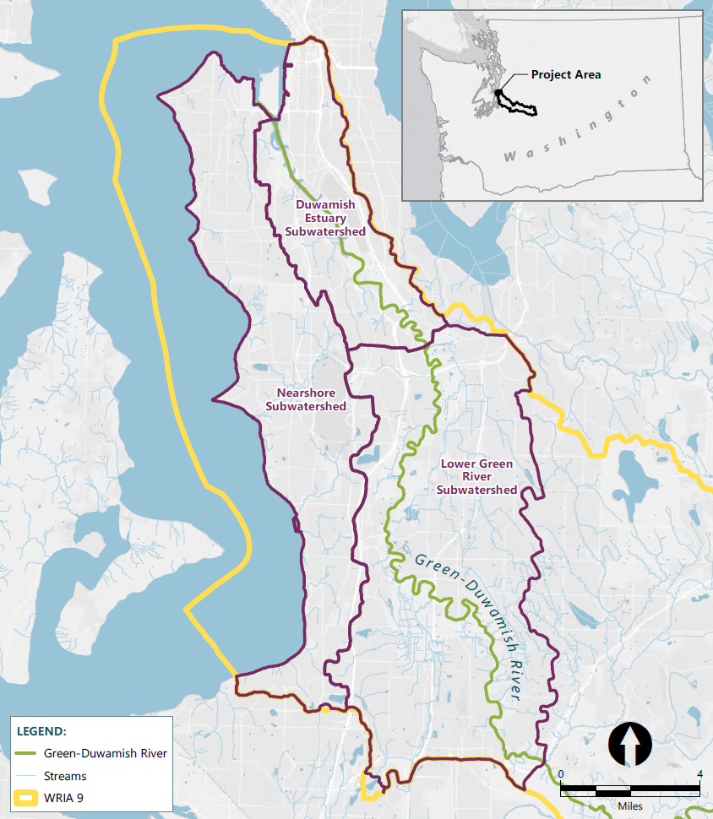
Green-Duwamish River
East Waterway Operable Unit of Harbor Island Superfund Site
Lower Duwamish
Waterway
Superfund sites
  East Waterway Operable Unit of Harbor Island Superfund Site
  Lower Duwamish Waterway (LDW)
Figure 1: Green/Duwamish River Watershed
Notes:
The Duwamish River is Seattle’s only river. It’s home to over 100,000 jobs and 25% of the manufacturing capacity in the region. People rely on it for sustenance, transportation, livelihood, and home.
However, Fish and wildlife in the river have suffered from years of pollution. So have people. So we worked together with the City to cleanup the neighborhood and transform one of our Duwamish properties into a habitat site, park, and mitigation bank.
Now it’s a triple bottom line asset.

Slide 5
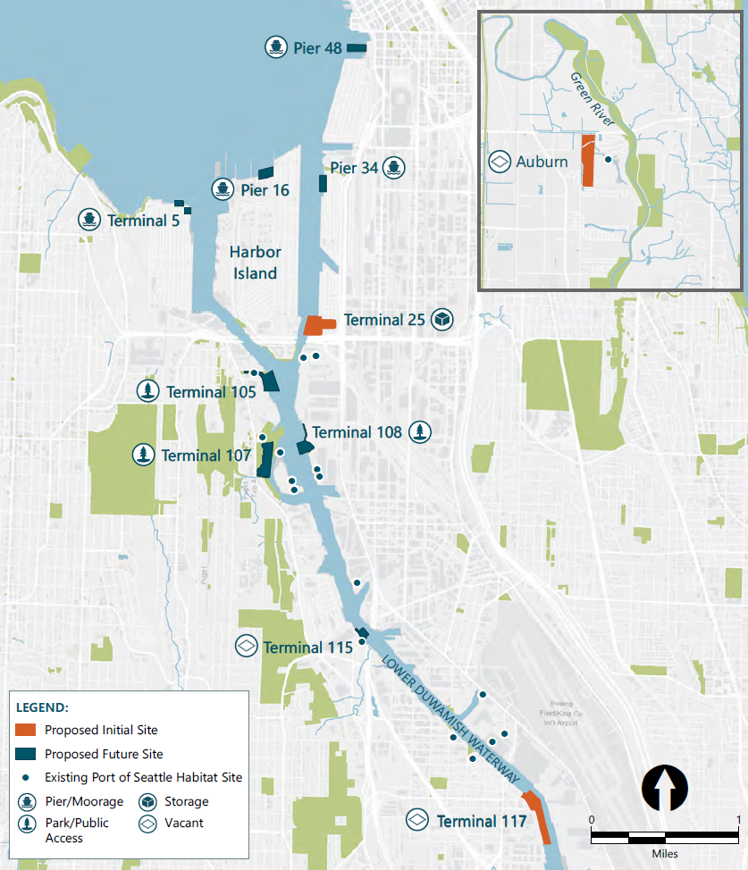
Habitat Line of Business
Initial sites
  Terminal 25 Early Action Site
  Terminal 117 Early Action Site, aka Duwamish River Peoples Park (DRPP) and Shoreline Habitat
Future sites
  Mitigation bank
  Natural Resource Damage Assessment (NRDA)
Figure 2: Proposed Restoration Sites

Slide 6
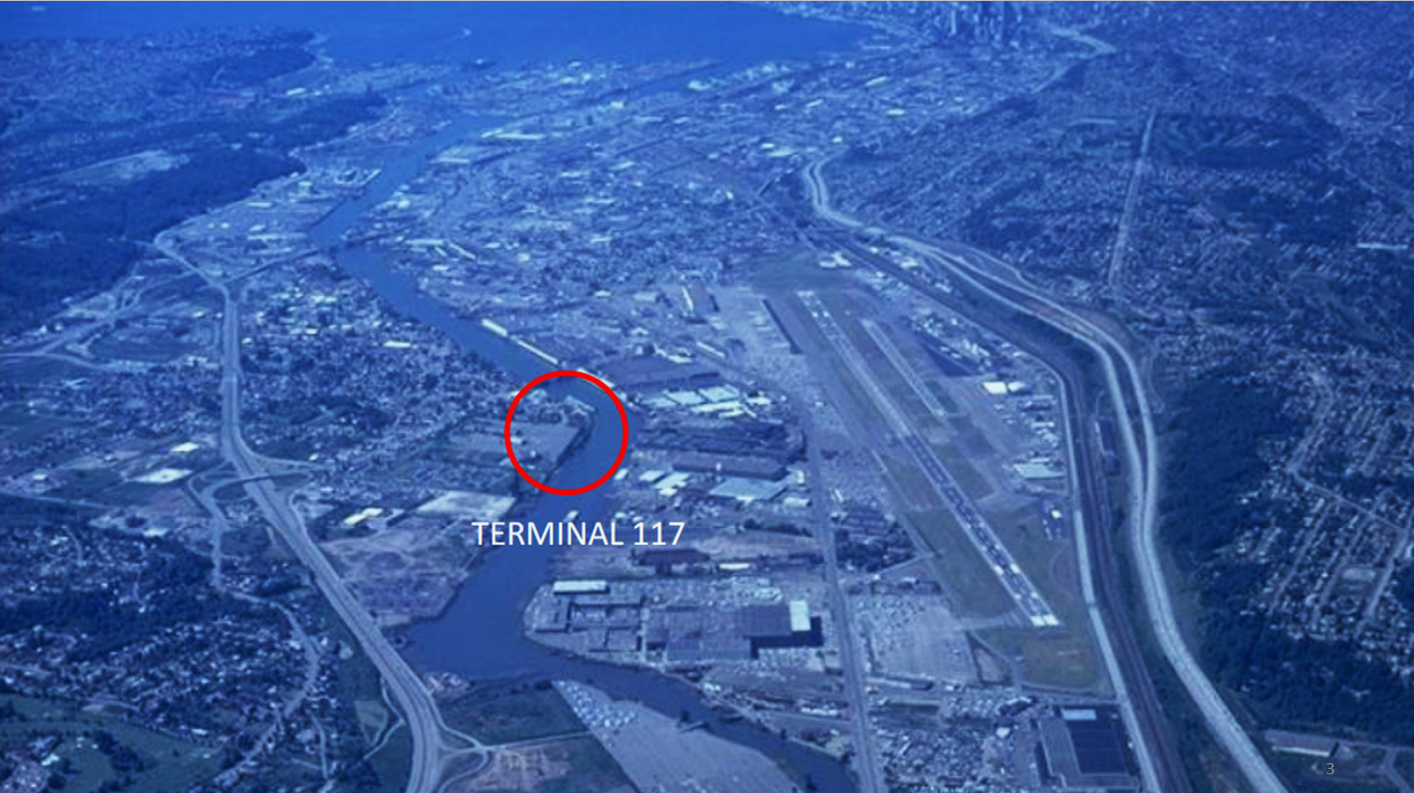
Duwamish River Peoples Park and Shoreline Habitat
Challenge
Notes:
The project, formerly called Terminal 117, sits at River Mile 4 on the Duwamish River, Seattle’s only river. The Duwamish was channelized in 1911 and turned into a marine highway, promoting large-scale conversion of farmland and saltmarsh into industrial property. While that conversion produced jobs and economic vitality, it took a toll on fish and wildlife and the people who call the Duwamish Valley home. The Port and City worked together over a twenty-year period to cleanup Terminal 117 and the surrounding area. Then, the Port turned Terminal 117 into the Duwamish River People’s Park & Shoreline Habitat, giving back a portion of the river to the residents, both human and fish, while also generating nearly $50m in revenue.

Slide 7
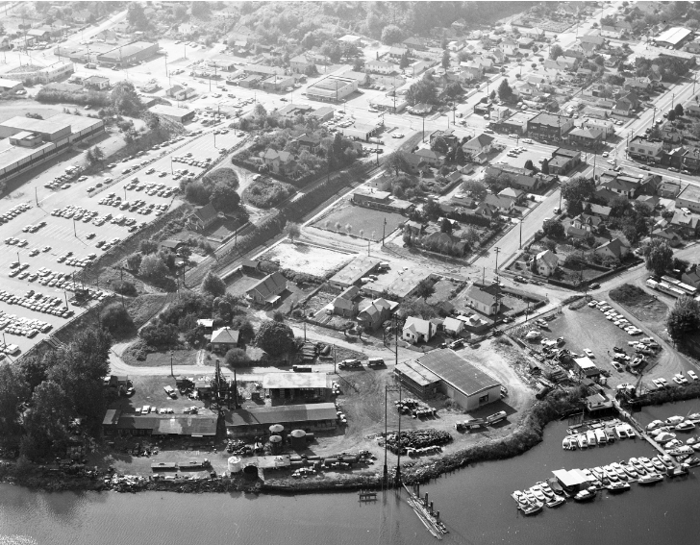
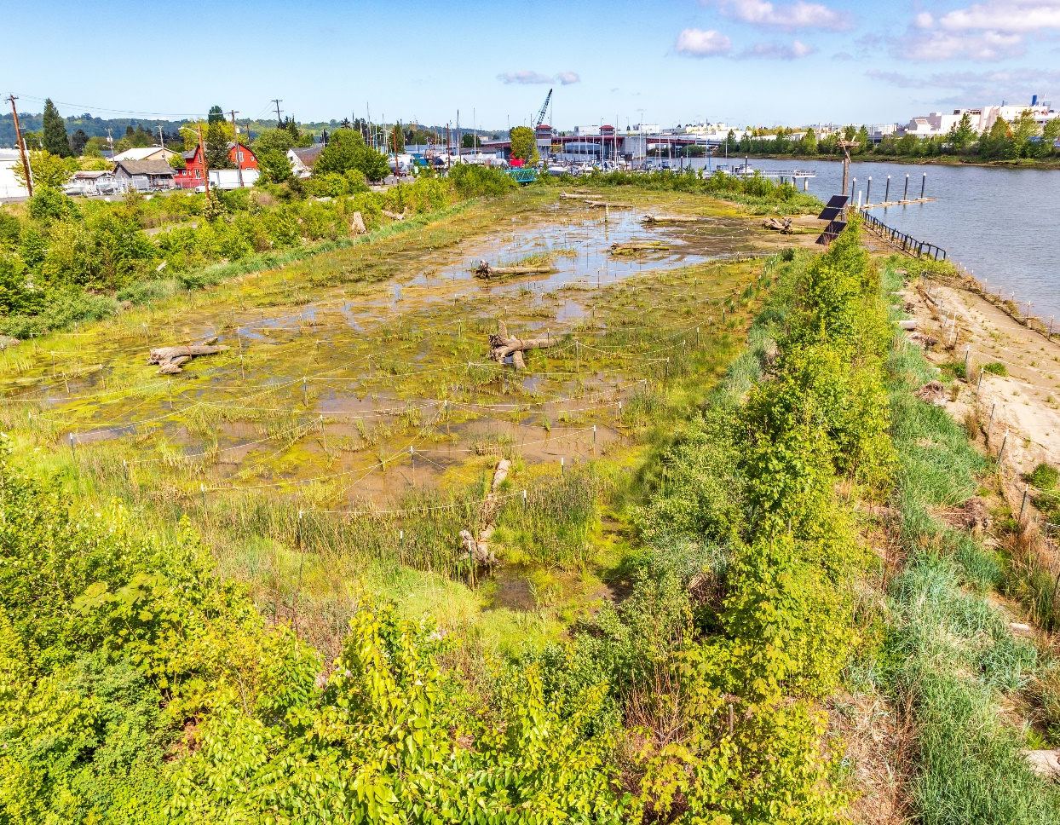
From Industrial Land to Restored Habitat
Before
After
Notes:
We turned one of the worst toxic cleanup sites in the country into a park for the neighborhood of South Park, which is the most racially and ethnically diverse neighborhood in Seattle. There are over 17 languages spoken in the neighborhood and it has the most children per household, while also the lowest per capita income. It’s truly an Environmental Justice neighborhood. We also turned the site into productive habitat for salmon, which are critically imperiled in Puget Sound. And the best part? We paid for all of this with other people’s money. But it’s not all rainbows and unicorns. This was a challenging project that took over twenty years to complete. I’ll talk about the challenges we faced throughout the process, and some of the difficult choices we had to make along the way.

Slide 8
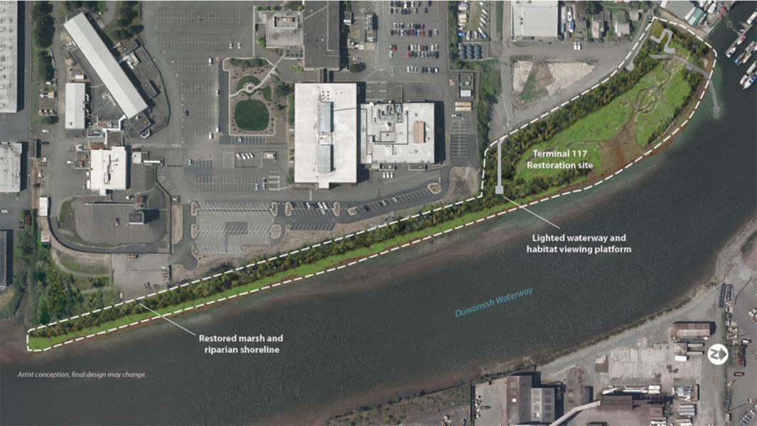
Challenge
Pocket
Neighborhood
Project Site: Overview
Boeing
Property
Notes:
So let’s dive in. This is our project site, which is tucked in between a large Boeing facility, other industrial properties, and the neighborhood of South Park, and the Duwamish River.
The site is located at the narrowest point in the 7-mile-long Duwamish Waterway. Its selection was purposeful. First, we knew it was a badly contaminated site that needed cleanup – possibly one of the worst in the country. The port and city were the only ones who could do it.
Second, because the river is so narrow in this location, we knew that fill-removal and habitat restoration would help relieve downstream flooding. That’s good for everybody.
Third, it’s adjacent to one of our most important fence-line communities – the South Park neighborhood – which have been affected by Port operations. Our license to operate relies on the support of communities like this.

Slide 9
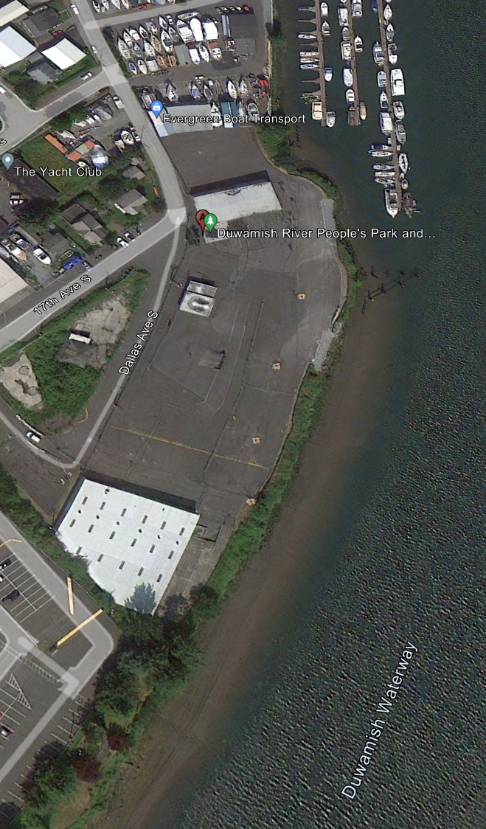
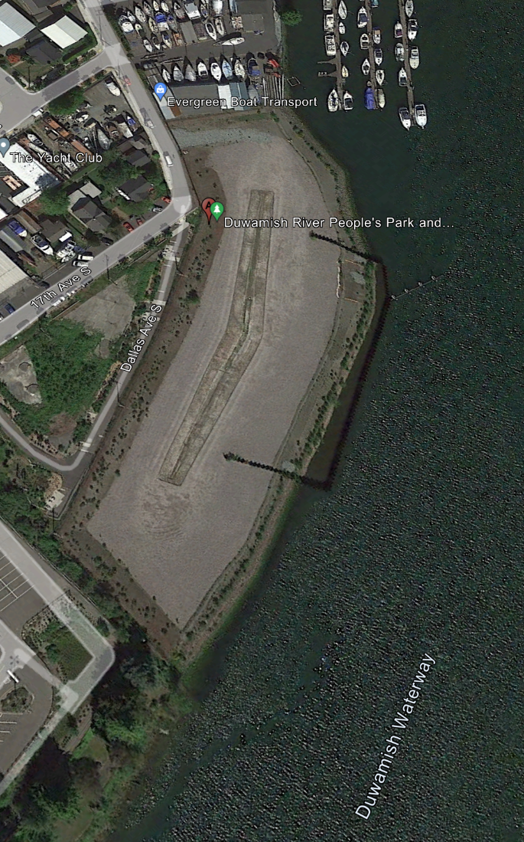
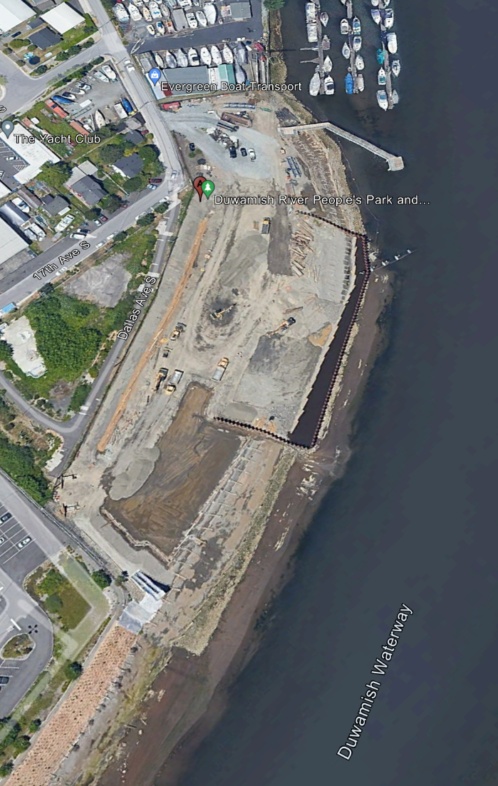
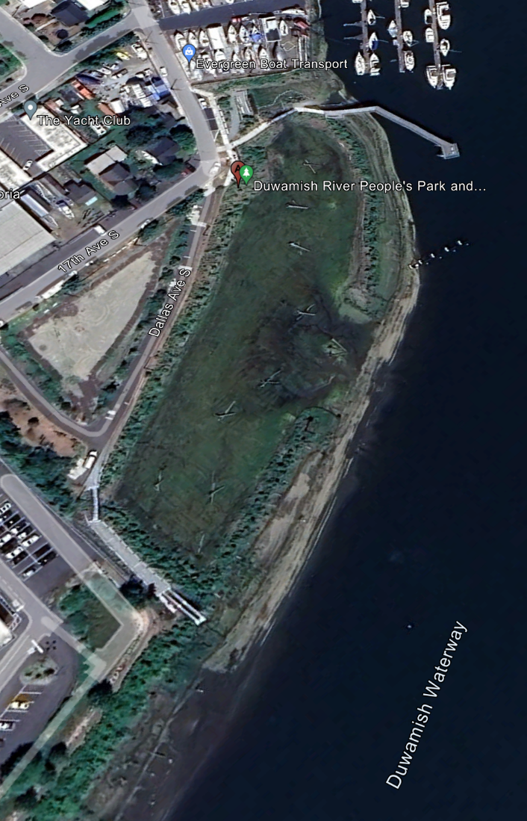
Cleanup and Restoration Timeline
2012
Industrial
2019
Post-Cleanup
2021
Restoration
2023
Complete
Notes:
Just for fun here’s a time-lapse of the site as it went through various stages. The 2012 aerial on left is immediately prior to the cleanup, then cleanup is complete in 2019, then construction on the park and habitat site is underway in 2021, then complete in 2023.

Slide 10
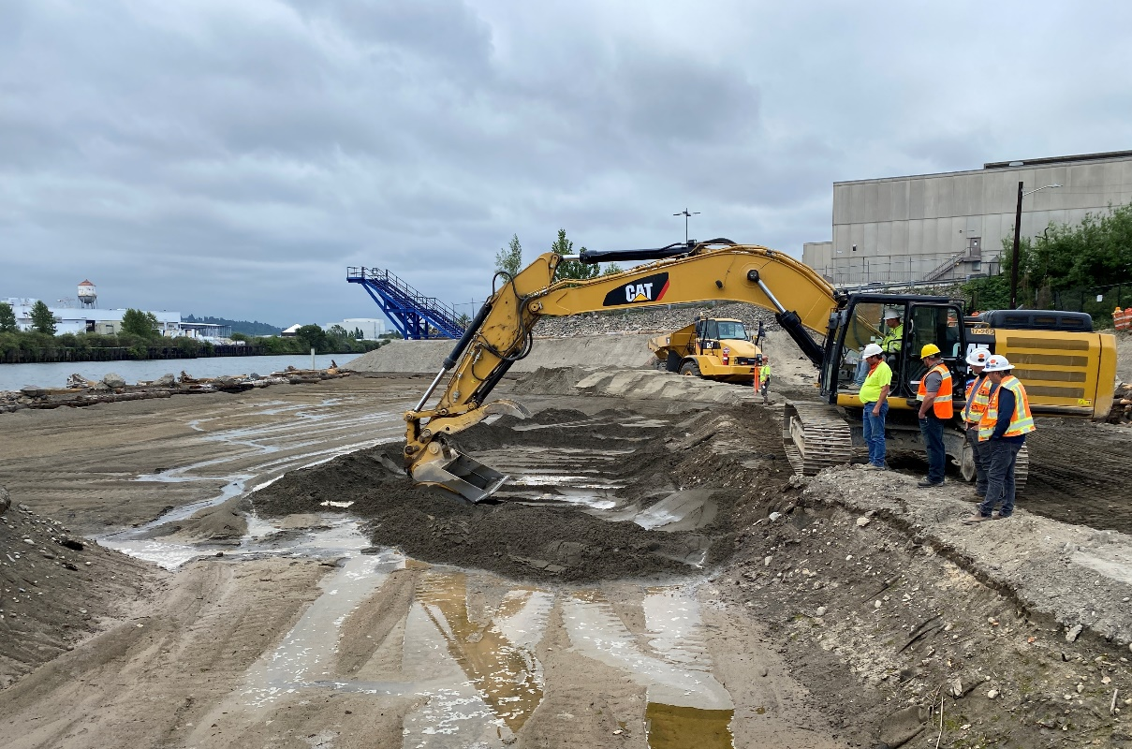
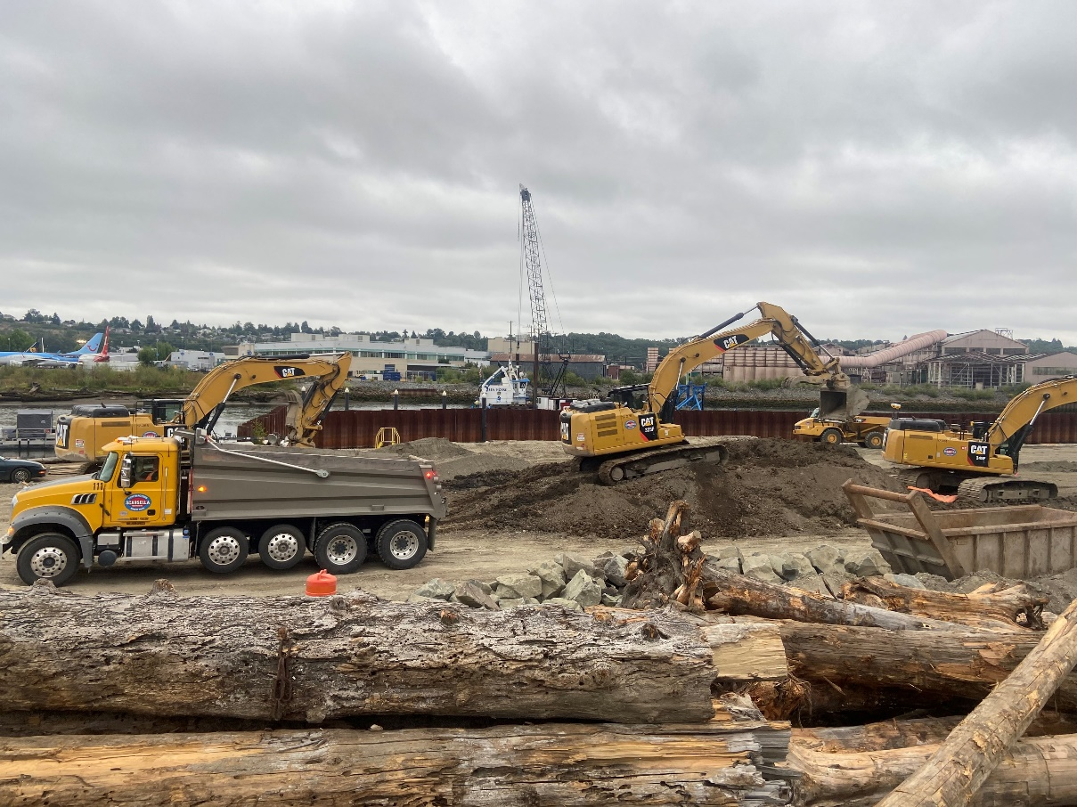
Construction Challenges
Early Action cleanup levels ≠ LDW Record of Decision (ROD) cleanup levels
Soil Management Plan
  Geotextile
  1 to >2.8 feet of clean backfill
Night work
Neighboring structure fire
Figure 3: DRPP Cleanup and Restoration Construction

Slide 11
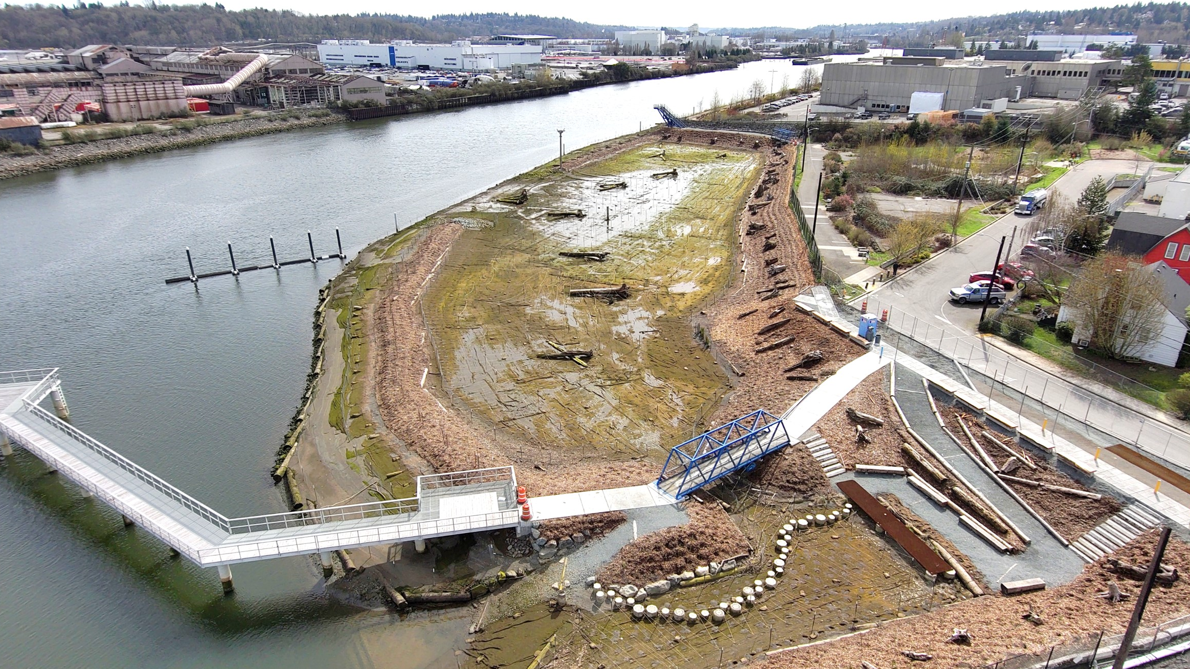
Challenge
Park Features
View Tower
(Repurposed)
Entry
Garden and
Sculpture
Interpretive
Signage
Bridge (Repurposed)
ADA-Accessible Pathways
Viewpoint
Pier
Amphitheater
Hand-Carry
Boat Launch
Stepping
Stones
Notes:
Here’s a different view to give you perspective on the park features. They are arranged in a semi-circle around the marsh basin, with the north end serving as a ‘touch-tank’ for visitors to get up close and personal with the habitat elements.
The permitting agencies were very concerned that too much public access might diminish the habitat value; their thinking was that people might disturb the habitat. We’ve found that the reverse is true. Because we incorporated public access, we created a built-in group of site stewards. The nearby neighbors have taken ownership of the site, including policing, trash removal, and other types of care.
I want to point out that we’ve used numerous recycled and repurposed items in the design, including two foot bridges and the viewpoint tower which were formerly at one of our cruise terminals as gangways. The stepping stones were formerly concrete piling at a cargo terminal, now cut-off and placed to offer a pathway through the touch-tank marsh. The abundant use of logs serves many purposes, including bankline stability, habitat, and even seating and play structures for visitors. Those logs came from the Corps of Engineers – they were removed from Puget Sound as part of their navigation safety program; now they are returned to the landscape where they would have ended up naturally, as habitat and park features.
One of the design choices we needed to make early on was whether to engage a landscape architect, which we often do, or a project artist, to flavor the project. We opted to hire an artist. In this case, it was essential. Our artist, Kristin Tollefson, spent several months in the community getting a sense of the ‘vibe’, so that she could shape the look and feel of the project. The art plan developed for this project has now been offered as an example for other park projects in Seattle.

Slide 12
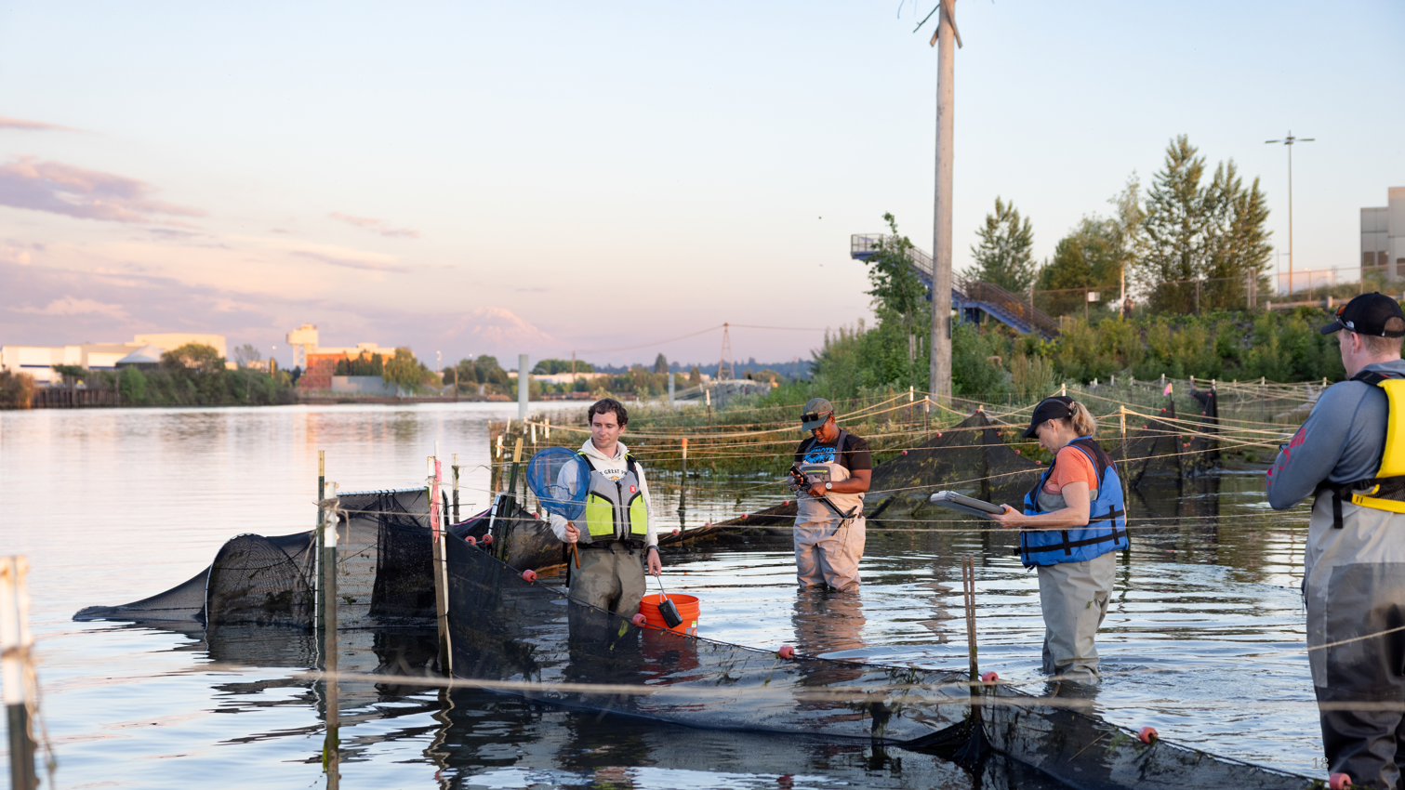
Challenge
Restoration Success
In one tide cycle in year 1, monitoring biologists counted
2,352 chum salmon
237 Chinook salmon
900 other fish
Notes:
Are there environmental benefits? Yes. The site is providing critical habitat for endangered species including Chinook salmon.

Slide 13
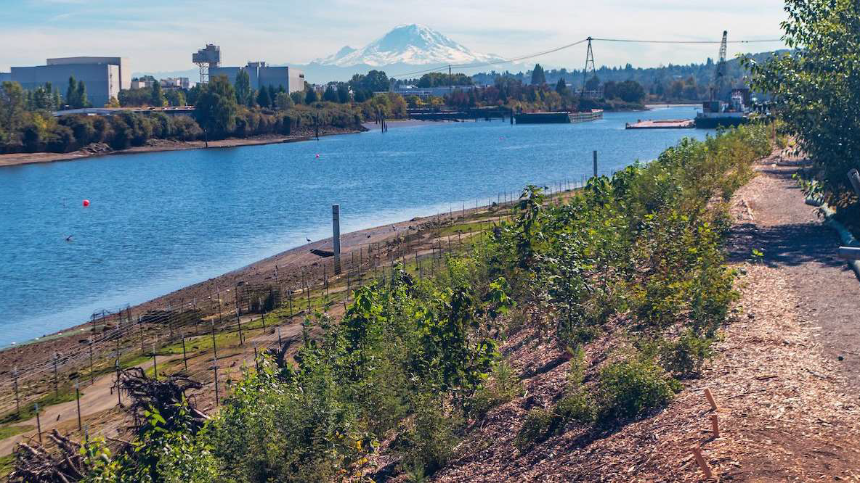
Challenge
Habitat Line of Business
521.5 Natural Resource Damage Assessment credits
$48M in credit sales → future projects
Positive return on investment
Figure 4: DRPP Post-Restoration

Slide 14
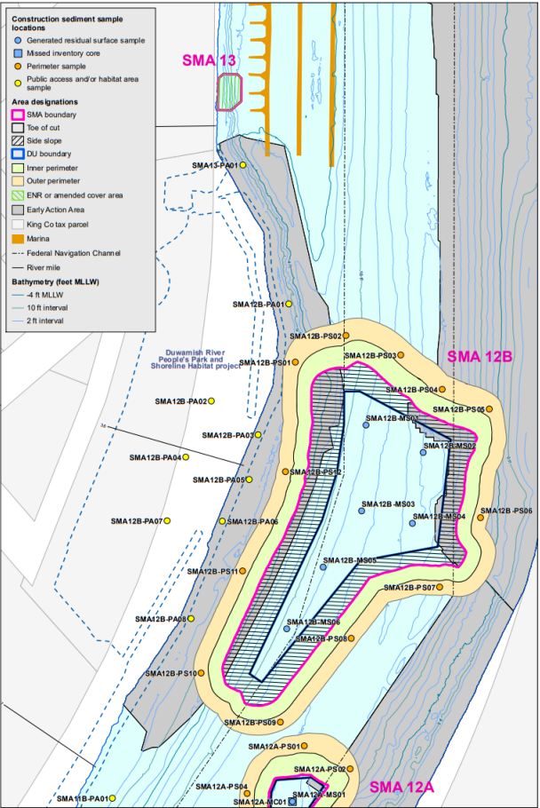
Recontamination Considerations
DRPP Sampling
Best management practices during 2025 cleanup dredging
Additional sediment sampling
Habitat repair, if needed
Long-term monitoring integrated into LDW plan
Cleanup Dredging
Figure 5: Cleanup Activities Near DRPP

Slide 15
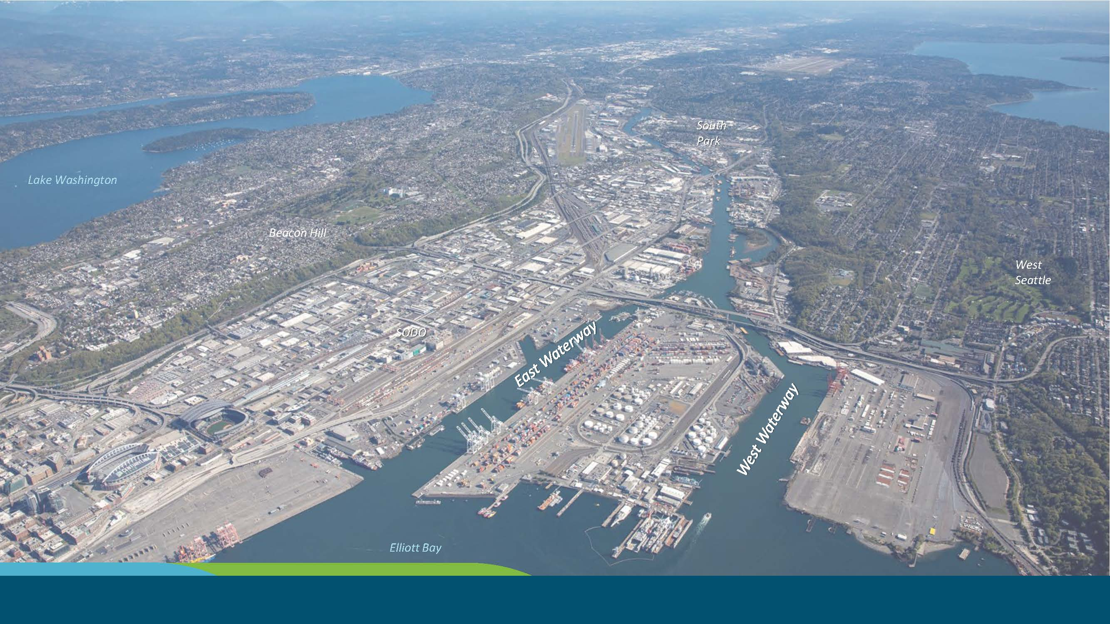
Challenge
Terminal 25
Terminal 25

Slide 16
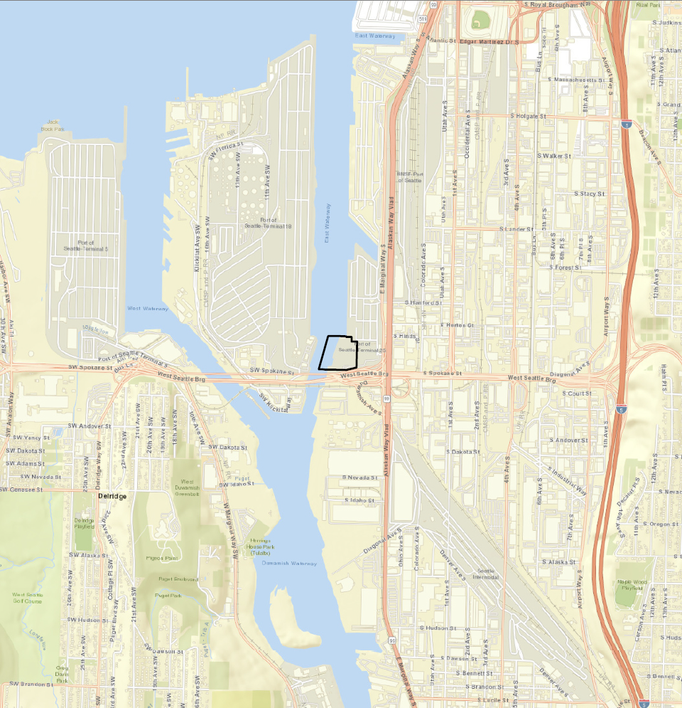
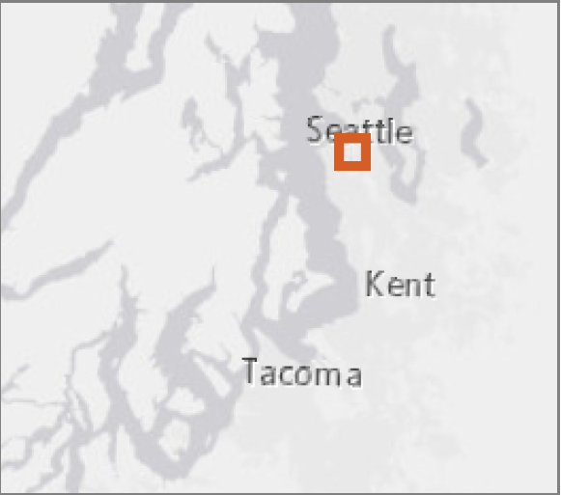
Terminal 25
East Waterway Operable Unit
Terminal 25 Early Action Area
East Waterway Operable Unit—Harbor Island Superfund Site
T-25 Early Action cleanup and restoration 2027–2028
East Waterway cleanup
2029–2035 (Interim ROD 2024)
Lower Reach LDW cleanup 2030–2033
Lower Duwamish Waterway Superfund Site

Slide 17
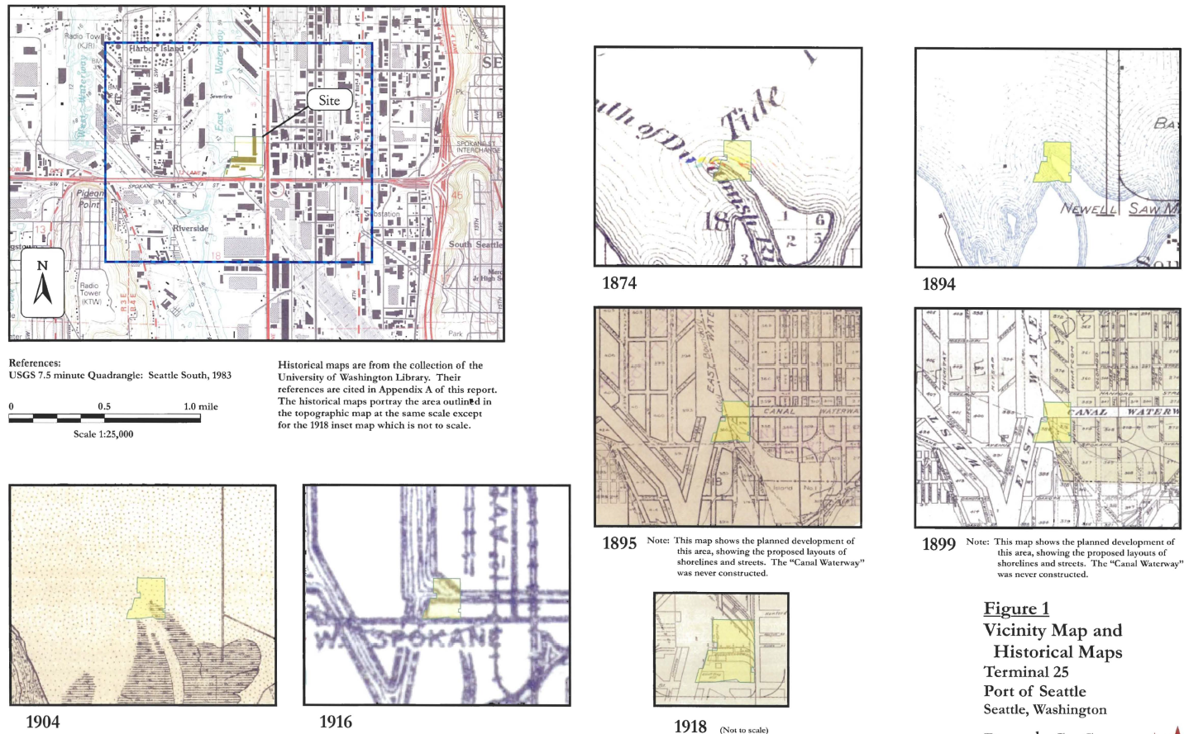
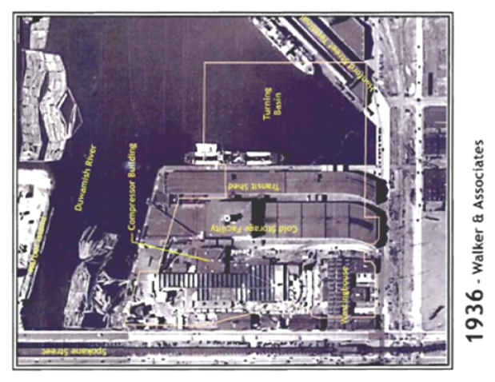
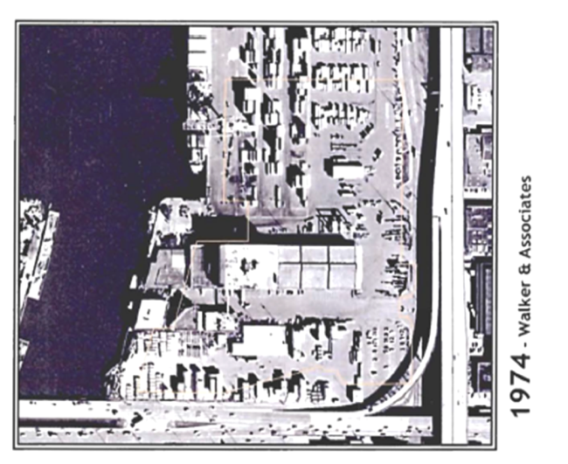
Industrial History
Historic filling
Sawmill, automobile preparation facility, cold storage
PCBs, dioxin/furan, PAHs, metals
1874
1916
1936
1974

Slide 18
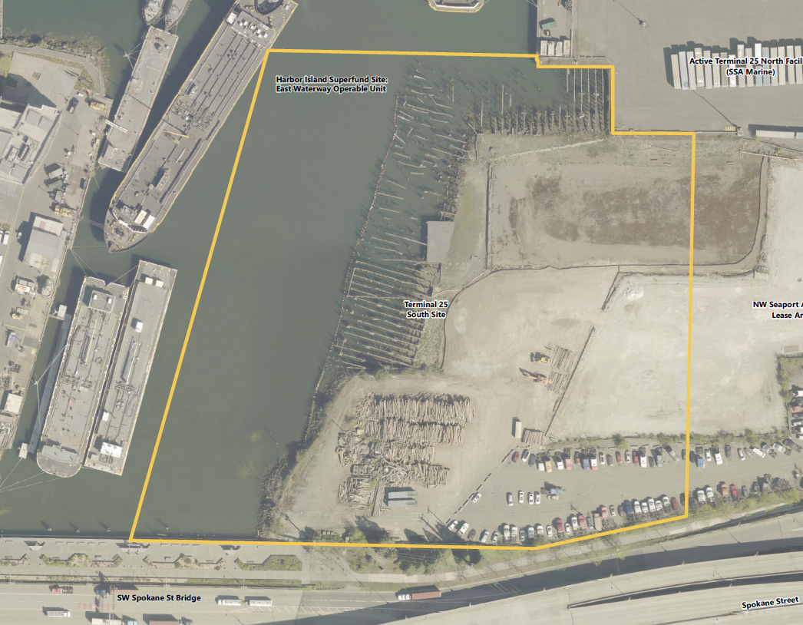
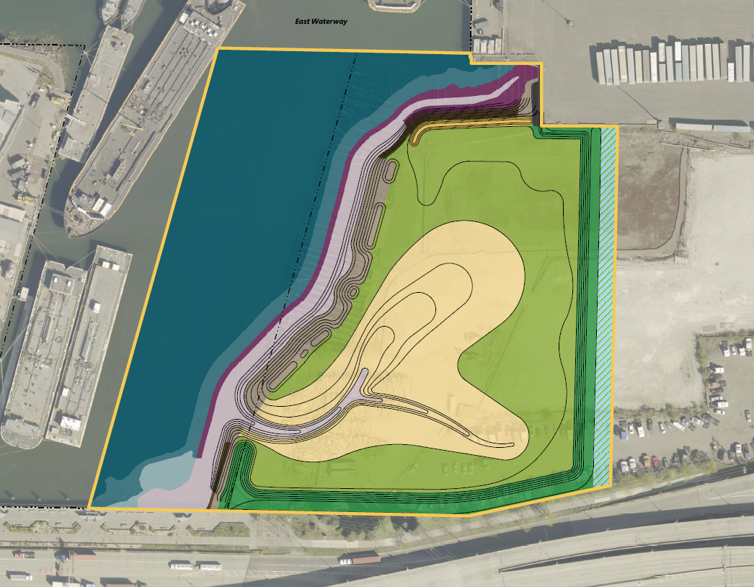
T-25 Restoration Plan
Current Conditions
Future Conditions

Slide 19
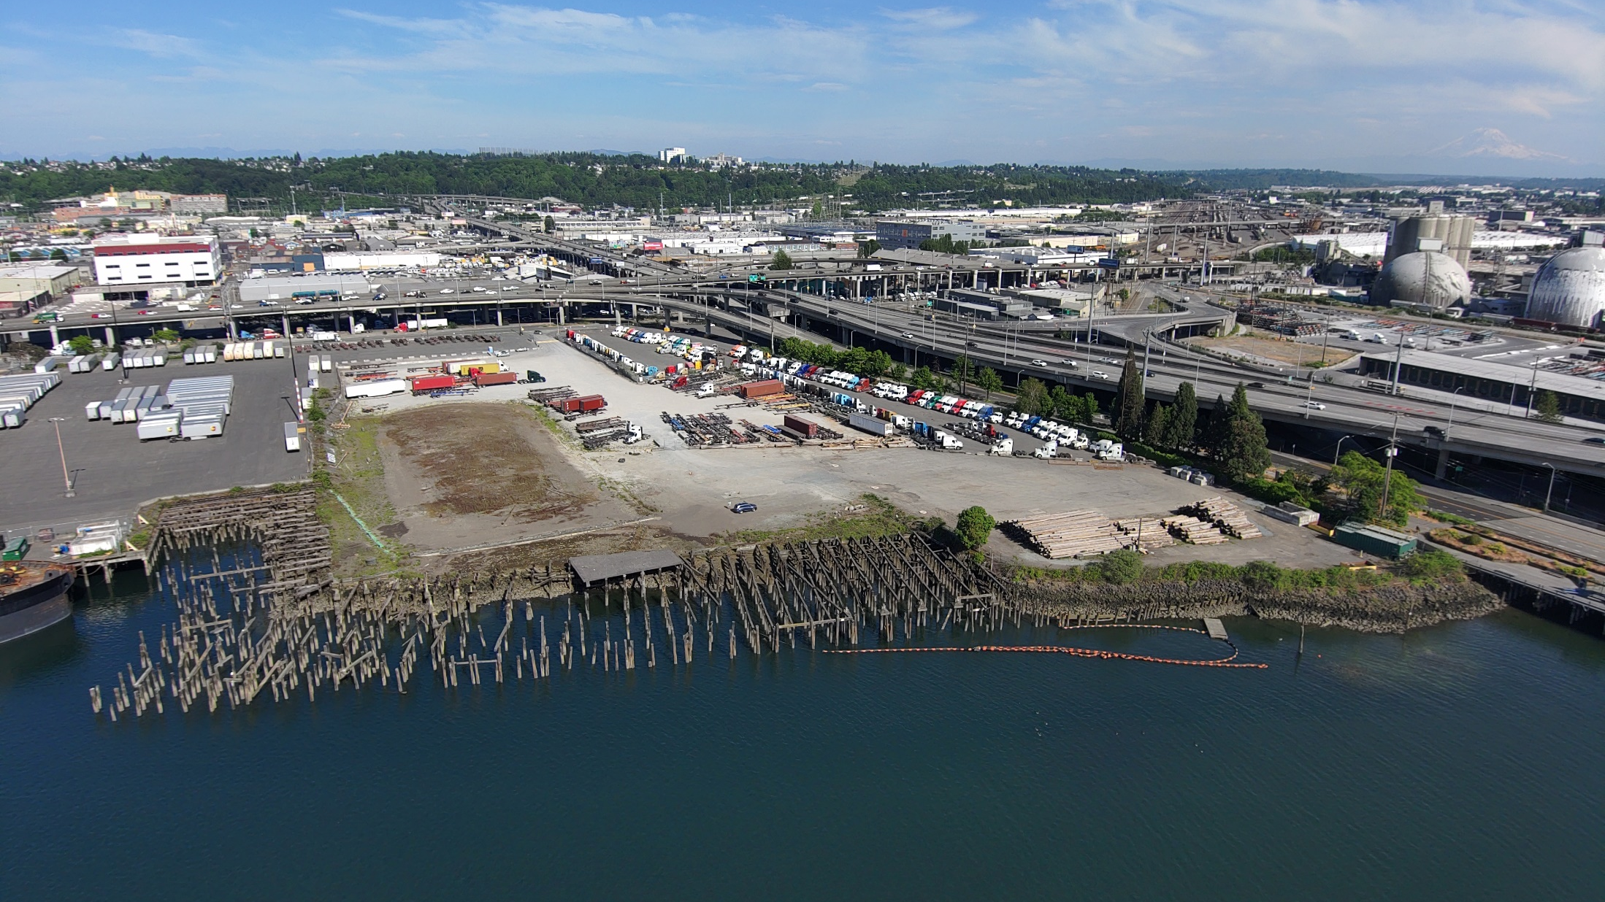
Current Conditions

Slide 20
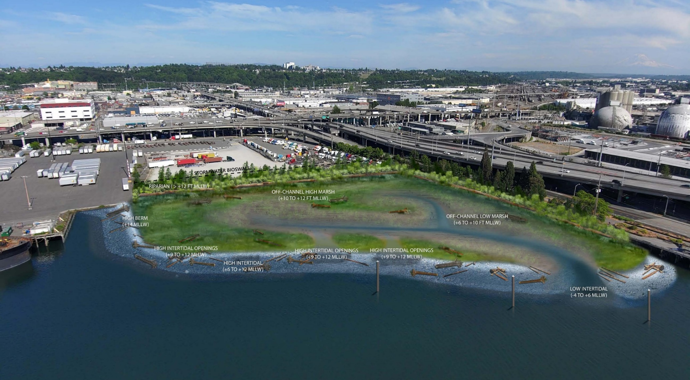
Rendering of Restoration Concept

Slide 21
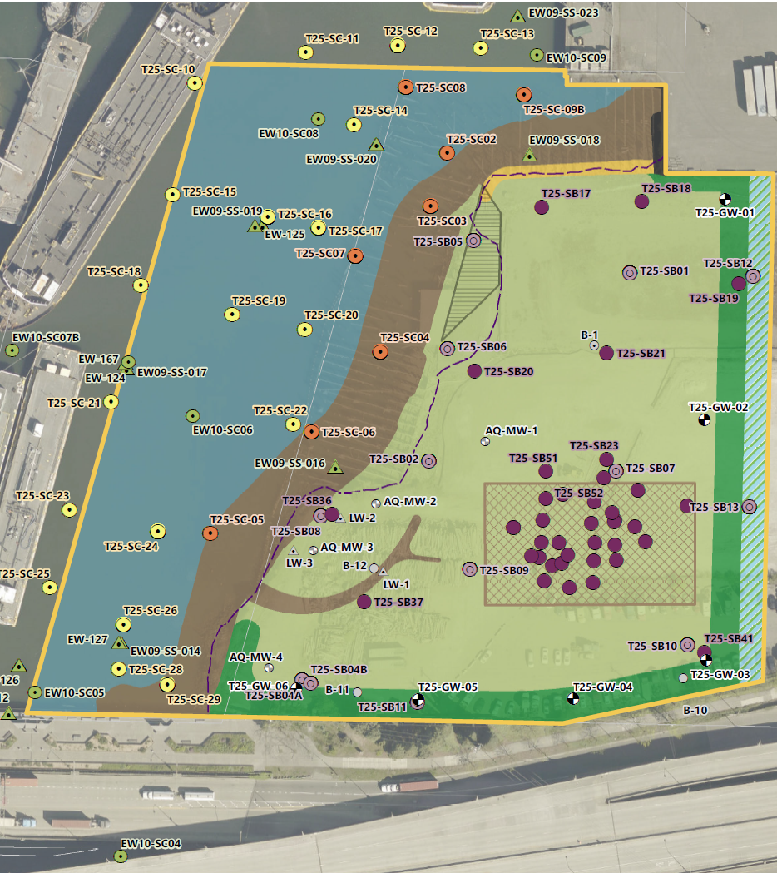
Dual Oversight
USEPA: Remedial Action Levels (RALs) in East Waterway Interim ROD
NRDA trustees: Apparent Effects Thresholds
  More contaminants
  More protective thresholds
Figure 6: T25 and East Waterway

Slide 22
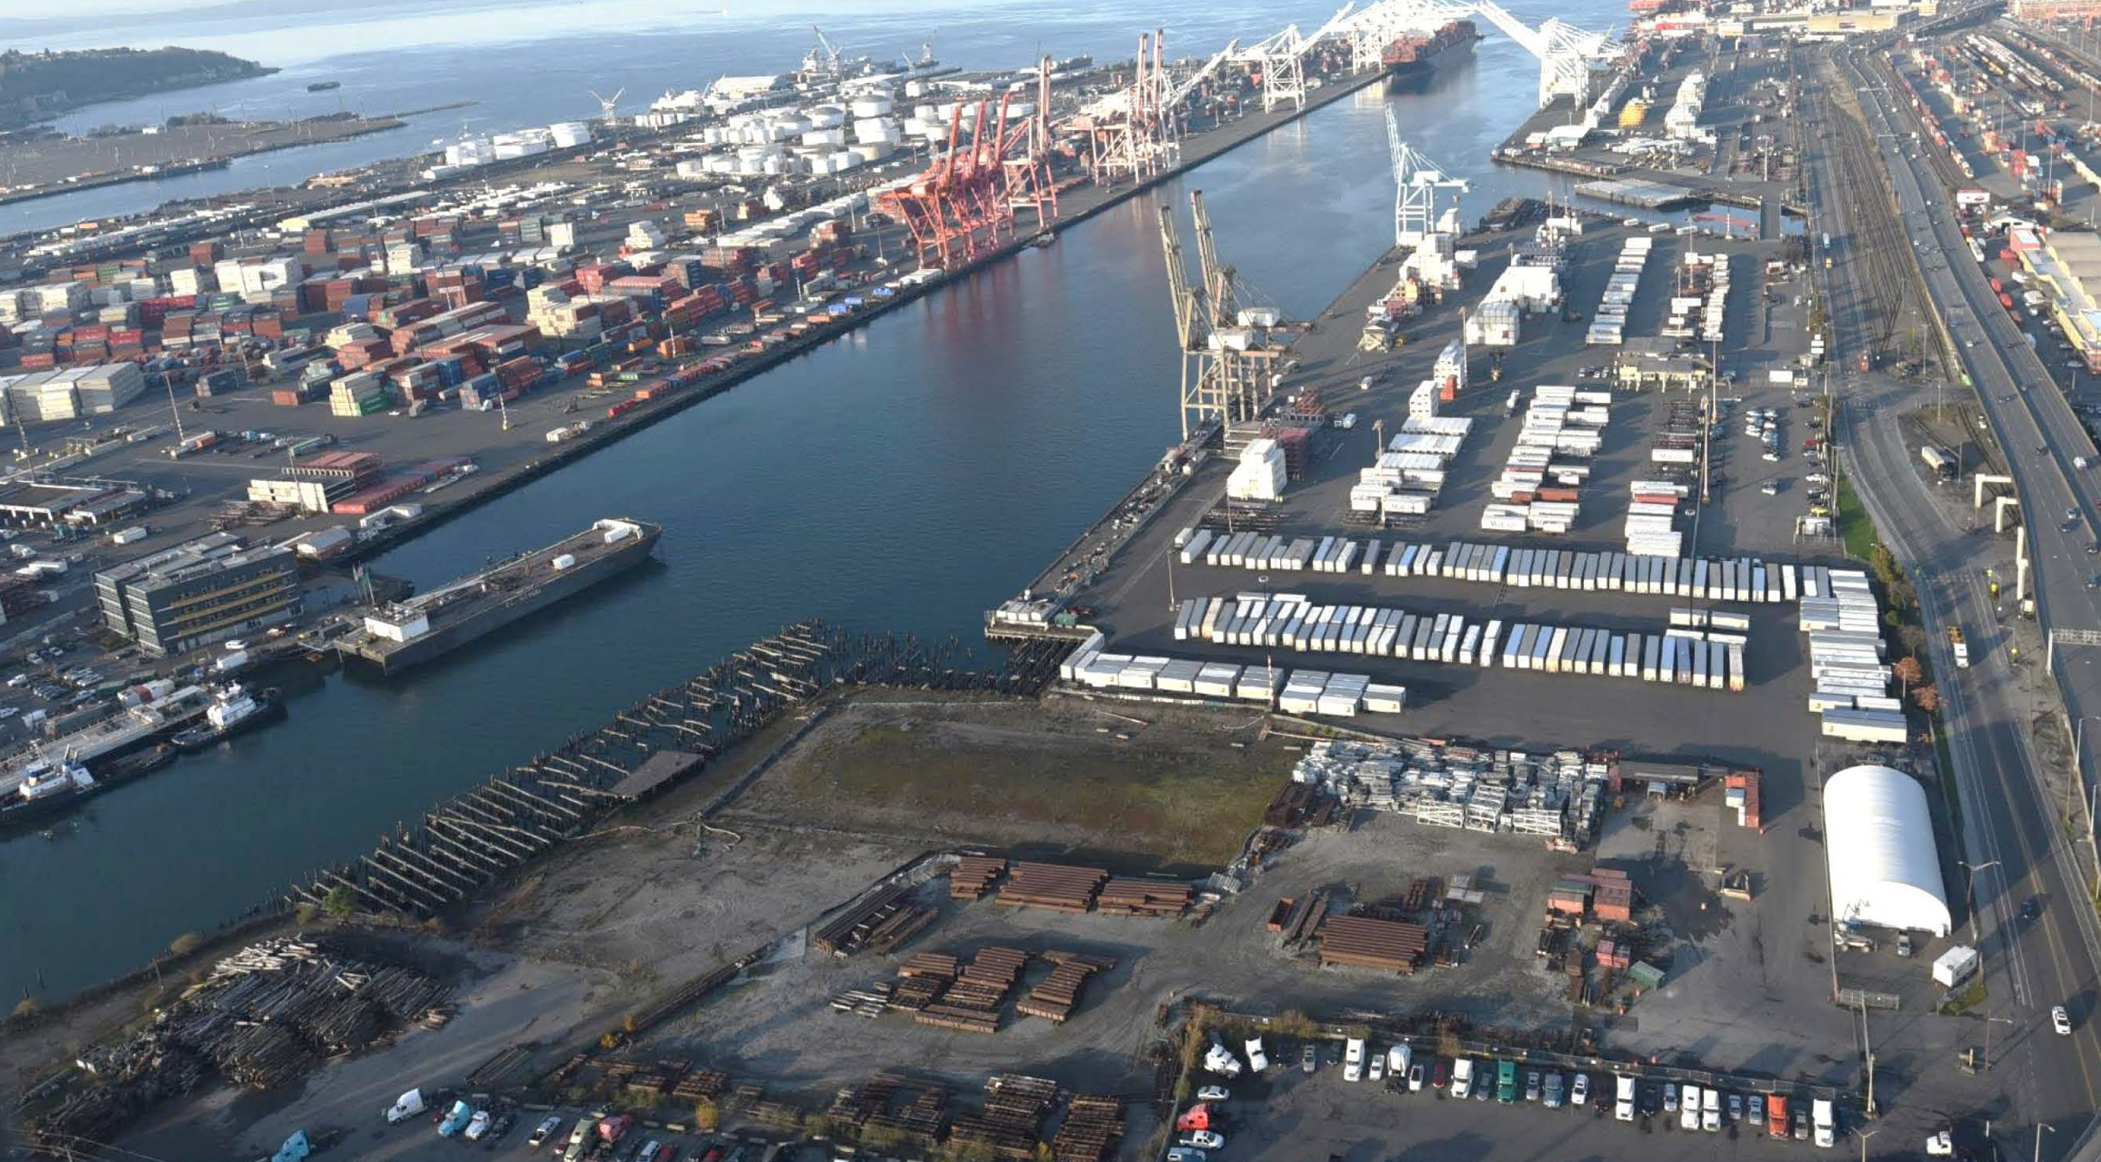

Recontamination Considerations
Challenge
2029–2036
2027–2028

Slide 23
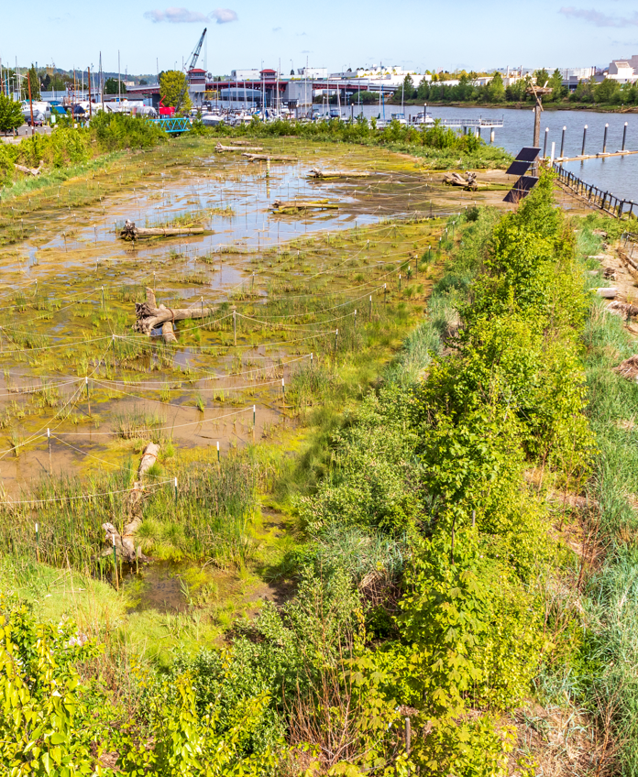
Summary
Longer timeframes
Cleanup complexity
Restoration benefits
Figure 7: DRPP Year 2
Notes:
Early complexity from constructing cleanup and restoration prior to larger cleanup, and larger cleanup complexity to avoid recontaminating restoration area

Slide 24
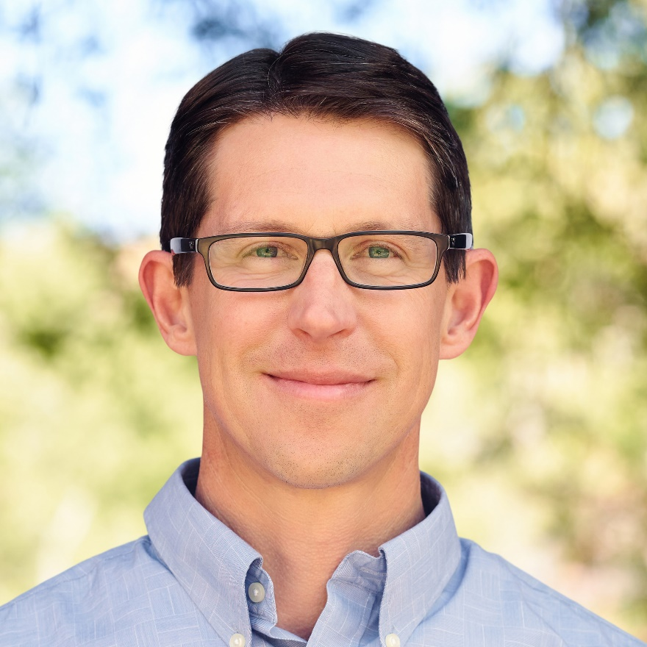

Dan
Berlin, PWS
Principal Scientist
dberlin@anchorqea.com

