Slide 1

Continued Assessment of the Effectiveness of the Upper Hudson River Remedy
Presented by: Christopher Yates
Collaborators: Jennifer Benaman, PhD; Beth Lamoureux; Miriam Mathew; and Cristin Wright, Anchor QEA
Robert Gibson, General Electric Company
Notes:
Acknowledge collaborators

Slide 2
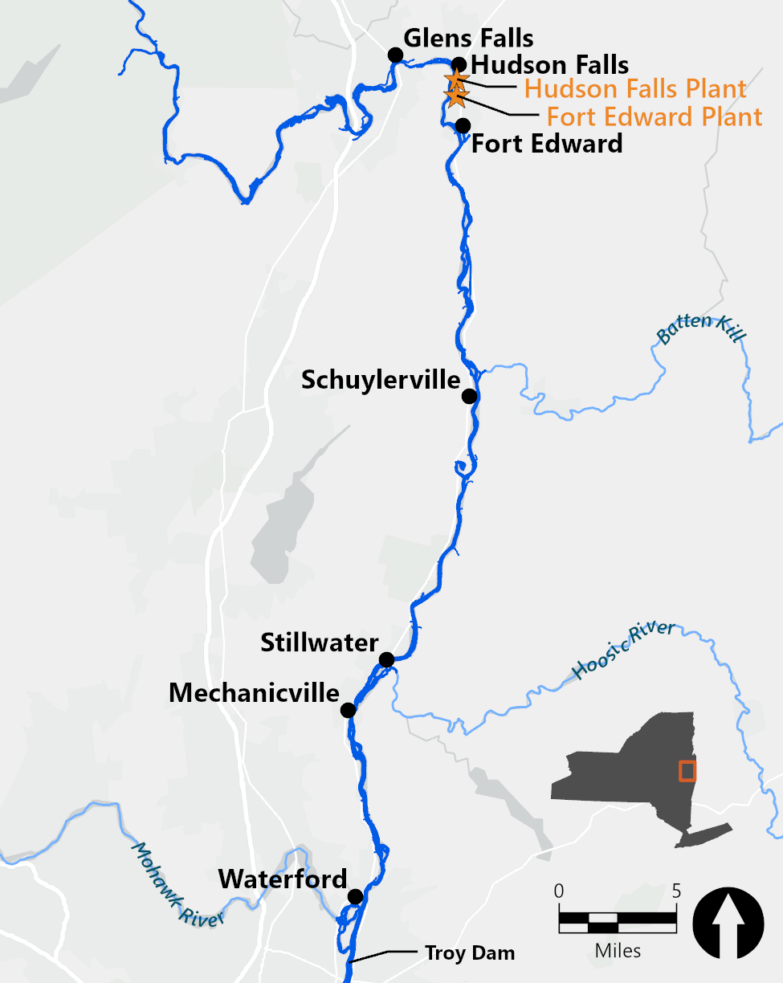
Upper Hudson River Superfund Site
40-mile stretch of river from Fort Edward to Troy, New York
2002 ROD included dredging, backfill, and monitored natural recovery
Dredging was conducted in 2009 and from 2011 to 2015
  500 acres dredged
  2.7 million cubic yards of sediment
  344,000 pounds of PCBs
Notes:
Upper Hudson River is a 40-mile stretch of river located in upstate NY that extends from Fort Edward to Troy NY
GE operated two plants adjacent to the Hudson River in HF and FE which made PCB filled capacitors
The use of PCBs was discontinued in the late 1970s
In 2002 EPA issued a record of decision (ROD) which included dredging and backfilling and monitored natural recovery
After a pre-design investigation and baseline sampling, dredging was initiated in 2009.
2010 was an off year during which the feasibility of the project was assessed and dredging resumed in 2011 and continued to 2015

Slide 3
Post-Dredge Monitored Natural Recovery
Remedial objectives and goals focused on water and fish PCB concentrations
  Reduce the risk to human and ecological receptors by reducing PCB concentration in fish
  Reduce the levels in sediments to reduce the PCB concentrations in river water
  Reduce the inventory of PCBs in sediments that are bioavailable
  Minimize the downstream transport of PCBs in the river
Dredging resulted in an initial reduction in PCB concentrations for all media, followed by natural recovery of the remaining PCBs
Assessment of natural recovery requires many years of data to overcome sample variability
Post-dredging data collected to date can provide early insights into the river’s recovery
Notes:
Hudson dredging project is currently in the long-term monitoring phase
Review RAO goals
No specific numeric goal for sediments
No target rate for MNR
The ROD envisioned an initial reduction in PCB concentrations followed by MNR
Many years of data
EPA’s evaluation in the FYR indicate 8-10 yrs or more data are needed to determine a rate of decline
However, 8yrs of data collected post dredging can provide insights into the river's recovery

Slide 4
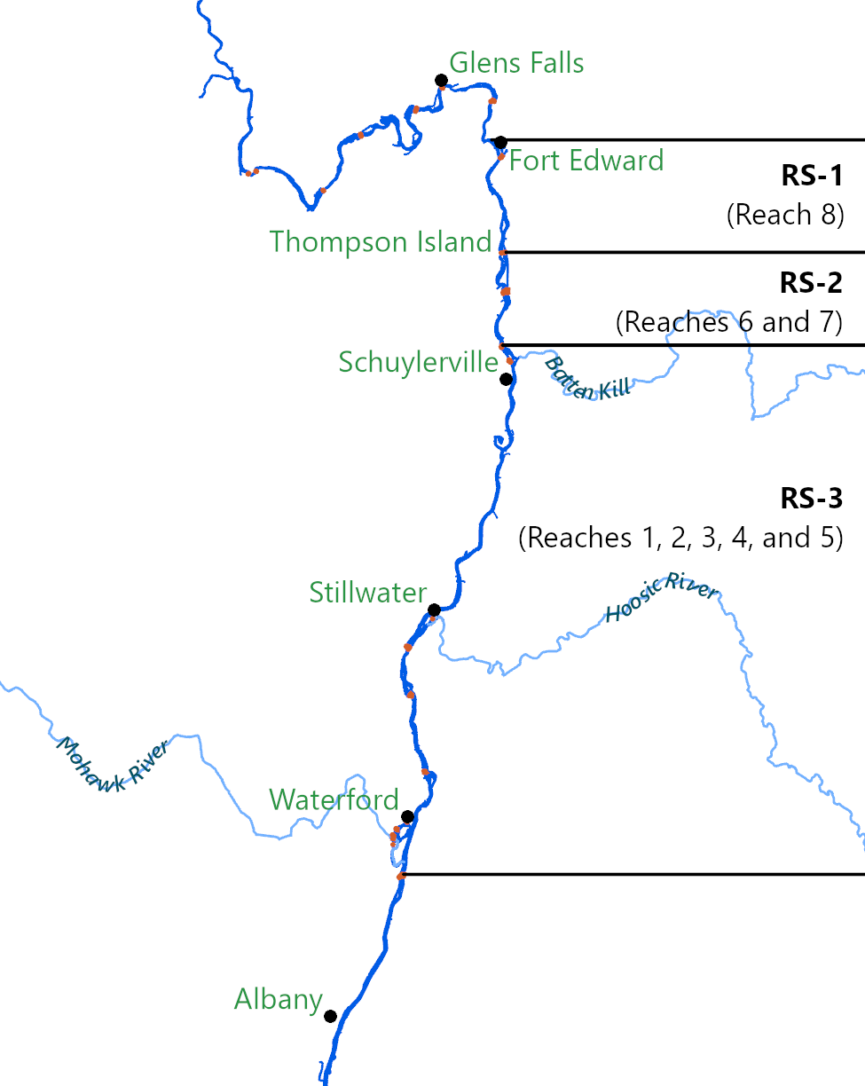
Discretization of the Upper River
ROD evaluated alternatives at a River Section (RS) level
River divided into reaches due to dams
    RS-1: Reach 8
    RS-2: Reaches 7 and 6
    RS-3: Reaches 1 through 5
Data evaluations are performed at this scale
Notes:
EPA 2002 ROD divided the river into three river sections, each with slightly different dredging criteria to evaluate remedial alternatives
River is further divided into Reaches based on the presences of dams to allow for navigation for the Champlain Canal

Slide 5
Water Assessment
Methods
Pre-dredge: 2004 through 2008
Post-dredge: 2016 through 2023
Upper River
  Thompson Island and Schuylerville stations sampled from April to November
  Waterford station sampled year-round and during high flow
Lower River
  Albany and Poughkeepsie sampled monthly
Poughkeepsie
80 miles south
Notes:
Review of the data starting with the water, then fish and finally sediments
The river has been sampled since the early 1980s
Current mythologies were initiated in 2004 with the start of the baseline monitoring program (2004-2008)
Different methods (automated stations and 24hr composites) were used during dredging
After completion of dredging, the locations and methods used for the BMP were resumed
The three UHR stations are shown with the boxes and represent the ends of each of the three RS
Data from each is representative of what is occurring in the respective RS
Waterford is the compliance location for measuring PCB load to the Lower Hudson

Slide 6
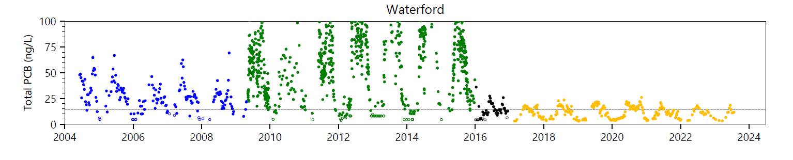
Consideration of Flow and Seasonal Variations
BMP
RAMP (dredging)
OMM (post-dredge; mGBM)
OMM (post-dredge; 1668C)
BMP: Baseline Monitoring Program
RAMP: Remedial Action Monitoring Program
OMM: Operation, Maintenance, and Monitoring
mGBM: Modified Green Bay Method
1668C: EPA Method 1668C
PCB comparisons need to control for:
Variability due to flow
Seasonal fluctuations
Assess the data two ways:
Summer low flow: July to September (<5,000 cfs)
High flow (>15,000 cfs)
Notes:
Evaluations of water data needs to account for variability due to river flow and seasonal fluctuations in the data
There is variably between years with River flows with some years that have higher average river flows
Within each year, differences in high flow conditions impact sediment resuspension
Describe data shown on plot
BMP in blue
RAMP in Green
OMM in black/yellow
There is a seasonal component in the PCB data where the concentrations are higher in the summer due to increase biologic activity, generally lower river flows and warmer water temperatures
Assess the data in two ways
- Summer Low Flow (Worst case scenario with highest PCB concentrations)
- High Flow

Slide 7
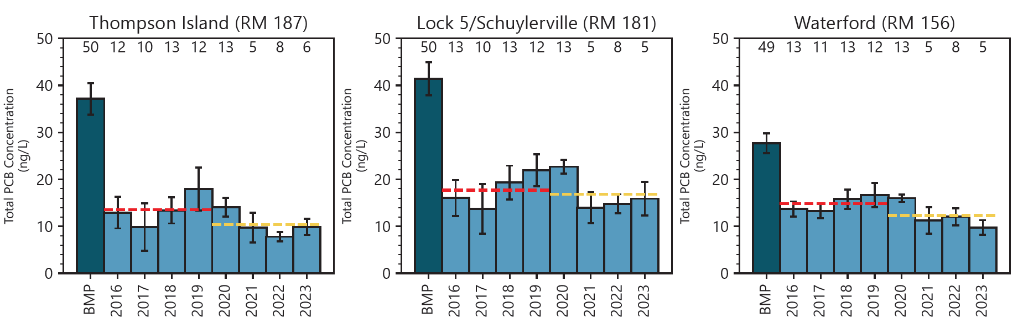
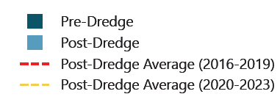
Summer Lower-Flow Average – Upper River
RESULTS - Water
Notes:
Sample results shown are from the three upper Hudson stations that have been sampled consistently since the start of the Baseline program in 2004
The locations were sampled weekly from April to November from 2004 to 2020
After a reviewed the data, the sample frequency was reduced to 3x/mo starting in 2021
The data shown is ‘low flow’ which is <5,000 cfs at the Fort Edward USGS gaging station
The numbers at the top of the graph are the sample counts
-
There has been significant reduction in PCB concentrations due to dredging from the BMP sampling (72% at TI, 60% at Schuylerville and 56% at Waterford)
Data shows continued declines with the recent 4yr low flow average below the 4yrs immediately after dredging
Thompson Island
BMP: 37.1
2016-2019: 13.5
2020-2023: 10.4
Lock 5/Schuylerville
BMP: 41.4
2016-2019: 17.7
2020-2023: 16.8
Waterford
BMP: 27.7
2016-2019: 14.8
2020-2023: 12.3

Slide 8
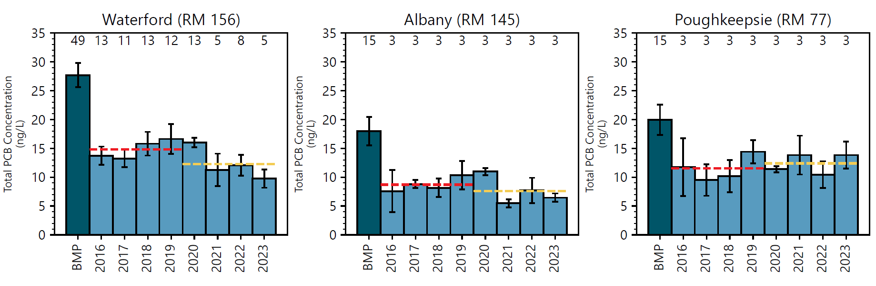
Summer Average – Lower River
RESULTS - Water
Upper River
Lower River
Notes:
- There are 2 locations routinely sampled in the lower Hudson at Albany and Poughkeepsie.
Locations are only sampled on a monthly basis
River is tidal so there is no flow restriction to the data
Waterford data (southern most UHR locations) is shown for comparing to the LHR
Between WF and ALB, the largest tributary to the Hudson, the Mohawk River, joins and is a significant dilution factor to the PCB concentrations at Albany
Impacts due to dredging seen at Albany with a 58% reduction in PCBs from the BMP period and recent data indicated continued recovery
Note that since the completion of dredging all the summer results at Albany are below the Federal Continuous water quality criteria of 14 ng/L
80 miles downstream of the UHR at PK, the PCB water concentration reductions have been reduced by 40%.
Data is generally flat post dredging with summer averages around 12 ppt.
The system is more complicated as you move south towards NYC
There are many other additional industries along the river with other potential sources of contaminates
Waterford
BMP: 27.7
2016-2019: 14.8
2020-2023: 12.3
Albany
BMP: 18.0
2016-2019: 8.7
2020-2023: 7.6
Poughkeepsie
BMP: 19.9
2016-2019: 11.5
2020-2023: 12.4

Slide 9
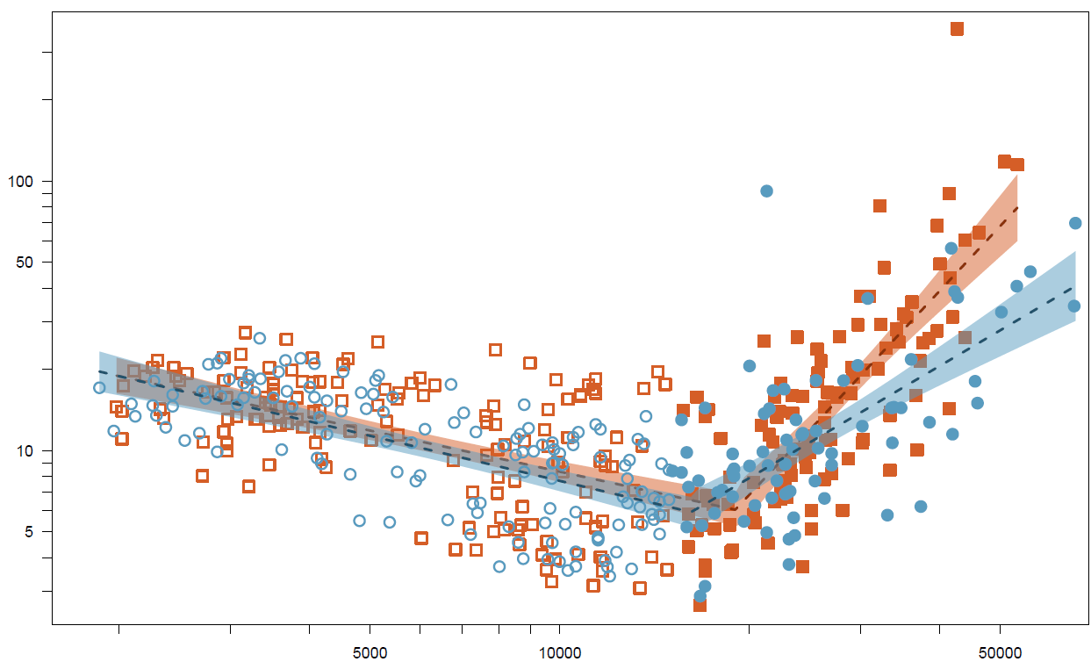
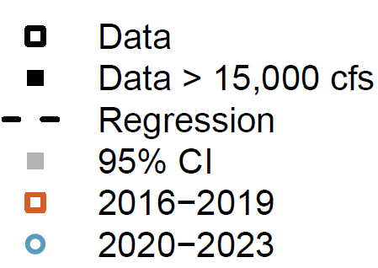


Waterford Post-Dredge High-Flow Data
RESULTS - Water
Recent data indicate a reduction in PCB concentrations during high-flow events
9
Notes:
- Other way to look at he water data is to focus on the high flow results
Targeted sampling is conducted at Waterford when river flows exceed 15,000 cfs
15,000 cfs is approximately when sediment resuspension starts to influence the PCB levels in the water
Filled symbols on the plots represent data collected above 15k cfs
Data colored red are sampled collect 2016-2019
Blue data is 2020-2023
Recovery with the more recent HFL data is lower than the period immediately after dredging

Slide 10
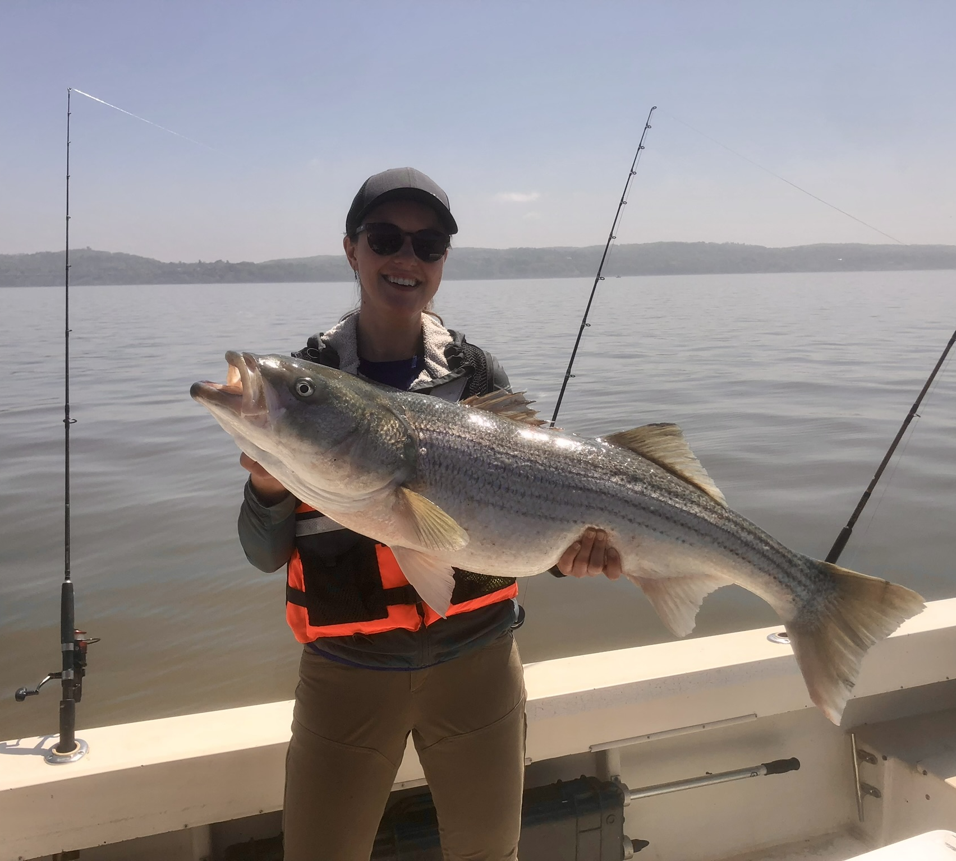
Fish Assessment
Sport fish and forage fish collected annually from the Upper and Lower Hudson River
Fish PCB concentrations are highly variable
  Habitat and prey availability vary year to year
  Bioenergetics
  River flows
  Water temperature
Many years of fish PCB data are needed to overcome factors that cause variability to statistically assess a trend
Notes:
Sport Fish (Stiped bass, Black Bass, Bullhead, Catfish, Perch)
Forage Fish (Blue Gill, Minnows)
Due to the variably many years of fish PCB data are needed
Hannah’s Stiped Bass - 42lbs and 32in long

Slide 11
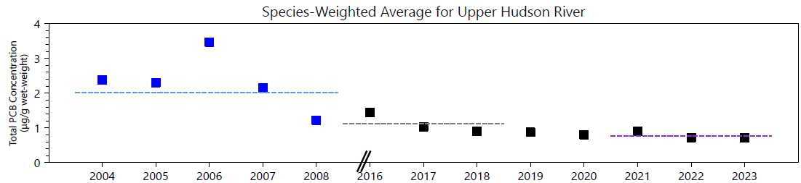

Species Weighted Average – Wet Weight
RESULTS – FISH
Species weighted averages are gradually declining
  Declines are gradual due to year-to-year variation and lag in fish response to sediment exposure reductions
Notes:
One way to look at the fish PCB concentrations is on a species weighted average
Average includes Black Bass, Bullhead and Yellow Perch
The averages are weighted based on the length of the River Section
- Data shown is wet weight fillet of the individual species
- Blue data is the BMP and 2016 on is post dredging OMM samples
Variability in the fish data is evident in the BMP dataset with high value in 2006 followed up 2yrs later with the 2008 average in line with the post-dredge data
Post dredge declines are still evident with the 3yrs of data immediately after dredging showing a 45% decline from BMP and the recent 3yrs showing a 61% decline
TPCB Average lines:
Pre-dredge (2004 - 2008) = 2.01 ug/g,
Post-dredge (2016 - 2018) = 1.11 ug/g
Post-dredge (2021 - 2023) = 0.78 ug/g

Slide 12
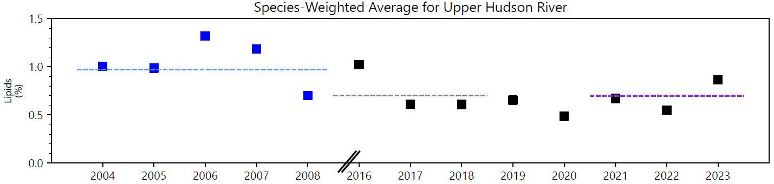
Species Weighted Average – Lipid
RESULTS – FISH
Lipid weighted averages for the post-dredge period are somewhat variable but do not indicate a decline
12
Notes:
When looking at the fish data you need to look at the % lipid in the fish.
There are concerns that decreases in PCBs may be due to decreases in % lipid.
Plot shows the sample species weighted average on a lipid basis
There is a difference from BMP to post dredge
Lab changes
Fillet method change
Extraction changes
Post dredge data is consistent
Lipids Average lines:
Pre-dredge (2004 - 2008) = 0.97%
Post-dredge (2016 - 2018) = 0.70%
Post-dredge (2021 - 2023) =0.70%

Slide 13
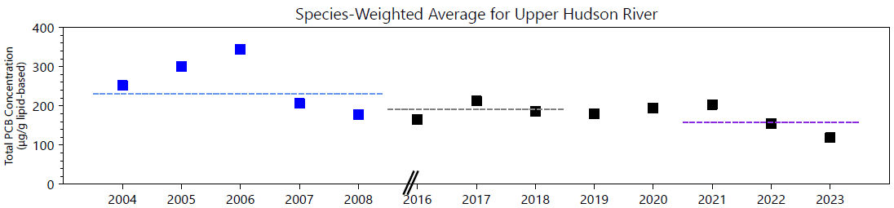
Species Weighted Average – Lipid Normalized
RESULTS – FISH
Lipid normalized averages indicate continuing post-dredge declines are apparent but not as pronounced
Notes:
LPCB Average lines:
Pre-dredge (2004 - 2008) = 230.1 ug/g lipid-based
Post-dredge (2016 - 2018) = 190.29 ug/g lipid-based
Post-dredge (2021 - 2023) = 158.15 ug/g lipid-based

Slide 14
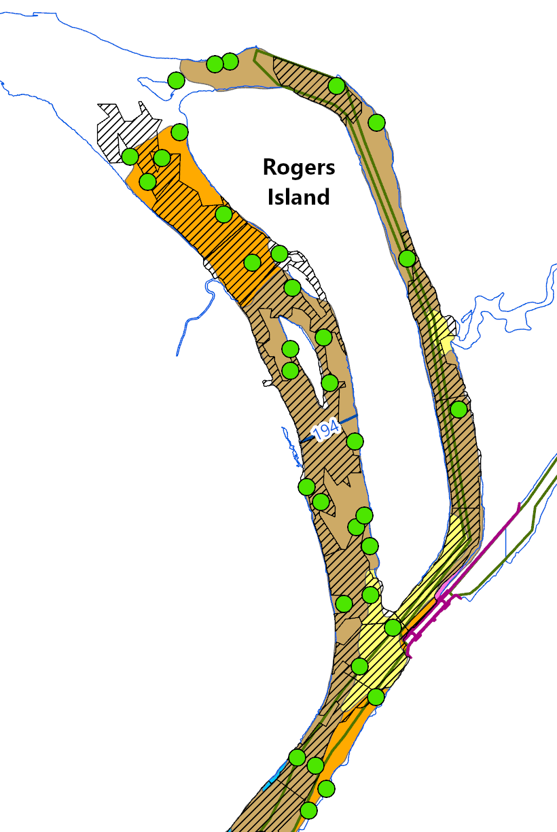
Sediment Assessment
Surface sediment sampling conducted every 5 years
At least 10 years of data (three rounds) needed to evaluate recovery rates
2016/2017: 1,330 samples collected by GE and NYSDEC
  Initial data collection used as the baseline for future comparisons to evaluate recovery rates
2021: 746 samples collected by GE under an EPA statistically designed unbiased program
2026: Pending third sampling round
Notes:
Post dredge sediment program initiated by GE in 2016. The NYSDEC conducted a larger program in 2017.
Both those datasets are combined to serve as the post dredge baseline sampling to assess recovery
For the 2021 sampling event, EPA conducted a statistically analyses of the data from 2016/2017 to determine the necessary sample size to assess rate recovery
Randomized sampling approach (two strata: inside and outside of the dredge areas)
The results from the first two rounds will be incorporated into the design of the third round to be conducted in 2026
However, the data collected for the first two rounds provides insights into the sediment recovery

Slide 15
Sediment Assessment
RESULTS – sediment
River Section | Tri+ PCB Surface Sediment Concentration (mg/kg) |  |  | % Decline
 | Pre-Dredge Average¹ | 2016/2017 Post-Dredge Average² | 2021 Post-Dredge Average³ | 2016/2017 | 2021 | Record of Decision Predicted
1 | 14.2 | 1.1 | 1.1 | 92% | 92% | 79%
2 | 11.0 | 2.0 | 1.9 | 82% | 83% | 64%
3 | 3.3 | 0.7 | 0.6 | 78% | 82% | 4.4%
Notes:
1. Pre-Dredge Average: surface-weighted averages of sediment data (2002 through 2007; Appendix A, Table 4, EPA 2012)
2. 2016/2017 Post-Dredge Average: surface-weighted averages of 2016 and 2017 surface sediment concentrations
4. 2021 Post-Dredge Average: surface-weighted averages of 2021 surface sediment concentrations
mg/kg: milligram per kilogram
Tri+ PCB: PCBs with three or more chlorine atoms
Notes:
Review concentration data (Pre-dredge -> 2016/2017 -> 2021)
Discuss River Section results
Compare 16/17 declines to 2021
Discuss ROD results

Slide 16
The remedy selected by EPA is functioning as intended
Water, fish, and sediment data indicate that the concentrations are continuing to decline in accordance with ROD expectations
  Pre- to post-dredge declines shown in all media
  Additional sediment data are needed to assess continued recovery
  For media with quantitative remedial goals (fish and water), post-dredge data are indicating continual decline
Additional data are needed to fully assess post-dredge recovery rates in all media
Notes:
- Seeing recovery
-

Slide 17


Christopher Yates
Senior Managing Scientist
cyates@anchorqea.com

