Slide 1

Three Years of Cap Monitoring to Evaluate Remedy Effectiveness in Esquimalt Harbour, BC, Canada
Presented By: Amy Corp, P. Chem, EP, Anchor QEA
Collaborators:
Michael Bodman, Department of National Defence
Kristen Ritchot, Public Services and Procurement Canada
Matt Woltman, Derek Ormerod, and Deirdre Reidy, Anchor QEA

Slide 2
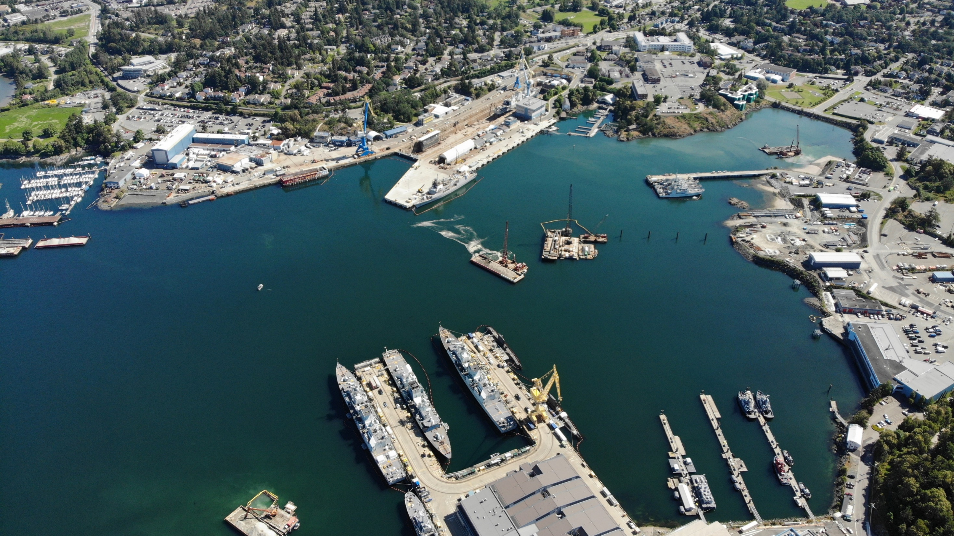

Slide 3
How can we demonstrate cap performance during the initial years following construction?

Slide 4
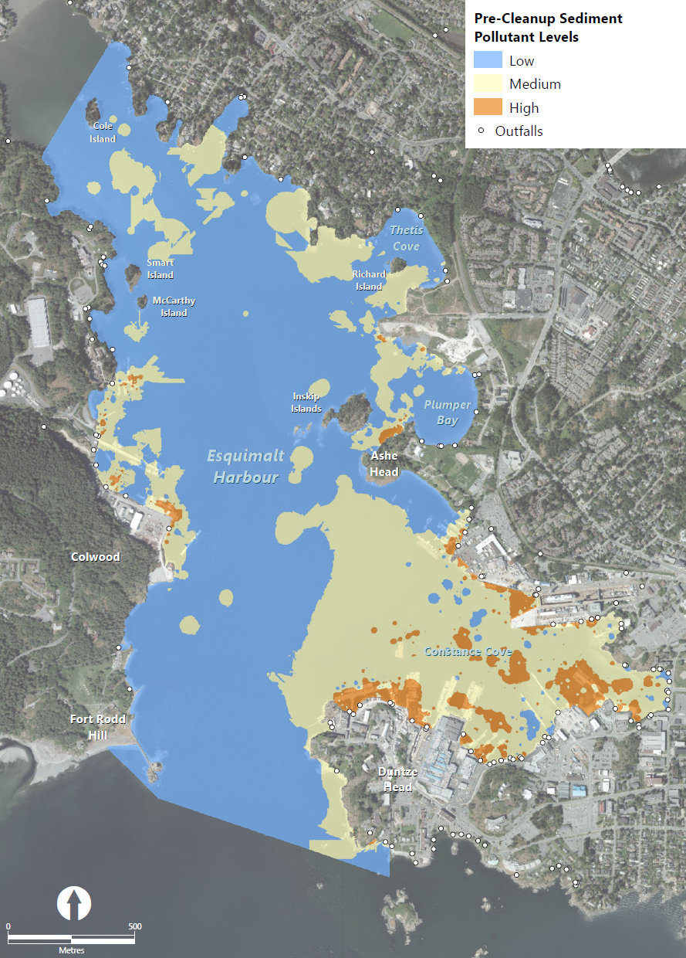
Pre-Construction Conditions
Metals, PCBs, and PAH exceedances
  Mercury up to 464 times the screening level
  Phenanthrene up to 235 times the screening level
  Total PCBs up to 109 times the screening level
In surface sediment and down to 3 metres below mudline

Slide 5
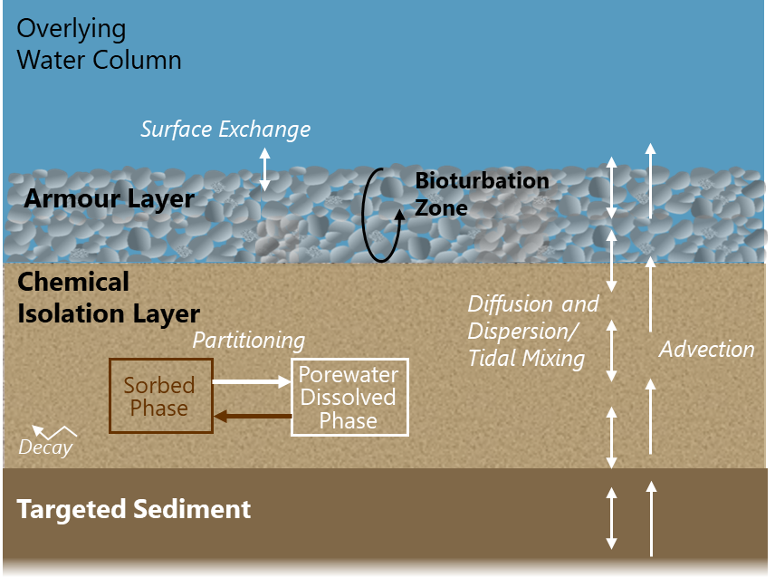
Cap Design
Chemical isolation layer
  Amendments added to reduce cap layer thickness
Armour layer
  Hydrodynamic forces
  Wind and vessel-generated waves
  Vessel-induced propeller wash

Slide 6
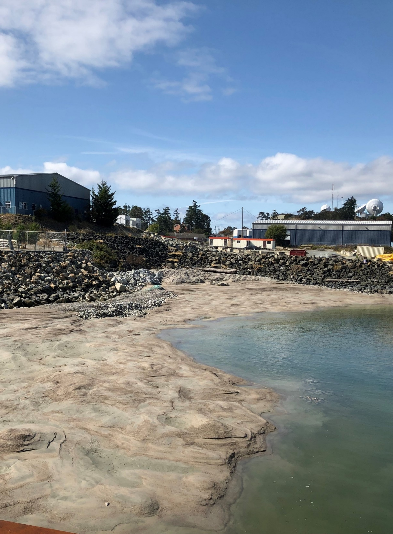
Construction
Conducted January 2019 to May 2020
  48,500 cubic meters dredged
  50,000 cubic meters cap/fill material placed
Shoreline/intertidal area required night work around low-tide windows
Shallow bedrock made dredging and material placement to full thickness challenging in some areas

Slide 7
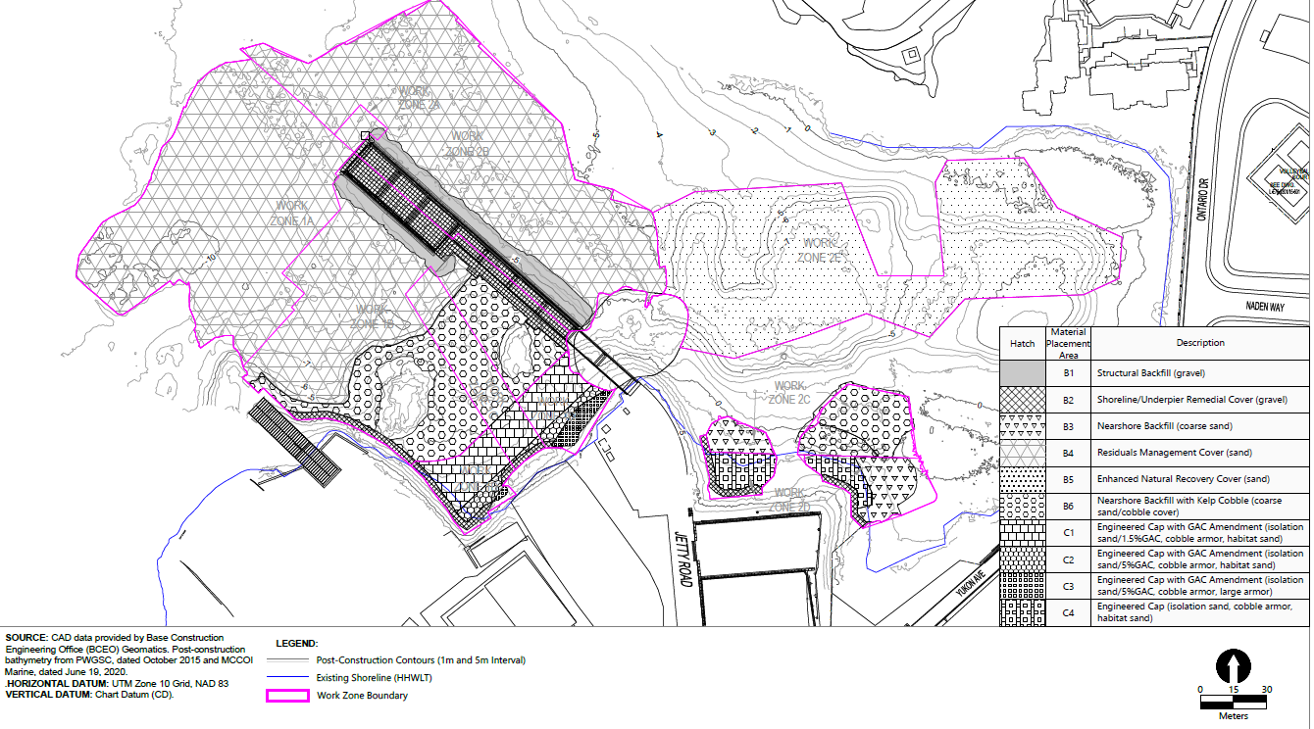
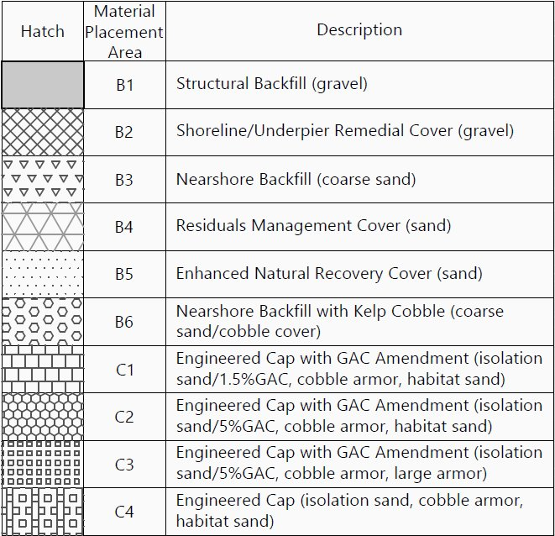
Cap Design
Cap model references: Reible 2012; Lampert and Reible 2009; Go et al. 2009; Appendix B of Palermo et al. 1998
Performance Monitoring Sampling Location

Slide 8
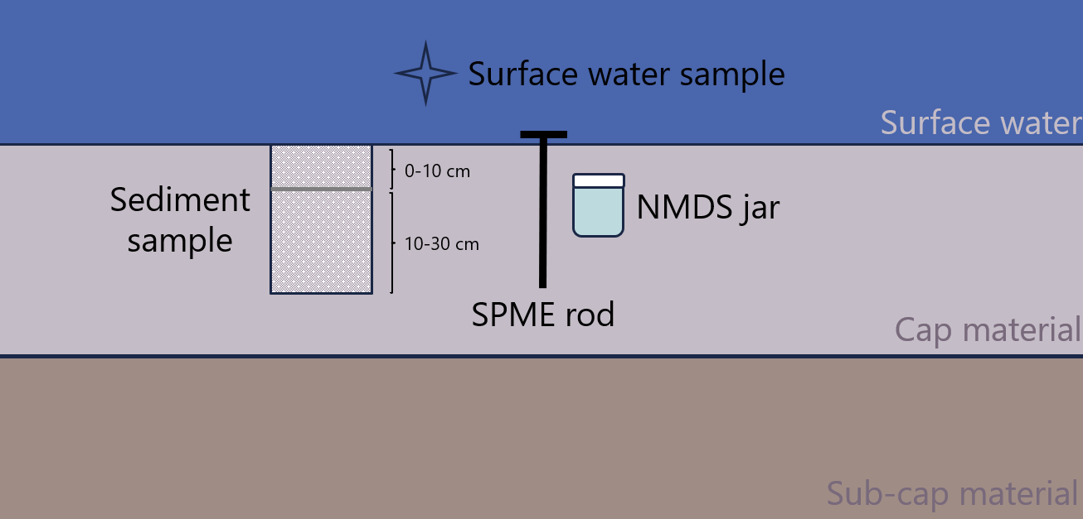
Monitoring Approach
NMDS: nylon mesh diffusion sampler
SPME: solid-phase microextraction

Slide 9
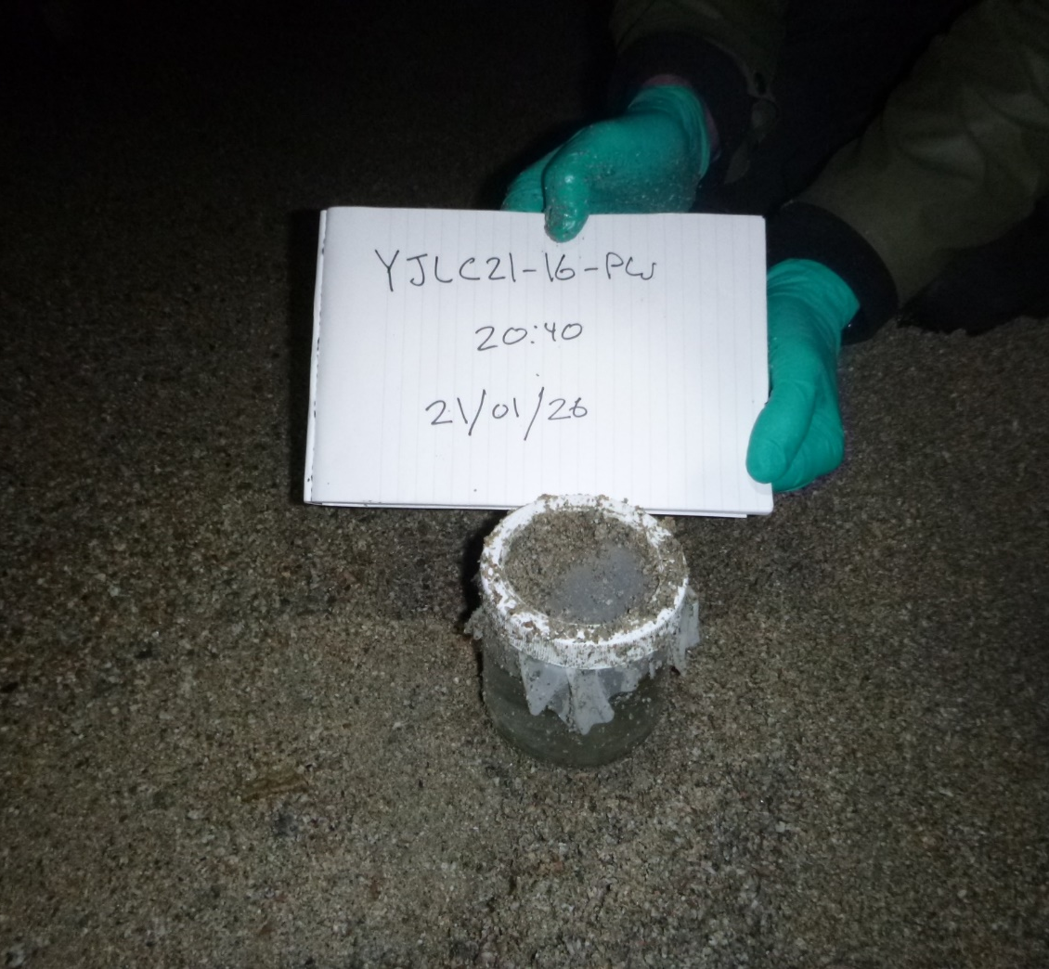
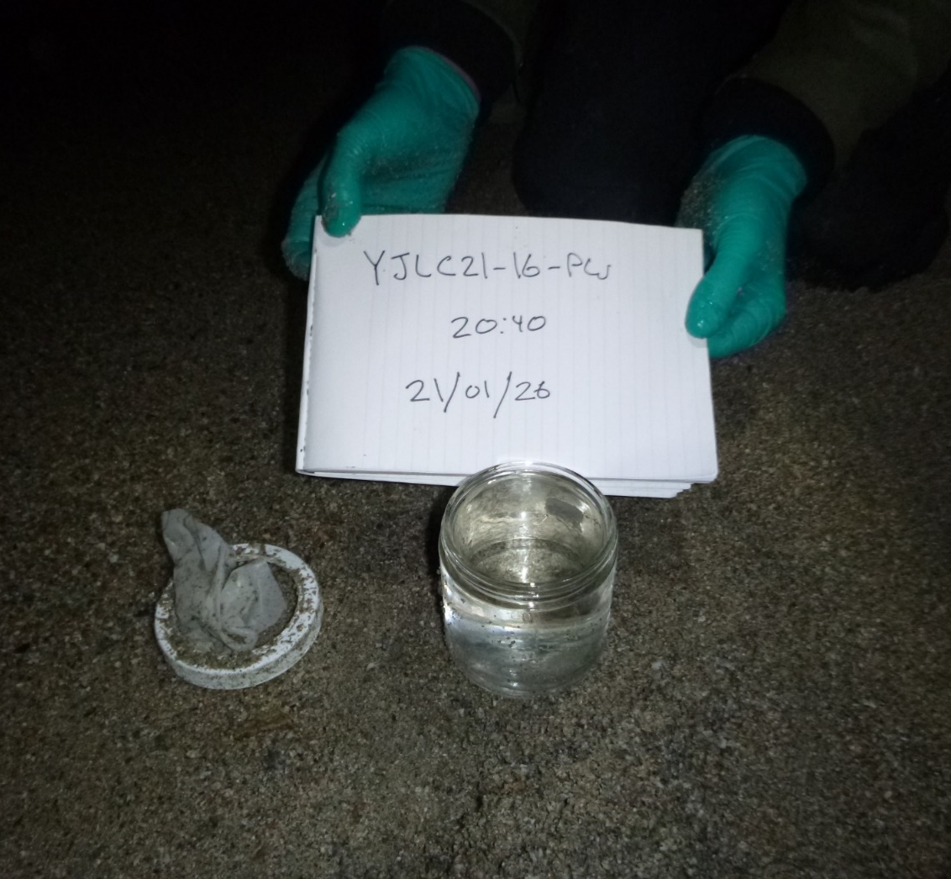
Nylon Mesh Diffusion Samplers

Slide 10
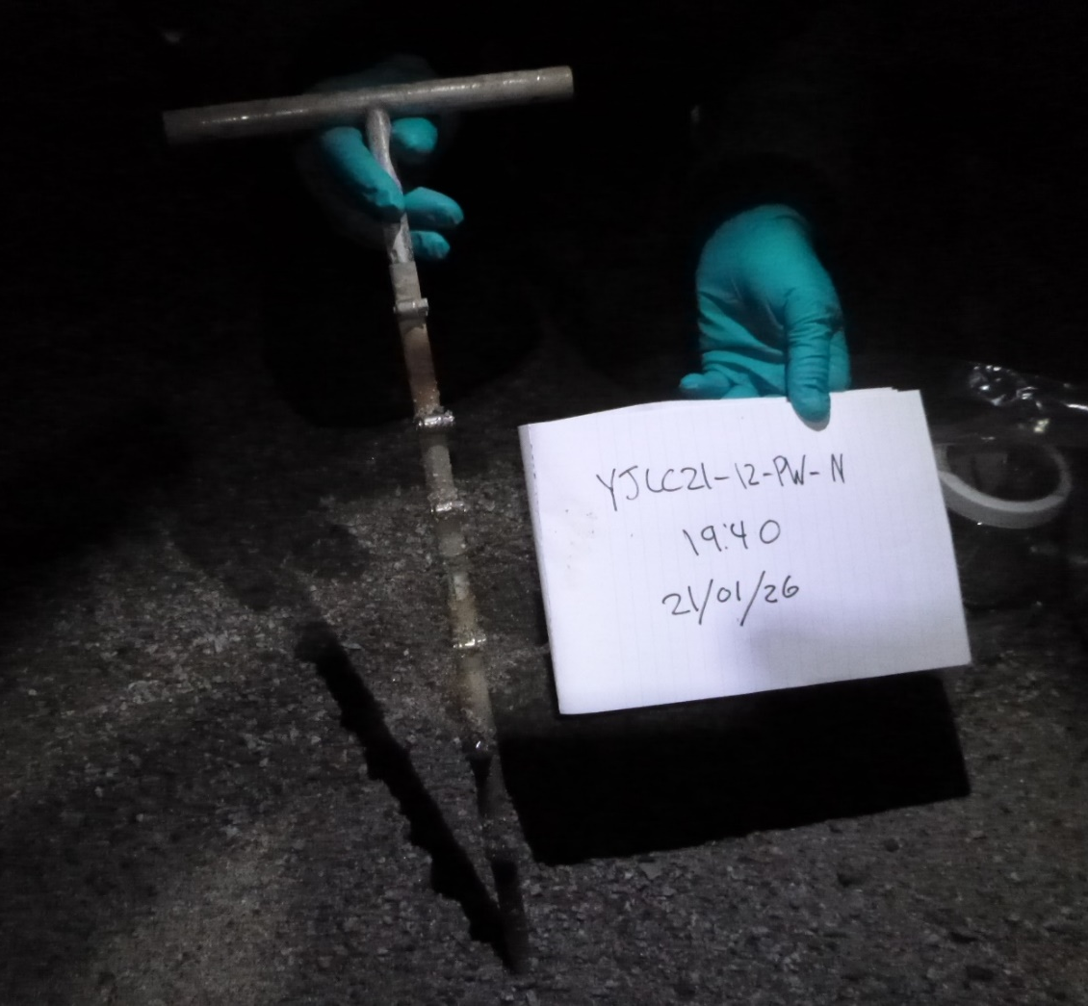
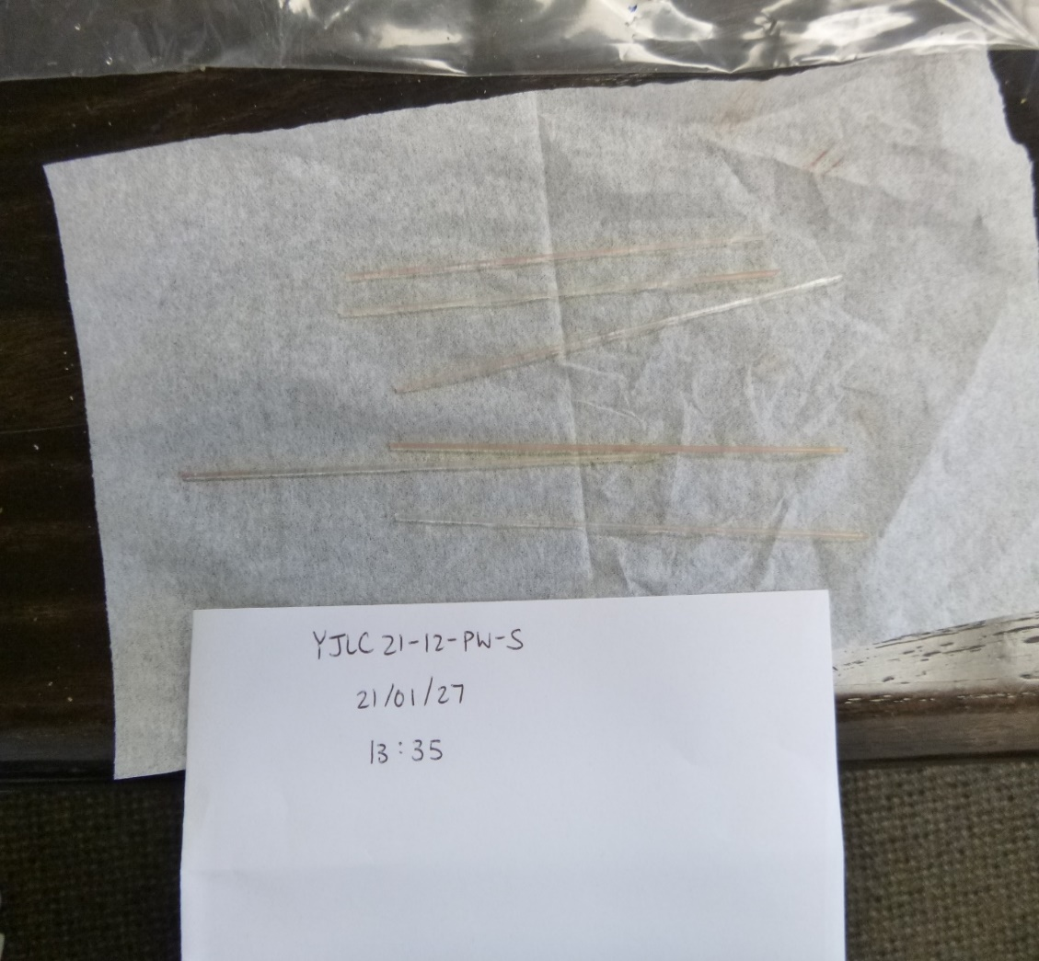
SPME Samplers

Slide 11
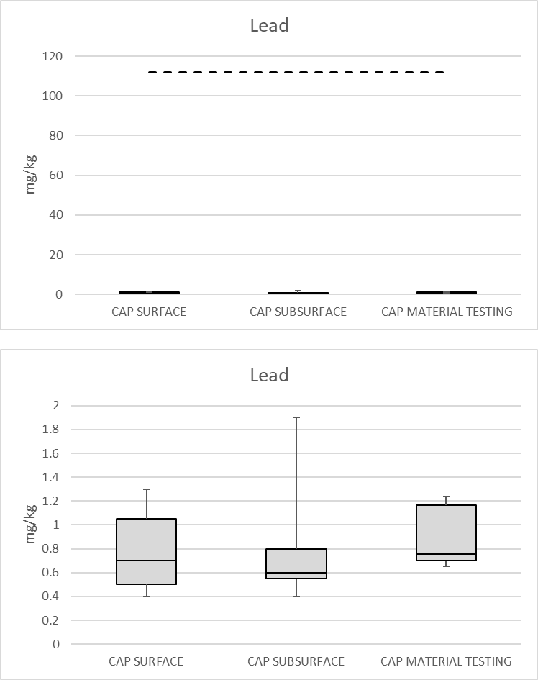
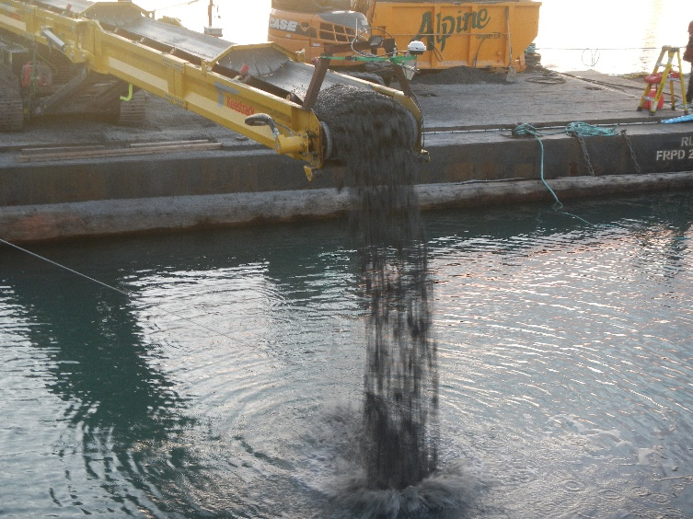
Cap Material Testing Results
Similar to baseline pre-placement cap material testing and below regional background levels
No trend observed with depth
Zoomed in
Note: Dashed line represents PEL value.

Slide 12
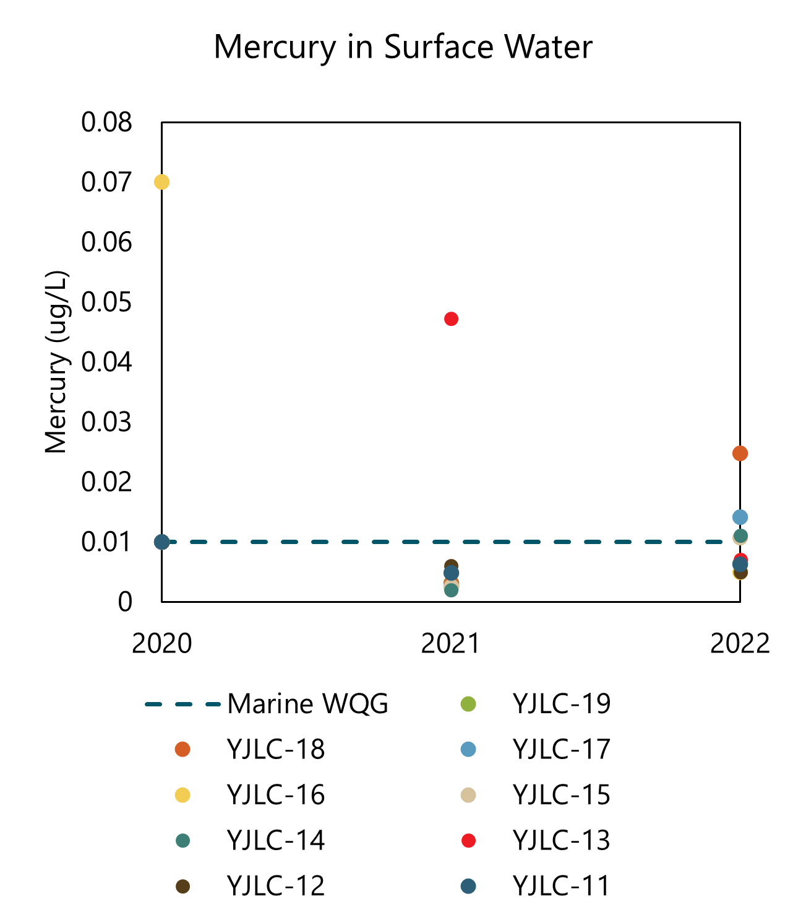
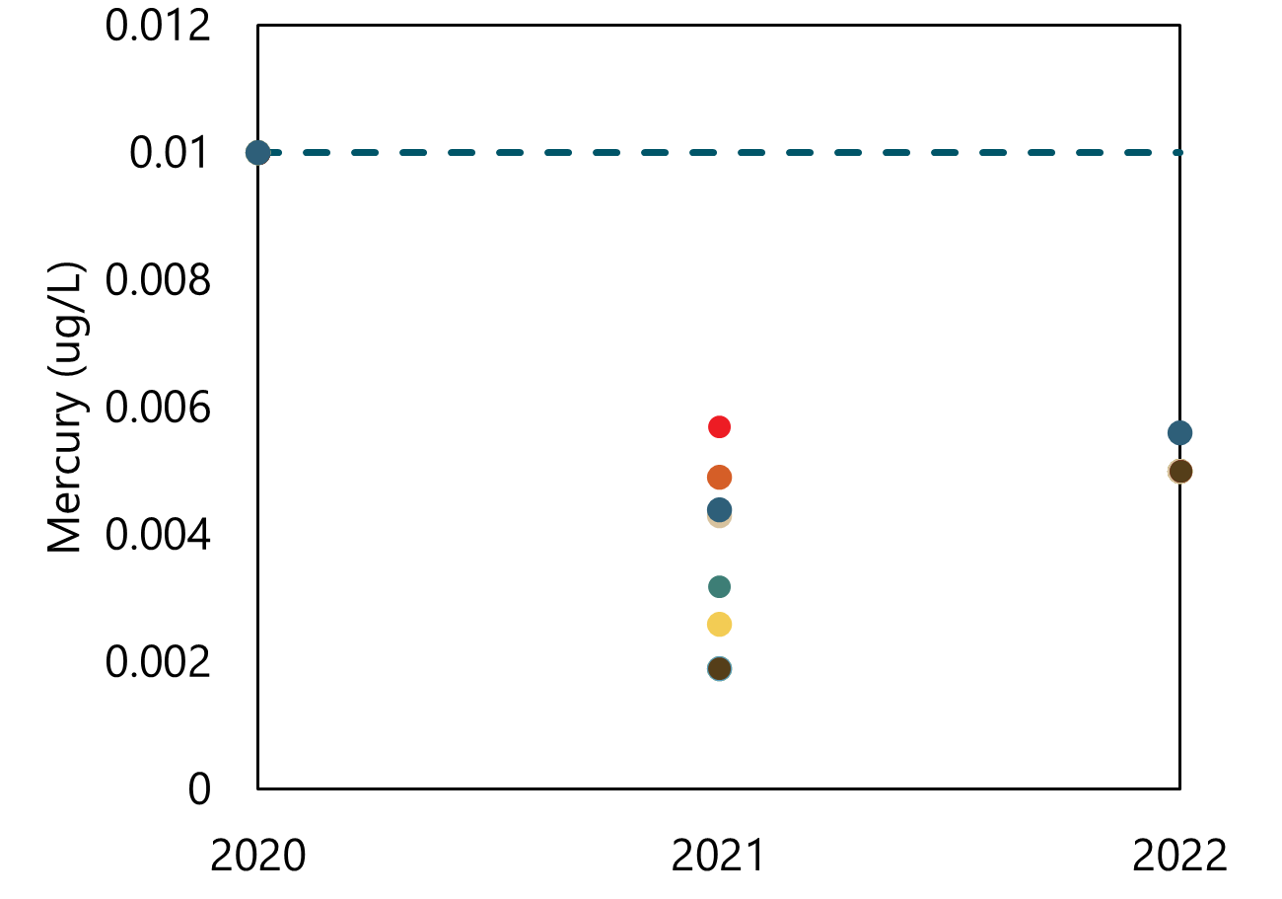
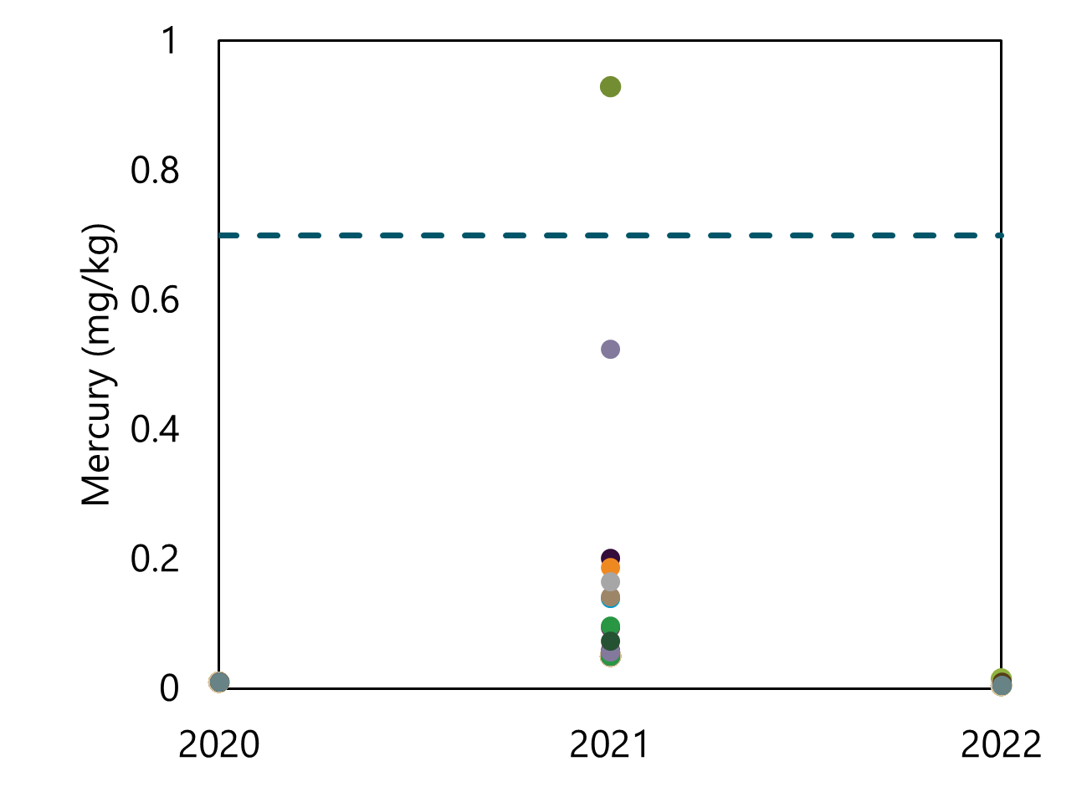
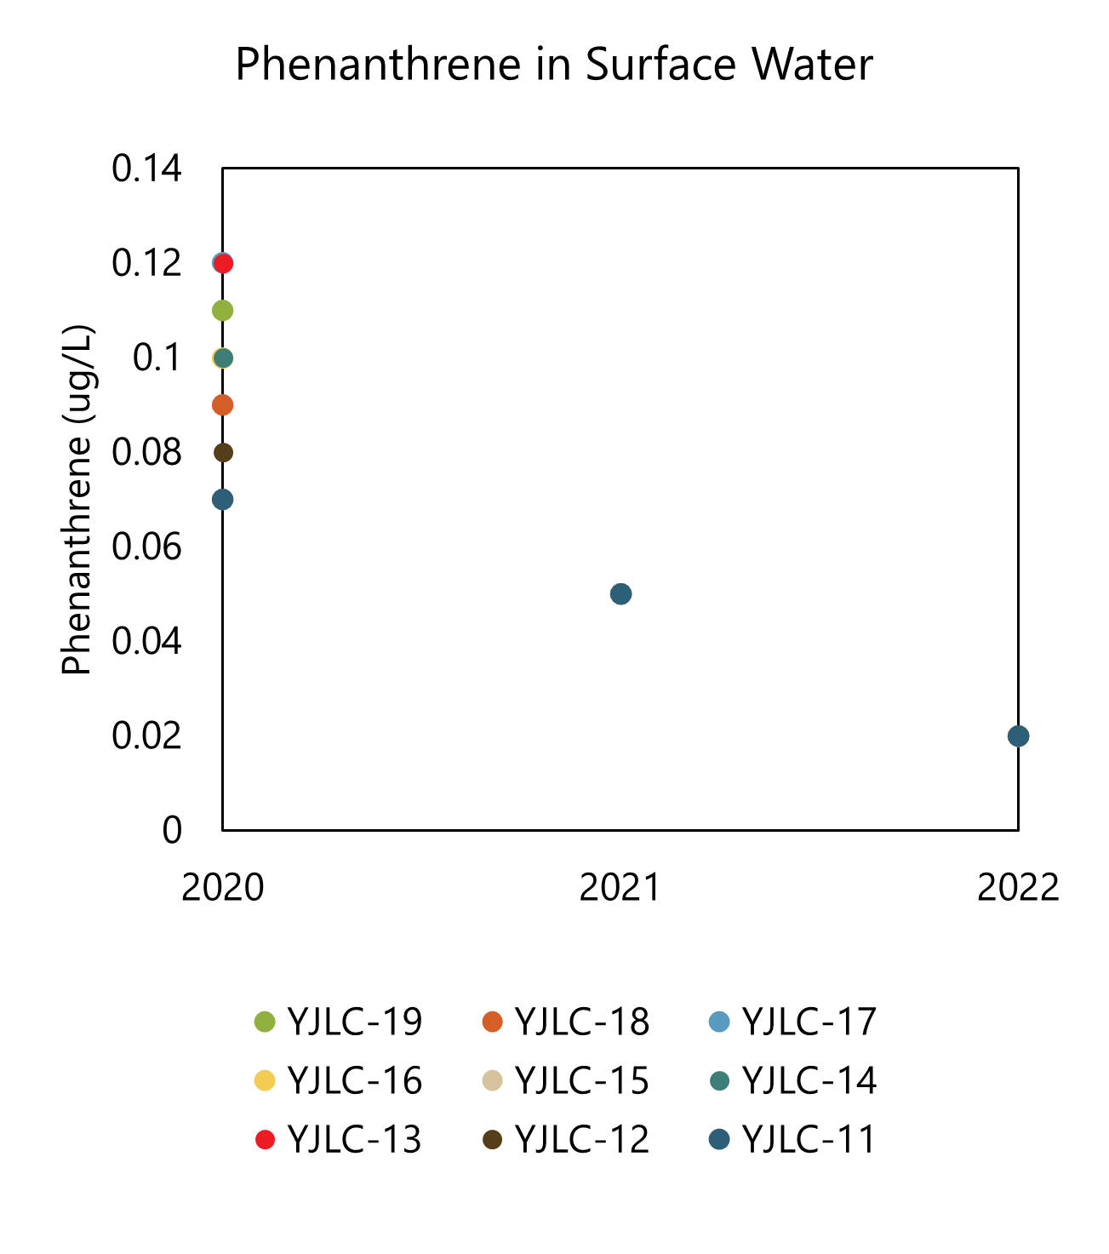
Chemical Trends: Mercury
Surface Water
Porewater
Cap Material
Dashed line presents screening criteria where available.

Slide 13
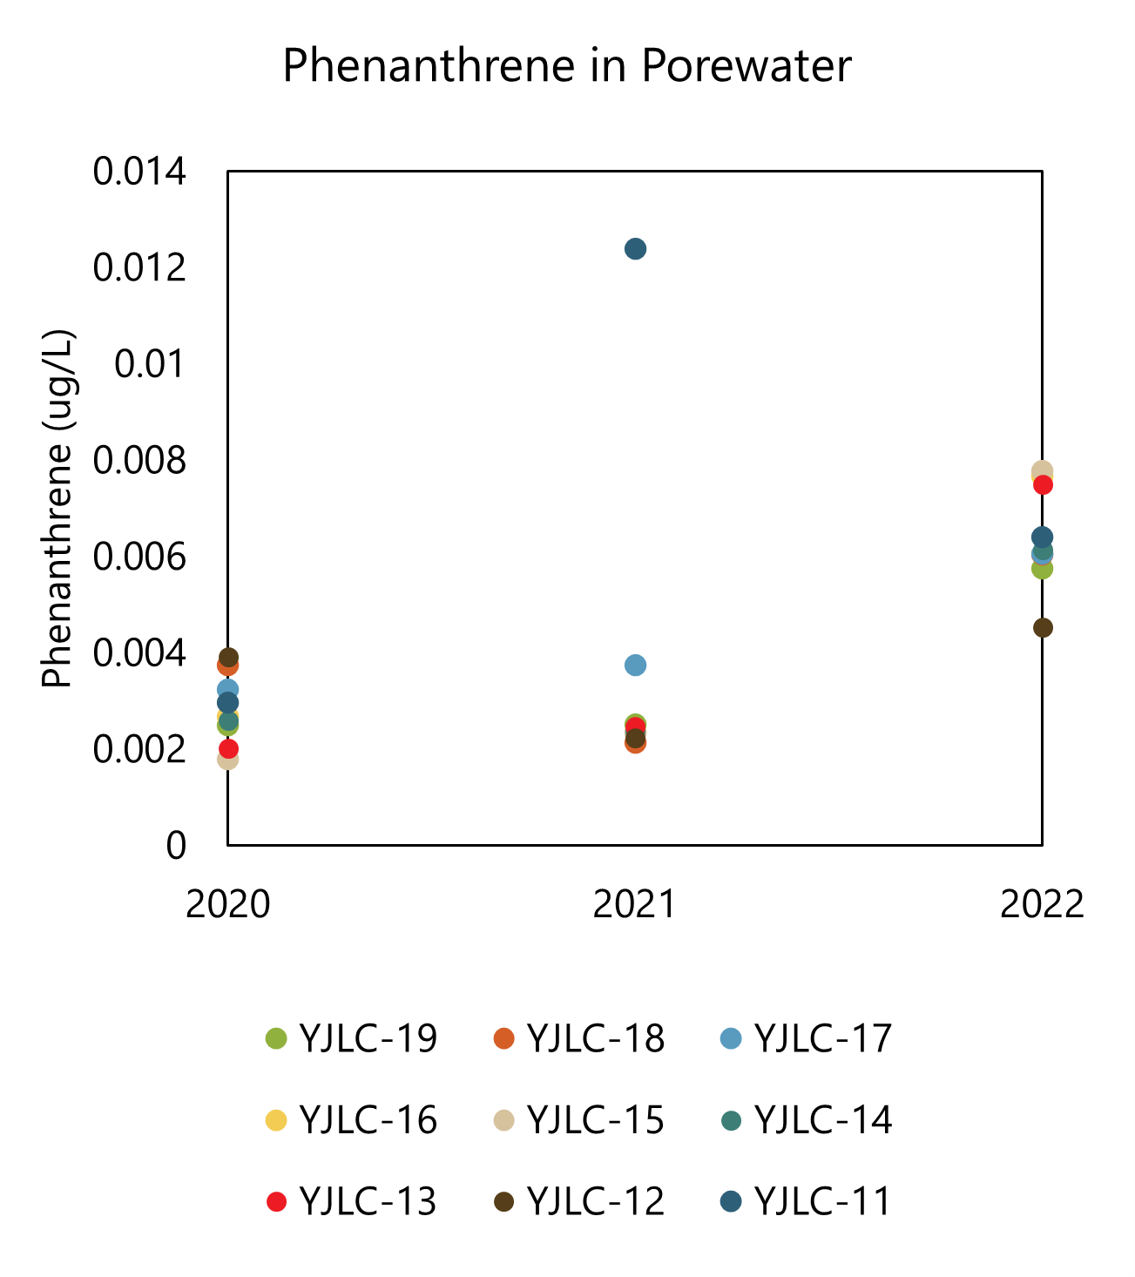
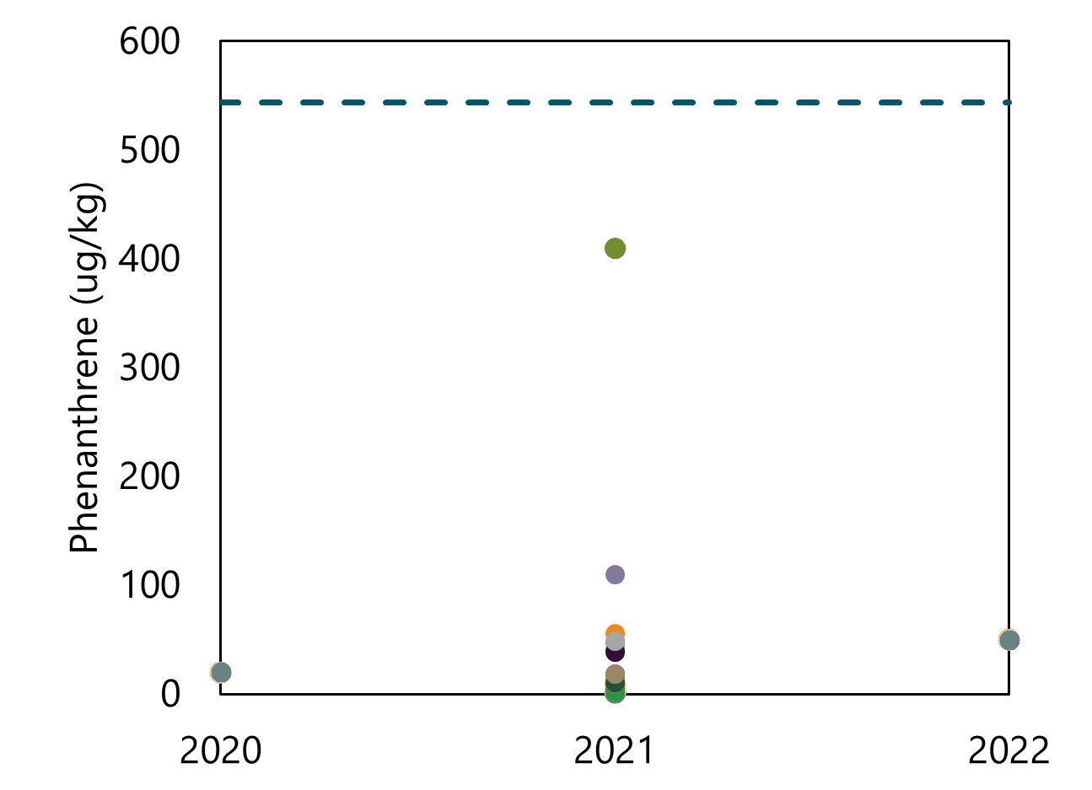
Chemical Trends: Phenanthrene
Surface Water
Porewater
Cap Material
Dashed line presents screening criteria where available.

Slide 14
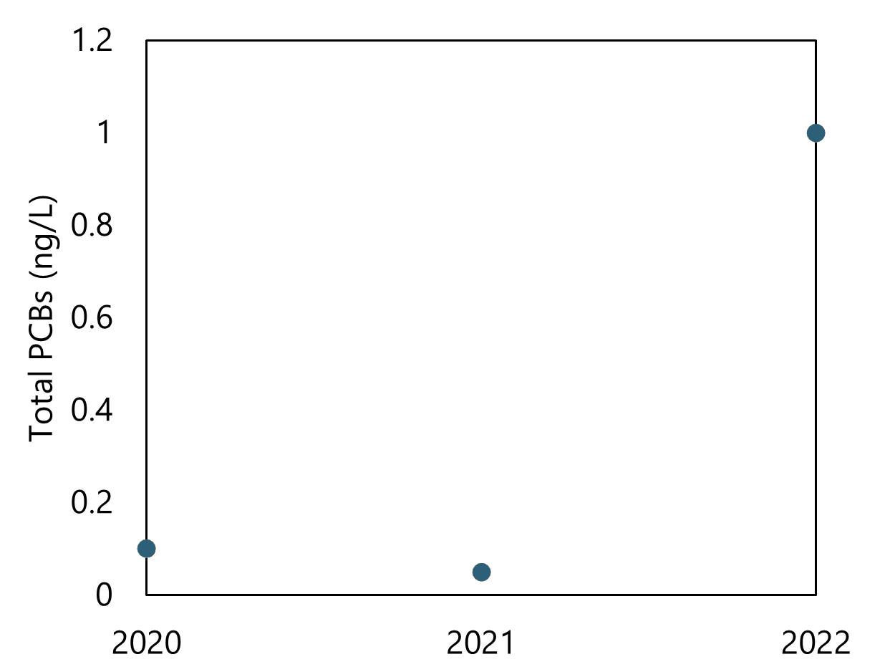
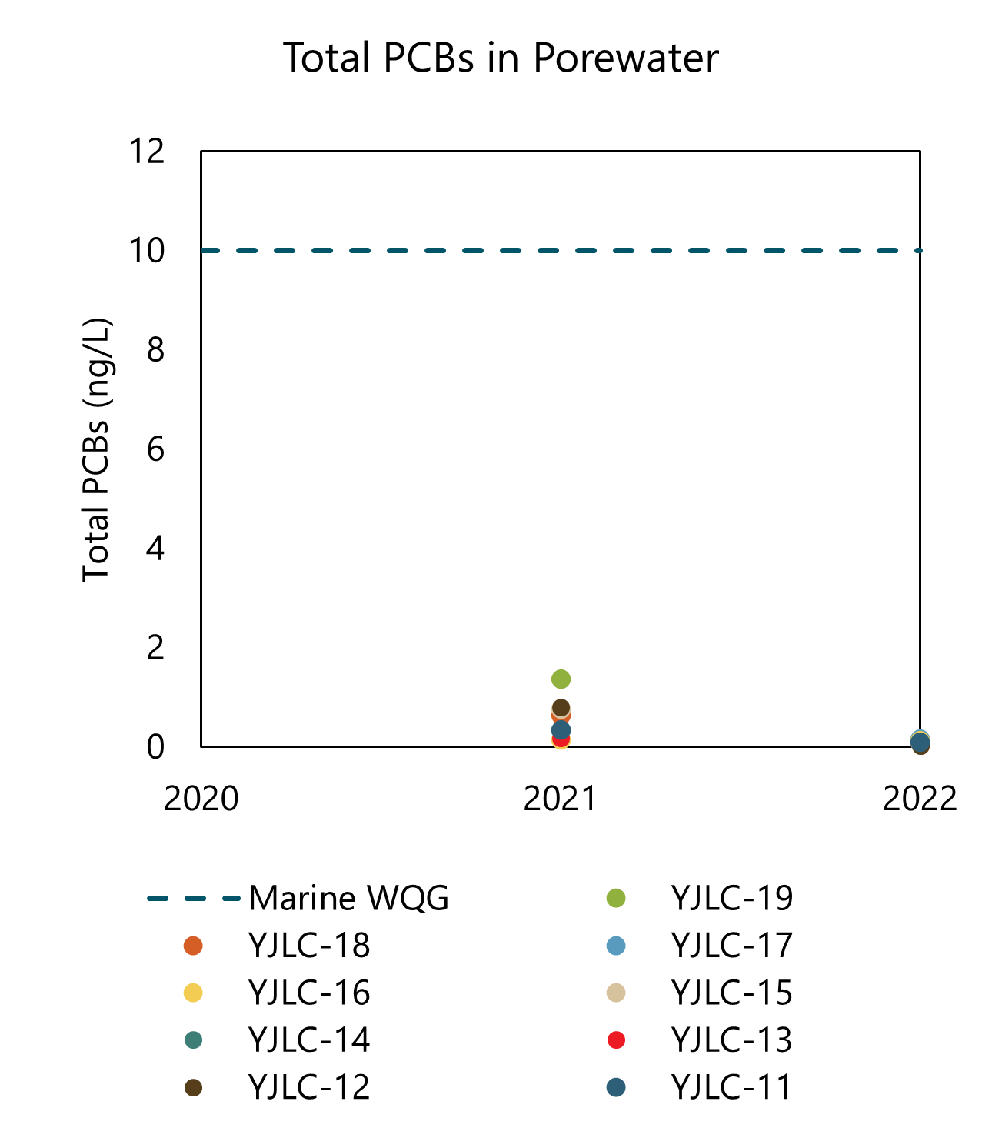
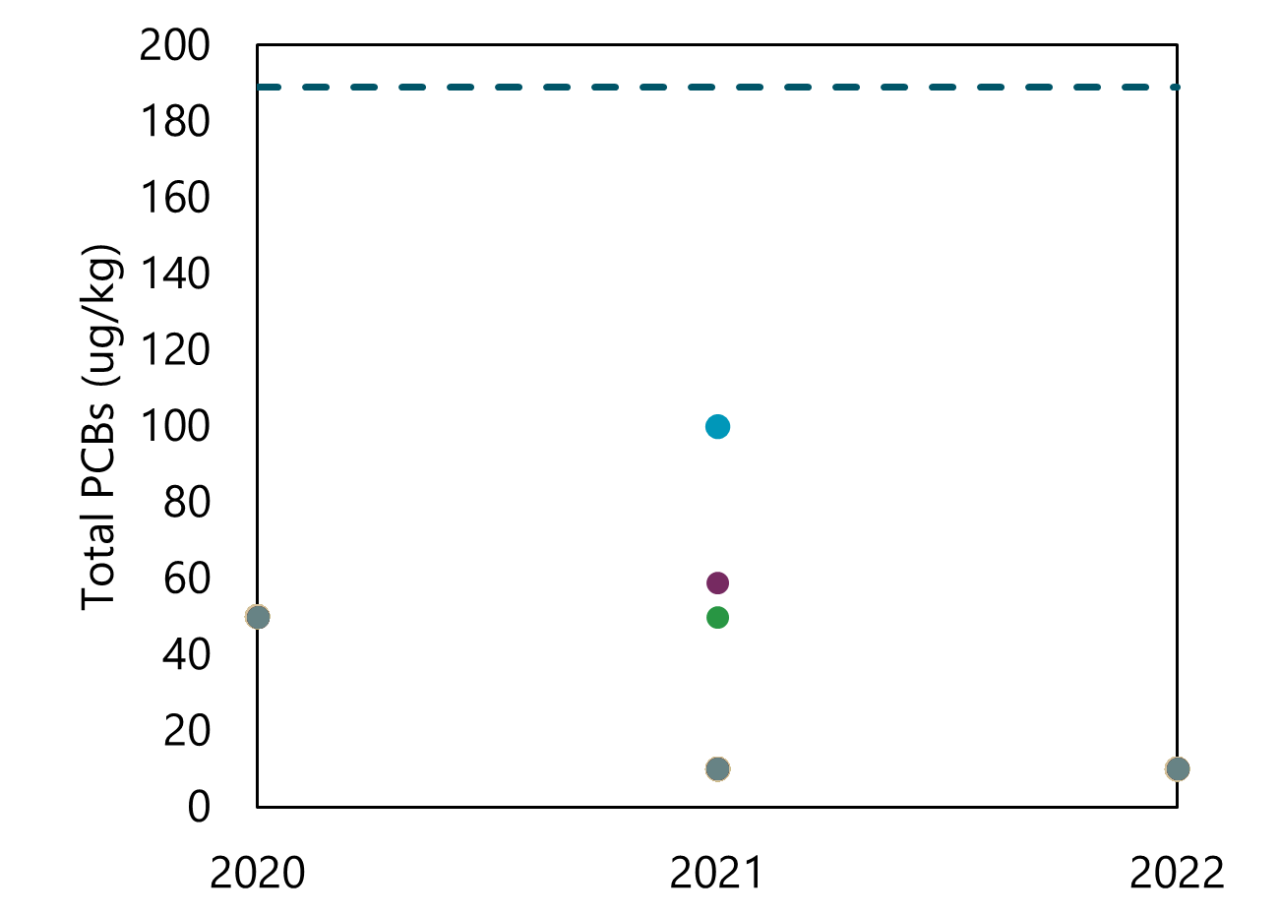
Chemical Trends: PCBs
Surface Water
Porewater
Cap Material
Dashed line presents screening criteria where available.

Slide 15
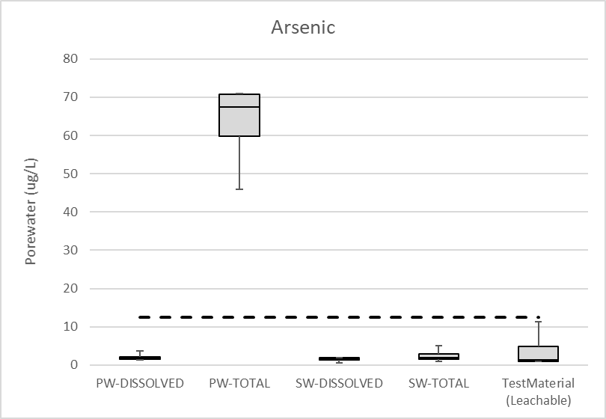
Porewater Sampling in Cap Surface: Arsenic
Arsenic in cap similar to surface water and test material concentrations
  Dissolved-phase concentrations appropriate for evaluating cap performance
Total porewater in year 1 much higher than other sample types
  Not indicative of breakthrough
  Potential presence of iron oxide
Note:
Dashed line represents WQG value.

Slide 16
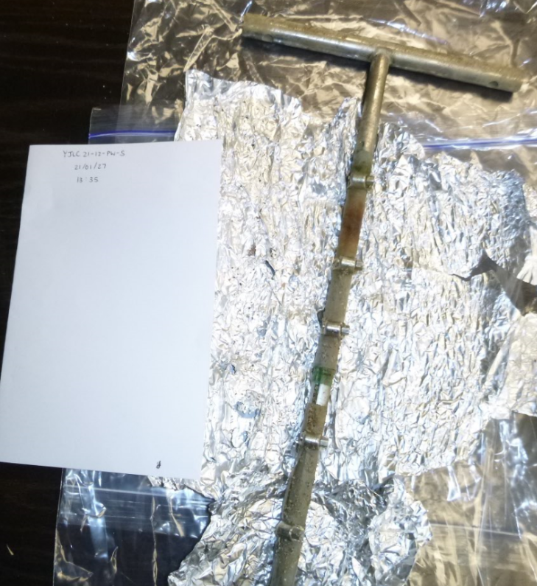
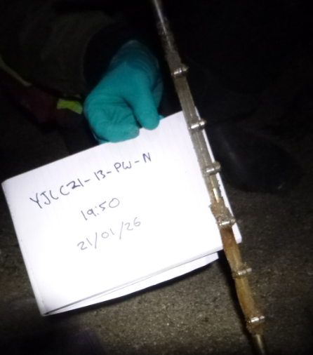
Elevated Arsenic in Total Porewater Samples
Iron in contact with oxygen produces iron oxide, which is a sink for arsenic
  Visual evidence of orange/brown
  staining on SPME samplers
Total arsenic in porewater in future years all below water quality guidelines

Slide 17
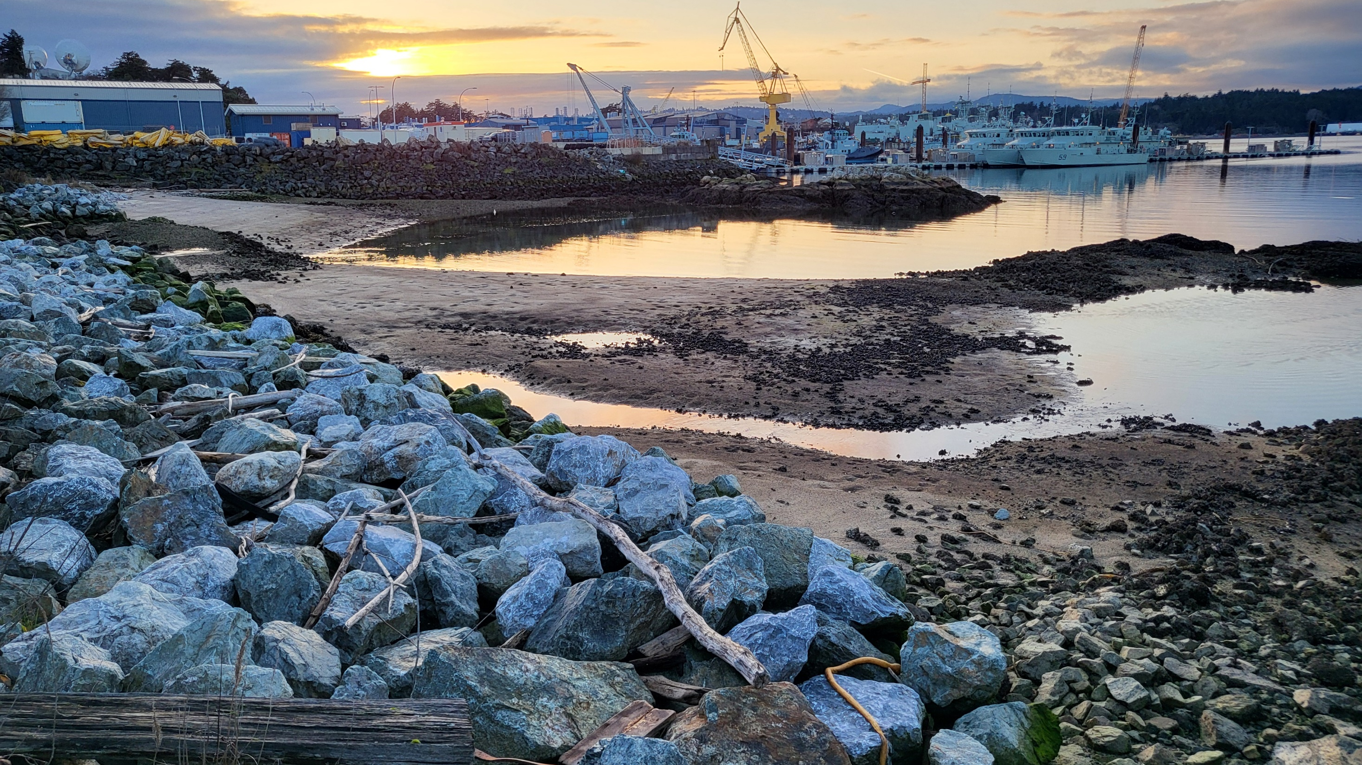

Slide 18
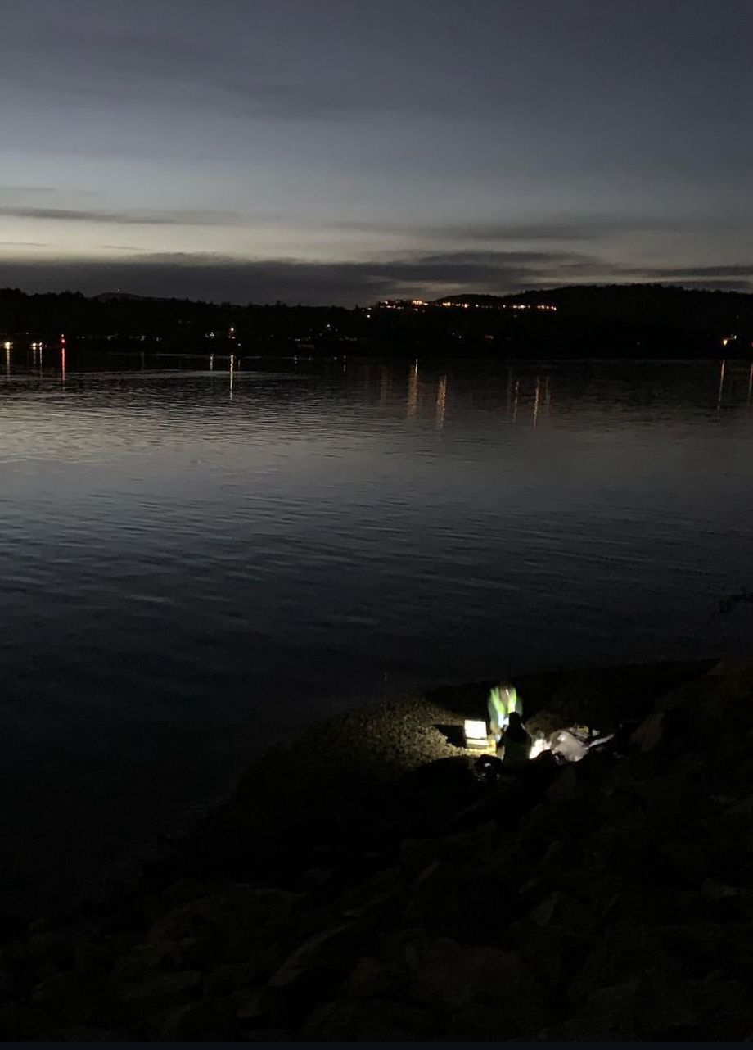
Lessons Learned
Cap is performing as expected
  Chemically
  Hydrodynamically
Sampling for multiple media provided greater certainty
Arsenic and sulfide investigations in area

Slide 19


Amy Corp
Principal Scientist
Anchor QEA
acorp@anchorqea.com

