Slide 1

Remediation and Restoration of an Indigenous Shoreline
Presented by: Amy Corp, P. Chem, EP, Anchor QEA
Collaborators: Michael Bodman, Department of National Defence
Rob Thomas and Kristen Ritchot, Public Services and Procurement Canada
Derek Ormerod, Anchor QEA

Slide 2
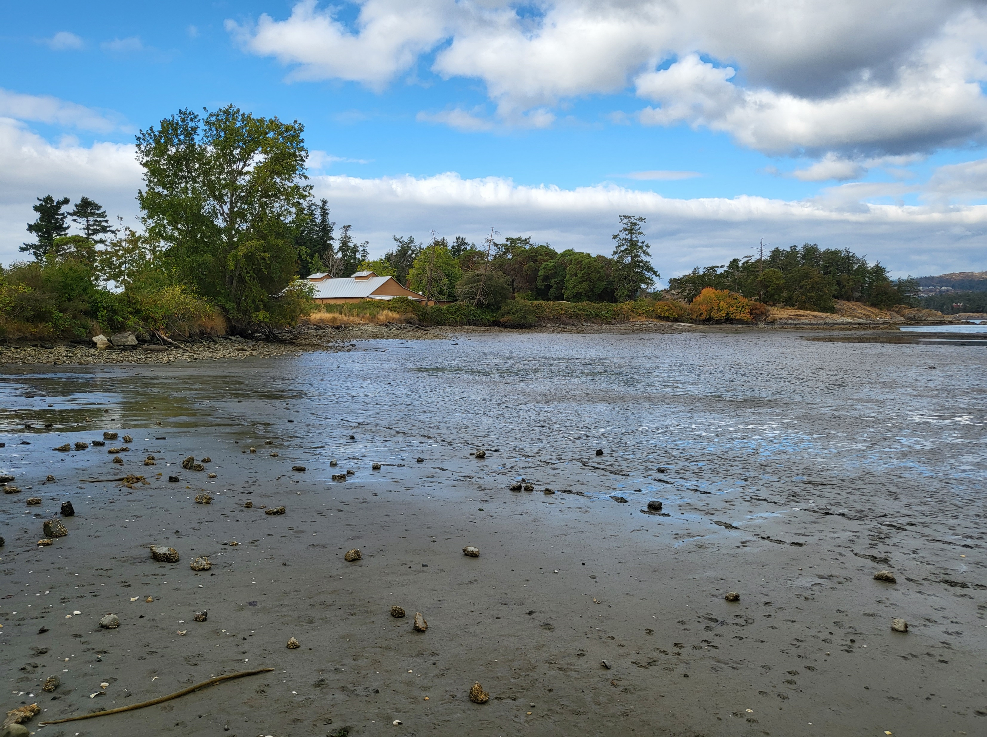

Slide 3
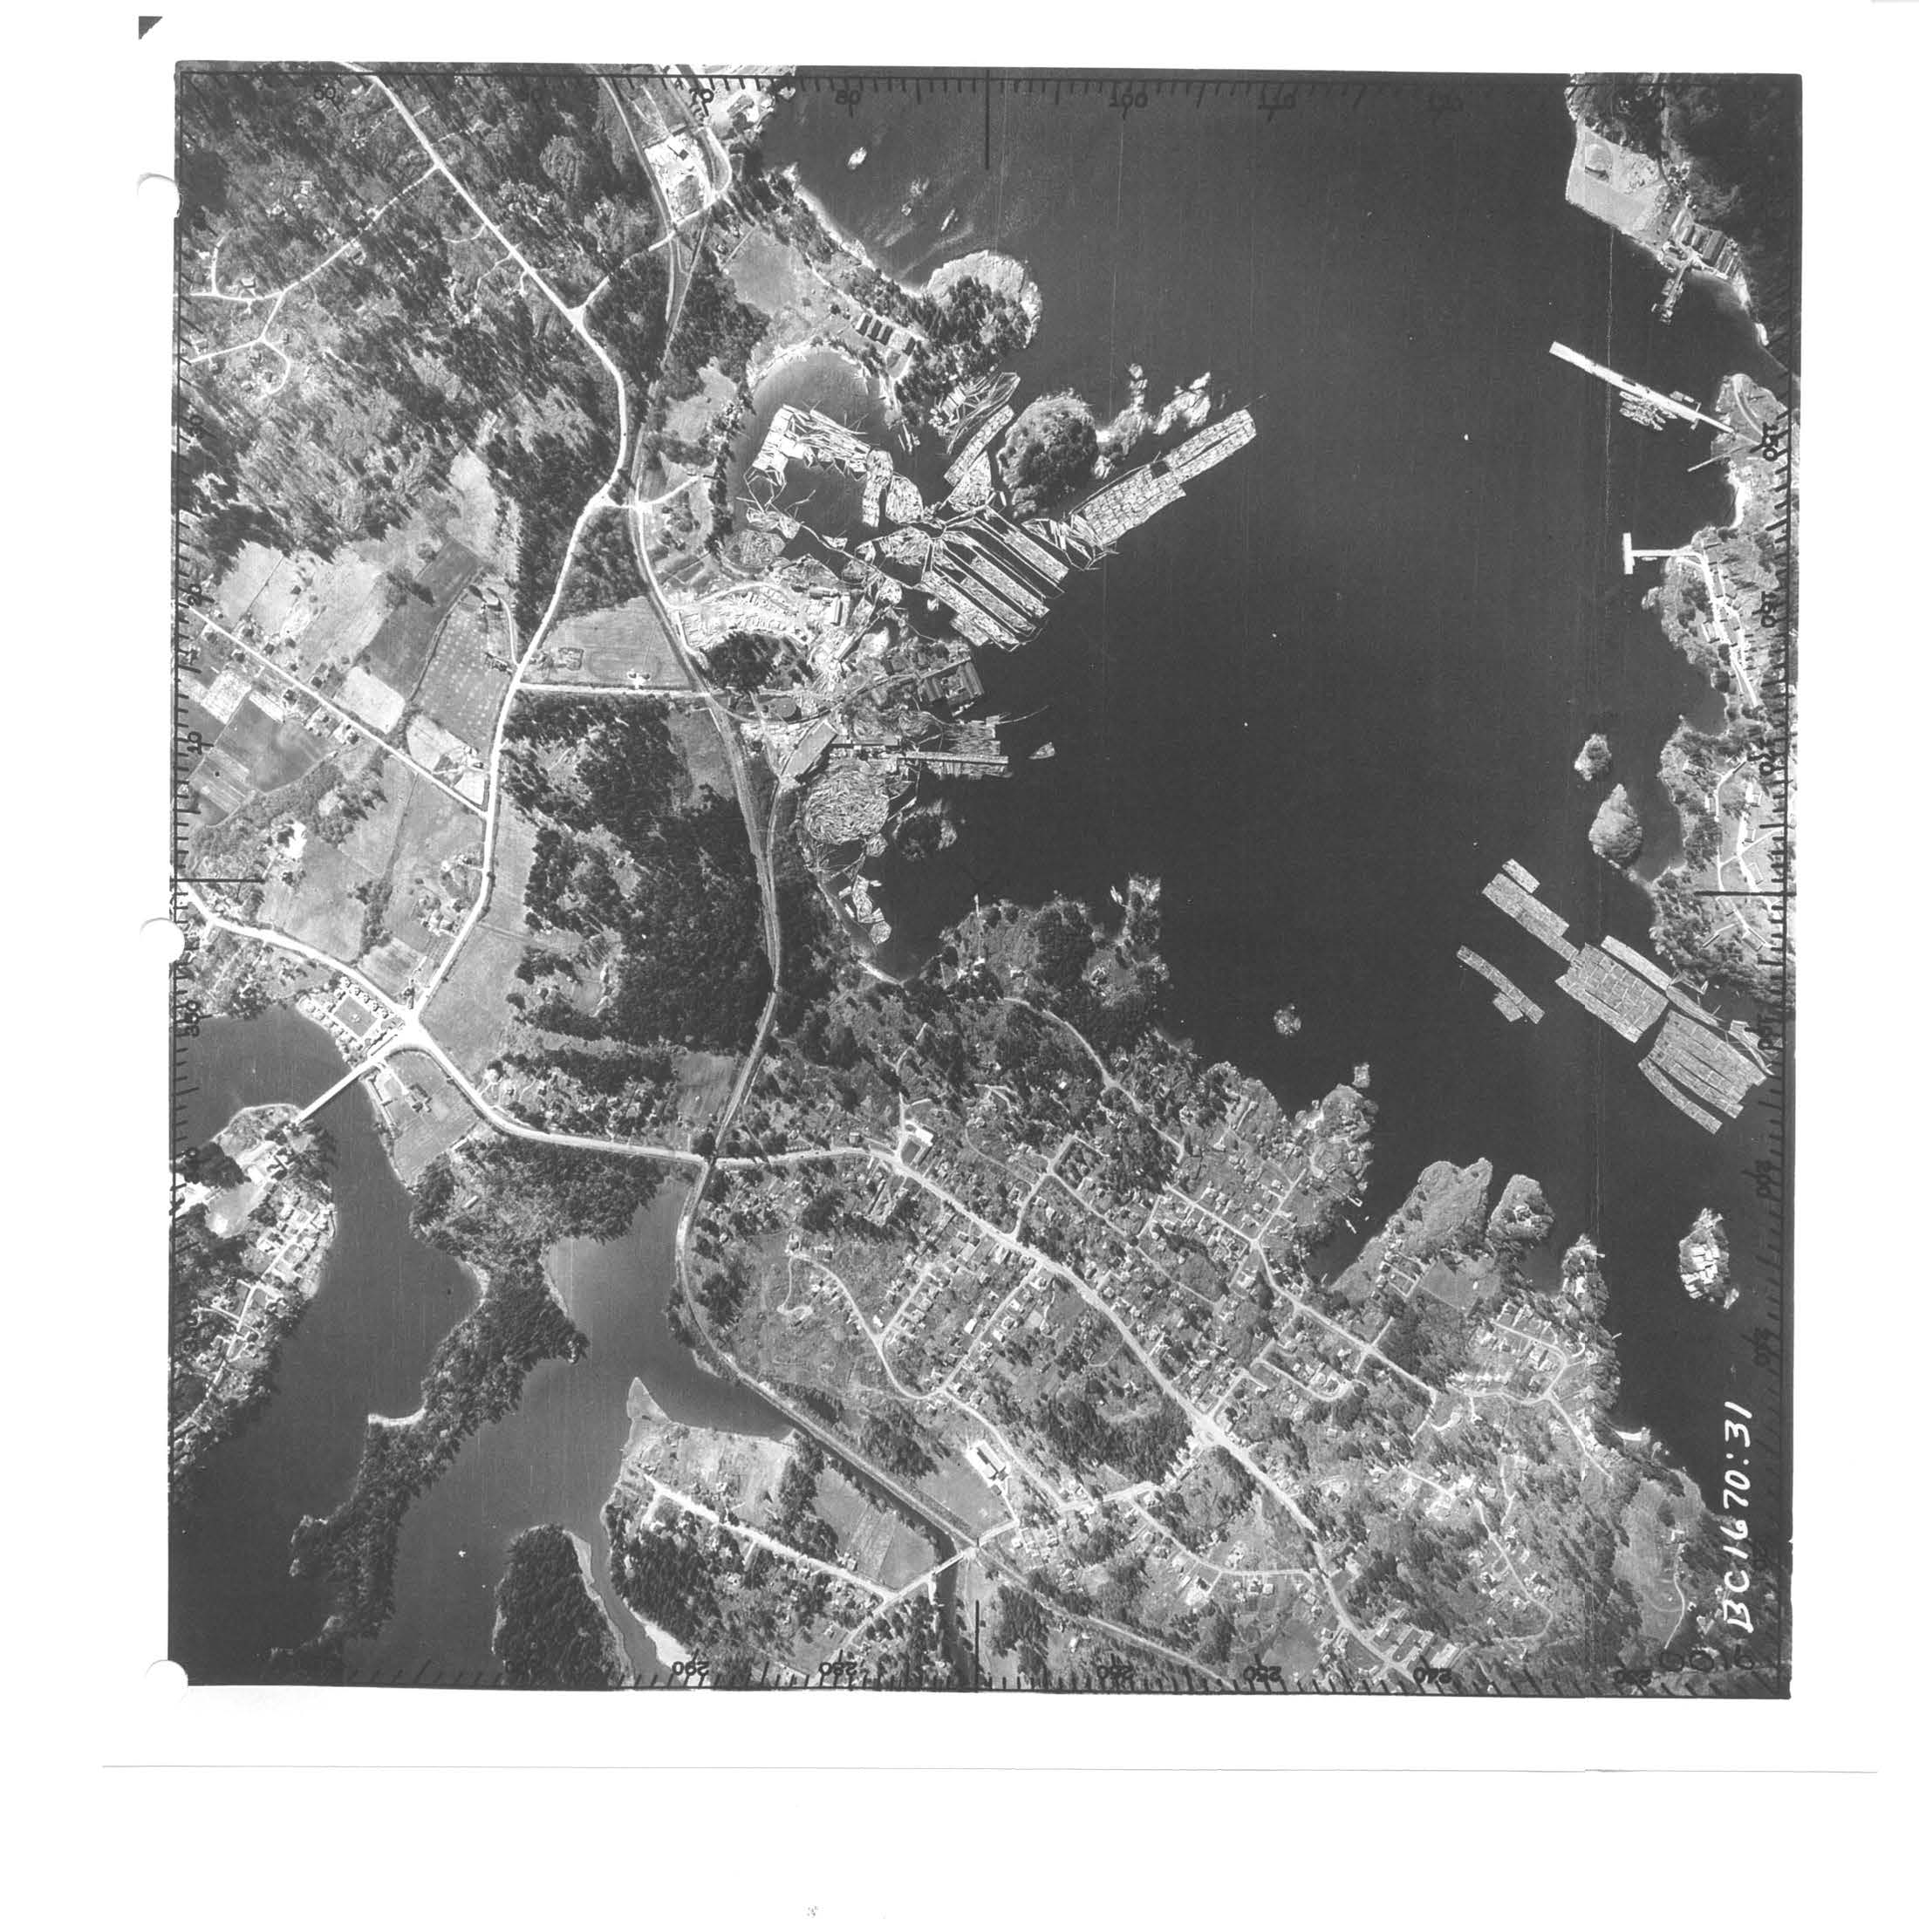
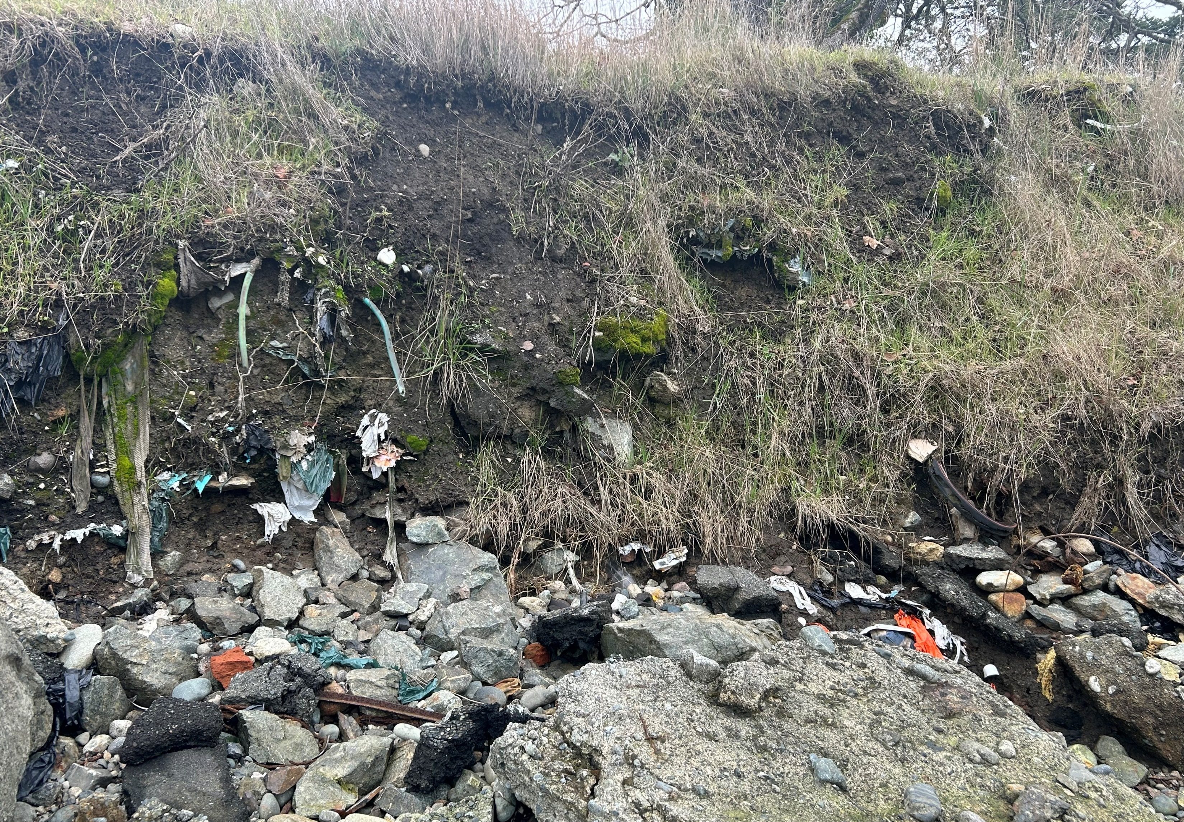
State of the Bay
Marine resource closures
  Seafood harvesting closed
Limited habitat
  Forage fish and clam substrate loss due to shoreline modifications and wood waste
Human health hazards
  Beach closures due to spills and elevated contaminant levels
Historical industrial shoreline
Modern shoreline

Slide 4
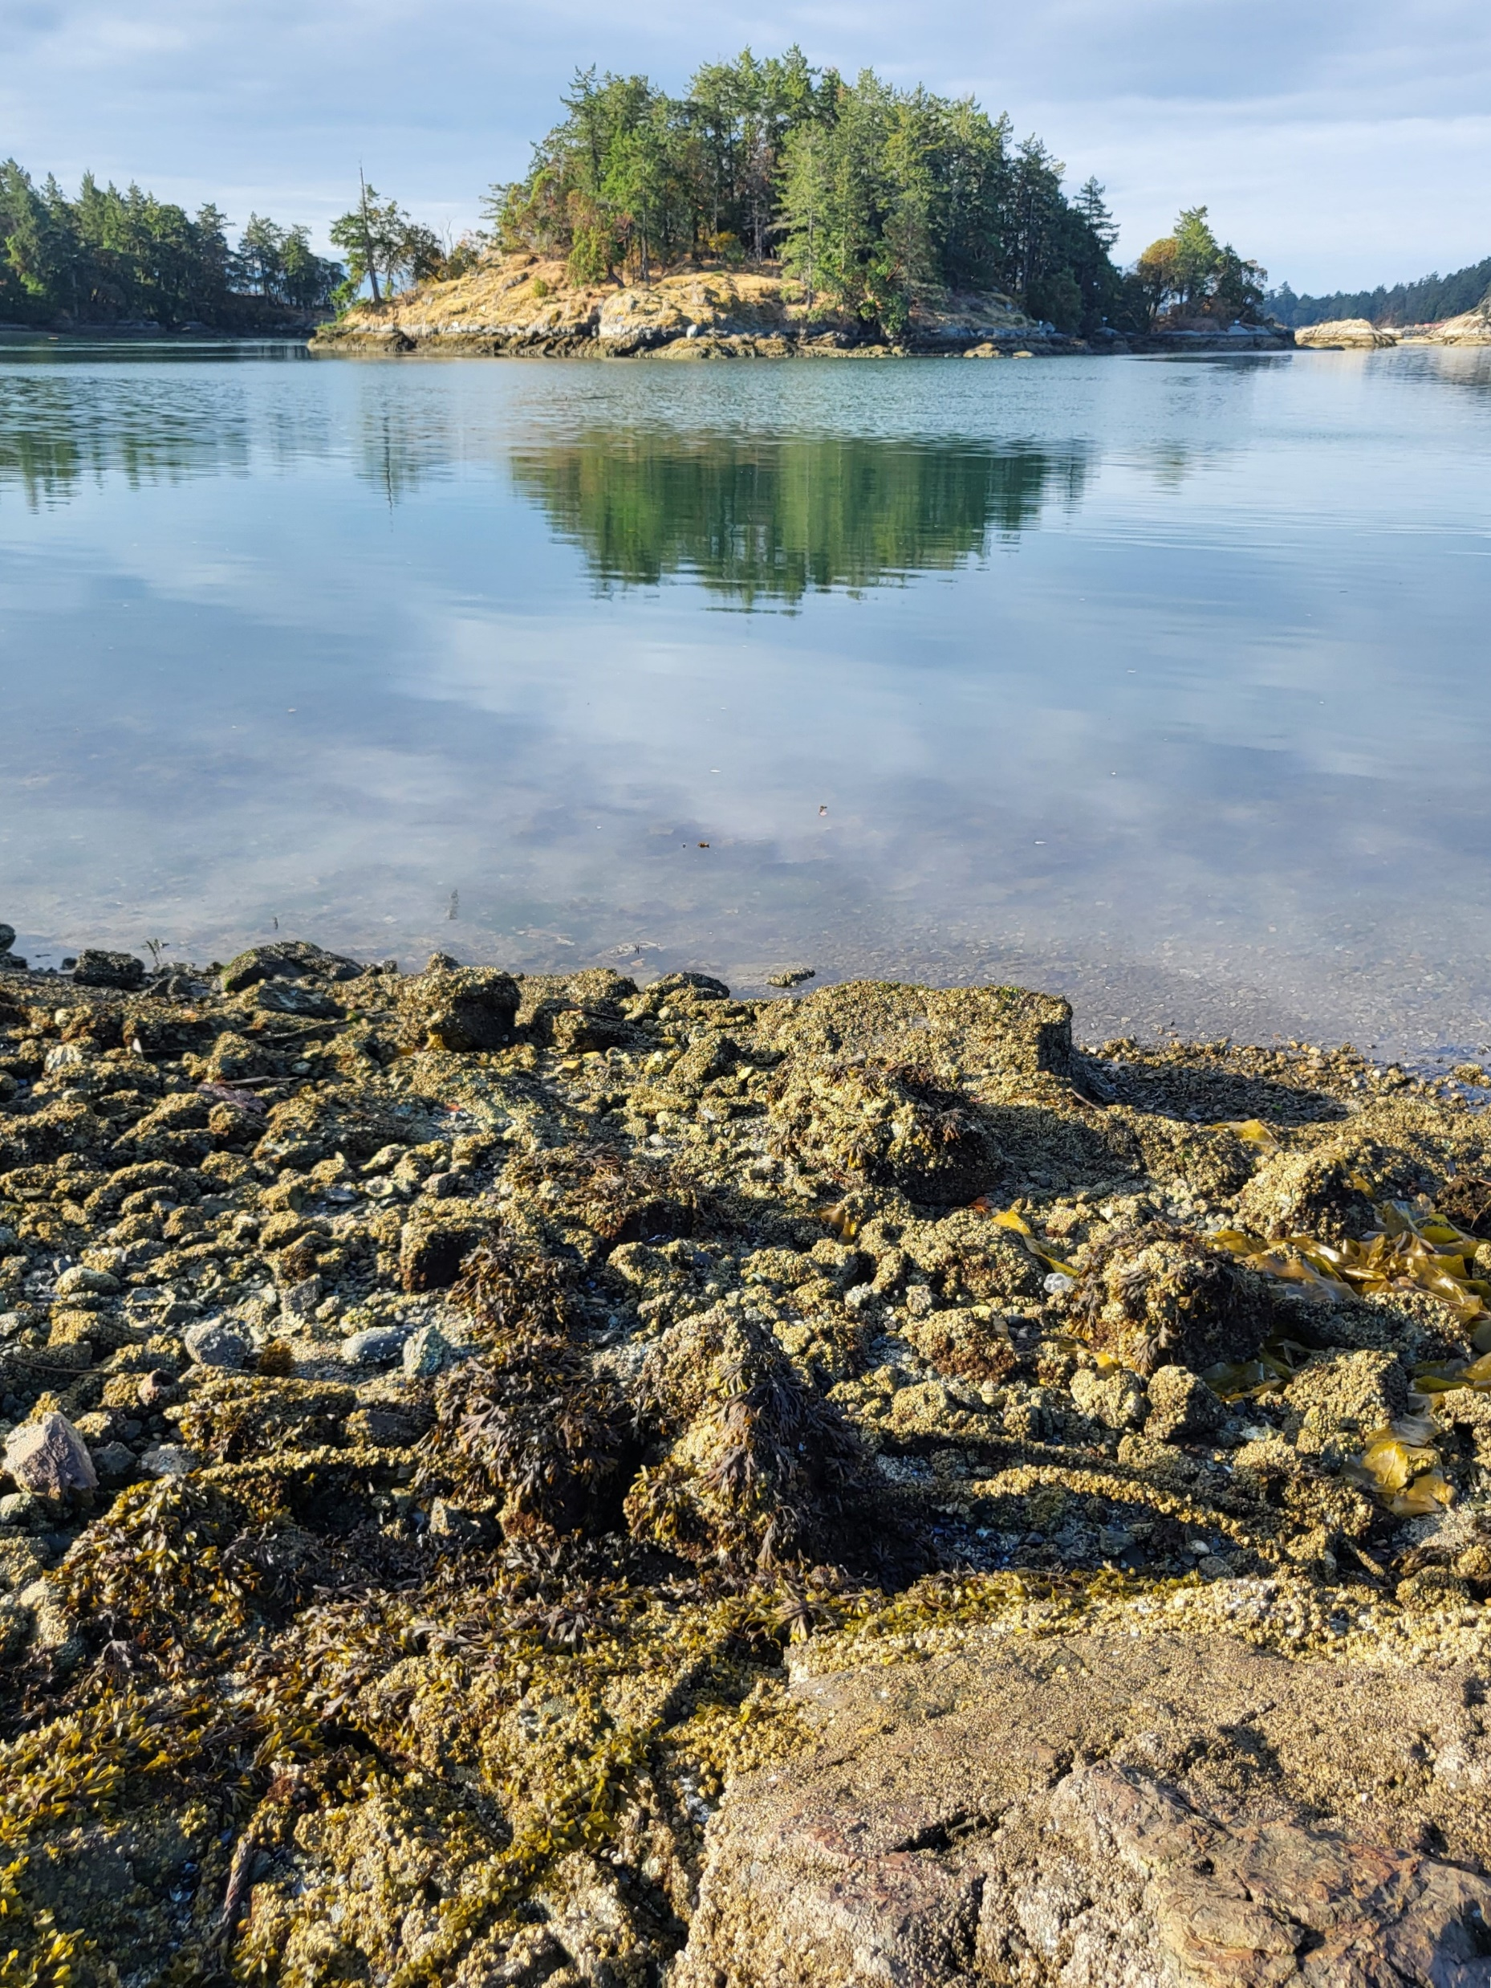
How to work with local
First Nations to align remedial objectives with Community expectations?

Slide 5
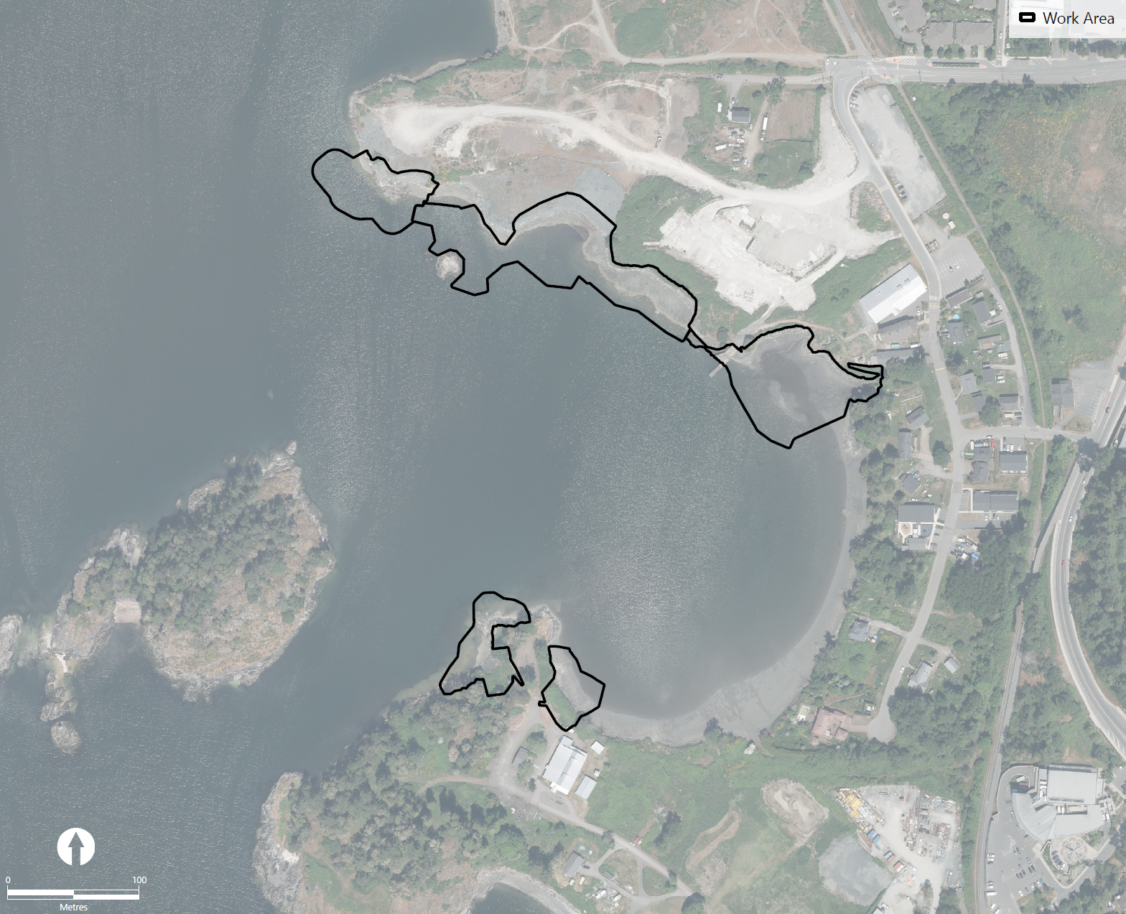
Start with Engagement
Work Area 1
First Nations beach use survey
Chief and Council meetings
First Nations Working Group workshops and shoreline walks
Community open houses
Community feedback
Work Area 2
Esquimalt Long House
Work Area 3
Work Area 4
Work Area 5
Songhees Wellness Center

Slide 6
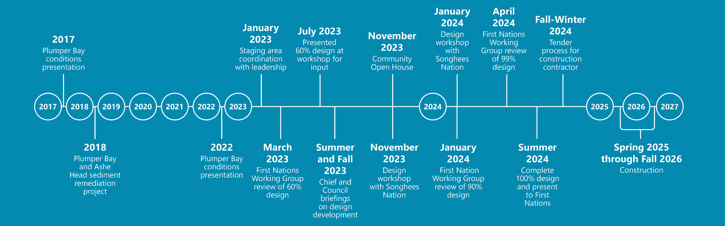
Engagement Timeline

Slide 7




Removal and capping of contaminated material
Project Features
Green shores soft armouring
Habitat restoration
Stormwater enhancement

Slide 8

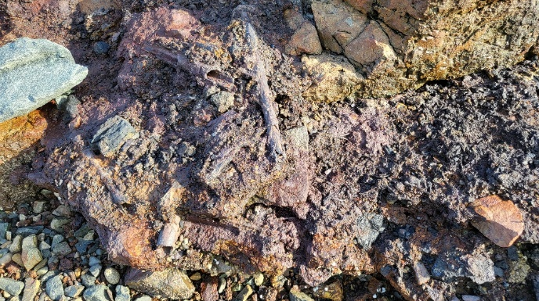
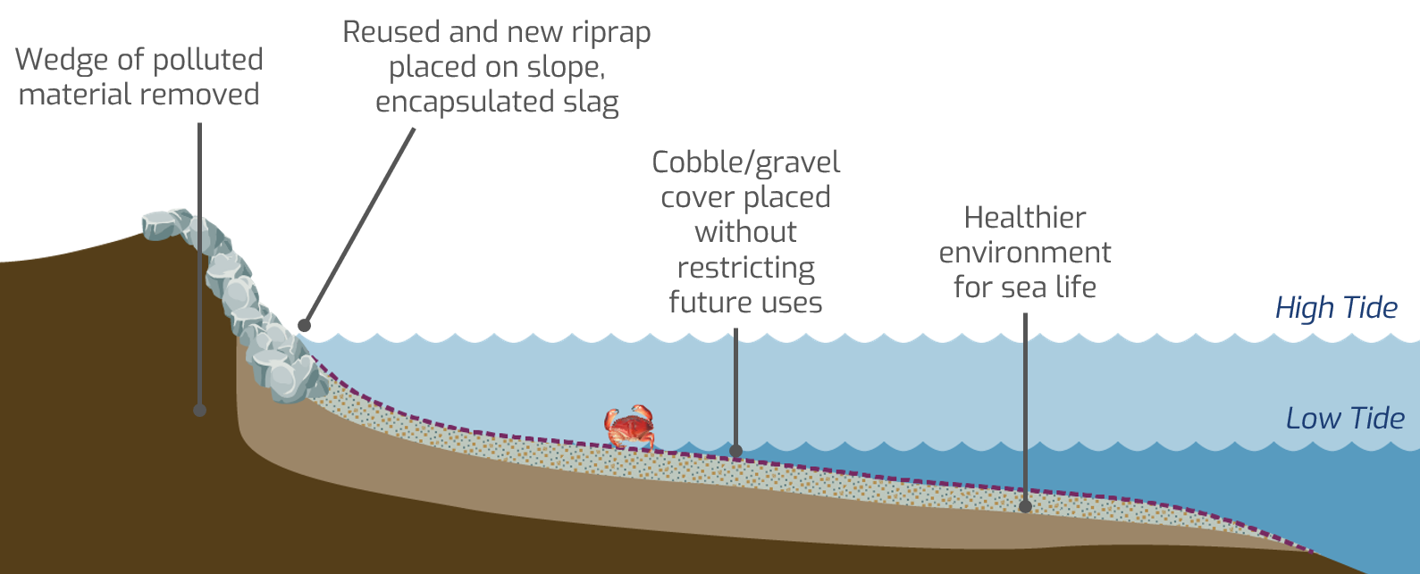
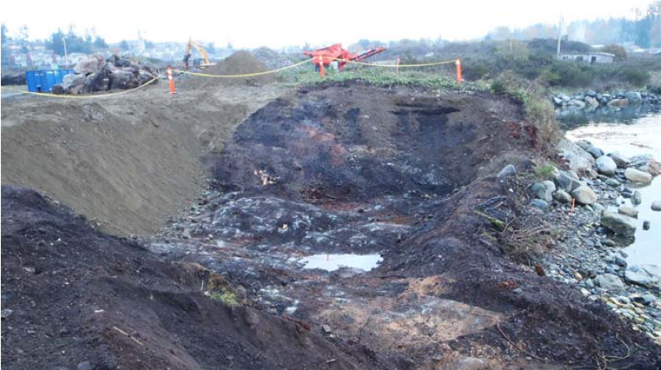
Contaminant Removal and Capping
Slag present on shoreline
Contaminant “wedge” between upland and in-water remediations

Slide 9

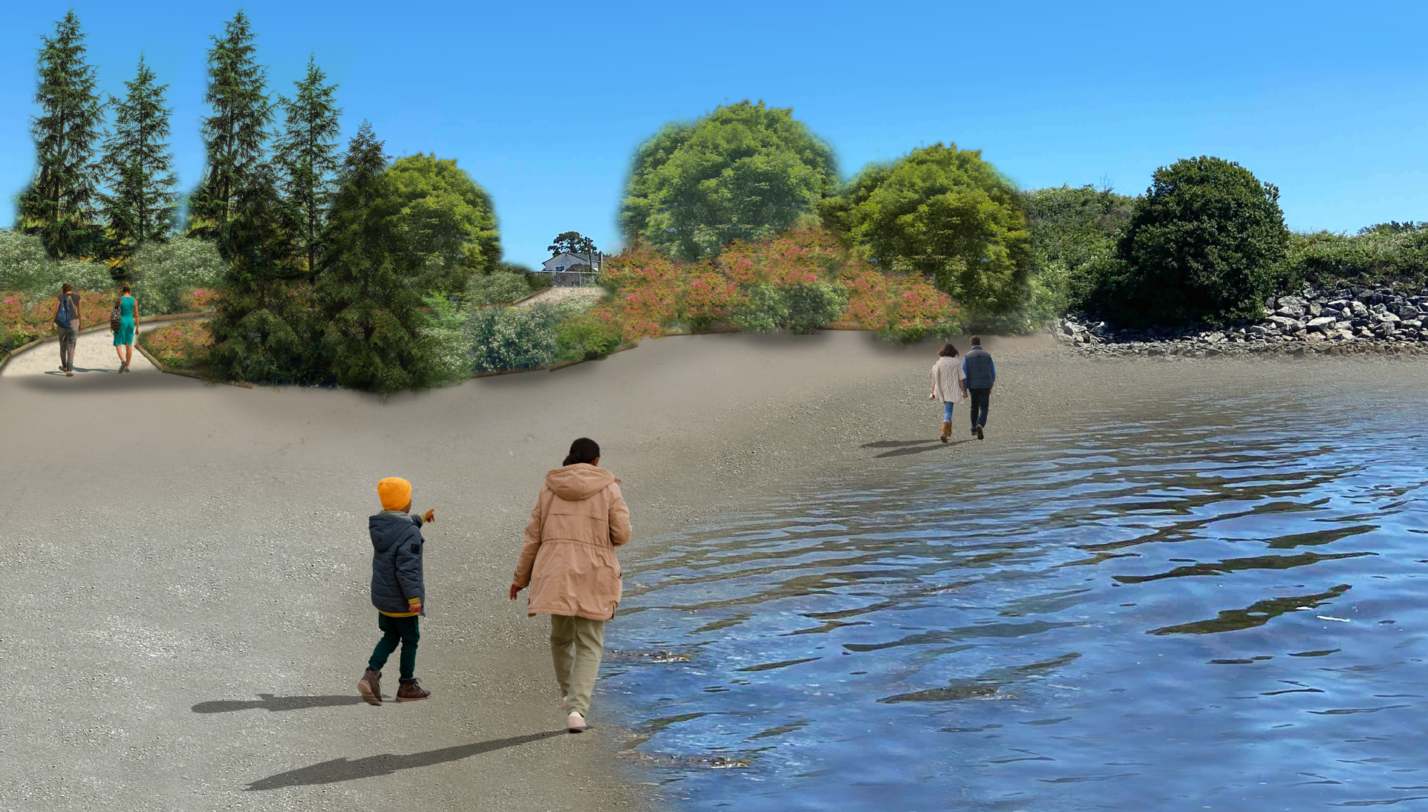
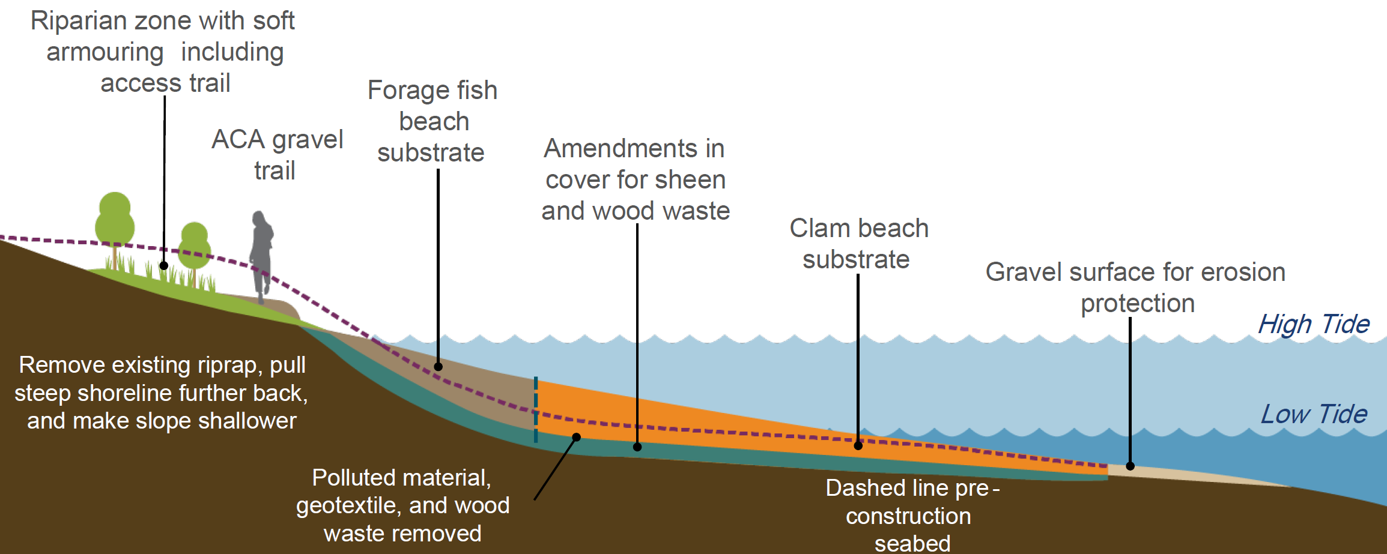
Green Shores Soft Armouring
Melding habitat, access, and resilience

Slide 10

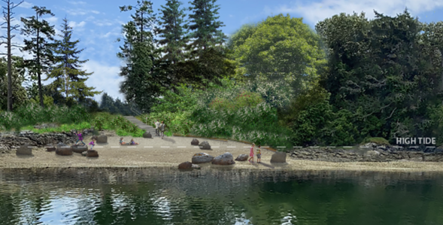
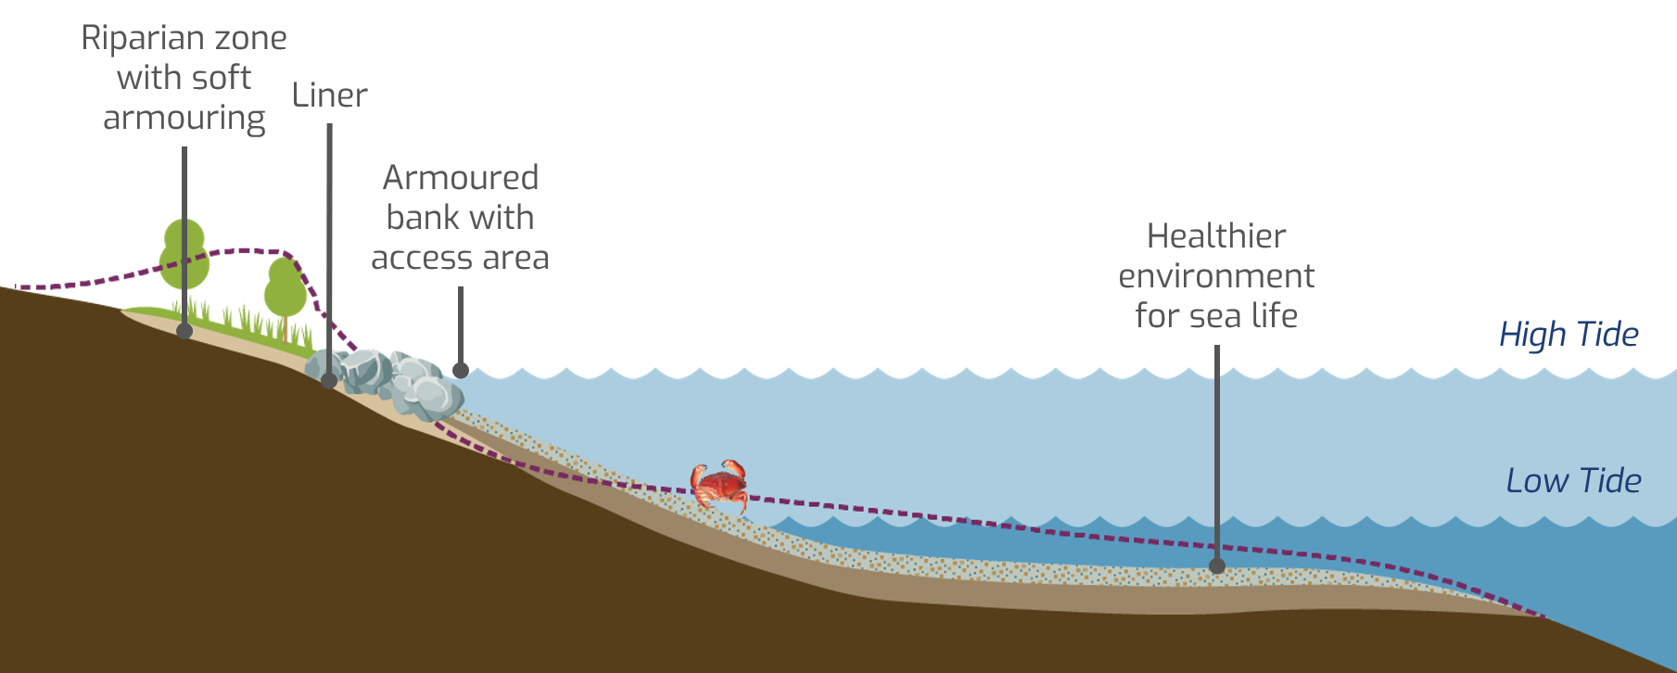
Habitat Restoration
Enhanced forage fish and clam habitat supports Traditional Use, local ecology, and natural resources

Slide 11

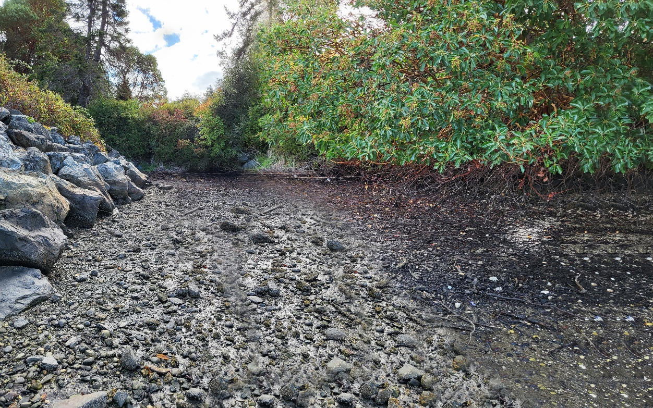
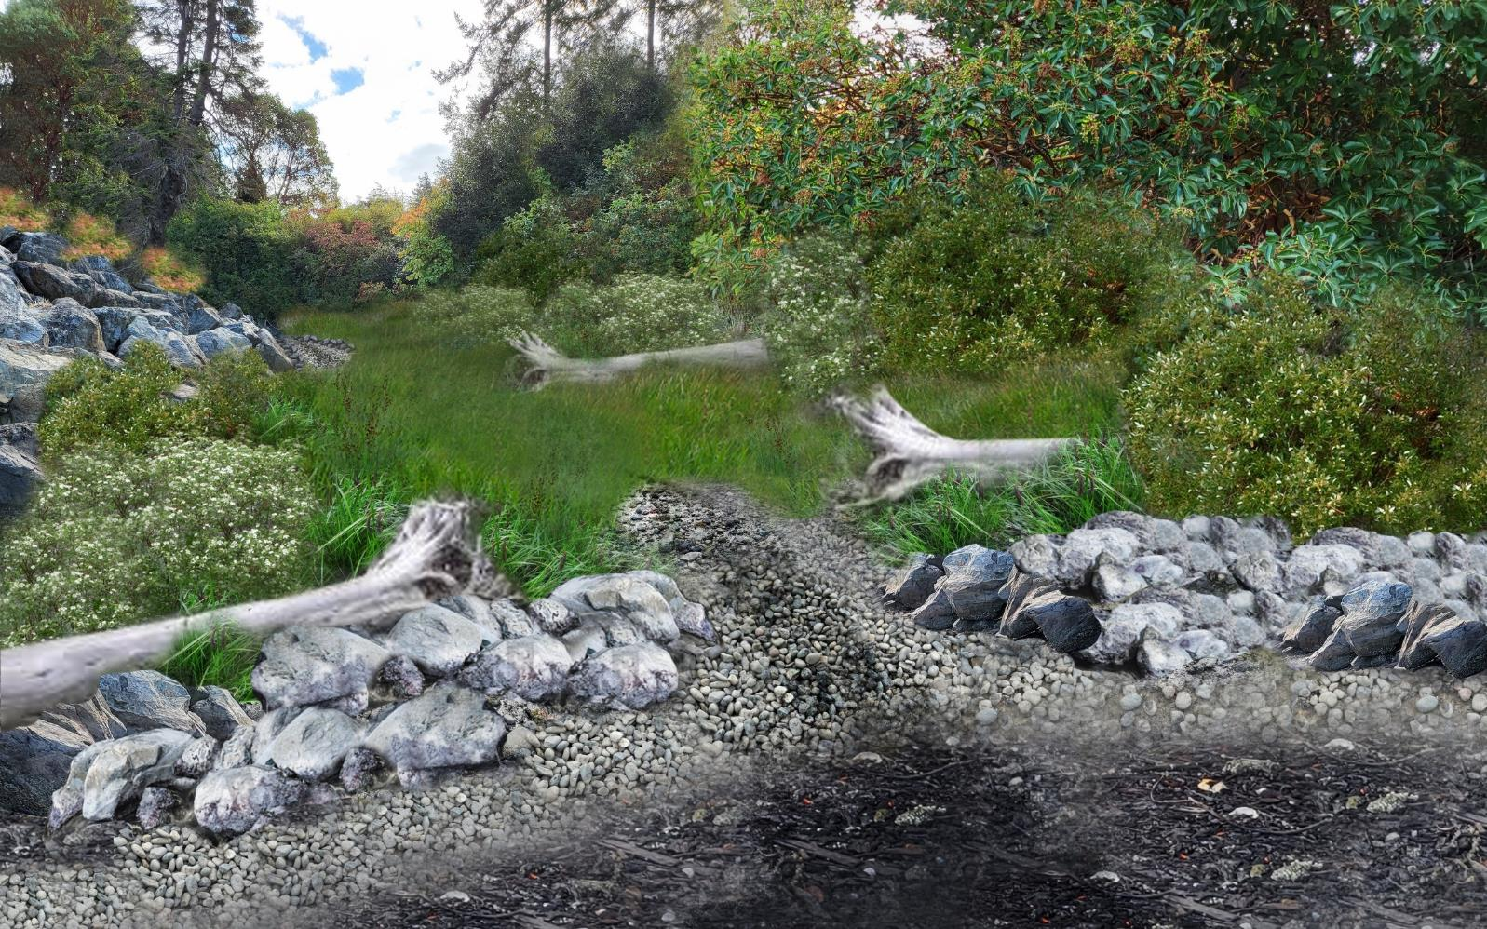
Stormwater Enhancement
Bioretention treatment areas improve stormwater runoff quality
Current Conditions
Rendering of Post-Construction

Slide 12

Continued Engagement
First Nations support during permitting process
Economic benefit during construction
Hiring on-site liaisons during construction
Construction communication plan development

Slide 13
Construction Communication Plan
Identifies roles and responsibilities including on-site liaisons
Includes key events such as
pre-construction blessing and community events
Stipulates frequency of community updates (newsletter postings)
Department of National Defence
Project Manager/Project Director and Team
First Nations Chief and Council
Key First Nation Contacts
External Stakeholders
Public Services and Procurement Canada
Program Manager/Department Representative and Team
On-Site First Nations Liaisons
Consultants
Contractor
First Nations Community

Slide 14
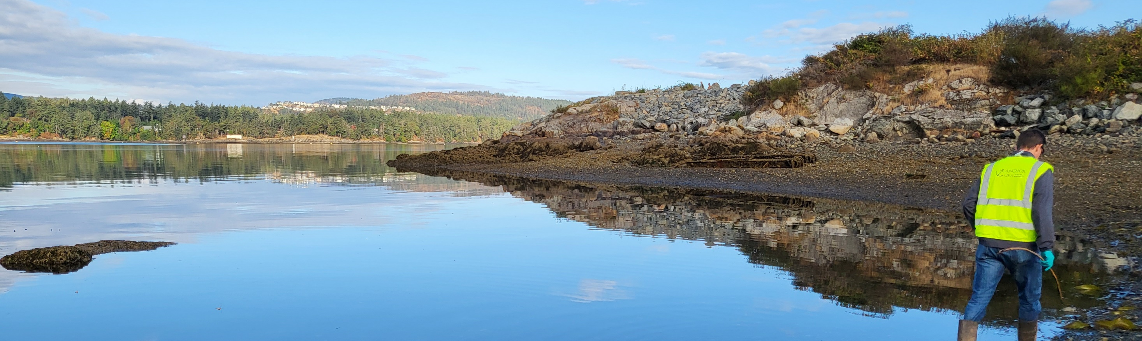
Next Steps:
Construction to Begin Spring 2025

Slide 15
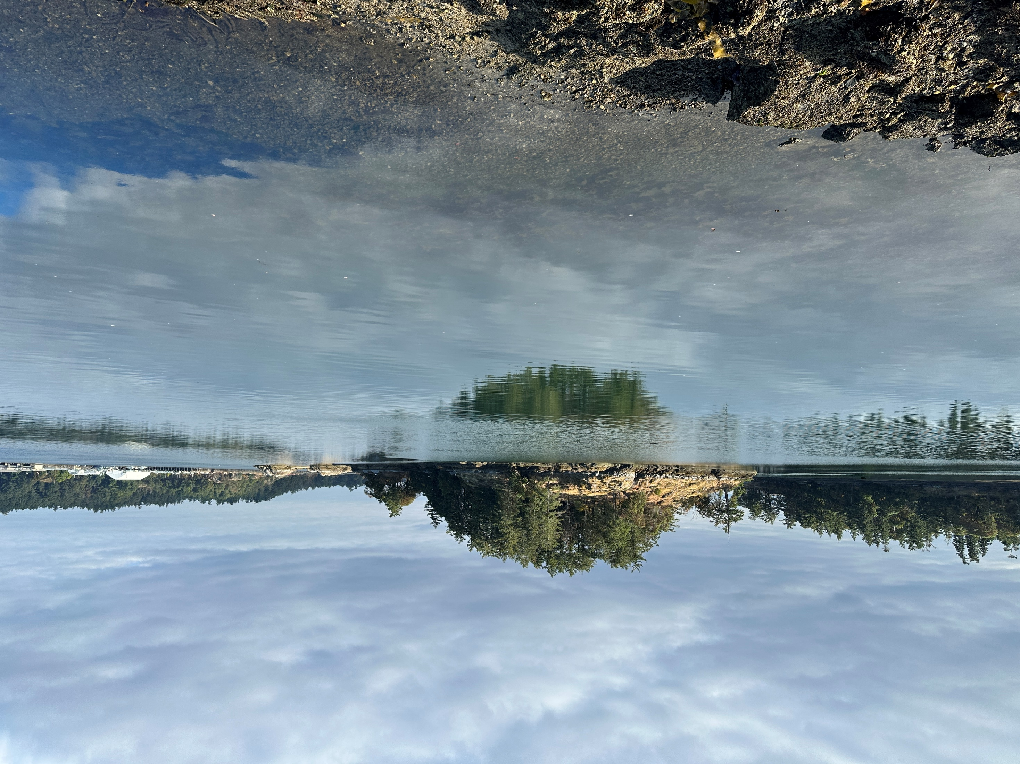
Lessons Learned
Prioritize First Nations goals for future use and ecological function
Facilitate early, open, and frequent communication
Bring together multiple disciplines to enhance cleanup, habitat, access, and resilience

Slide 16
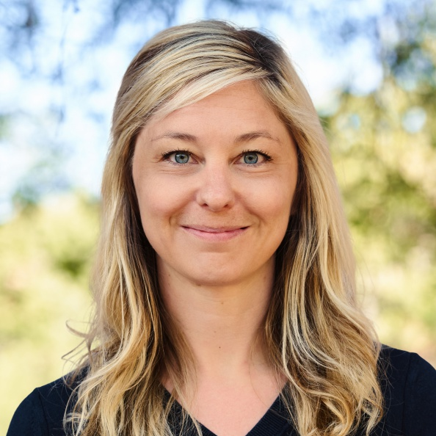

Amy Corp
Principal Scientist
Anchor QEA
acorp@anchorqea.com

