Slide 1

Developing a Long-Term Monitoring Strategy with Local First Nations
Presented by: Amy Corp, P. Chem, EP, Anchor QEA
Collaborators: Eric Crawford, Transport Canada
Fiona Wong, Public Services and Procurement Canada
Ariel Blanc and Mark Larsen, Anchor QEA

Slide 2
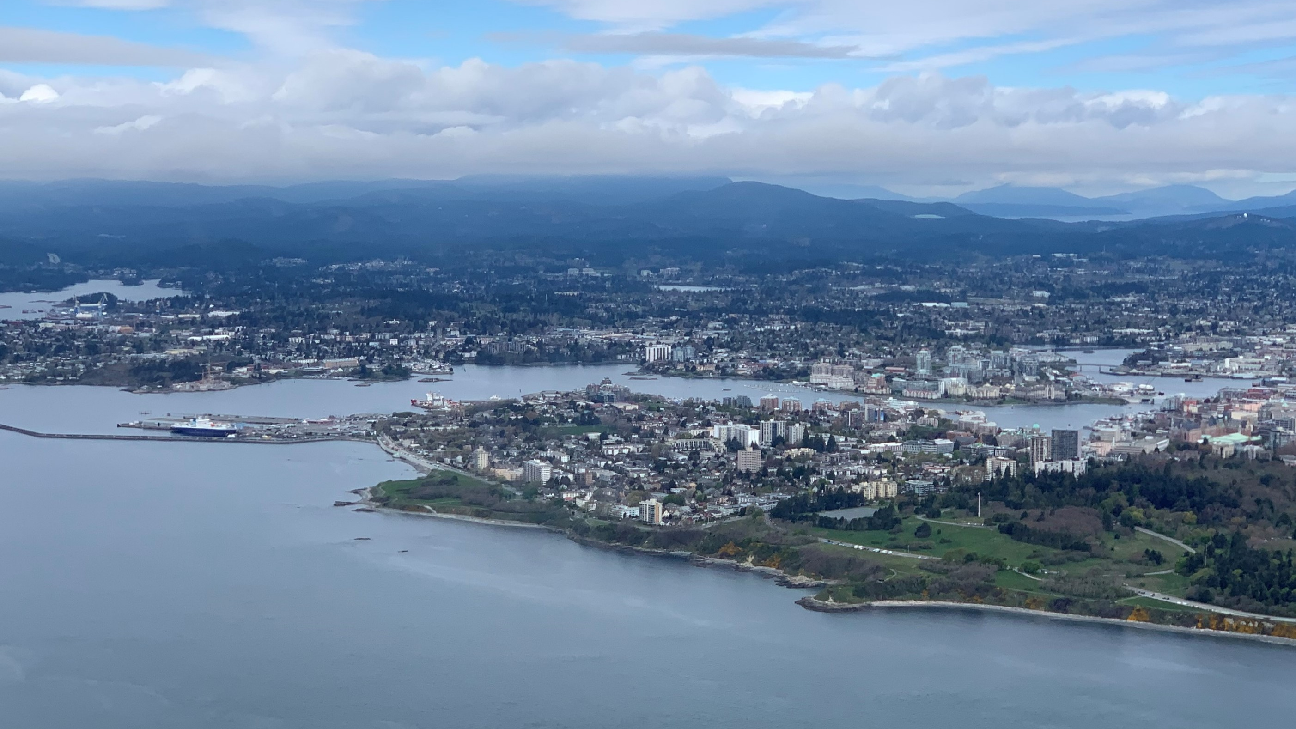

Slide 3
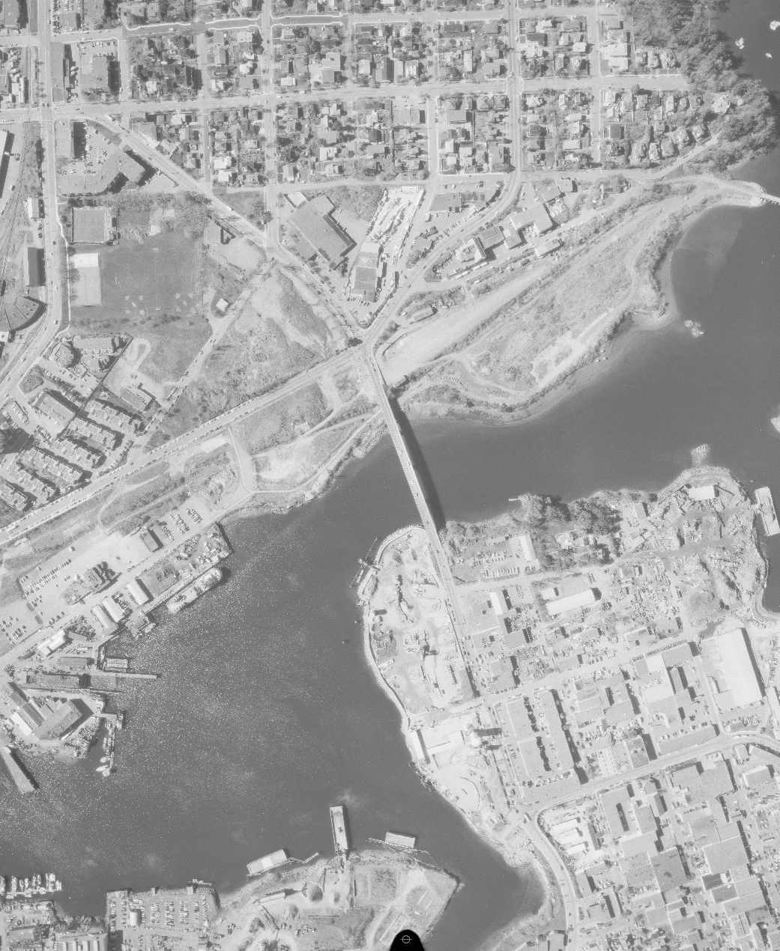
Project Background
Historic use: shipbuilding, lumber mills, manufacturing, coal storage, and gasification
Current use: tourism, airport, shipyards, recycling, cruise ships
Contaminants of concern: PCBs, lead, cPAHs, dioxin/furans, PCP

Slide 4
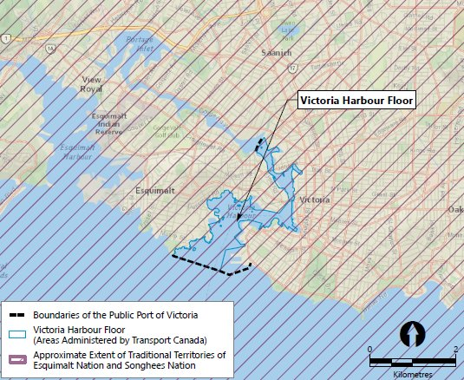
First Nations Traditional and Current Use
Victoria Harbour is part of the territory of Esquimalt Nation and Songhees Nation, whose members trace their ancestry to the Coast Salish lək̓ʷəŋən (Lekwungen) People
Marine resources are central to Esquimalt Nation and Songhees Nations’ ways of life and remain important for food, social, cultural, and ceremonial reasons

Slide 5
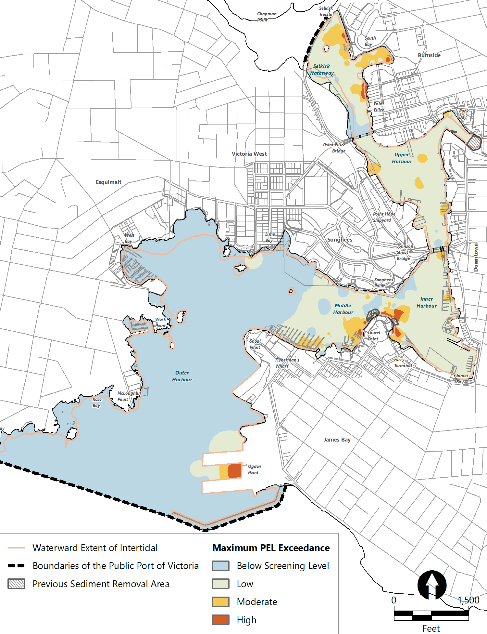
Remedial Strategy and Status
Early actions complete in worst areas
Remaining moderate- to low-level shoreline sediment contamination and ongoing sources
Monitored natural recovery (MNR)

Slide 6
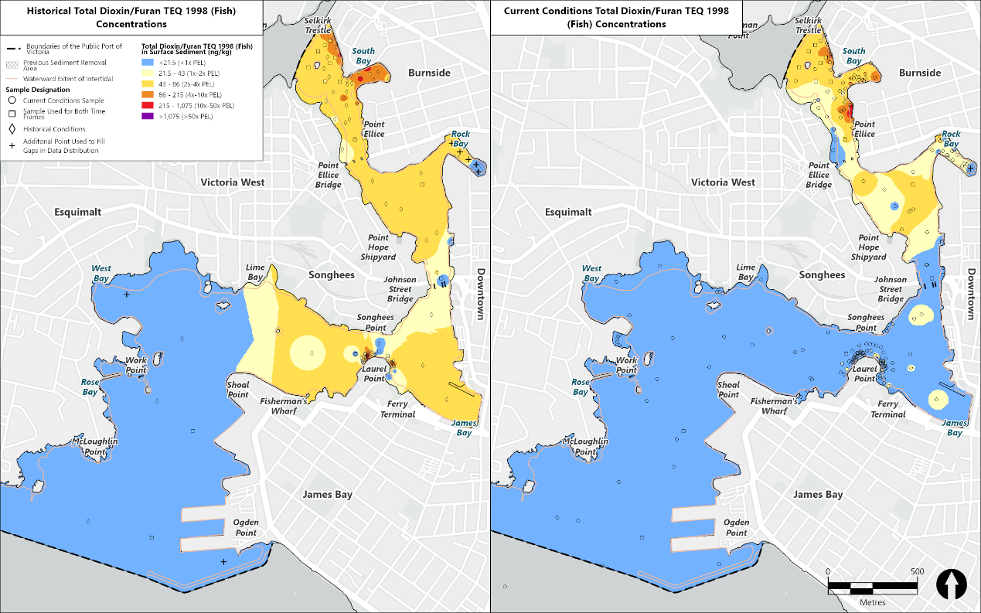
Sediment Quality Improvements
Total Dioxin/Furan TEQ has decreased in surface sediment by 51% in the last decade

Slide 7
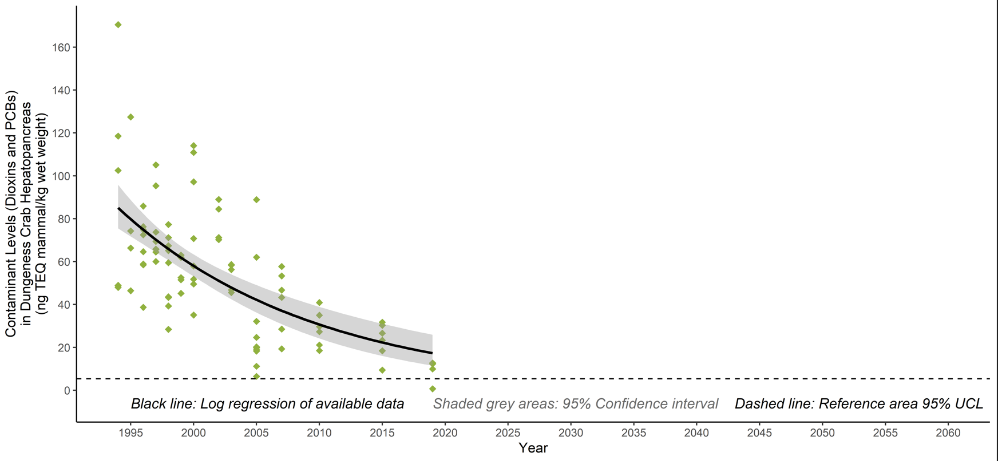
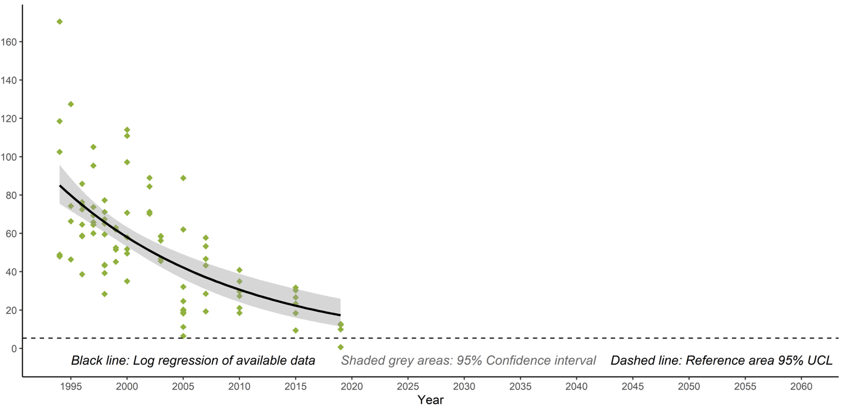
Sea Life Tissue Improvements
Available data indicate reduced concentrations over time
Concentrations are anticipated to continue to decrease
Future concentrations are anticipated to approach reference area concentrations
Available data trend
Expected future concentrations
Reference area concentration (95% UCL)
Dungeness Crab Hepatopancreas Dioxin/Furan and PCB TEQ (1995–2019)

Slide 8
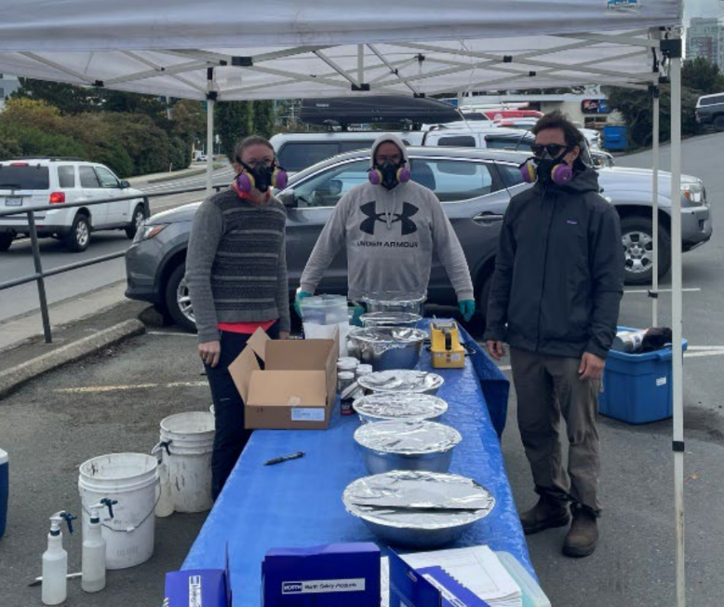
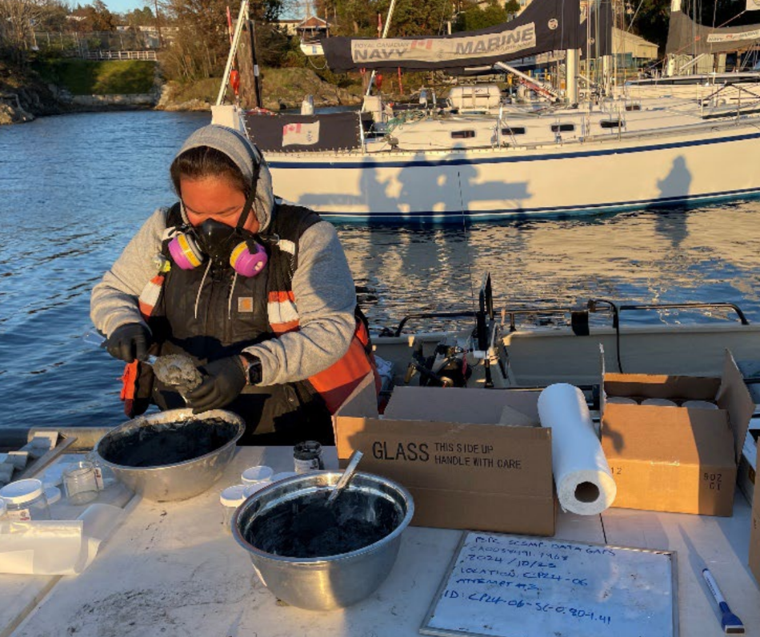
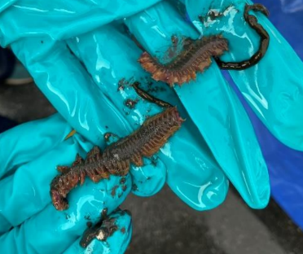
Traditional Knowledge and Traditional Use
Traditional Knowledge and Traditional Use (TKTU) workshops and sampling were conducted to elicit information from the community on the:
  Areas of the harbour traditionally used
  Types/amounts of seafood consumed
  Seafood tissue processing
  Qualitative assessments of environmental conditions
HHRA incorporated this TKTU information

Slide 9
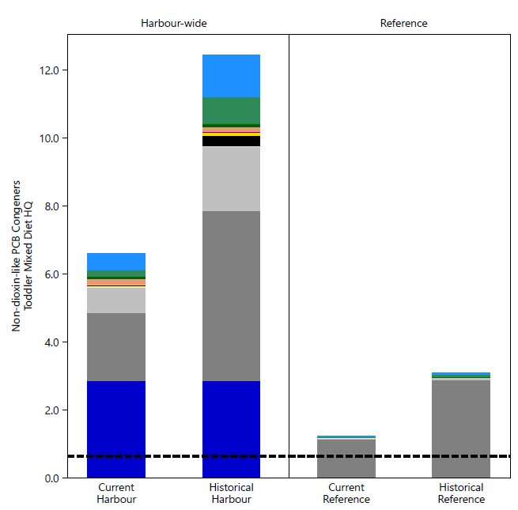
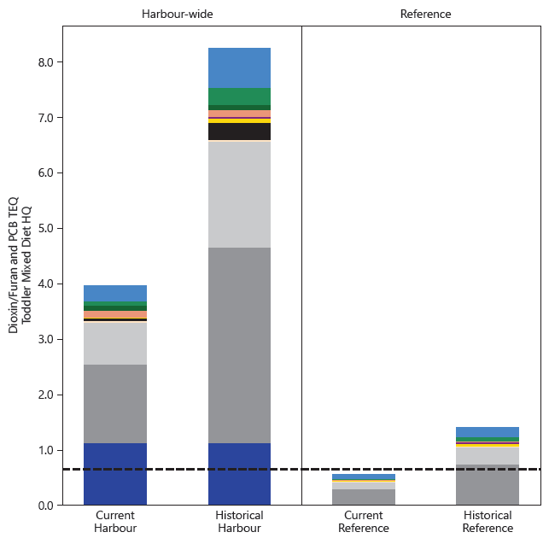

First Nations Sea Life Consumption Risk
Non-Dioxin-Like PCBs
Dioxin/Furan and PCB TEQ

Slide 10
How can monitoring incorporate First Nations’ Traditional Use and long-term priorities?

Slide 11
Monitoring Objectives
Harbour-wide monitoring needs to provide information on:
Harbour Floor Monitoring
Conditions of the harbour floor and sea life
Changes to human health and ecological risks
Progress on project goals and objectives
Early-warning detections of potential recontamination

Slide 12
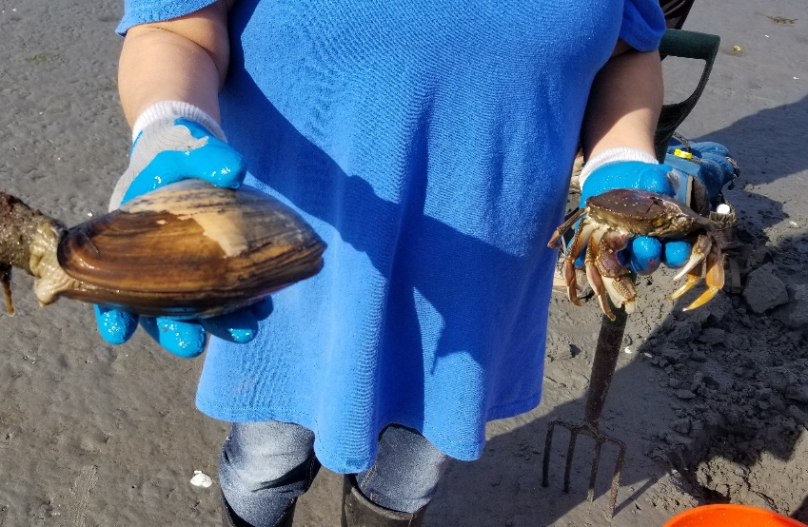
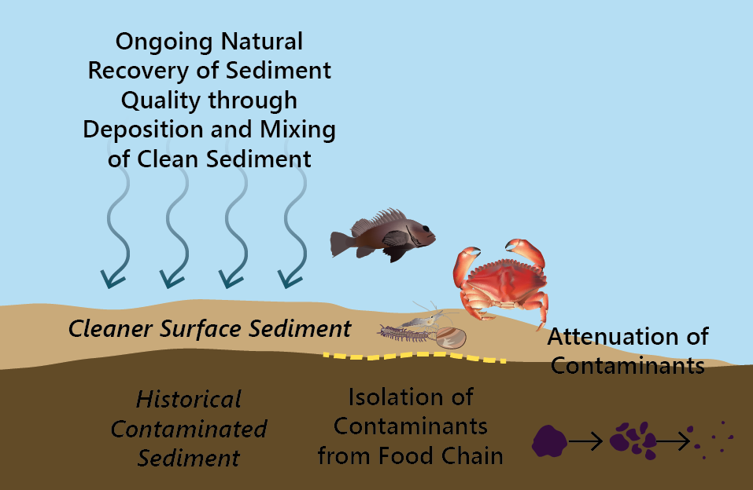
Monitoring Program Basis
Developed with an understanding of the conceptual site model and informed by TKTU
  Traditional use of marine resources
  Food web and bioaccumulation modeling to understand relative impacts of sediment versus surface water on tissue concentrations
  Review by the First Nations Working Group to confirm approach

Slide 13
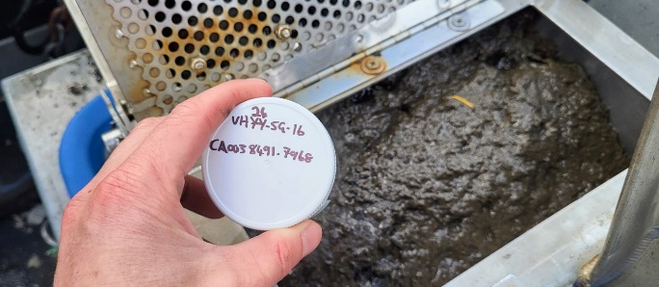
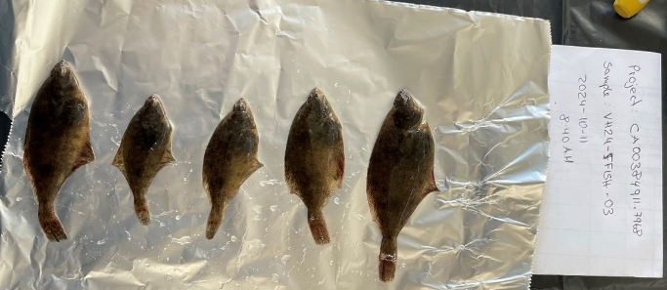
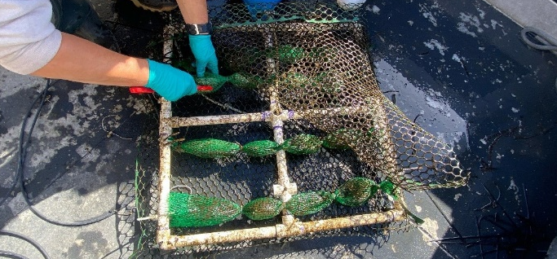
Input into Monitoring Elements
Surface sediment | First Nations engagement in selecting reference areas
Tissue | TKTU findings in selecting species and processing
Caged bivalves and surface water | Use of oysters for water quality impacts

Slide 14
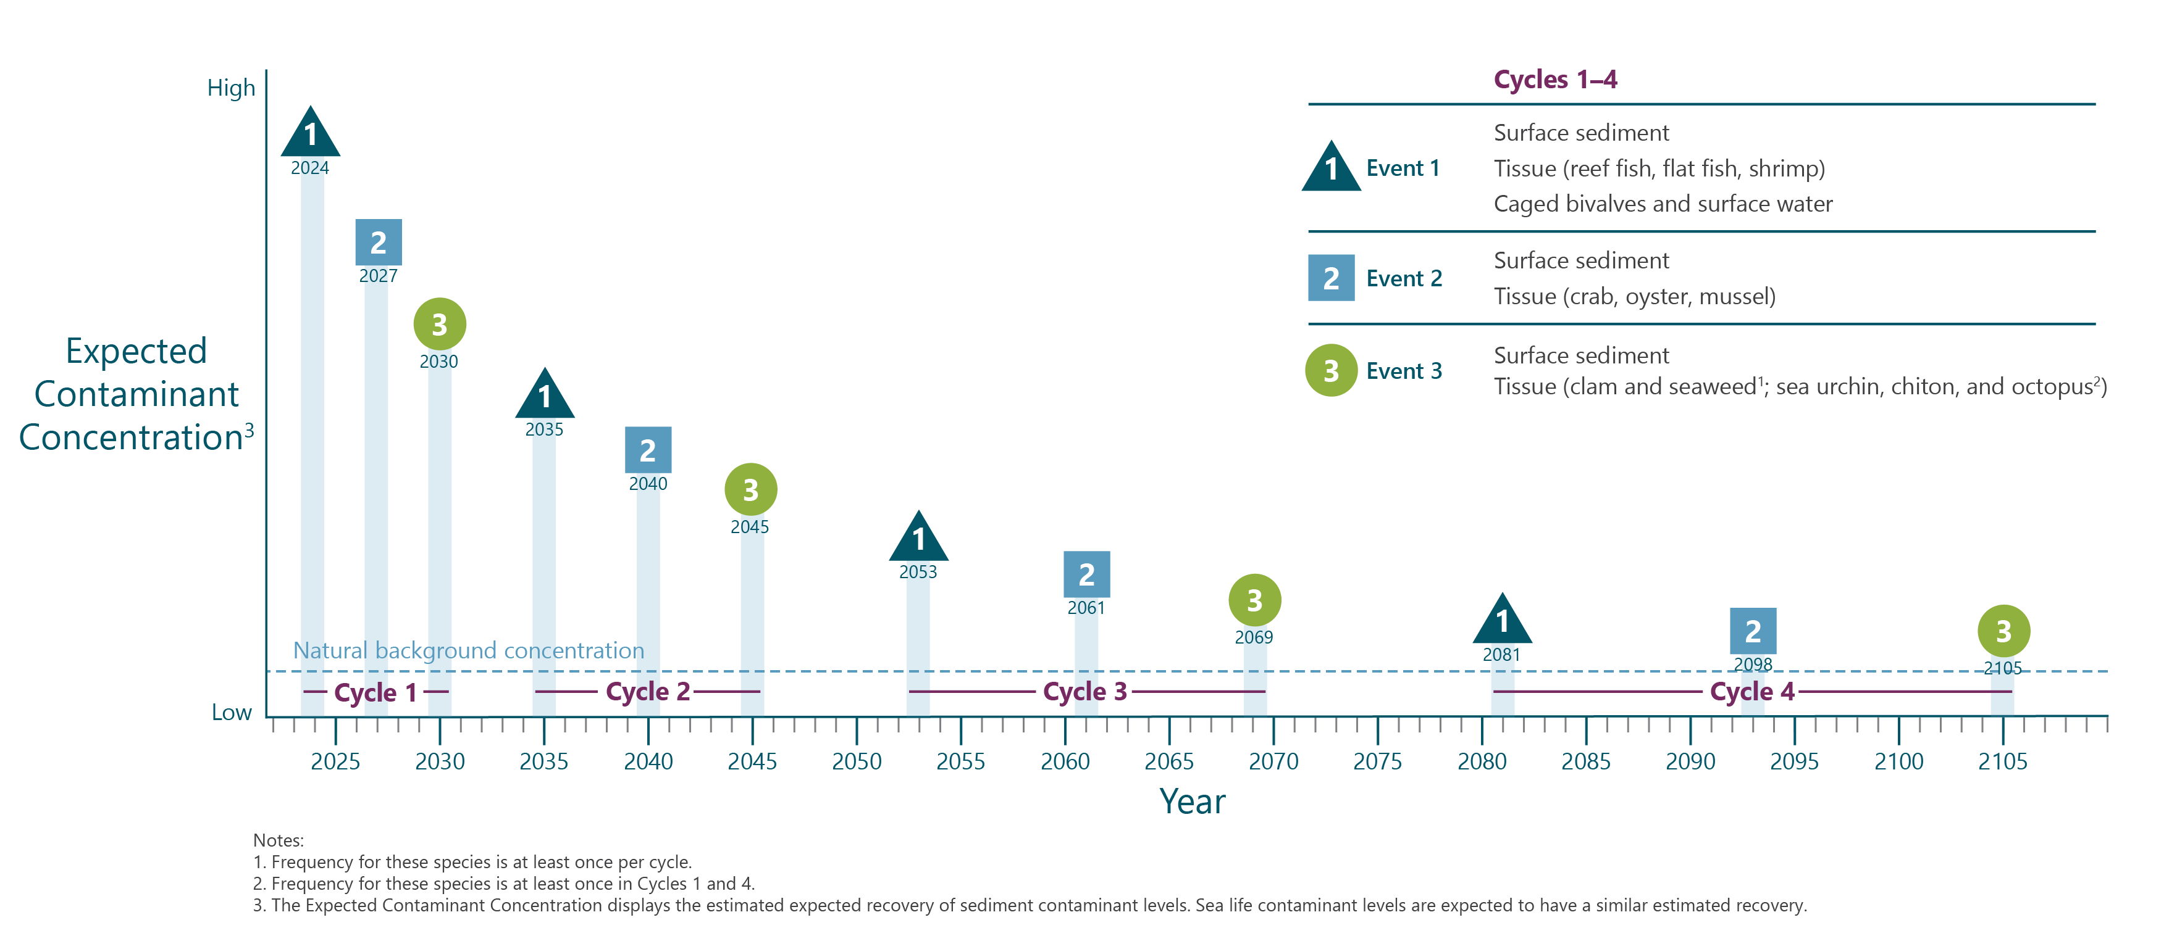

Slide 15
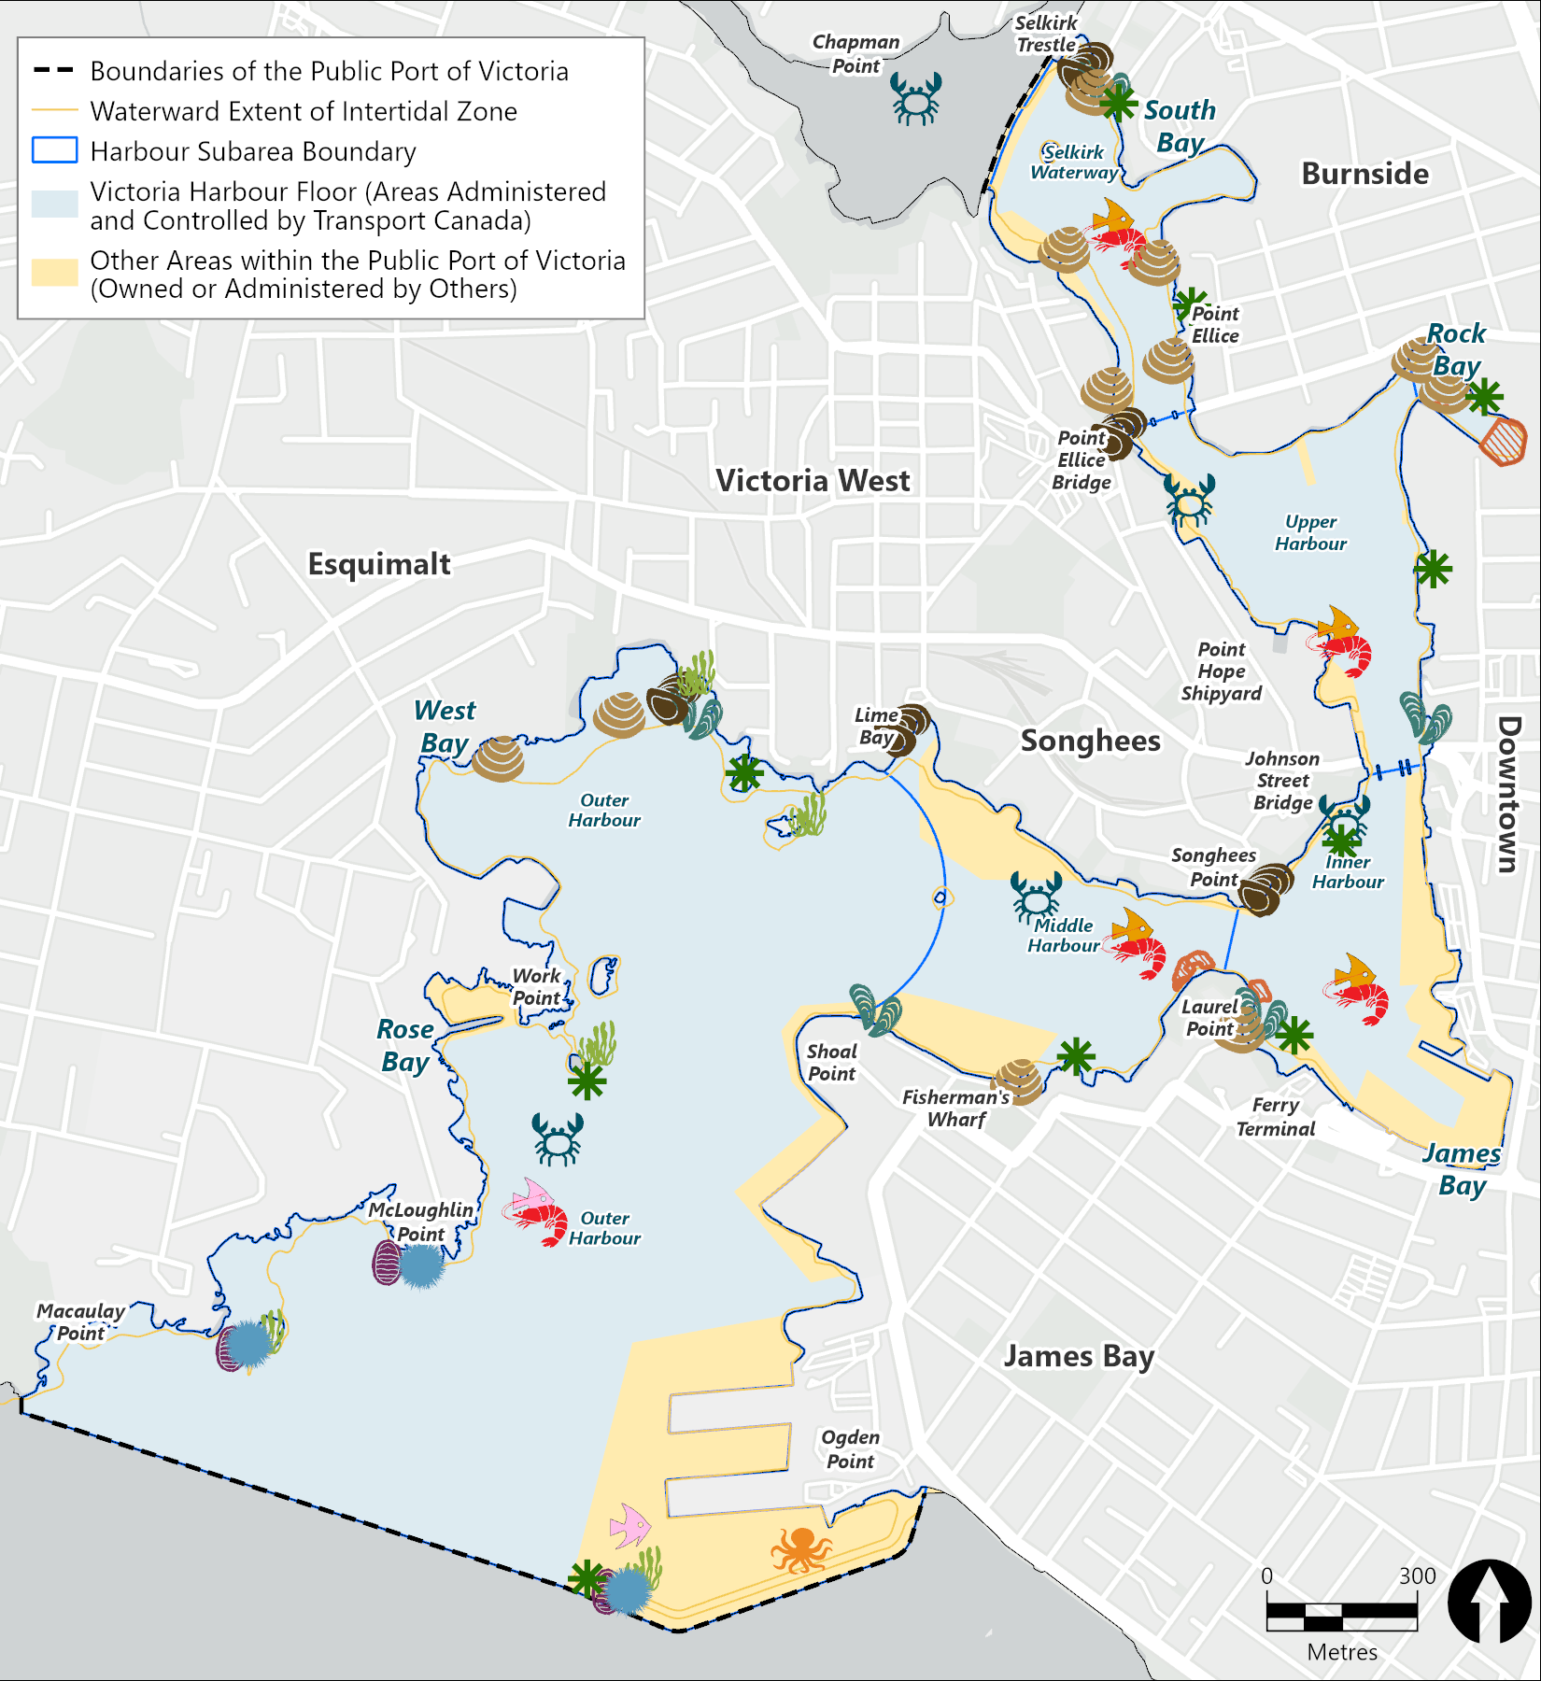





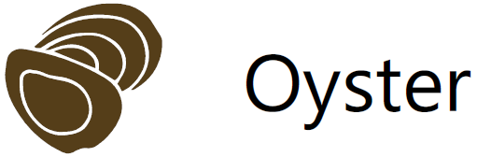
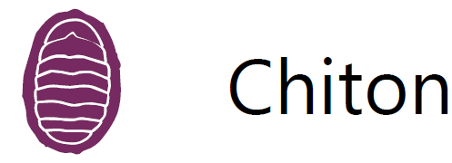
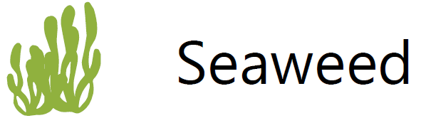

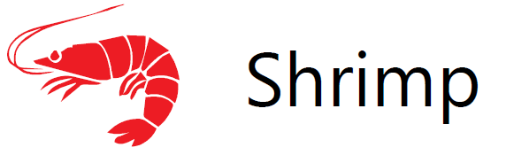
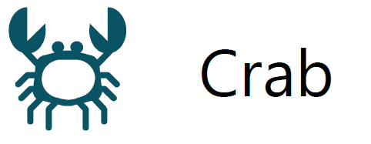

Harbour Tissue Monitoring Locations
Proposed Number of Samples
8
10
4
2
10
10
6
5
33
10
10
6

Slide 16
Monitoring Flowchart
Harbour Floor Monitoring Cycles
(three monitoring events per cycle)
Lift or modify seafood advisory
(coordinate with DFO)
Are there remaining risk drivers?
NO
Continue long-term monitoring of sediment and crab at a reduced frequency
YES
Improvement
YES
Have conditions improved?
Are reference contaminant levels increasing?
NO
Sources Identified
NO
YES
Update Risk Tool and SWAC
Continue monitoring through the next cycle
(reassess contaminant list, including emerging contaminants)
Are average contaminant levels increasing?
Source control evaluation
Implement source control measures
NO
No Improvement
Continue Monitoring
YES
Potential remediation

Slide 17
Monitoring Flowchart
Harbour Floor Monitoring Cycles
(three monitoring events per cycle)
Lift or modify seafood advisory
(coordinate with DFO)
Are there remaining risk drivers?
NO
Continue long-term monitoring of sediment and crab at a reduced frequency
YES
Improvement
YES
Have conditions improved?
Are reference contaminant levels increasing?
NO
Sources Identified
NO
YES
Update Risk Tool and SWAC
Continue monitoring through the next cycle
(reassess contaminant list, including emerging contaminants)
Are average contaminant levels increasing?
Source control evaluation
Implement source control measures
NO
No Improvement
Continue Monitoring
YES
Potential remediation

Slide 18
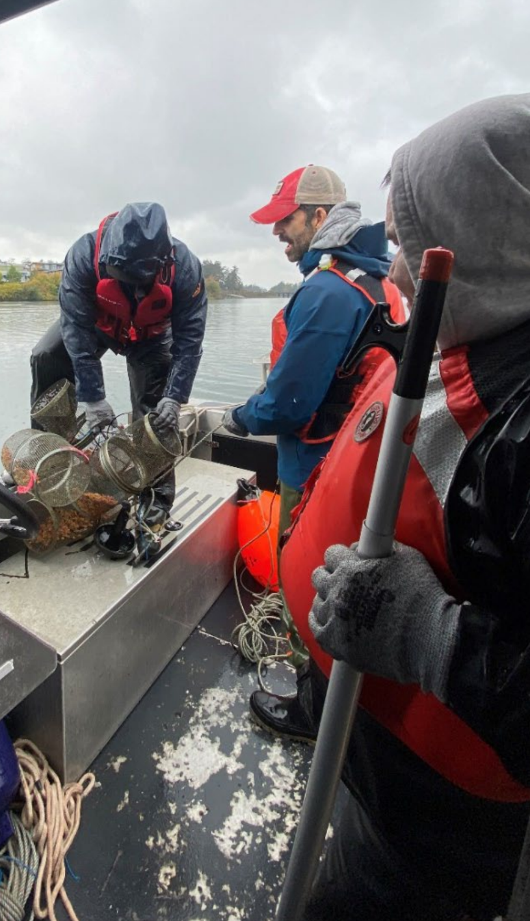
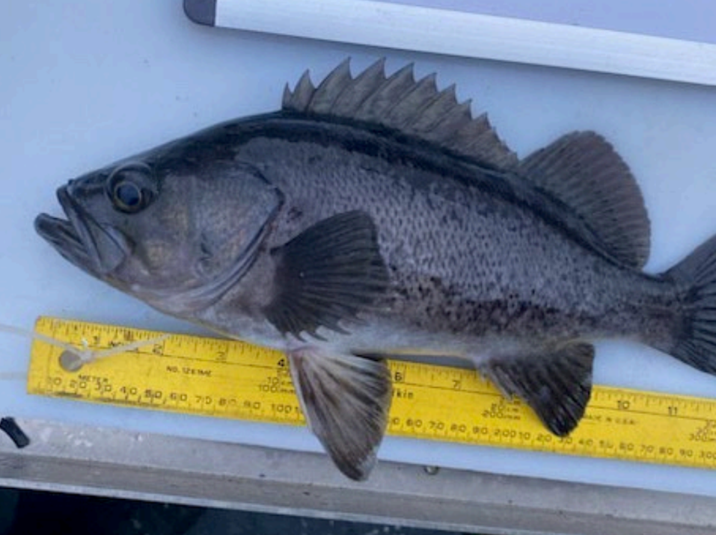
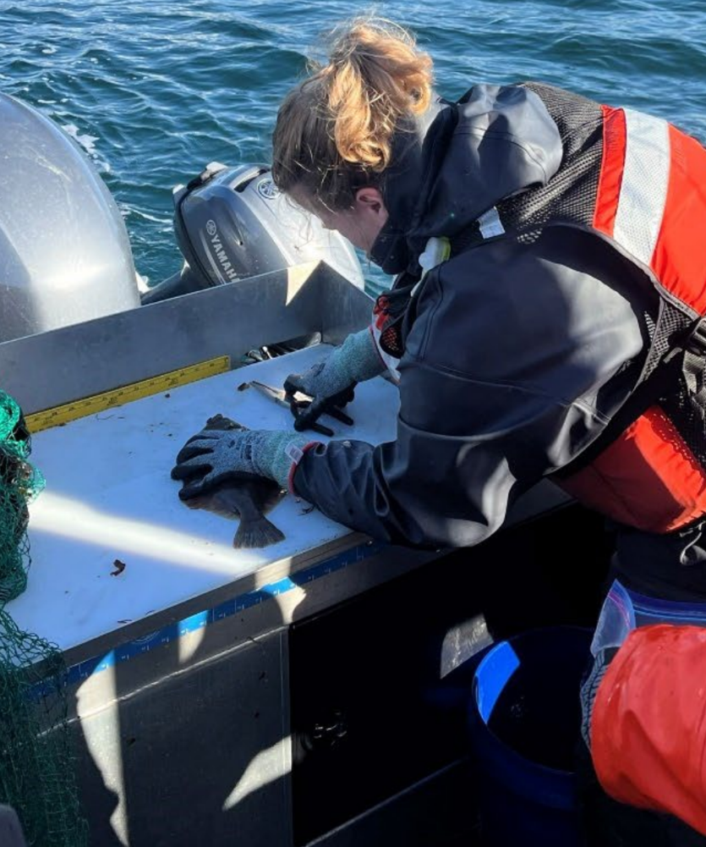
Next Steps
First sampling event occurred this past Fall with both Esquimalt Nation and Songhees Nation members participating
Looking forward to discussing the results with the First Nations Working Group in March

Slide 19
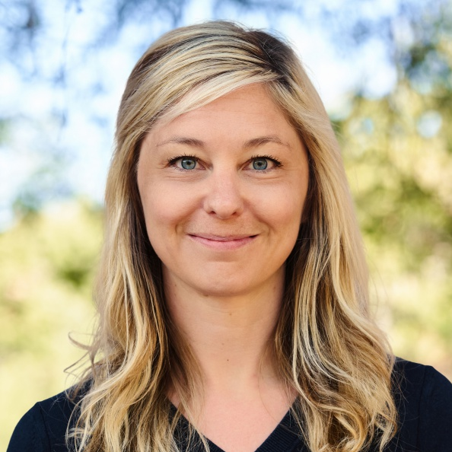

Amy Corp
Principal Scientist
Anchor QEA
acorp@anchorqea.com

