Slide 1
Implementing an Interim Early Action with Adaptive Management in a Portion of the Newtown Creek Superfund Site
Presented by: David Haury, Anchor QEA
Collaborators: Amanda Shellenberger and Paul LaRosa, Anchor QEA

Slide 2

Photograph by Bill Rhodes
Photograph by Bill Rhodes
Notes:
Overview/Background slide template. Start your presentation with ONE captivating full-bleed image to help place folks into presentation: Who? What? Where?

Slide 3
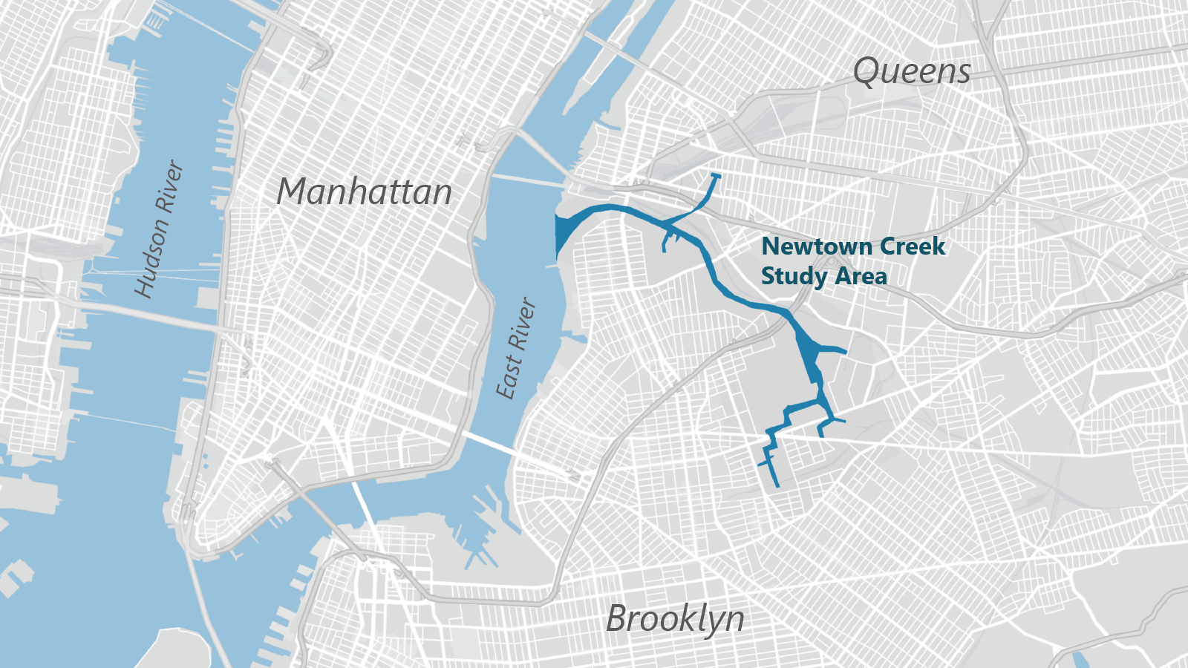

Slide 4
Proposed Plan for an Early Action (EA) in the East Branch tributary issued in 2024—ROD expected
1st quarter of 2025
Hybrid remedy: 100,000 cy sediment removal followed by placement of engineered cap over ~10 acres
Pre-design Investigation and post-remedy monitoring
USEPA is implementing a creek-wide adaptive management approach

Slide 5
As part of a creek-wide adaptive management framework, the EA should accomplish the following:
Gain direct remedial experience in the creek
Inform the creek-wide remedial approach
Accelerate post-remedy monitoring to evaluate remedy performance, remedy effectiveness, and attainment of creek-wide remedial action objectives (RAOs)

Slide 6
The EA will only address a small portion of the site and external sources of contamination will continue.
Adaptive management framework for Newtown Creek must differentiate between:
Remedy performance (meeting RAOs: risk reduction and control of internal sources)
Impacts from ongoing external sources (site-specific background conditions)

Slide 7
Meeting Creek-wide Exposure RAO
Ongoing External Sources of Contamination:
East River solids
Point source discharges (e.g., combined sewer overflows [CSOs], stormwater, direct drainage, and treated groundwater effluent)
Atmospheric deposition
Lateral groundwater
Bank erosion
Shoreline seeps
Risk-based preliminary remediation goals (PRGs) developed both on a not‐to-exceed basis and a surface-weighted average concentration (SWAC) basis
EAs in a portion of the site should recognize risk reduction over multiple spatial scales—a creek-wide, SWAC-based PRG may be met even if not fully met in a small portion of the site
Natural recovery processes, where occurring, need to be considered
Ongoing external sources (background) make it difficult to meet risk‐based PRGs for some contaminants of concern (COCs) in some reaches (PCBs, dioxins/furans, and C19-36 aliphatics)

Slide 8
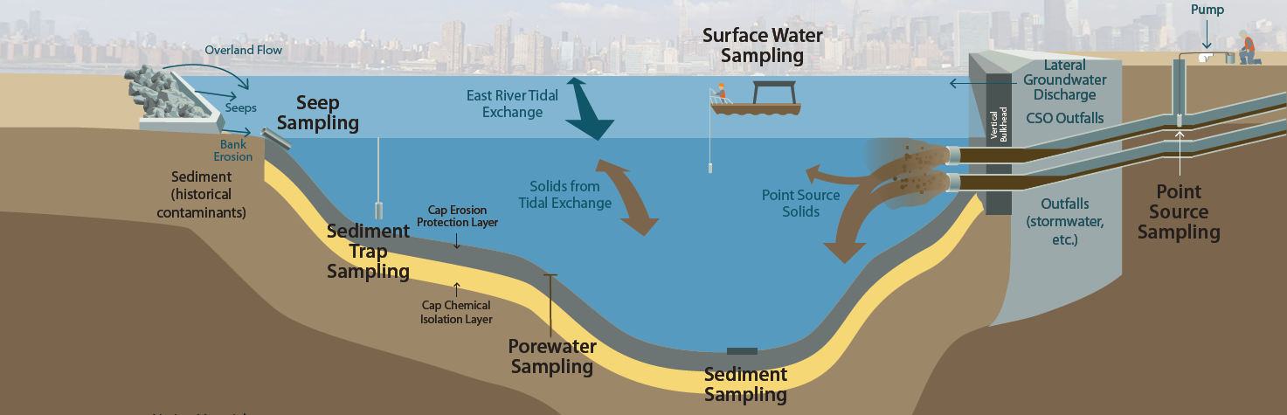
Remedy Performance vs. Background
Sediment-based remedy will control internal COC sources
Many ongoing external sources will continue—some of which will adversely impact overall remedy effectiveness
USEPA’s adaptive management framework is designed to evaluate remedy performance and the impact of site-specific background conditions over time to determine if additional control of external sources is needed

Slide 9
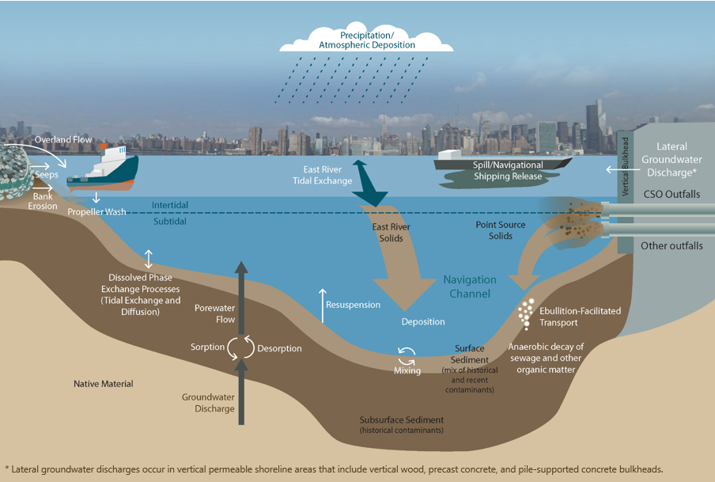
Contaminant Sources
to Newtown Creek
Note: White boxes indicate ongoing external sources of contamination that are included in the long-term equilibrium model.

Slide 10
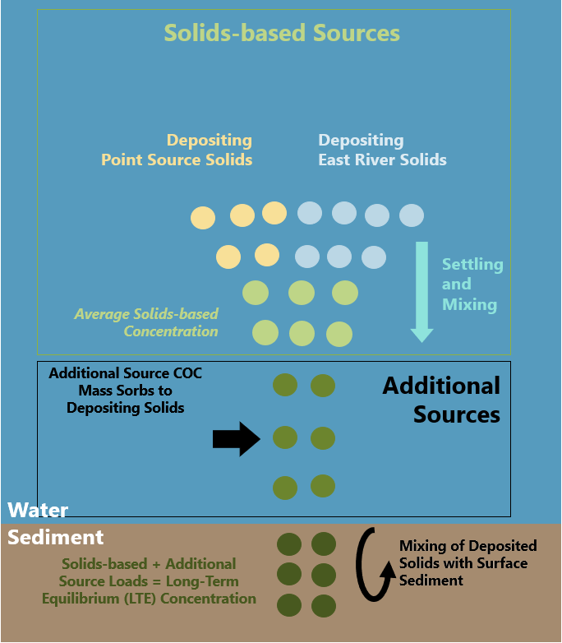
USEPA’s Adaptive Management Framework
Set long-term risk-based PRGs consistent with human health and ecological endpoints
Define interim evaluation measures (IEMs) (i.e., long-term equilibrium [LTE] surface sediment COC concentrations) using empirical data and an LTE model
  IEMs will be used to evaluate post-remedy monitoring data in place of traditional background values
Implement post-remedy, long-term monitoring program to evaluate both remedy performance and the impact of ongoing external sources on remedy protectiveness
If LTE concentrations are not trending toward long-term expectations, evaluate whether additional control of external sources is necessary
LTE Model Framework

Slide 11
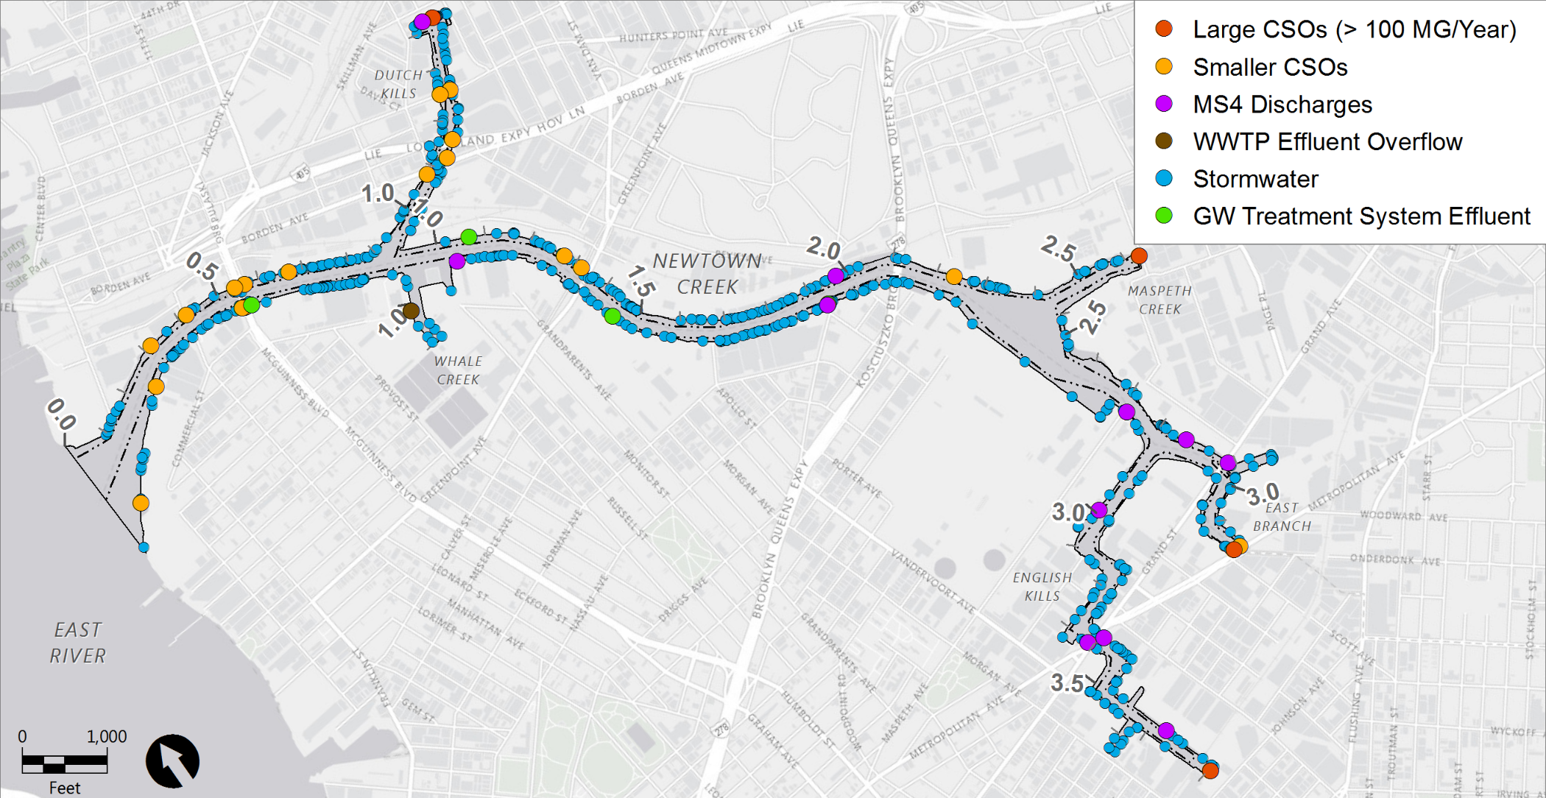
Point Sources
Newtown Creek
Large CSOs (>100 MG/year)
Smaller CSOs (<100 MG/year)
MS4 Discharges
WWTP Effluent Overflow
Stormwater Discharges
GW Treatment System Effluent
East Branch Early Action Area
Tidal Exchange

Slide 12
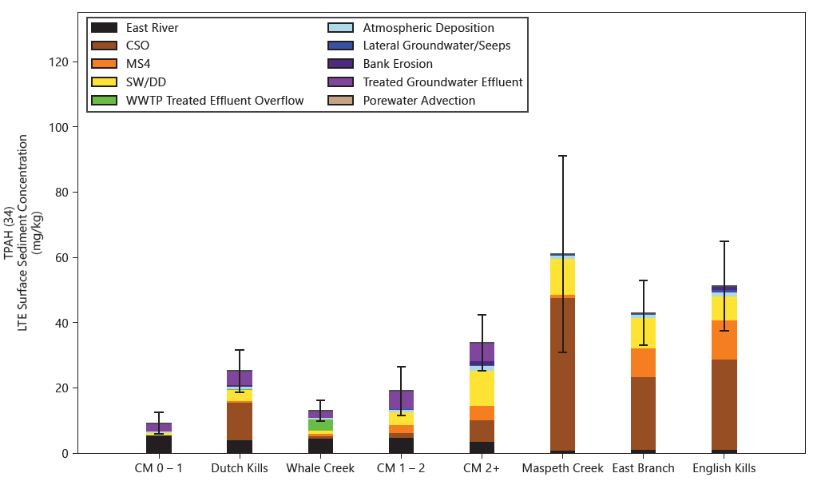
Estimated LTE Concentrations: Total PAH (34)
Risk-based PRG:
100 mg/kg
point-by-point
Risk-based PRG is greater than the LTE estimate for all reaches

Slide 13
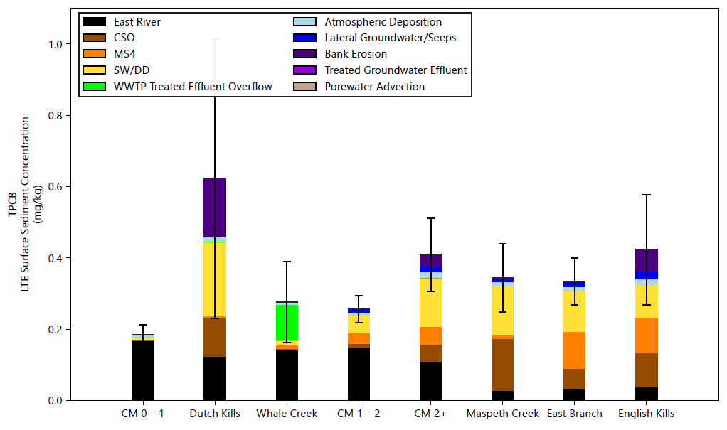
Estimated LTE Concentrations: Total PCBs
LTE estimate exceeds risk-based PRGs for some reaches
Risk-based PRG:
0.3 mg/kg SWAC

Slide 14
Summary
USEPA’s Adaptive Management Framework for Newtown Creek recognizes the value of an interim early action as well as the reality of ongoing external sources in Newtown Creek’s urban setting
Critical components
  Post-remedy monitoring program must clearly distinguish between ongoing sources and remedy performance
  Prior to remedy implementation, define the spatial and temporal context in which post-remedy ongoing source-related data are collected to avoid incorrect decisions regarding the need for additional source control

Slide 15
Anchor QEA, 2021. Development of Risk-Based Preliminary Remediation Goals. Remedial Investigation/Feasibility Study, Newtown Creek. December 2021. Available at: https://newtowncreek.com/drbprg/.
NYCDEP (New York City Department of Environmental Protection), 2017. Combined Sewer Overflow Long Term Control Plan for Newtown Creek. Capital Project No. WP-169. June 2017. Date accessed: December 31, 2024. Available at: http://www.nyc.gov/html/dep/pdf/cso_long_term_control_plan/ltcp-newtown-creek-cso.pdf.

Slide 16

David Haury
Principal
Anchor QEA
dhaury@anchorqea.com

